Slide 1
Mental Health Chatbot using Artificial Intelligence
Team Members: Darshan Krishna (210701046)
Kesarikumaran S (210701324)

Slide 2
Abstract
The Mental Health Chatbot project develops an AI-driven agent for emotional support and mental health information. Using a Neural Network built with PyTorch and NLP techniques via nltk, the chatbot understands inquiries and provides helpful resources. Trained on a mental health intents.json file, it uses tokenization, stemming, and a bag-of-words model to predict user intents and generate accurate responses. Key features include robust data preparation, a three-layer neural network, user privacy, continuous performance evaluation, and multi-platform accessibility, ensuring a supportive, secure, and widely usable mental health resource.

Slide 3
Existing System
The existing system for mental health support primarily relies on traditional methods such as face-to-face therapy sessions, hotlines, and online forums. However, these systems often face challenges such as long waiting times, geographical limitations, and stigma, hindering access to timely and personalized support. Additionally, the scalability of human-based systems is limited, making it challenging to meet the growing demand for mental health services. While online platforms and mobile applications offer some level of accessibility, they may lack the real-time interaction and empathy needed for effective support. Overall, the existing system falls short in providing universally accessible, immediate, and empathetic mental health assistance.

Slide 4
Proposed System
The proposed system aims to enhance existing mental health support by leveraging AI for personalized assistance. Key modules include:
Data Collection and Preprocessing: Gathers and preprocesses mental health inquiries for model training.
Model Development: Designs a neural network in PyTorch to classify user inputs accurately.
Training and Evaluation: Trains the neural network and evaluates its performance for accuracy.
Integration of NLP: Applies NLP techniques for effective user query analysis.
Chatbot Interface Development: Creates a user-friendly interface for real-time interactions.
Deployment and Testing: Deploys the chatbot and tests its functionality with user feedback.

Slide 5
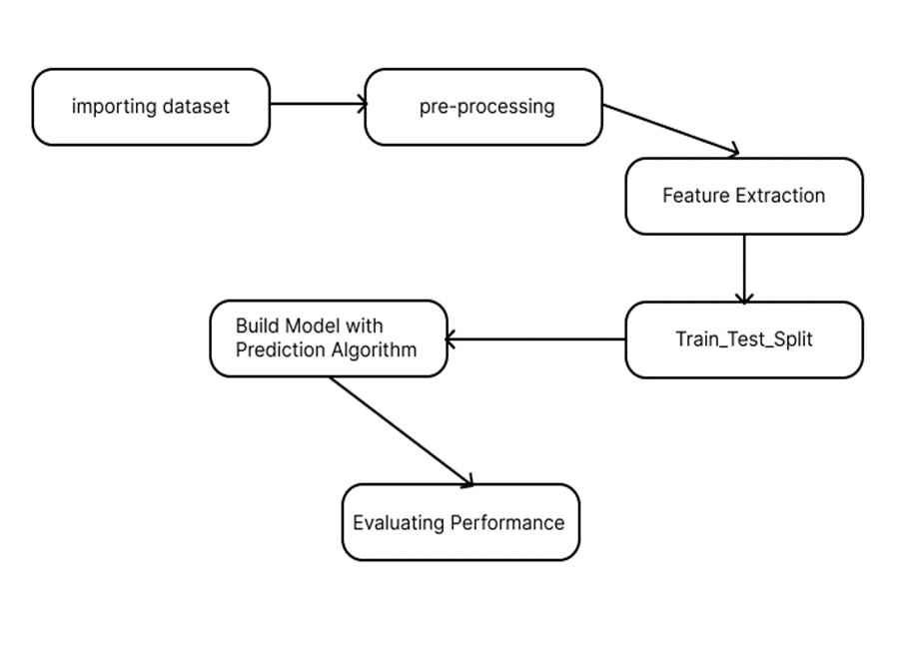
System Architecture

Slide 6
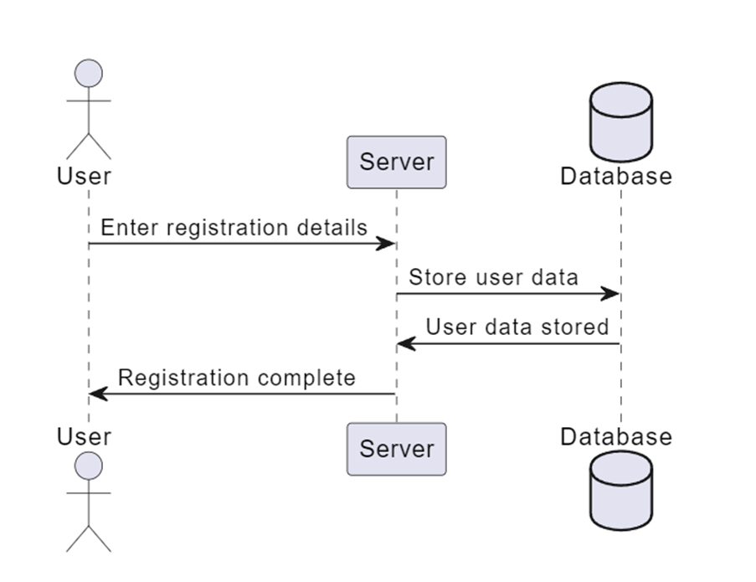
Sequence Diagram

Slide 7
List of Modules
Data Collection and Preprocessing
Model Development
Training and Evaluation
Integration of Natural Language Processing (NLP)
Chatbot Interface Development
Deployment and Testing

Slide 8
Data Collection and Preprocessing
Function: This module is responsible for collecting a diverse range of mental health-related inquiries and responses. It involves curating a dataset containing patterns of user inquiries and corresponding responses categorized under different mental health topics or intents.
Process: The data collection process may involve sourcing data from various sources such as online forums, mental health websites, or existing datasets. Once collected, the data is preprocessed to ensure consistency and quality. This preprocessing includes steps like removing duplicates, standardizing formats, and organizing the data into a structured format suitable for training the model.
Output: The output of this module is a well-curated dataset, typically in JSON or CSV format, containing a variety of user queries and their corresponding intents or categories. This dataset serves as the foundation for training the neural network model.

Slide 9
Model Development
Function: This module focuses on designing and implementing a neural network architecture suitable for classifying user inputs into predefined intents or categories.
Process: The neural network architecture is typically a feedforward neural network with multiple layers, including input, hidden, and output layers. The input layer receives the preprocessed text data, while the output layer produces probabilities for each intent or category. The hidden layers perform nonlinear transformations to learn complex patterns in the data.
Training: The neural network is trained using backpropagation and gradient descent optimization techniques. During training, the model learns to minimize a loss function by adjusting its parameters to improve prediction accuracy.
Output: The output of this module is a trained neural network model capable of classifying user inputs into predefined intents with a high degree of accuracy.

Slide 10
Training and Evaluation
Function: This module involves training the neural network model on the curated dataset and evaluating its performance to ensure accuracy and generalizability.
Training: The dataset is split into training and validation sets, typically using a 70-30 or 80-20 split. The model is trained iteratively over multiple epochs using the training set, with the validation set used to monitor performance and prevent overfitting.
Evaluation Metrics: Performance metrics such as accuracy, precision, recall, and F1 score are calculated to assess the model's performance on both the training and validation sets.
Hyperparameter Tuning: Hyperparameters such as learning rate, batch size, and network architecture are tuned to optimize the model's performance.
Output: The output of this module is a trained neural network model with optimized parameters and satisfactory performance metrics on the validation set.

Slide 11
Integration of Natural Language Processing (NLP)
Function: This module integrates NLP techniques such as tokenization, stemming, and the bag-of-words model to preprocess and analyze user queries before inputting them into the neural network model.
Tokenization: Text data is split into individual tokens or words to represent the input query.
Stemming: Words are reduced to their base or root form to normalize the text data and reduce vocabulary size.
Bag-of-Words Model: The frequency of each word in the input query is counted and represented as a vector, ignoring word order and grammar.
Output: The output of this module is preprocessed input data ready for input into the neural network model.

Slide 12
Chatbot Interface Development
Function: This module focuses on developing a user-friendly interface for the chatbot, enabling real-time interaction with users.
Interface Design: The interface design includes components such as text input fields, buttons, and chat history displays to facilitate communication between the user and the chatbot.
Real-time Interaction: The interface enables users to input text queries, receive responses from the chatbot, and engage in a conversational exchange.
Accessibility: The interface is designed to be intuitive and accessible to users of all backgrounds, ensuring ease of use and inclusivity.
Output: The output of this module is a fully functional chatbot interface that users can interact with to receive mental health support and information.

Slide 13
Deployment and Testing
Function: This module involves deploying the chatbot system and rigorously testing its functionality to ensure reliability and effectiveness.
Deployment: The chatbot system is deployed on a server or hosting platform, making it accessible to users via a web application or messaging platform.
Testing: The chatbot undergoes various testing procedures, including unit testing, integration testing, and user acceptance testing. Testing ensures that the chatbot performs as expected, handles different scenarios gracefully, and provides accurate and helpful responses to user inquiries.
Feedback Mechanism: A feedback mechanism is implemented to collect user feedback and improve the chatbot's performance over time based on user interactions and suggestions.
Output: The output of this module is a deployed and tested chatbot system ready for use by individuals seeking mental health support.

Slide 14
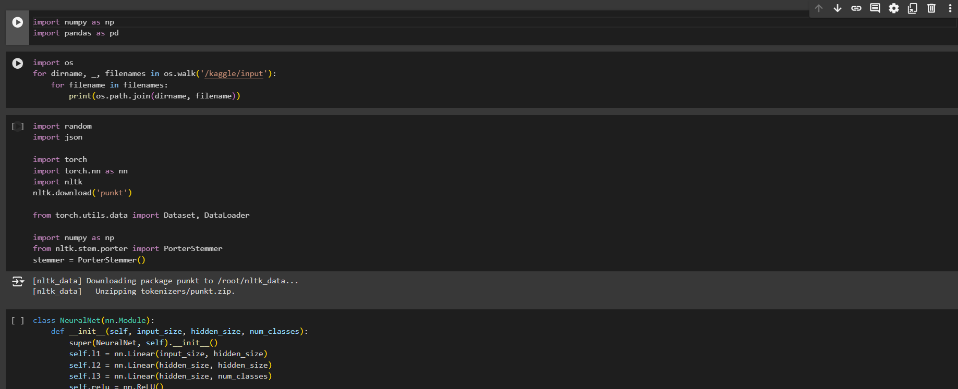
Coding Screenshots

Slide 15
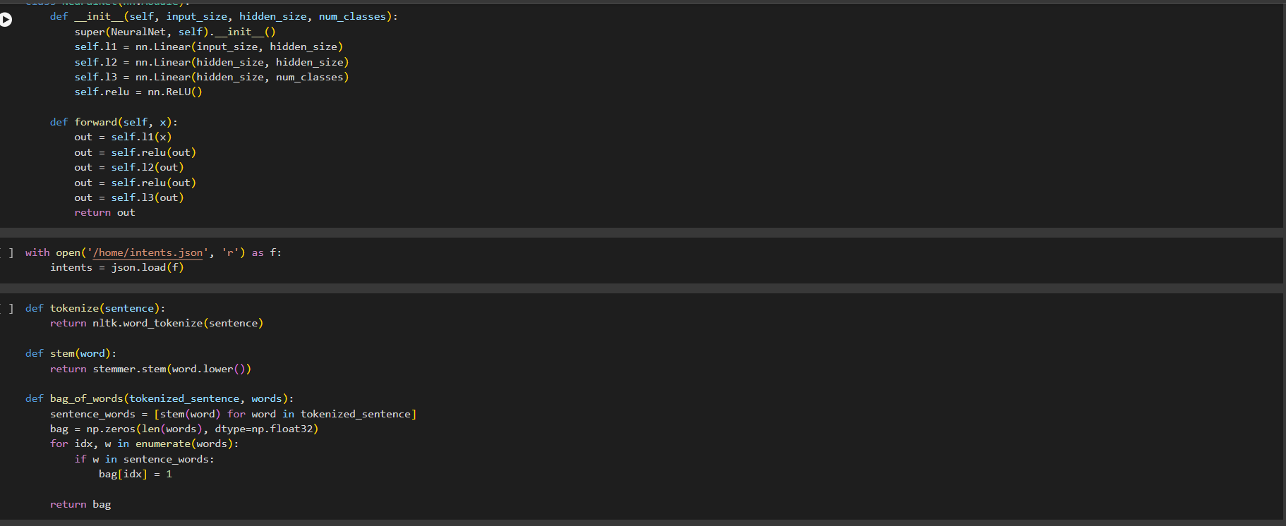

Slide 16
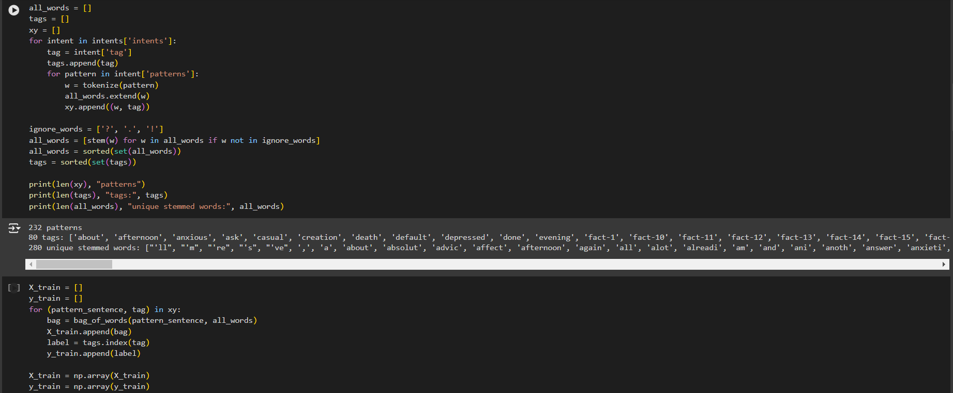

Slide 17
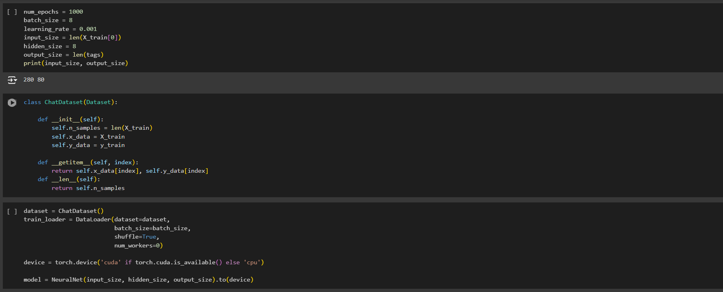

Slide 18
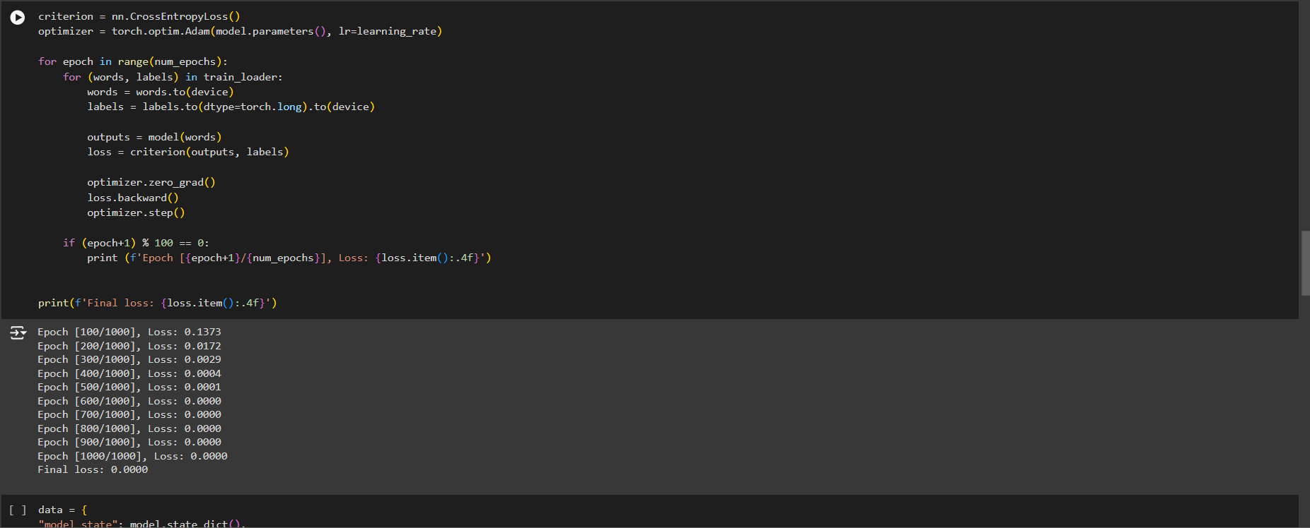

Slide 19
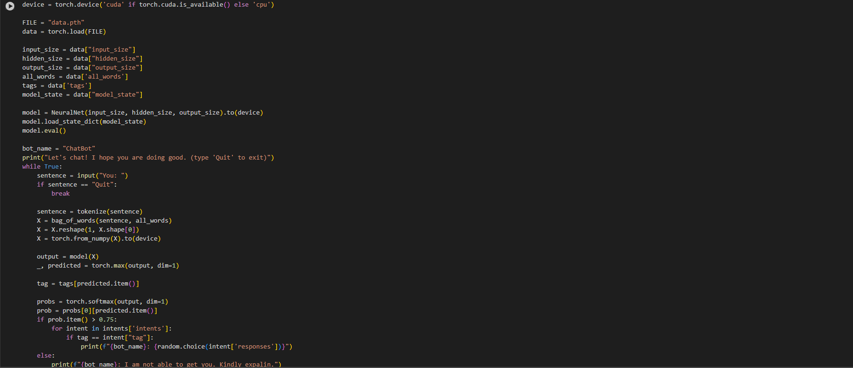

Slide 20
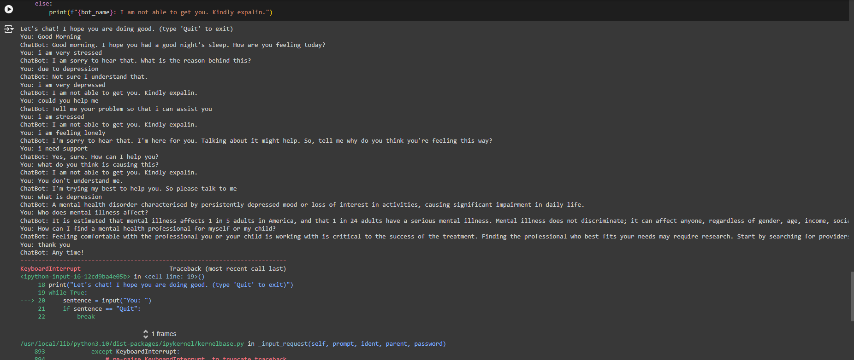
Output

Slide 21
Conclusion
In conclusion, the development and deployment of the AI-driven mental health chatbot represent a significant advancement in the provision of accessible and immediate support for individuals facing mental health challenges. The project successfully demonstrated the efficacy of utilizing machine learning and natural language processing techniques to create a chatbot capable of understanding and responding to diverse user inquiries with accuracy and empathy. Through rigorous training, testing, and user feedback, the chatbot emerged as a valuable resource for individuals seeking mental health support, offering timely assistance and valuable resources. Moving forward, continued refinement and enhancement of the chatbot's capabilities will further solidify its role as a supportive tool in promoting mental well-being and addressing the growing demand for accessible mental health resources.

Slide 22
References
“Deep Learning" by Ian Goodfellow, Yoshua Bengio( published in 2018).
"Hands-On Machine Learning with Scikit-Learn, Keras, and TensorFlow" by Aurélien Géron (Published in 2019)
"Python Deep Learning" by Ivan Vasilev and Daniel Slater in 2017.
"Deep Learning with Python" by Francois Chollet (Published in 2017).
"Practical Python and OpenCV" by Adrian Rosebrock (Published in 2019)
“Machine Learning Yearning" by Andrew Ng (Published in 2018)
"Python Deep Learning Projects" by Matthew Lamons, Rahul Kumar, and Abhishek Nagaraja (Published in 2019)
“Blockchain and the Supply Chain Concepts, Strategies and Practical Applications" by Tiana Laurence (Published in 2019)

