Slide 1
VIP - ML for Agricultural Commodity Market
Final Presentation
Final Alternative Data and
Preliminary Investment Strategy
TCN
Temporal Convolutional Network
Presenter: Kenji Funaki
May 12th, 2026

Slide 2
Alternative Data for Wheat Futures (TCN Model): Recap
Objective
Enhance directional prediction of wheat futures by incorporating cross-asset and macro alternative data that capture global economic conditions, risk sentiment, and supply-demand dynamics.
Prior Alternative Data
Updated Direction
DXY / dollar index, VIX, oil, gold, soybeans, and FRED-MD macro PCA factors.
Earlier validation metrics were close to baseline and still looked like tuning.
Main lesson: more data sources did not automatically improve wheat direction prediction.
Narrow the alternative-data set to economically motivated cross-asset returns.
Use leakage-safe scaling and PCA inside chronological folds.
Report the update as an ablation, not a claim of strong alpha.
The earlier presentation motivated the alternative-data idea; the final update makes the test narrower, cleaner, and easier to defend.
VIP Forecasting Project | Kenji Funaki | May 2026 | 0/5

Slide 3
1. Alternative Data Update: Narrower, Cleaner, More Honest
April issue
May update
Interpretation
Broad alternative-data list was too noisy for daily direction.
Validation looked weak and hard to explain.
Pipeline was still being tuned, so claims were not stable.
Focused on economically motivated daily returns: corn, soy, UUP, CAD.
Combined 7 wheat features + 4 cross-asset returns.
Used train-fold-only scaling and PCA(5), then TCN.
Small improvement over the TCN reference, but not a strong signal.
Larger cross-asset + macro PCA panel underperformed on this tail.
The update is better framed as an ablation, not a victory lap.
Core change: move from 'many possible alternative data sources' to a leakage-safe comparison of two PCA-augmented TCN tracks.
Wheat features + selected cross-asset returns -> fold-safe PCA -> TCN probabilities -> holdout evaluation
VIP Forecasting Project | Kenji Funaki | May 2026 | 1/5

Slide 4
2. Table III: PCA-Augmented TCN on Terminal Holdout
Pipeline | Acc. | ROC-AUC | F1_M
TCN_Revised reference | 0.541 | 0.526 | 0.541
TCN_PCA_WHEAT_ONLY: 7 wheat + corn/soy/UUP/CAD returns, PCA(5) | 0.543 | 0.506 | 0.508
TCN_PCA: Yahoo overlay + FRED-MD + 4 returns -> macro PCA(5) | 0.482 | 0.501 | 0.463
Key read: the narrower wheat-centered PCA track reached 54.3% accuracy, barely above the reference TCN. The broader cross-asset + macro PCA track fell below 50%.
Why it matters: alternative data helped only when it was selective and leakage-safe. More data did not automatically mean a better signal.
Replay: Adam LR=1e-6, 50 epochs, channels {128,64}, Apple MPS; terminal 15% chronological holdout; threshold 0.5 for Acc.
VIP Forecasting Project | Kenji Funaki | May 2026 | 2/5

Slide 5
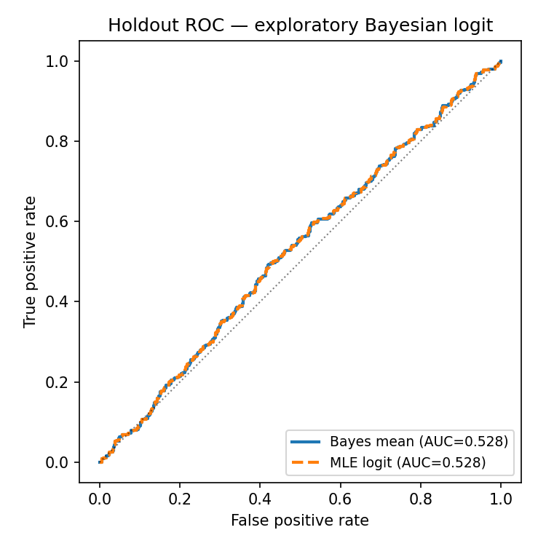
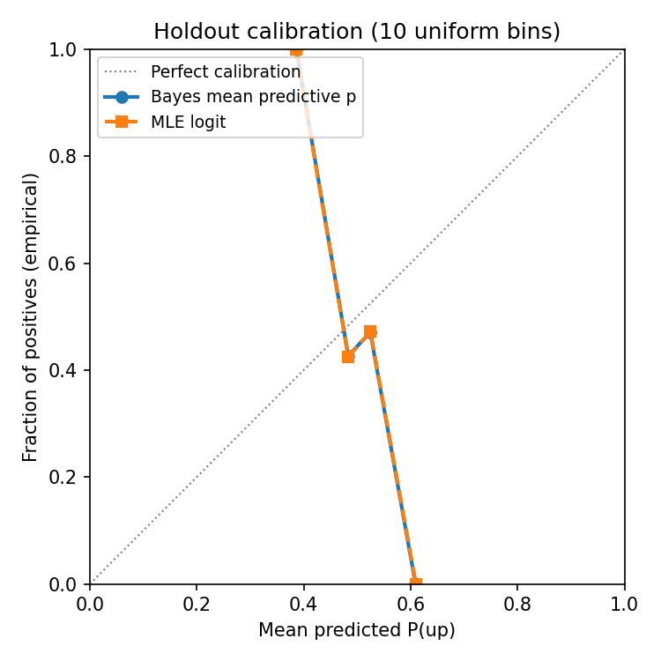
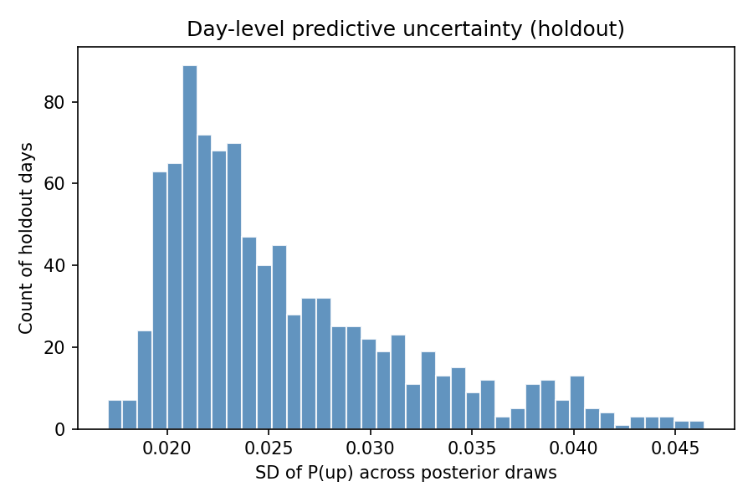
3. Why MCMC? Strategy Needs Probabilities and Uncertainty
Investment overlay consumes P(up), not just a hard up/down label.
A TCN can rank days, but a single probability does not show uncertainty.
Bayesian logistic MCMC gives posterior-mean probabilities and dispersion.
This supplements the strategy layer; it is not the champion forecaster.
Model | Acc. | AUC | Brier
MLE logit | 0.500 | 0.509 | 0.255
Bayes mean p | 0.542 | 0.508 | 0.249
MCMC role: expose calibration and uncertainty for threshold-aware long-flat rules.
Default design: same wheat + cross-asset PCA inputs as TCN_PCA_WHEAT_ONLY, flattened into a linear Bayesian logit.
VIP Forecasting Project | Kenji Funaki | May 2026 | 3/5

Slide 6
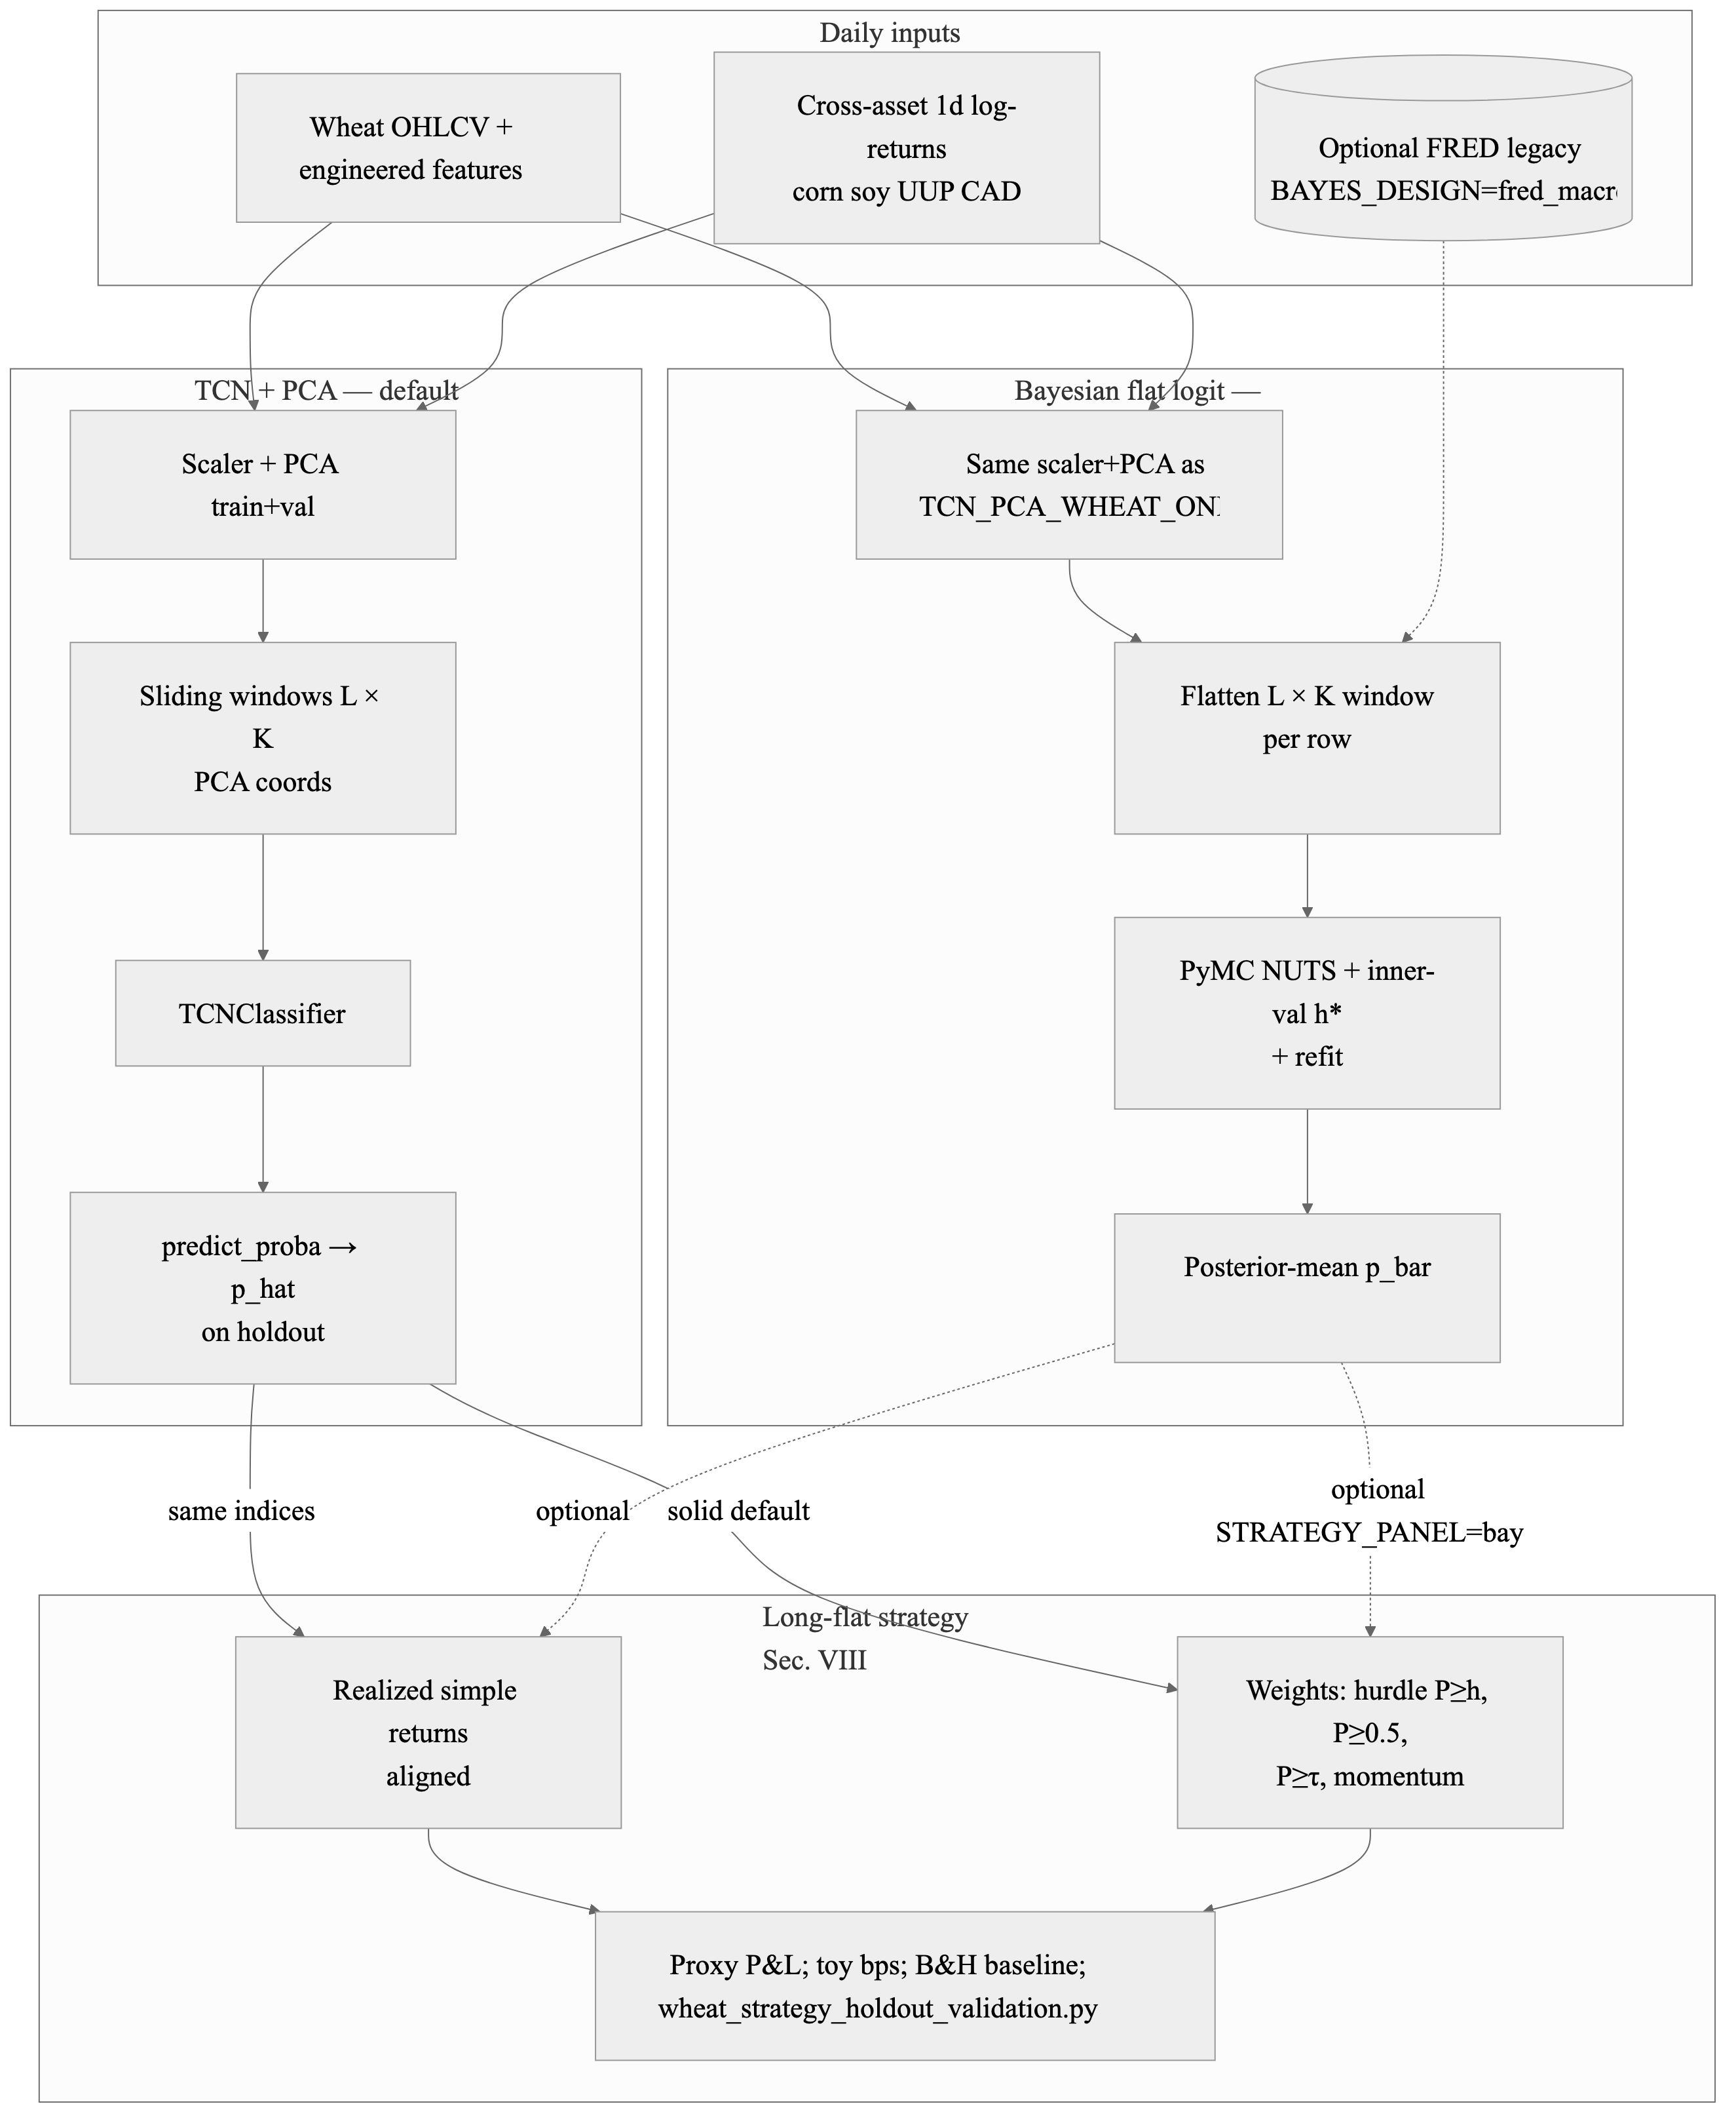
4. Investment Strategy: Tactical Long-Flat Holdout Proxy
Retrain TCN_PCA_WHEAT_ONLY on train+validation only.
Score the terminal 15% holdout with predicted P(up).
Go long only when P(up) clears a hurdle; otherwise stay flat.
Proxy only: no commissions, rolls, margin, options, slippage, or live order timing.
Rule | Tot. ret. | Vol. | Sharpe | Max DD | % long
Buy-and-hold | -0.468 | 0.319 | -0.36 | -0.613 | 1.00
P >= 0.52 | 0.000 | 0.000 | -- | 0.000 | 0.00
P >= 0.50 | 0.009 | 0.005 | 0.51 | 0.000 | 0.001
P >= tau | 0.000 | 0.217 | 0.11 | -0.400 | 0.42
Momentum | -0.155 | 0.211 | -0.11 | -0.399 | 0.46
Interpretation: on one bearish holdout tail, sitting out part of the decline reduced drawdown versus full exposure. This is risk management evidence, not proof of alpha.
VIP Forecasting Project | Kenji Funaki | May 2026 | 4/5

Slide 7
5. Conclusion and Future Work
What I learned
Final conclusion
Daily wheat direction is a weak-signal problem.
Chronological discipline matters more than model complexity.
Alternative data must be selective, causal, and tested as ablations.
AI/ML helped organize experiments, but did not remove market noise.
TCN and PCA-augmented TCN showed the best descriptive holdout results.
Model differences should not be read as statistically significant superiority.
Probability use, calibration, and when to stay flat may matter as much as accuracy.
If more time were allowed
Run expanding-window walk-forward tests with nested tuning.
Add FRED-vintage sensitivity and alternate calendar cutoffs.
Model commissions, rolls, contract multipliers, margin, and liquidity.
Compare TCN with/without macro PCA on identical splits.
Use Bayesian uncertainty for calibration-aware thresholds, not overfitting.
VIP Forecasting Project | Kenji Funaki | May 2026 | 5/5

Slide 8
Thank You!
Kenji Funaki
kf2623@nyu.edu
https://www.linkedin.com/in/kfunaki/

