Slide 1
VIP –ML for Agricultural Commodity Market
Final Presentation
Final Alternative Data and
Preliminary Investment Strategy
TCN Temporal Convolutional Network
Presenter : Kenji Funaki
May 12th , 2026
Notes:
This final presentation summarizes the most recent stage of the VIP wheat forecasting project. The focus is on the update from the earlier alternative-data work toward a cleaner PCA-augmented TCN pipeline, a Bayesian MCMC probability layer, and a preliminary investment-strategy proxy. The key framing is cautious: this is an empirical machine-learning forecasting study and strategy evaluation, not a production trading system or investment recommendation.

Slide 2
Alternative Data for Wheat Futures (TCN Model) :Recap
Objective
Could Not Beat the Baseline TCN Model Result
Enhance directional prediction of wheat futures by incorporating cross-asset and macro alternative data that capture global economic conditions, risk sentiment, and supply-demand dynamics.
RAW DATA
├── Wheat Futures (price)
├── Alt Data (oil, gold, DXY, soy, VIX)
└── Macro (31 FRED variables)
│
▼
[1] FEATURE ENGINEERING
├── Returns (1d, 3d, 5d)
├── Volatility (rolling std)
├── Momentum
└── Alt-data returns + vol
│
▼
[2] MACRO COMPRESSION (PCA)
├── Scale macro variables
├── Apply PCA → 5 factors
└── Remove noise / redundancy
│
▼
[3] FEATURE CONCATENATION
├── Price features
├── Alt features
└── PCA factors
│
▼
[4] SLIDING WINDOW
├── Lookback = 30 days
└── Shape → (Samples, Time, Features)
│
▼
[5] TCN MODEL
├── Causal 1D Convolution
├── Dilations (1, 2, 4, 8…)
├── Temporal feature extraction
│
▼
[6] CLASSIFIER
└── Output → Up / Down
2. Selected Alternative Data Features
We have struggle to find one good datasets and explores some alternative way with the best model, TCN.
We enhance wheat prediction by integrating cross-asset signals (oil, FX, volatility, crops) and compressing macro data into latent factors, enabling TCN to learn nonlinear market regimes.
Macro Compression (FAVAR Approach) 31 macro variables → PCA (5 factors)
Category | Features
Price signals | returns, volatility, momentum
Alt data | oil, gold, DXY, soy, VIX
Macro | PCA factors (5)
DXY: Dollar Index, VIX: Volatility Index, oil, gold and soy.
Still Tuning the model and methodology
Validation metrics: acc=0.5174 f1_macro=0.5168 roc_auc=0.5246
Validation predictions shape: (1034,)
Baselines: majority acc=0.5358, f1=0.3489, auc=0.5000 | momentum acc=0.5019, f1=0.4993, auc=0.4993
Notes:
This slide recaps the earlier alternative-data presentation. At that point, the goal was to improve wheat direction prediction by adding cross-asset and macro features such as oil, gold, DXY, soybeans, VIX, and FRED-MD PCA factors. The pipeline used feature engineering, macro compression through PCA, sliding windows, and a TCN classifier. The important result was that the approach still could not clearly beat the baseline TCN. That was a useful negative result: it showed that broad alternative data and more features do not automatically create better directional signal.

Slide 3
1. Alternative Data Update: Narrower, Cleaner, More Honest
April Issue
May Update
Interpretation
Broad Alternative-Data List was too Noisy for Daily Direction. oil, gold, DXY, soy, VIX
Validation Looked Weak and Hard to Explain.
Pipeline was Still being Tuned, so Claims were not Stable.
Focused on Economically Motivated Daily Returns: Positive Pearson Cor corn(.5752), soy(.3626)
Negative Pearson Cor UUP (-.1174), CAD (-.1144).
Combined 7 Wheat Features + 4 Cross-Asset Returns.
Used Train-Fold-Only Scaling and PCA(5), then TCN.
Small Improvement Over the TCN Baseline, but Not a Strong Signal.
Larger Cross-Asset + Macro PCA Panel Underperformed on this Tail.
The Update is better Framed as an Ablation, Not a Victory Lap.
Core Change: Move from 'Many Possible Alternative Data Sources' to a Leakage-Safe Comparison of Two PCA-augmented TCN tracks.
Wheat features + selected cross-asset returns -> fold-safe PCA -> TCN probabilities -> holdout evaluation
Pipeline | Acc. | ROC-AUC | F1_M
TCN Baseline Reference | 0.541 | 0.526 | 0.541
TCN_PCA_WHEAT_ONLY: 7 wheat + corn/soy/UUP/CAD returns, PCA(5) | 0.543 | 0.506 | 0.508
TCN_PCA: Yahoo overlay + FRED-MD + 4 returns -> macro PCA(5) | 0.482 | 0.501 | 0.463
Replay: Adam LR=1e-6, 50 epochs, channels {128,64}, Apple MPS; terminal 15% chronological holdout; threshold 0.5 for Acc.
VIP Forecasting Project | Kenji Funaki | May 2026 | 1/5
Notes:
This slide shows the update from the earlier work. I narrowed the alternative-data design to four economically motivated daily return series: corn and soybeans as related agricultural markets, UUP as a U.S. dollar proxy, and CAD/USD as a North American export and FX channel. The Pearson correlations help explain the selection: corn and soy had positive correlations with wheat, while UUP and CAD/USD had modest negative correlations. The final PCA track used seven wheat-derived features plus those four cross-asset returns, with train-fold-only scaling and PCA before the TCN.
The table gives the main result. The baseline TCN reference reached 0.541 holdout accuracy. The narrower TCN_PCA_WHEAT_ONLY pipeline reached 0.543, which is only a small descriptive improvement. The broader TCN_PCA version, which added the Yahoo overlay and macro PCA block, underperformed at 0.482. My interpretation is that the useful progress is not a claim that alternative data solved the problem, but a cleaner and more defensible ablation showing that selective data worked better than broad expansion.

Slide 4
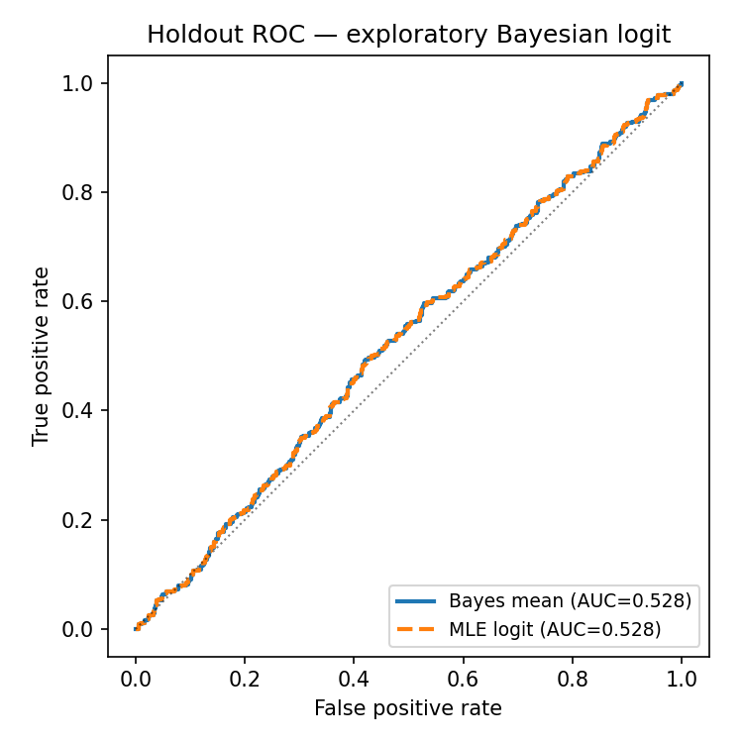
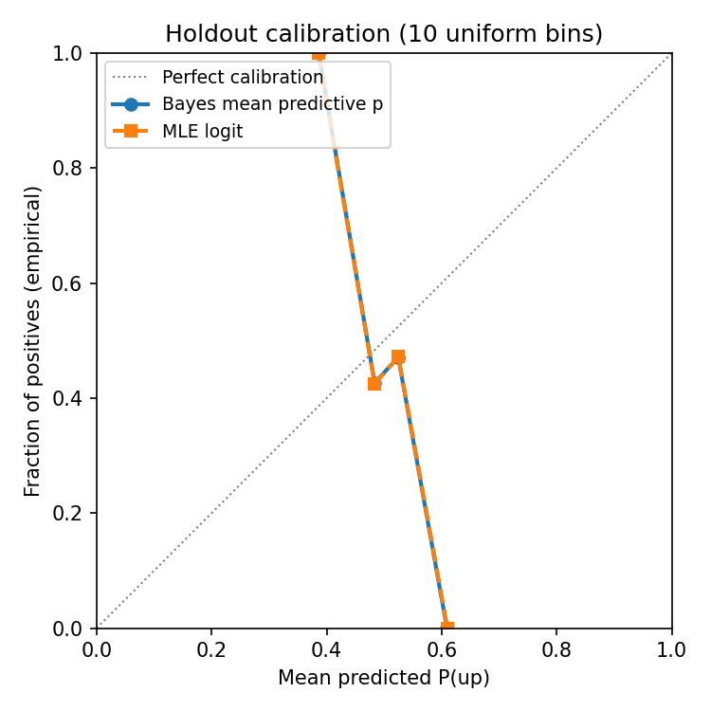
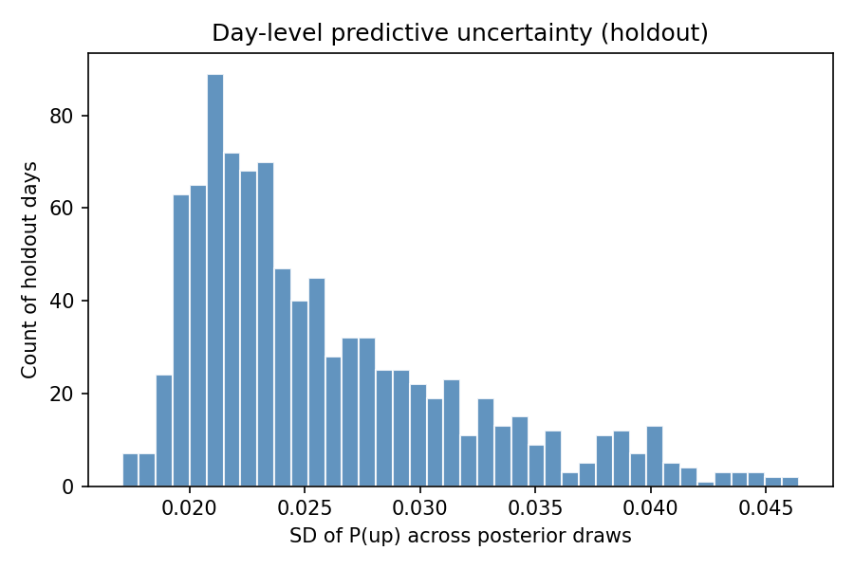
2. Strategy Needs Probabilities and Uncertainty
Investment Overlay Consumes P(up), Not Just a Hard Up/Down Label.
A TCN can Rank Days, but a Single Probability Does not Show Uncertainty.
Bayesian Logistic MCMC(Markov Chain Monte Carlo) gives Posterior-Mean Probabilities and Dispersion.
This Supplements the Strategy Layer; It Is Not the Champion Forecaster.
Model | Acc. | AUC | Brier
MLE Logit | 0.500 | 0.509 | 0.255
Bayes Mean p | 0.542 | 0.508 | 0.249
MCMC role: Expose Calibration and Uncertainty for Threshold-Aware Long-Flat Rules.
Default design: same wheat + cross-asset PCA inputs as TCN_PCA_WHEAT_ONLY, flattened into a linear Bayesian logit.
VIP Forecasting Project | Kenji Funaki | May 2026 | 3/5
Notes:
The motivation for MCMC came from the investment-strategy layer. A strategy does not only need a hard up-or-down label; it needs probabilities, thresholds, and some understanding of uncertainty. The TCN can rank days and output probabilities, but a single probability does not show how uncertain the model is. The Bayesian logistic MCMC model supplements the TCN by producing posterior-mean probabilities and uncertainty diagnostics on a flattened wheat-PCA design.
The table compares a standard maximum-likelihood logistic model with the Bayesian posterior-mean probability model. The Bayesian version had 0.542 accuracy and a slightly better Brier score, while the AUC stayed close to coin-flip. I do not present MCMC as the champion forecaster. Its role is to support calibration, uncertainty analysis, and threshold-aware long-flat rules.

Slide 5
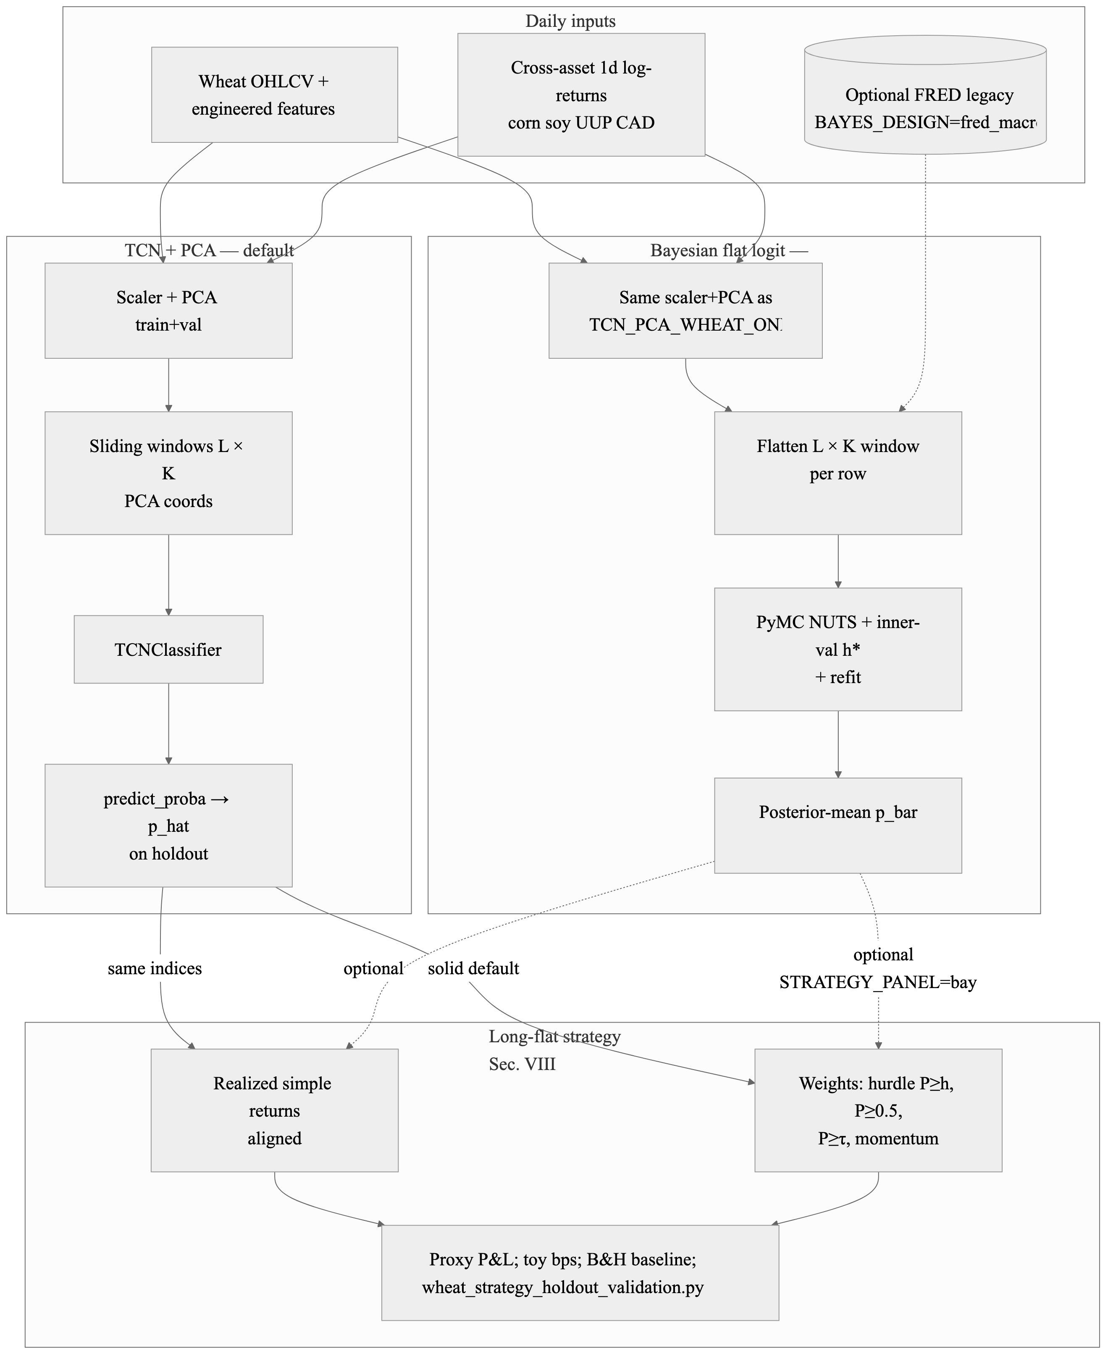
3. Investment Strategy: Tactical Long-Flat Holdout Proxy
Retrain TCN_PCA_WHEAT_ONLY on Train + Validation Only.
Score the Terminal 15% Holdout with Predicted P(up).
Go Long Only When P(up) Clears a Hurdle; Otherwise Stay Flat.
Proxy Only: No Commissions, Rolls, Margin, Options, Slippage, Storage or Live Order Timing.
Rule | Tot. ret. | Vol. | Sharpe | Max DD | % Long
Buy-and-hold | -0.468 | 0.319 | -0.36 | -0.613 | 1.00
P >= 0.52 | 0.000 | 0.000 | -- | 0.000 | 0.00
P >= 0.50 | 0.009 | 0.005 | 0.51 | 0.000 | 0.001
P >= tau | 0.000 | 0.217 | 0.11 | -0.400 | 0.42
Momentum | -0.155 | 0.211 | -0.11 | -0.399 | 0.46
Interpretation: On One Bearish Holdout Tail, Sitting Out Part of the Decline Reduced Drawdown Versus Full Exposure. This is Risk Management Evidence, Not Proof of Alpha.
VIP Forecasting Project | Kenji Funaki | May 2026 | 4/5
Notes:
This slide explains the preliminary investment-strategy proxy. I retrain TCN_PCA_WHEAT_ONLY on the train-plus-validation period only, then score the terminal 15 percent holdout with predicted probability of an up day. The rules convert those probabilities into long-flat exposure: go long only when the probability clears a threshold, otherwise stay flat. Buy-and-hold stays long every day.
The results are best read as a risk-management comparison on one bearish holdout window. Buy-and-hold lost about 46.8 percent, while the long-flat rules reduced exposure by sitting out part of the decline. The validation-threshold rule was long about 42 percent of the time and had a smaller maximum drawdown than full exposure. This is not proof of alpha. It is a frictionless proxy that still excludes commissions, contract rolls, margin, options, slippage, storage, and live order timing.

Slide 6
4. Discussion and Conclusion
What I Learned in this Semester ... and Conclusion
Daily Wheat Direction Forecasting Remains A Weak-Signal Problem.
TCN And PCA-Augmented TCN Produced The Best Descriptive Holdout Results, But The Improvement Was Modest.
Chronological Discipline Matters More Than Model Complexity.
Selective Alternative Data Helped More Than Broad Alternative Data Expansion.
More Data Did Not Automatically Improve Performance.
Leakage-Safe Design Was One Of The Most Important Lessons.
Model Accuracy Alone Is Not Enough For An Investment Strategy.
MCMC Helped Supplement The Strategy Layer With Posterior Probabilities And Uncertainty.
The Long-Flat Strategy Reduced Exposure During A Bearish Holdout Window.
The Strategy Result Should Be Interpreted As Risk Management, Not Proof Of Alpha.
Overall, The Project Became A Reproducible And Cautious ML Forecasting Evaluation.
VIP Forecasting Project | Kenji Funaki | May 2026 | 5/5
Notes:
The main conclusion is that daily wheat direction forecasting remains a weak-signal problem. The TCN and PCA-augmented TCN produced the best descriptive holdout results, but the improvement was modest. Chronological discipline mattered more than model complexity: train-only scaling, leakage-safe PCA, and honest holdout evaluation were essential. Selective alternative data helped more than broad data expansion, but more data did not automatically improve performance.
The investment-strategy work reinforced the same lesson. Model accuracy alone is not enough; probabilities, calibration, and uncertainty matter when forecasts are mapped into positions. MCMC helped supplement the strategy layer with posterior probabilities and uncertainty. The long-flat strategy reduced exposure during a bearish holdout window, but the result should be interpreted as risk management, not proof of alpha. Overall, the project became a reproducible and cautious ML forecasting evaluation.

Slide 7
5. Future Work (Next Semester Tasks?)
Add Alternative Trading Rules Beyond Long-Flat, Such As Long-Short, Volatility-Scaled Exposure, Confidence-Weighted Sizing, And Stop-Loss / Take-Profit Rules.
Extend The MCMC Model So Posterior Uncertainty Affects Position Size, Not Only The Trade/No-Trade Threshold.
Compare TCN Probabilities, Bayesian Posterior-Mean Probabilities, And Ensemble Probabilities Under The Same Strategy Rules.
Add Transaction-Aware Strategy Testing With Commissions, Slippage, Bid-Ask Spread, Futures Rolls, Margin, And Contract Multipliers.
Run Walk-Forward Strategy Validation With Expanding Windows So Each Rule Is Tested Across Multiple Market Regimes.
Use MCMC Posterior Predictive Draws To Stress-Test Strategy Outcomes, Including Downside Risk And Probability Of Loss.
Explore Regime-Aware Bayesian Models, Where Parameters Or Thresholds Can Differ Across High-Volatility, Low-Volatility, And Macro-Stress Periods.
VIP Forecasting Project | Kenji Funaki | May 2026 | 5/5
Notes:
If this work continues next semester, I will extend both the strategy side and the probabilistic modeling side. On the strategy side, I would test rules beyond long-flat, including long-short, volatility-scaled exposure, confidence-weighted sizing, and stop-loss or take-profit rules. I would also add transaction-aware testing with commissions, slippage, bid-ask spread, futures rolls, margin, and contract multipliers.
On the validation side, I would use expanding-window walk-forward tests, so each rule is evaluated across multiple market regimes. On the Bayesian side, I would let posterior uncertainty affect position size, compare TCN probabilities with Bayesian posterior-mean probabilities and ensemble probabilities, and use posterior predictive draws to stress-test downside risk and probability of loss. A later extension could also use regime-aware Bayesian models where parameters or thresholds differ across high-volatility, low-volatility, and macro-stress periods.

Slide 8
Thank You!
Kenji Funaki kf2623@nyu.edu https://www.linkedin.com/in/kfunaki/
Notes:
Thank you so much, Professor Amine Aboussalah, the course TAs regarding the guidance this semester. I am happy to discuss the alternative-data choices, the PCA-augmented TCN results, the Bayesian MCMC probability layer, or how the preliminary long-flat strategy proxy could be made more realistic in a follow-on term.

