Slide 1

Risk and Compliance Tracking System
Presented by Krisztina Fabo

Slide 2

Agenda

Slide 3
“are our internal controls effective at stopping cyber attacks?” “how our results of the latest audit tie back to our overarching legal compliance?”

Slide 4
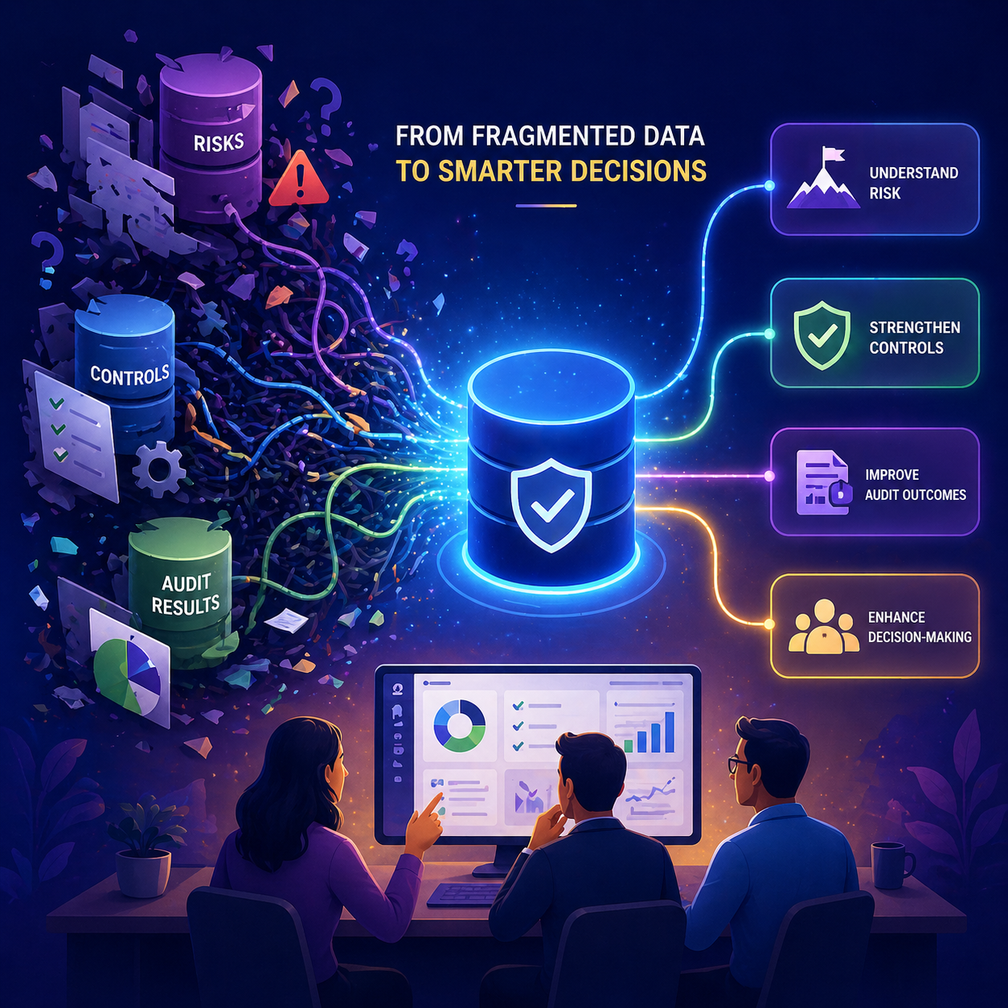
PURPOSE of the project
Problem:
GRC data is often fragmented across systems
Difficult to connect risks, controls, and audit results
Limits visibility for decision-making
Goal:
Design a structured relational database system that enables organizations to better understand and manage risk and compliance

Slide 5
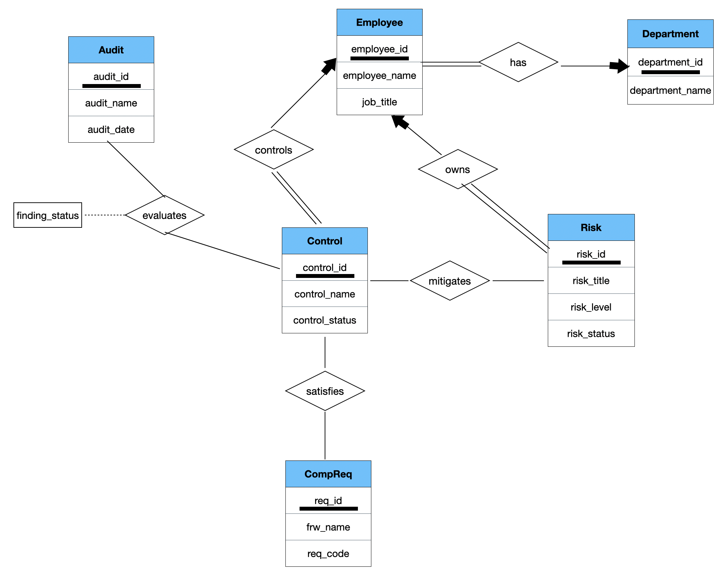
Relationships Drive Value
Design features
Six core entities
Value comes from relationships, not just data
Traceability across risk, control, compliance, and audit
Key design decisions
No redundant Risk–Department relationship
Relationship attribute: finding_status
Ownership enforced via foreign keys

Slide 6
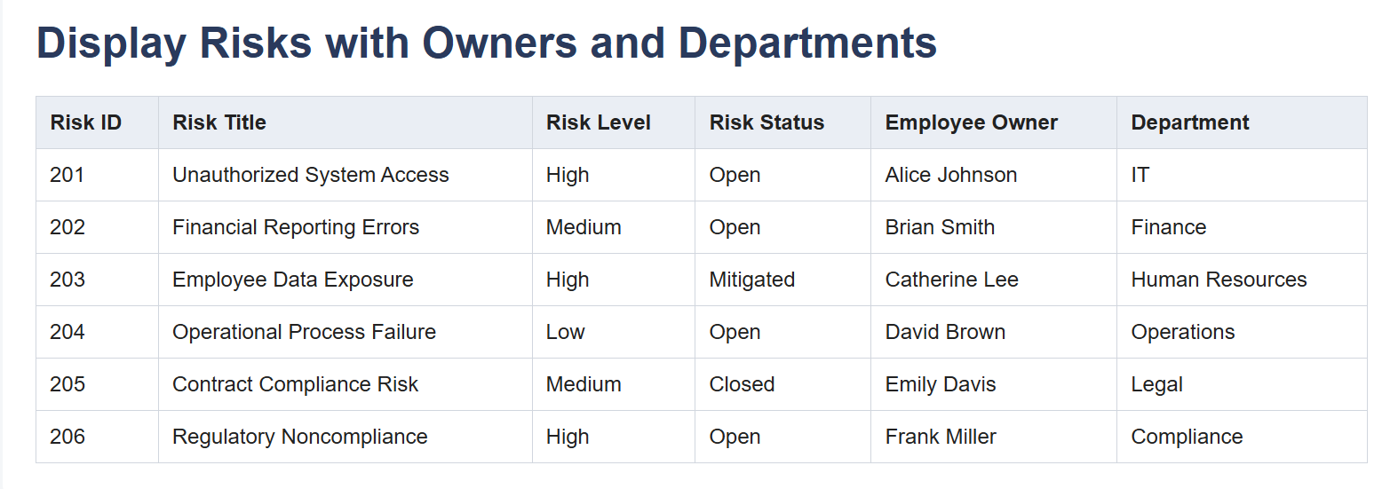
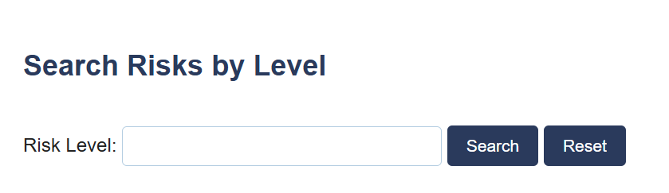
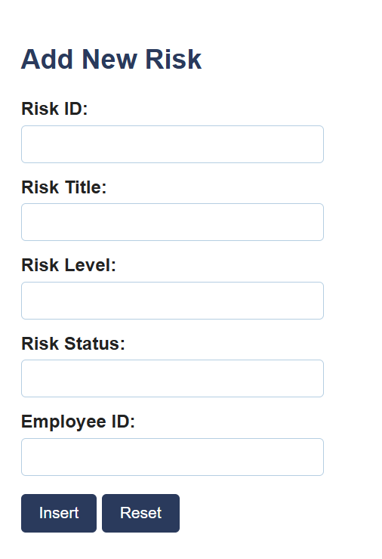
bridge between the user and the database
https://pluto2.hood.edu/~kf19/GRC_Project/project_home.php

Slide 7

TAKEAWAY
Lessons Learned
Importance of normalization and avoiding redundancy
Value of relationships in structuring complex data
Translating real-world problems into database design
Future Work
Improve user interface (dropdowns, usability)
Add authentication and role-based access
Extend system with reporting or dashboards

Slide 8
“How much potential financial risk is currently exposed due to controls that failed their most recent audit?”

