Slide 1

RETHINK, REINVENT, REALIZE.
How to successfully scale digital
innovation to drive growth
AUTOMOTIVE – OES
INTO THE NEW

Slide 2

THE IDEA:
FIND INDUSTRY X.0 BEST PRACTICES!
OUR PREMISE AND RESEARCH QUESTION
When it comes to digital transformation, scaling innovation pilots is critical.
Can we find key best practices that could help them overcome their challenges, and drive real change, for real new growth?
Yet many clients tell us that they are struggling with this very step – and feel that they might get stuck with
“piecemeal projects” that don’t deliver significant value.
Copyright © 2019 Accenture. All rights reserved.
2

Slide 3
GLOBAL SURVEY AT-A-GLANCE
AUTOMOTIVE – OES AT-A-GLANCE
n=1,350
responses from companies with 1bn+ in revenue
60%
C-suite respondents
13 industries
and 17 countries
n=108
responses from companies
with 1bn+ in revenue
57%
C-suite respondents
13
countries
Source: Accenture 2019 Industry X.0 Survey

Slide 4
THE RESULT:
IT’S ALL A MATTER OF MANAGEMENT!
OUR KEY FINDINGS
Companies are scaling more than 60 percent of all digital PoCs, but less than two out of ten companies are doing it successfully.
What’s the difference? The leading 15 percent manage their scaling efforts differently.
Following the four best practices of these “Champions” is a recipe to succeed at innovating for digital transformation.
A SURPRISE!
(we didn‘t expect to find that many
companies trying to scale!)
THE REASON TO READ!
(these best practices are what readers will come for)
Source: Accenture 2019 Industry X.0 Survey

Slide 5


Q: WHAT’S THE CURRENT STATUS
IN SCALING DIGITAL INNOVATION?
A:
THINGS ARE SPEEDING UP – IN SURPRISING WAYS.
Copyright © 2019 Accenture. All rights reserved.
5

Slide 6
DESIGN AND PRODUCTION AND OPERATIONS ARE
INNOVATION PRIORITIES FOR AUTO–OES COMPANIES
Design is an obvious innovation priority as they focus deeply on product quality and features. Production & Operations is a close second due to the emphasis on streamlined manufacturing operations and rapid turnaround.
INNOVATION PRIORITY*
35,2%
25,0%
21,4%
_{16,7%} 17,5%
15,7%
15,7%
14,5%
11,1%
12,1%
9,5%
5,6%
Product & Service Design Production & Operations Supply Chain & Logistics
Sales & Aftersales Service
Digital /Physical Security
Continuous Customer Engagement
Automotive - OES Cross-Industry
* “innovation priority” = percentage of respondents who are prioritizing digital innovation in these business areas
Source: Accenture 2019 Industry X.0 Survey

Slide 7
AUTOMOTIVE – OES COMPANIES ARE SCALING DIGITAL POCs ACROSS BUSINESS FUNCTIONS
Automotive – OES manufacturers are almost evenly scaling digital POCs across key business areas
SCALING INTENSITY*
62,0%
63,0%
63,8%
61,1%
59,8%
58,8%
59,5%
58,7%
60,8%
58,4%
59,2%
59,0%
Product & Service Design
Production & Operations
Supply Chain & Logistics
Sales & Aftersales Service
Digital/Physical Security
Continuous Customer Engagement
Automotive - OES Cross-Industry
* “scaling intensity” = ratio of avg. number of proof of concepts scaled to avg. number initiated in each business function, across discrete and process industries.
Source: Accenture 2019 Industry X.0 Survey

Slide 8

AUTOMOTIVE – OES COMPANIES RECOGNIZE THE NEED FOR INNOVATING AT SCALE TO:
Operate at speed with an innovative and robust supply chain, and
Continuously deliver reliable and connected products to the customers.
Copyright © 2019 Accenture. All rights reserved.
8

Slide 9
ANOMALY DETECTION AND PURCHASE ORDER
MANAGEMENT ARE KEY OUTCOMES…
Top 10 outcomes targeted by Automotive – OES companies through scaling of digital PoCs
Automated systems anomaly detection |  |  |  |  |  |  |  |  |  | 36%
Digitized purchase order management |  |  |  |  |  |  |  |  |  | 36%
Higher growth in service revenues |  |  |  |  |  |  |  | 36%
Lower number of prototype iterations |  |  |  |  |  |  |  | 36%
Improved data privacy |  |  |  |  |  | 34%
Higher customer satisfaction score |  |  |  | 33%
Improved supply chain efficiencies |  |  |  | 33%
Reduction in process complexity |  |  |  | 33%
Reduced conversion costs (direct labor costs + manufacturing overheads)
Greater plant flexibility
32%
32%
% of respondents who achieved this outcome
Source: Accenture 2019 Industry X.0 Survey

Slide 10
…AND THEY ARE CHOOSING BIG DATA
ANALYTICS, AR/VR & CLOUD TO DRIVE THESE OUTCOMES
Top 3 technologies leveraged to facilitate scaling, by function
PRODUCT & SERVICE DESIGN |  | PRODUCTION & OPERATIONS | SUPPLY CHAIN & LOGISTICS | SALES & AFTERSALES SERVICE | DIGITAL/ PHYSICAL SECURITY | CONTINUOUS CUSTOMER ENGAGEMENT
AI/AI-powered Automation |  | RANK 1
AI Assistants
3D printing
Mobility
IIOT Sensors & Transmitters
Immersive Experience |  |  | RANK 3 |  |  | RANK 1
Industrial Robotics
Big Data Analytics |  | RANK 3 |  | RANK 1 | RANK 2 | RANK 2
Digital Twin
Cloud | RANK 1 |  |  |  |  | RANK 3
Blockchain |  |  |  | RANK 2 | RANK 3
Autonomous Vehicles | RANK 3 |  | RANK 1
Machine Learning/Deep Learning | RANK 2 |  | RANK 2
Quantum Computing |  |  |  | RANK 3
Cyber Security Protocols |  | RANK 2 |  |  | RANK 1
Source: Accenture 2019 Industry X.0 Survey

Slide 11
Q:
WHAT ABOUT SCALING SUCCESS – DOES EVERYONE SEE IT?
A:
NO. SOME COMPANIES RACE AHEAD, OTHERS STRUGGLE.
Copyright © 2019 Accenture. All rights reserved.
11

Slide 12






SO, WHO’S SCALING THE BEST?
The Automotive – OES industry has a lower percentage of Champions compared to the global average
AUTOMOTIVE - OES
CROSS-INDUSTRY
CHAMPIONS
Earn RODI higher than industry ROIC
8%
15%
13%
and industry RODI; scale more than 50% of their digital Proof-of-Concepts
22%
CONTENDERS
Earn RODI lower than industry ROIC and
lower than industry RODI; scale more than
50% of their PoCs
CADETS
Earn RODI lower than industry ROIC and
lower than industry RODI; scale less than
50% of their PoCs
77%
65%
*Percentage of champions in each geography = 100 x (The number of champions in a particular geography)/(Total number of companies surveyed in that particular geography)
**Percentage of champions in each industry = 100 x (The number of champions in a particular industry)/(Total number of companies surveyed in that particular industry)
Source: Accenture 2019 Industry X.0 Survey ₁₂

Slide 13
AUTO-OES CHAMPIONS SET THEMSELVES HIGHER
“RODI” TARGETS AND ACHIEVE THEM TOO.
Automotive – OES Champions achieved over 4 times the RODI clocked by Contenders; proving
that its not how much you scale, but how you scale that matters
AUTOMOTIVE - OES CROSS-INDUSTRY
Returns on Digital
Investment (RODI)
25,5% | RODI expected |  |  | 22,2% | RODI expected
27,1% | RODI achieved |  |  | 25,4% | RODI achieved
7,4% | RODI expected |  |  | 7,1% | RODI expected
CHAMPIONS
RODI = Returns on Investment
(Net Gain/Total Investment) from
scaled digital PoCs across all the key business functions.
CONTENDERS
6,5%
RODI achieved
6,4% RODI achieved
We asked executives about the average RODI they expected before scaling digital PoCs, and the RODI they finally achieved.
CADETS
6,1%
RODI expected
11,4%
RODI expected
4,7%
RODI achieved
9,7% RODI achieved
Source: Accenture 2019 Industry X.0 Survey ₁₃

Slide 14
Q:
WHAT’S STOPPING CONTENDERS AND CADETS FROM BECOMING CHAMPIONS?
A:
LIKE CHAMPIONS, CONTENDERS AND CADETS TOO FACE ALIGNMENT AND TALENT DEFICITS. WHILE CHAMPIONS OVERCOME THESE, OTHERS CONTINUE TO GRAPPLE WITH THEM.
Copyright © 2019 Accenture. All rights reserved.
14

Slide 15
SECURING FUNDING FOR DIGITAL REINVENTION FROM THE BOARD IS A MAJOR ROADBLOCK FOR AUTO – OES COMPANIES
EXTENT TO WHICH SECURING FUNDING FROM THE
BOARD FOR DIGITAL REINVENTION IS A CHALLENGE
RANK | KEY REASONS WHY BOARDS OF AUTOMOTIVE – OES COMPANIES REFUSE TO FUND DIGITAL REINVENTION
1. | Failure to scale digital PoCs in the past
2. | Shortage of and difficult access to digital skills; Lack of a clear digital roadmap; Foreseen immaturity of technology
3. | Shortage of budget for capital investments
4. | Inadequate ROI from digital investments
5. | Poor understanding of digital reinvention within Top Management
6. | Lack of a digital-native mindset among Board members
To a great | 19%
extent | 24%
To a large |  | 37%
extent |  | 35%
To a moderate extent
33%
24%
To a limited extent
8%
12%
3%
Automotive – OES
Not at all
5%
Cross-Industry
Source: Accenture 2019 Industry X.0 Survey

Slide 16
ALIGNMENT CHALLENGES AND SKILL DEFICITS ARE OF PRIMARY CONCERN
Automotive – OES executives’ top picks* for “biggest challenges to scaling digital PoCs”
Biggest challenge
Second biggest
PRODUCT & SERVICE DESIGN |  |  |  | PRODUCTION & OPERATIONS |  |  | SUPPLY CHAIN & LOGISTICS |  |  | SALES, AFTER SALES SERVICE |  |  | DIGITAL / PHYSICAL SECURITY |  |  | CONTINUOUS CUSTOMER ENGAGEMENT
CHAMPIONS (CH), CONTENDERS (CT), CADETS (CA) | CH | CT | CA | CH | CT | CA | CH | CT | CA | CH | CT | CA | CH | CT | CA | CH | CT | CA
Inability to align top and middle management to innovate customer value
Inability to align talent pools and IT assets across key business functions
Inability to align top management view on 'digital value’
Lack of adequate skills to translate digital proofs of concept into scaled-up action plans
Inadequate infrastructure to innovate relevant digital value with speed
Absence of culture to stimulate technology driven cross-functional innovations
* other options which weren’t picked and often included: “Inability to align to in-house innovation systems/architecture with agile digital ecosystems”, "Lack of skills to innovate with digital technologies and platforms," "Lack of skills to identify and articulate business case for digital," "Absence of culture to design, develop and deliver digital business models," "Absence of culture to stimulate cross- functional innovation with digital," "Absence of culture to drive on-time innovation of monetizable customer experiences", "Lack of partnerships to bridge digital gaps across processes," "Inadequate metrics to systematically track digital investments"
Source: Accenture 2019 Industry X.0 Survey

Slide 17
WHAT DO COMPANIES STAND TO LOSE IF THEY FAIL TO ADDRESS THESE CHALLENGES?
Around 80% of Automotive – OES leaders fear significant escalations in cost (>5%) alongside losing talent (>5%), if they fail to overcome organizational challenges
AUTOMOTIVE – OES
CROSS-INDUSTRY
LOSS IN MARKET CAP 4
% | 24% |  | 23% |  | 28% | 17% 5%
6% | 25% |  |  | 21% | 29% |  | 16% 3%
8% |  | 21% |  | 24% | 32% |  |  | 12%2%
8%
23%
27%
24%
13% 6%
8%
21%
23%
15% 5%
FALL IN MARKET SHARE
28%
8%
21%
24%
15% 5%
REDUCTION IN REVENUES
27%
INCREASE IN ATTRITION RATES
5%
11%
30%
27%
24% 4%
8%
19%
28%
26%
14% 5%
COST ESCALATIONS 3
% 19%
21%
31%
19%
6%
5%
19%
28%
27%
15% 5%
No Impact 11-15%
1-5%
16-20%
6-10%
Above 20%
No Impact 11-15%
1-5%
16-20%
6-10%
Above 20%
Source: Accenture 2019 Industry X.0 Survey

Slide 18
HOW MUCH CAN COMPANIES GAIN IF THEY OVERCOME THESE DEFICITS?
Automotive – OES companies have the opportunity to achieve sizeable increase in RODI, if they focus on overcoming skill and alignment deficits
INCREMENTAL RODI POTENTIAL IF DEFICIT IS OVERCOME
12,1%
12,1%
8,4%
8,4% 8,4%
6,5%
6,0% 6,0%
4,1% 4,1%
3,7% 3,7%
Alignment Deficit
Infrastructure Deficit Skills Deficit
Automotive - OES
Partnership Deficit
Measurement Deficit
Cultural Deficit
Cross-Industry
Source: Accenture 2019 Industry X.0 Survey

Slide 19
Q:
HOW DO CHAMPIONS OVERCOME THESE CHALLENGES AND SCALE THEIR DIGITAL INNOVATIONS?
A: WITH 4 SPECIFIC
BEST PRACTICES.

Slide 20
1.
2.
DEFININGTHEVALUETHATGUIDES INNOVATION EFFORTS
FOCUSONINTERNALCHANGEAND EXTERNALVALUE
Champions assess the opportunities before them, and narrow in on the market opportunities they want to pursue. They then use that clarity to communicate with middle management and direct their innovation efforts to secure expected returns.
Champions prefer a measured approach to blend organizational change with digital transformation initiatives, creating what we call an ambidextrous organization. With a clear view of the customer value, managers and employees are less likely to feel blindsided by a digital learning curve that is too steep.
20

Slide 21
3.
4.
BUILDIN-HOUSE INNOVATIONFACTORIES WITHTARGETEDINFLUENCE
MAPKEYINNOVATION ENABLERSTO APPROPRIATE BUSINESS FUNCTIONS
Champions recognize the enormity of integrating rapidly advancing technologies, along with talent and assets, back into their organization. In line with their ambidextrous approach, they take the vital step to re- rig the core of their organizations, seeding and growing new digital innovations organically within organizational boundaries.
Most manufacturers use the same enablers to drive innovation, such as software applications to support operations, or analytics platforms to generate better insights. However, Champions alone are masters at matching the support to the function that needs it most and will use it best.
21

Slide 22
Q:
IS THERE A ROADMAP TO MATURE AS AN ORGANIZATION TOWARDS SUCCESSFULLY SCALING DIGITAL INNOVATION?
A:
YES THERE IS…
22

Slide 23





… WE HAVE BUILT ONE LEVERAGING FIVE
KEY ORGANIZATIONAL LEVERS
LEADERSHIP &
CULTURE
ECOSYSTEM
PARTNERSHIPS
SKILLSETS
TECHNOLOGY
PLATFORM
23

Slide 24


CHAMPIONS
Reorganized to Reinvent
Maturity curve of organizational levers in the Automotive – OES sector
Product Lifecycle Management
CONTENDERS
Platform
Application Lifecycle Management
Machine Learning/Dee p Learning
Product Data Management
Industrial Robotics
Management Information System
Immersive Experience
Digital Program Management
Technology
Big Data Analytics
Data Analysis/ Visualization
CADETS
Competitors
Simulation Data Management
UX Design
Channel Partners
Skill Sets
Social Media
Autonomous Vehicles
Academia
Digitally rotating to
the new
Digital Platform
Management
Strategic acquisitions to scale wisely
Cloud
Developer Community
Digital Sales & Marketing
Ecosystem
Partnerships
Digital vision and value and execution roadmap
Suppliers
Digitally transforming and growing the core
Digital Production Management
Research Clusters
Collaborations to scale more
Tech Partners
Strong belief in digital
Leadership & Culture
Digitally transforming core business
Traditional Organization
‘Easy-win’
collaborations
Digital experimenters
Source: Accenture 2019 Industry X.0 Survey

Slide 25
TOP 10 SKILL SETS FOR AUTOMOTIVE – OES CHAMPIONS
Digital Production Management along with Digital Program Management are critical skills to scale
digital PoCs
Digital Production Management
Digital Program Management
39%
18%
18%
36%
Data Analysis/ Visualization
20%
35%
Digital Platform Management
22%
34%
Network Architecture
19%
33%
Automation Expertise
33%
Champions
19%
32%
Others
Digital Systems Engineering
14%
Agile/SCRUM Expertise
17%
29%
Engineering
19%
27%
AI/ML Training
17%
27%
% of Automotive - OES respondents saying “Very Important”
Source: Accenture 2019 Industry X.0 Survey

Slide 26
TOP 5 PARTNERSHIPS FOR AUTOMOTIVE – OES CHAMPIONS
Competitors and suppliers are critical partnerships to scale digital PoCs
Competitors
32%
25%
Suppliers
31%
26%
Channel Partners
31%
Champions
26%
Others
Academia
31%
23%
Tech Partners
31%
22%
% of Automotive - OES respondents
Source: Accenture 2019 Industry X.0 Survey

Slide 27
_{Q:} WHAT CAPABILITIES DO AUTOMOTIVE – OES COMPANIES NEED TO BUILD AS THEY NAVIGATE ALONG THIS ROADMAP?
A:
CHAMPIONS PRIORITIZE CERTAIN CAPABILITIES, AND INVEST HEAVILY IN THEM
Copyright © 2019 Accenture. All rights reserved.
27

Slide 28
CHAMPIONS WANTS TO INVEST IN STRATEGIC
DIGITAL ALIGNMENT, DIGITAL ROLES AND MAN- MACHINE COLLABORATION
This corresponds with their choice of Competitors and suppliers as partners
TOP 5 CAPABILITIES
Strategic Digital Alignment:
100%
82%
56%
Man-Machine Collaboration
100%
86%
78%
Champions Contenders Cadets
94%
Digital Roles
86%
78%
94%
Reskilling for Digital
83%
89%
94%
Open and Co-Innovation
78%
78%
% of respondents who will invest in these capabilities
Source: Accenture 2019 Industry X.0 Survey
Copyright © 2019 Accenture. All rights reserved.
28

Slide 29

Striving to scale your own innovations?
Get in touch!
Whether you are seeking to start new initiatives the right way, help with scaling those you already have—we are ready to help you improve your outcomes by putting our knowledge to work! Please reach out to raghav.narsalay@accenture.com or aarohi.sen@accenture.com at Accenture Research, or visit accenture.com/scaling-innovation
References:
David Abood, Aidan Quilligan, Raghav Narsalay, and Aarohi Sen (2019), Rethink, Reinvent, Realize, downloadable from here.
29

Slide 30




KEY CONTACTS
Axel Schmidt
Senior Managing Director and Industry Managing Director, Mobility axel.schmidt@accenture.com
Jean
Cabanes
Managing Director,
global Industrial Equipment lead,
jean.cabanes@accenture.com
Raghav Narsalay
Managing Director,
global Research lead, Industry X.0
raghav.narsalay@accenture.com
Aarohi Sen
Principal,
Thought Leadership, Industry X.0
aarohi.sen@accenture.com
30

Slide 31
APPENDIX
31

Slide 32
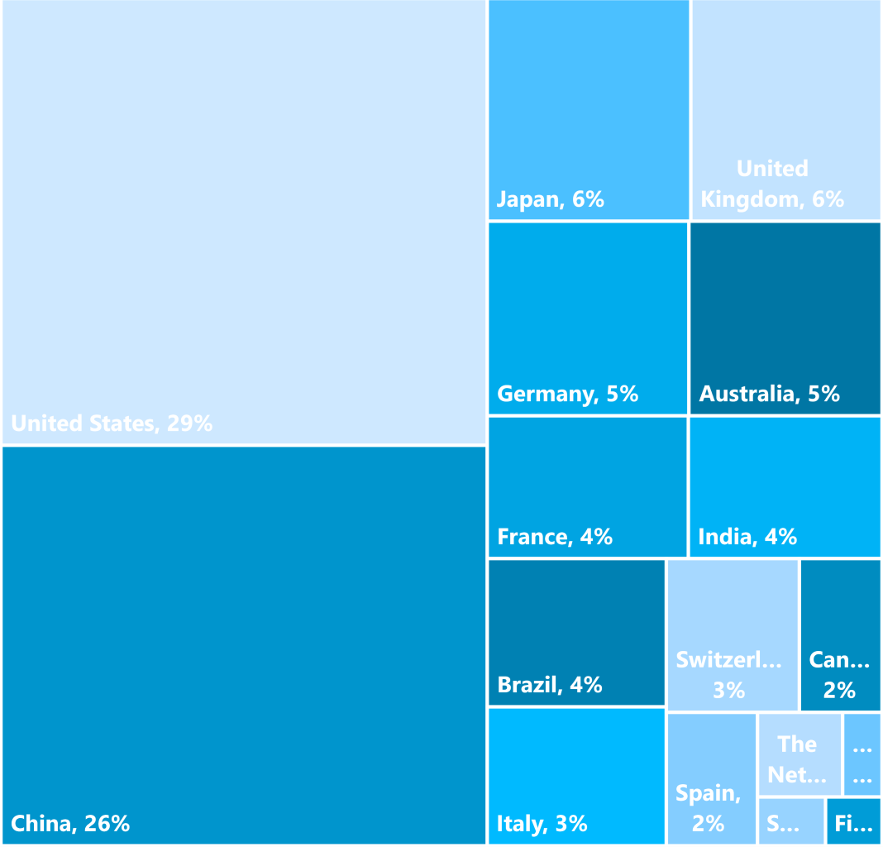
SURVEY DEMOGRAPHICS – OVERALL (n=1350)
INDUSTRY
GEO-SPREAD
Consumer Goods & Services Industrial Equipment
Utilities High Tech
Chemicals (incl. Petrochemicals)
Life Sciences (Pharmaceuticals/Bio-tech) Automotive – Auto-ancillary/Auto-parts Medical Technologies
Oil & Gas Automotive – OEM
Metals & Mining (Metals/Mining)
Aerospace & Defense Other Natural Resources
5%
7%
5%^{3%} 11%
10%
7%
10%
7%
8%
9%
8%
9%
EXEC PROFILE
ANNUAL REVENUE
5
%
22%
4%
12%
18%
60%
C-Suite
Senior VP/EVP
79%
US$1 - 10 Billion US$11 - 30 Billion US$31 - 50 Billion Over US$50 Billion
32

Slide 33
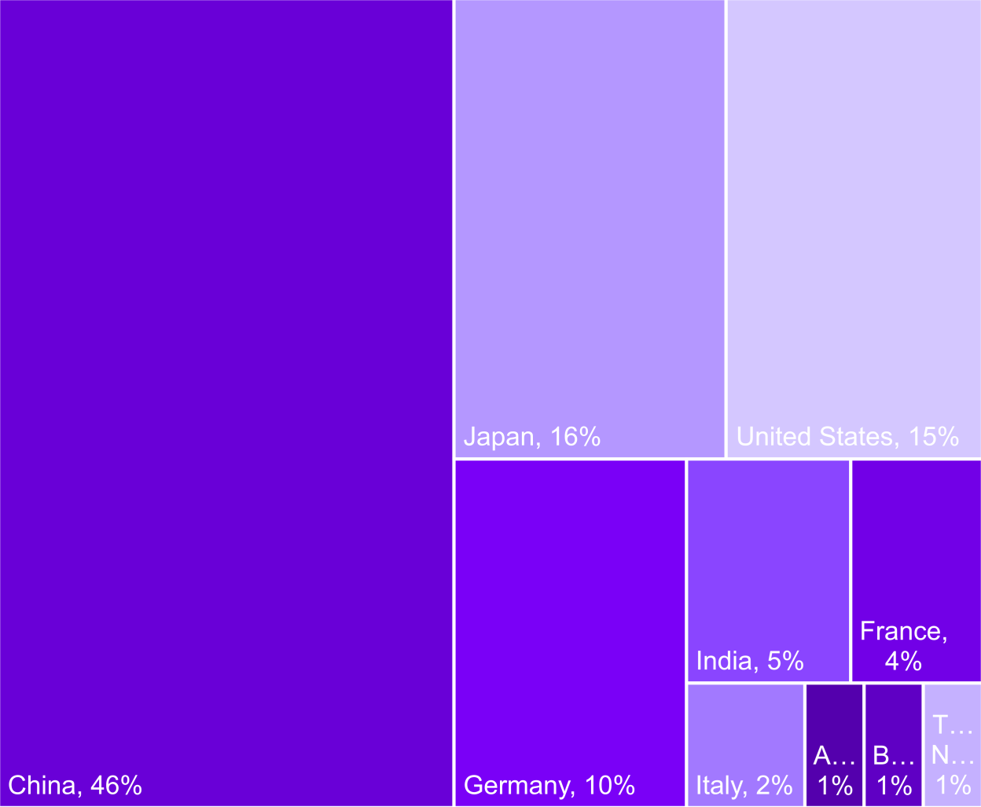
SURVEY DEMOGRAPHICS – AUTO–OES (n=108)
GEO-SPREAD
EXEC PROFILE
16%
C-Suite
Senior VP/EVP VP/Director
27%
57%
ANNUAL REVENUE
3%
6%
10%
US$1 - 10 Billion US$11 - 30 Billion US$31 - 50 Billion Over US$50 Billion
81%
33

Slide 34

About Accenture Research
Accenture research shapes trends and creates data driven insights about the most pressing issues global organizations face. Combining the power of innovative research techniques with a deep understanding of our clients’ industries, our team of 300 researchers and analysts spans 20 countries and publishes hundreds of reports, articles and points of view every year. Our thought-provoking research—supported by proprietary data and partnerships with leading organizations, such as MIT and Harvard— guides our innovations and allows us to transform theories and fresh ideas into real-world solutions for our clients.
For more information, visit www.accenture.com/research
34

