Slide 1
環境認識介紹

Slide 2
開發環境
Windows OS (Windows 7、8、10，Server 2003、2008、2012…)
IIS(Internet Information Services)
Net Framework(2.0、3.5、4.0、4.5)
SQL Server(2008R2、2014)
ASP Net(VB.Net、C#)

Slide 3
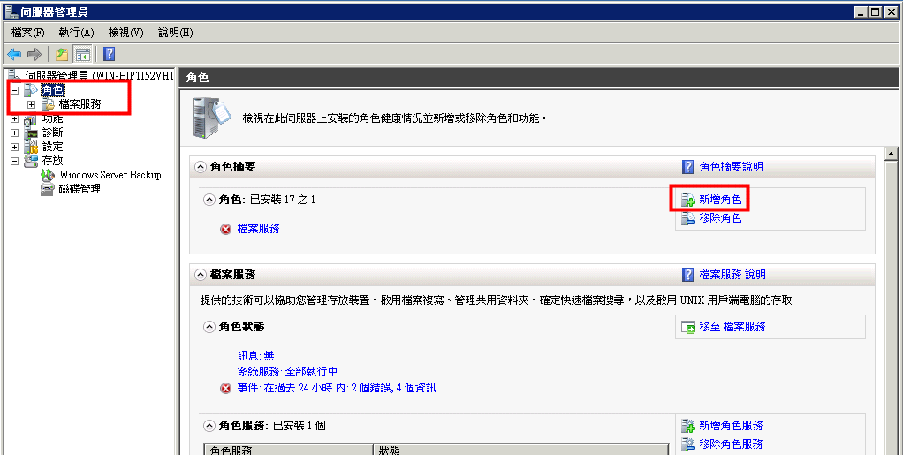
Windows Server install IIS

Slide 4
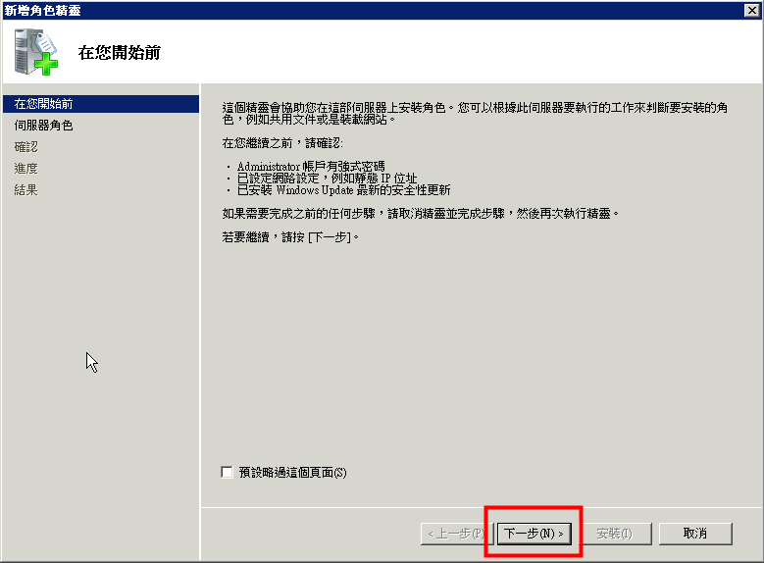
Windows Server install IIS

Slide 5
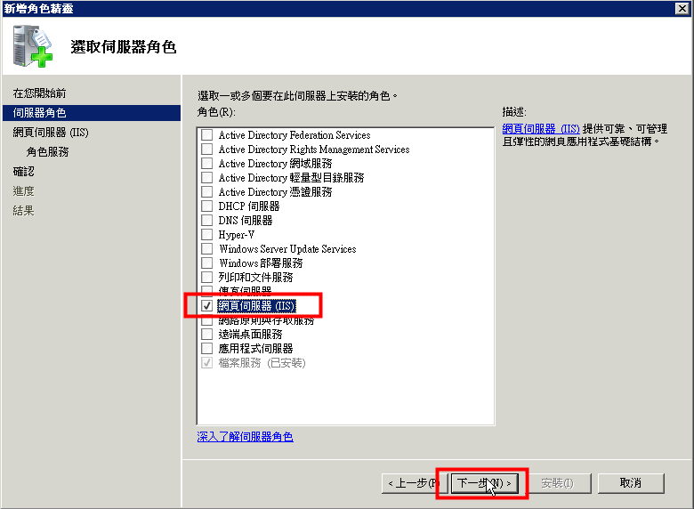
Windows Server install IIS

Slide 6
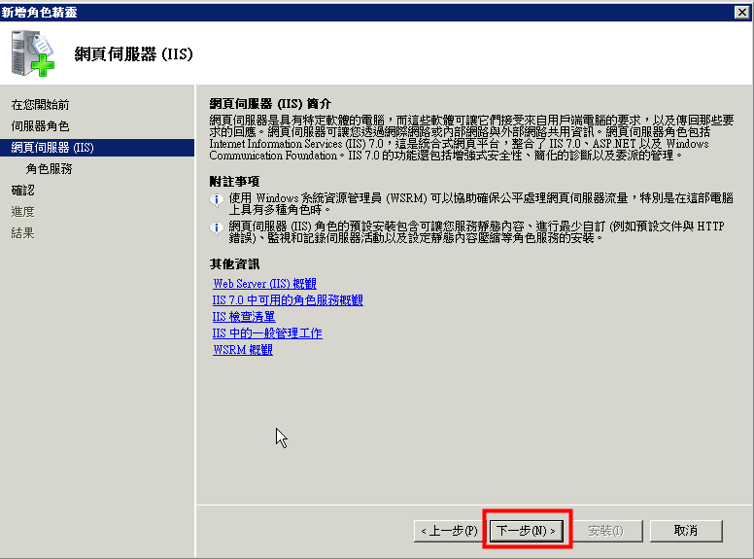
Windows Server install IIS

Slide 7
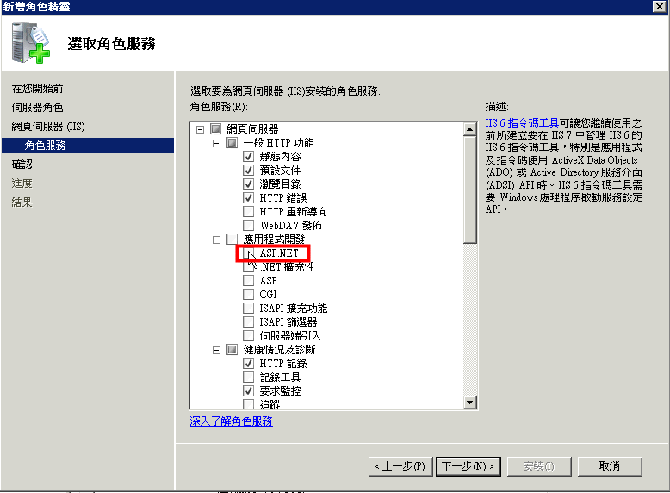
Windows Server install IIS

Slide 8
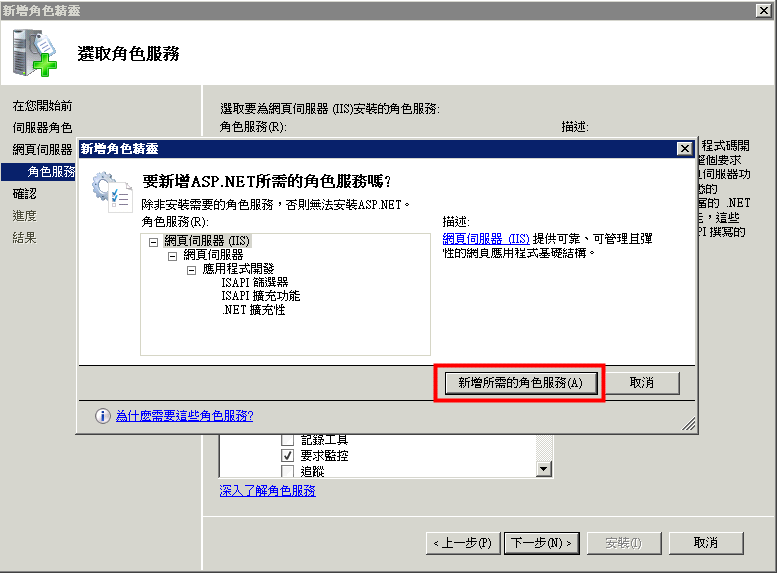
Windows Server install IIS

Slide 9
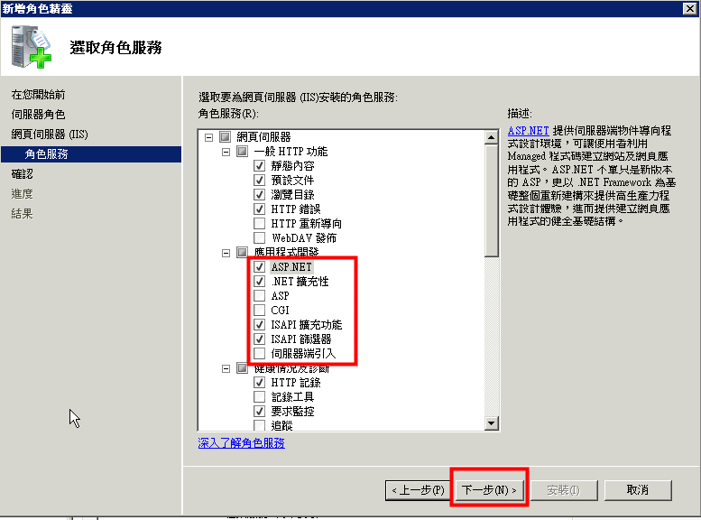
Windows Server install IIS

Slide 10
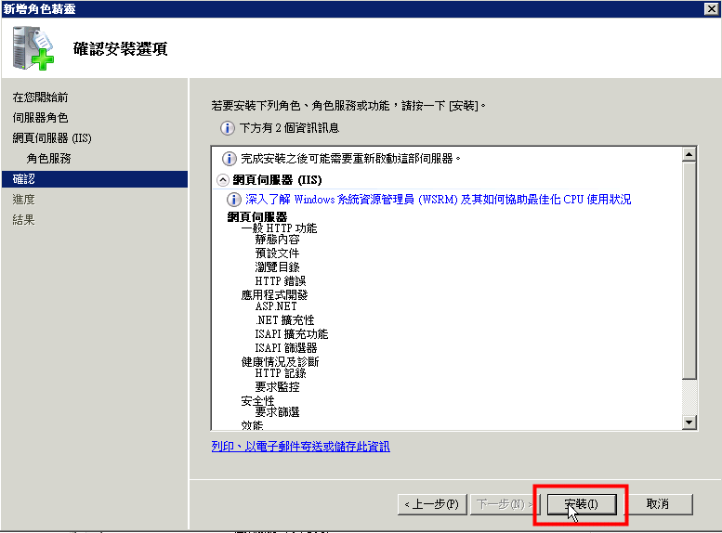
Windows Server install IIS

Slide 11
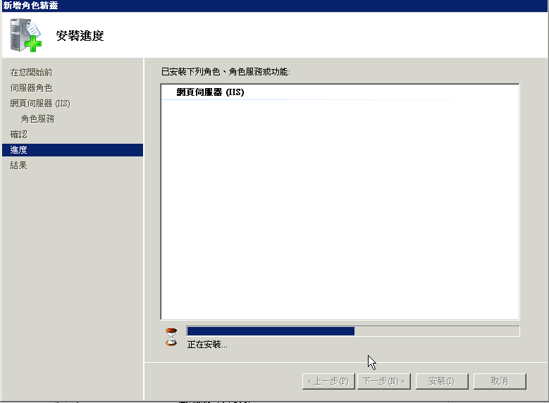
Windows Server install IIS

Slide 12
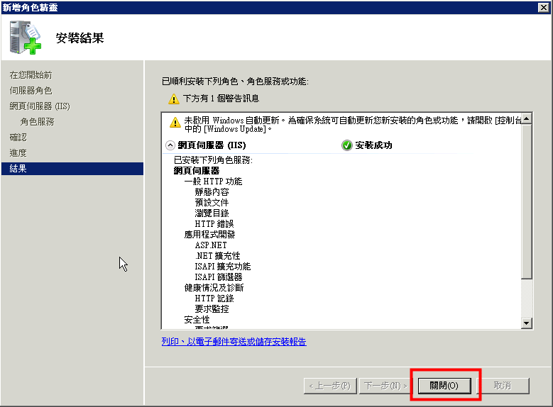
Windows Server install IIS

Slide 13
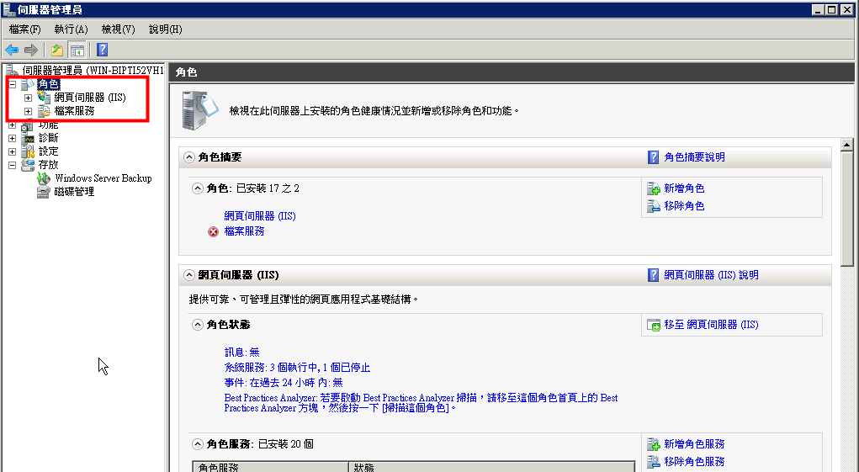
Windows Server install IIS

Slide 14
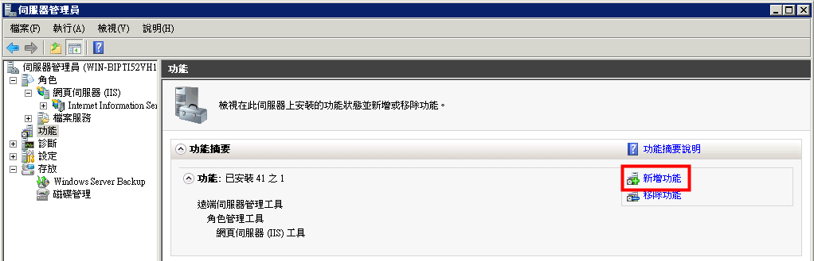
Install Net Framework3.5

Slide 15
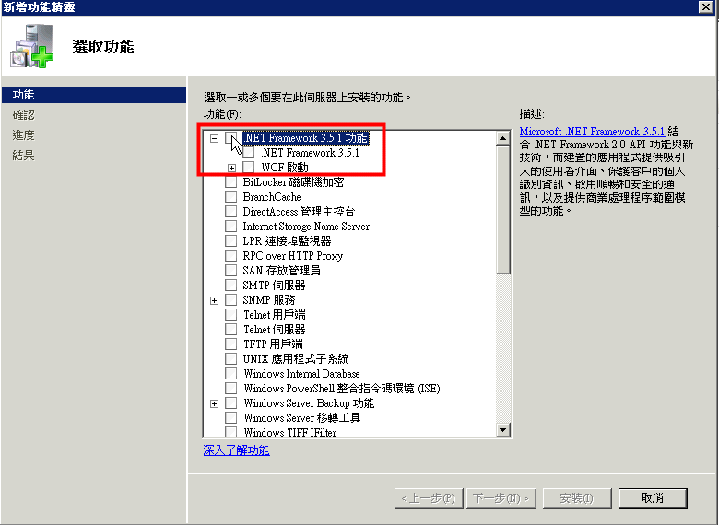
Install Net Framework3.5

Slide 16
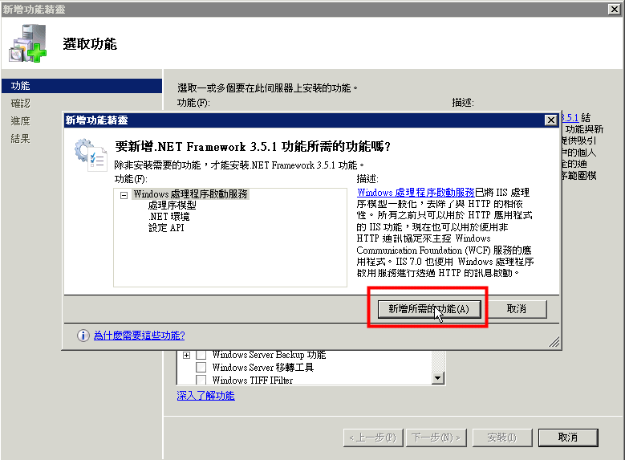
Install Net Framework3.5

Slide 17
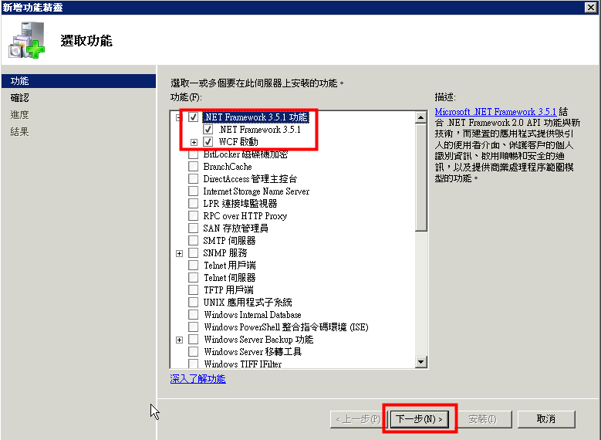
Install Net Framework3.5

Slide 18
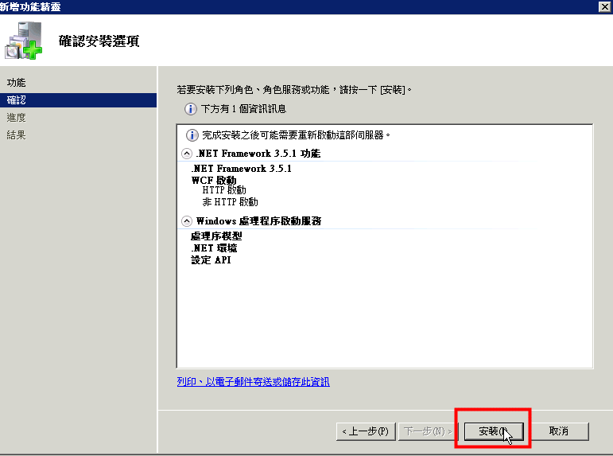
Install Net Framework3.5

Slide 19
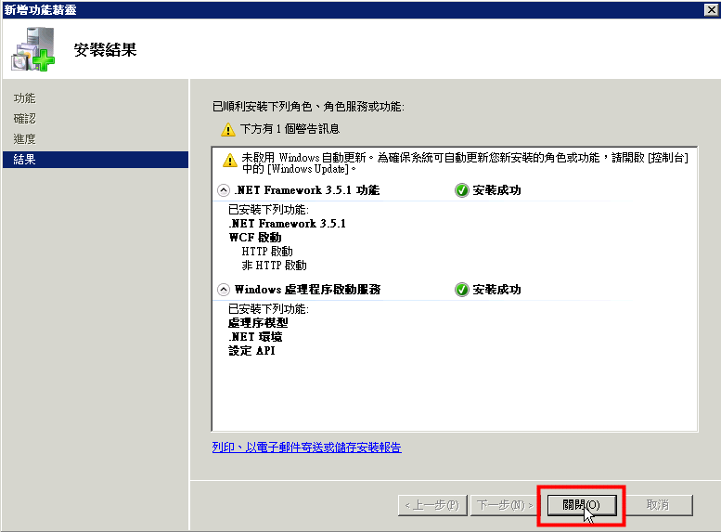
Install Net Framework3.5

Slide 20
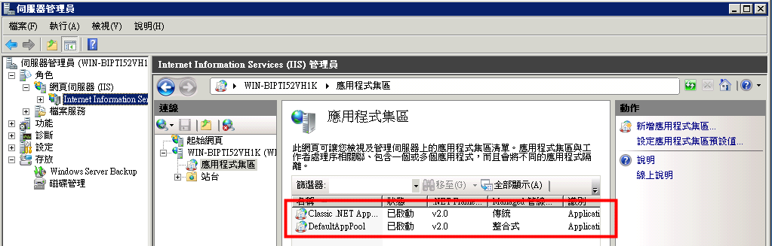
Check website pool No 4.0

Slide 21
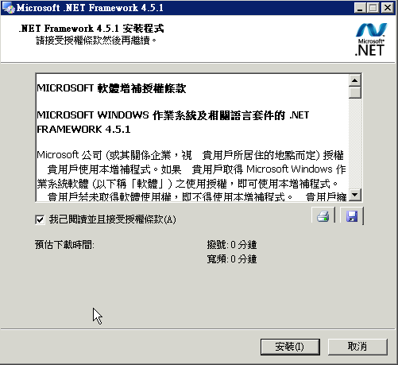
Install Net Framework4.5

Slide 22
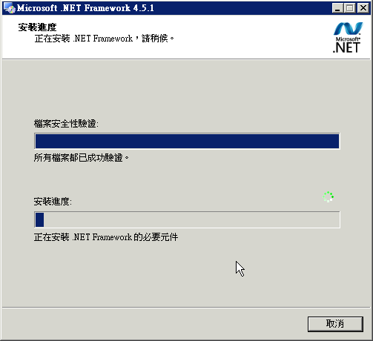
Install Net Framework4.5

Slide 23
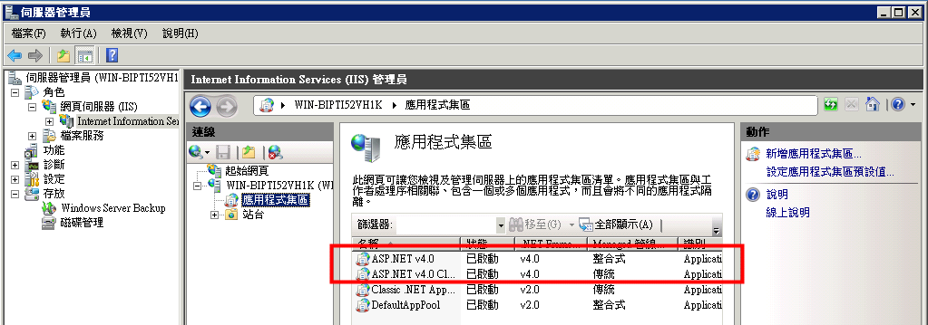
Check website pool has 4.0

Slide 24
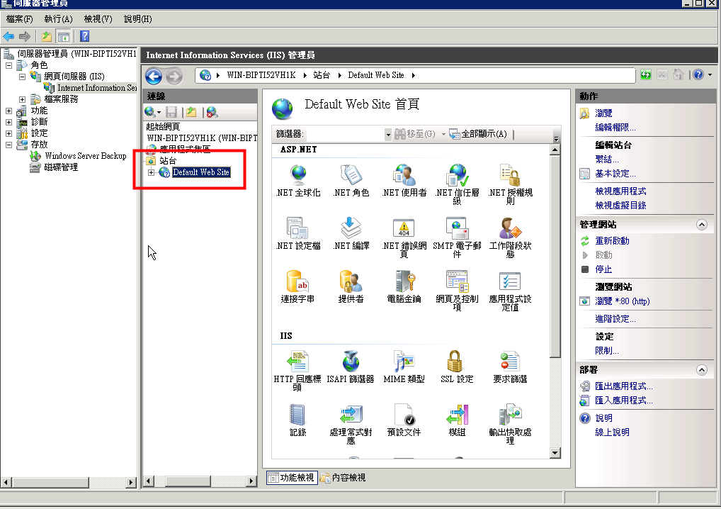
Deploy application

Slide 25
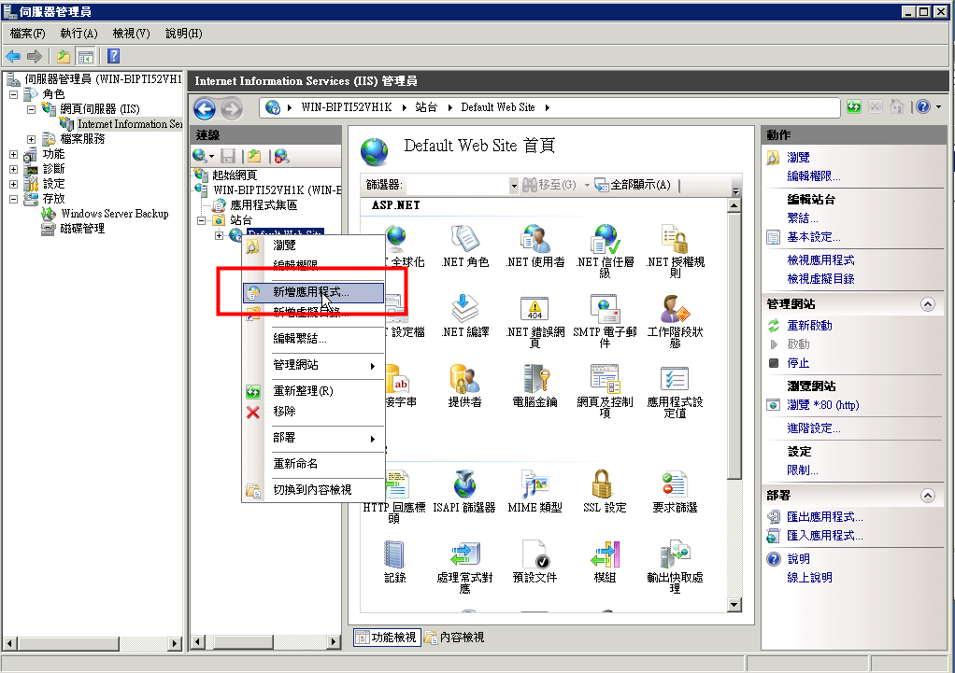
Deploy application

Slide 26
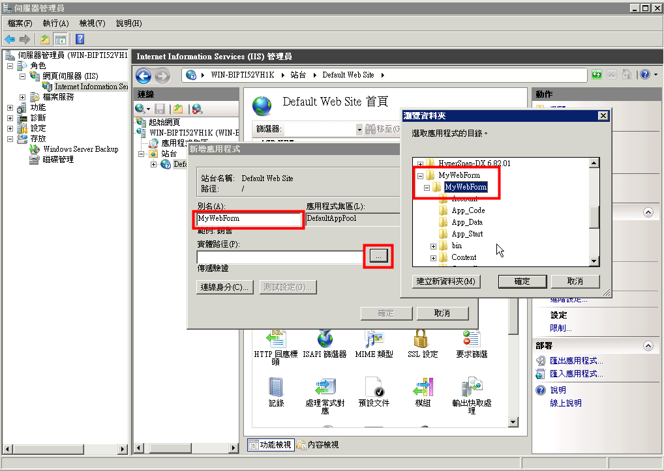
Deploy application

Slide 27
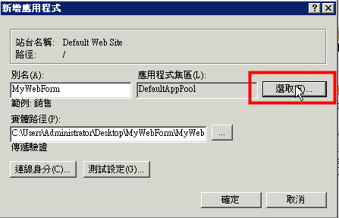
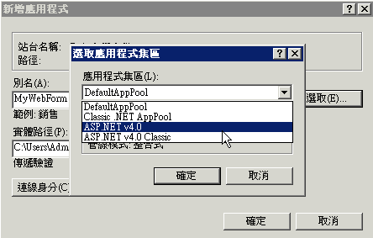
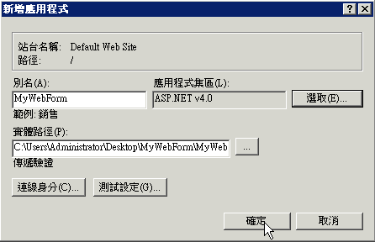
Deploy application

Slide 28
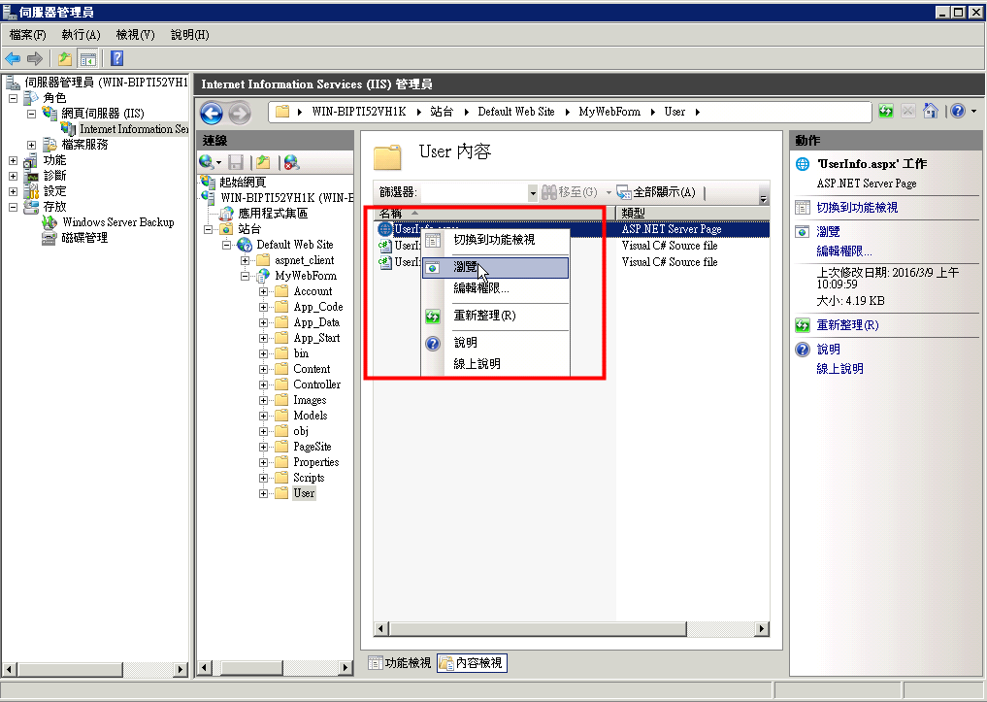

Deploy application

Slide 29
Install SQL Server

Slide 30
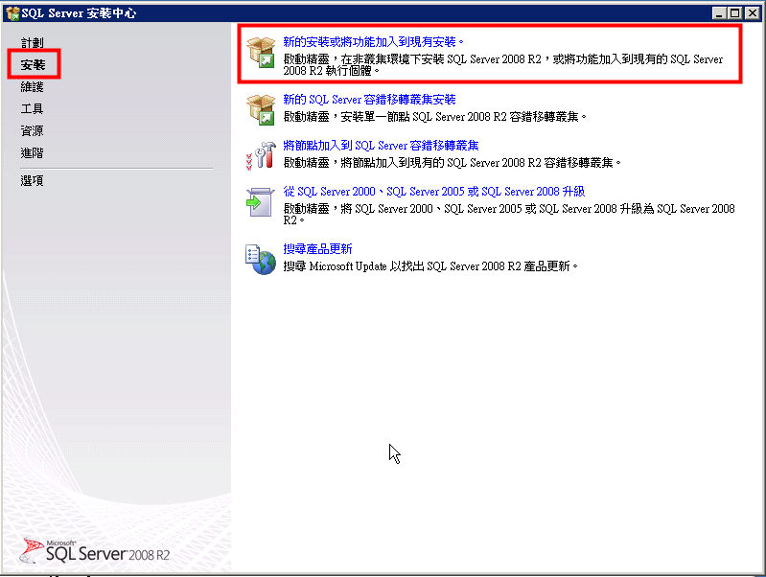
Windows Server install SQL Server

Slide 31
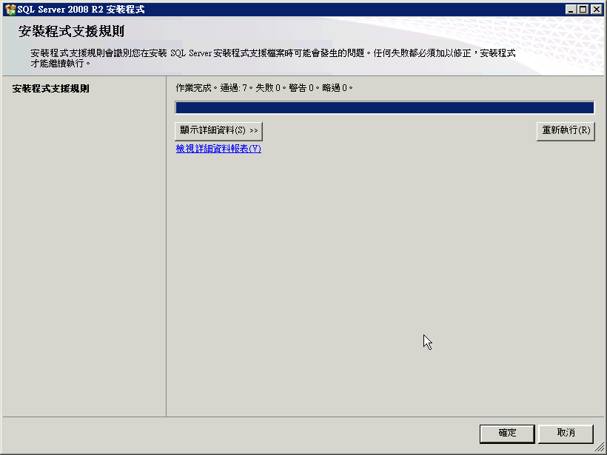
Windows Server install SQL Server

Slide 32
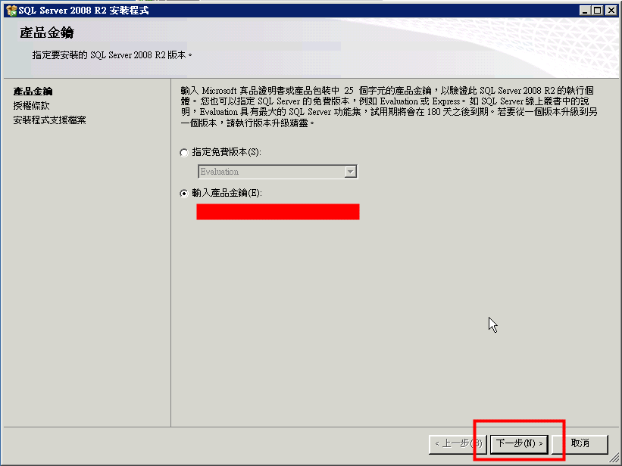
Windows Server install SQL Server

Slide 33
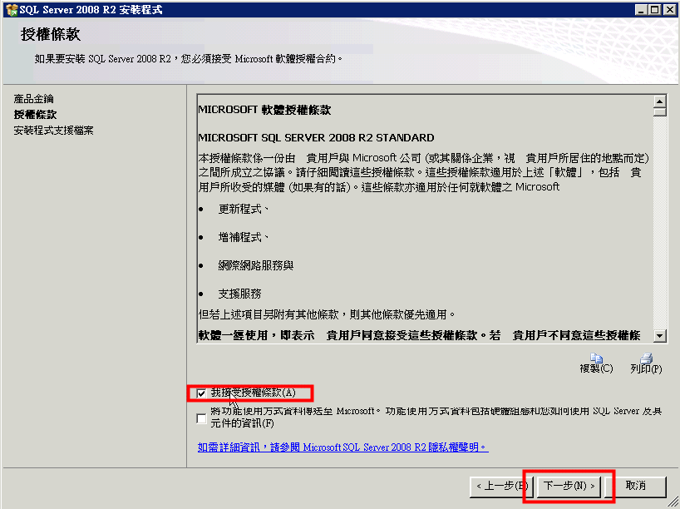
Windows Server install SQL Server

Slide 34
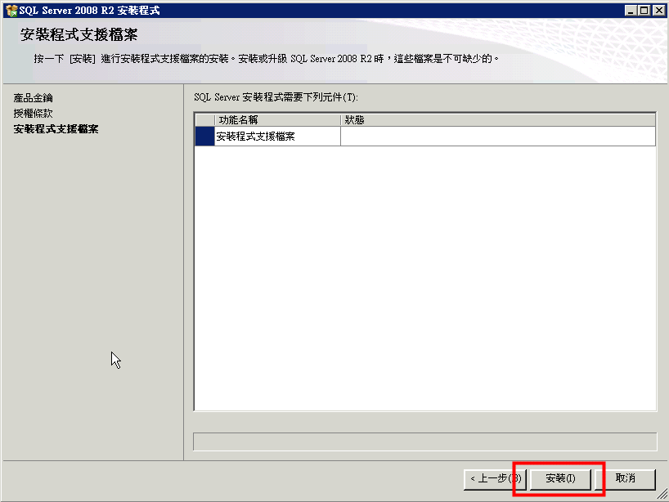
Windows Server install SQL Server

Slide 35
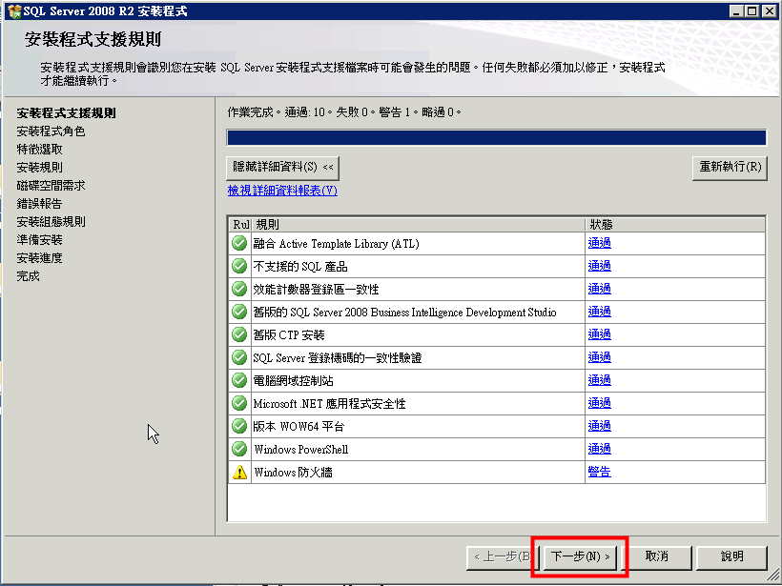
Windows Server install SQL Server

Slide 36
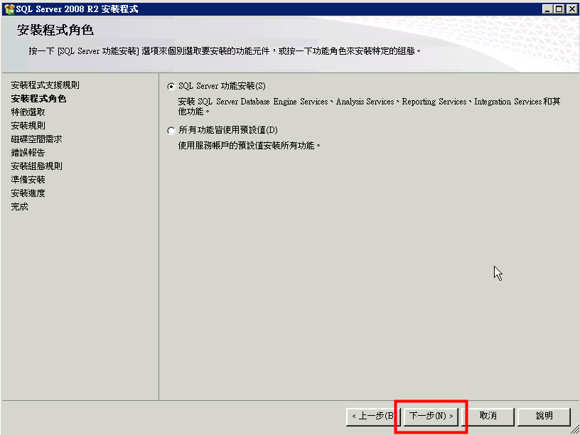
Windows Server install SQL Server

Slide 37
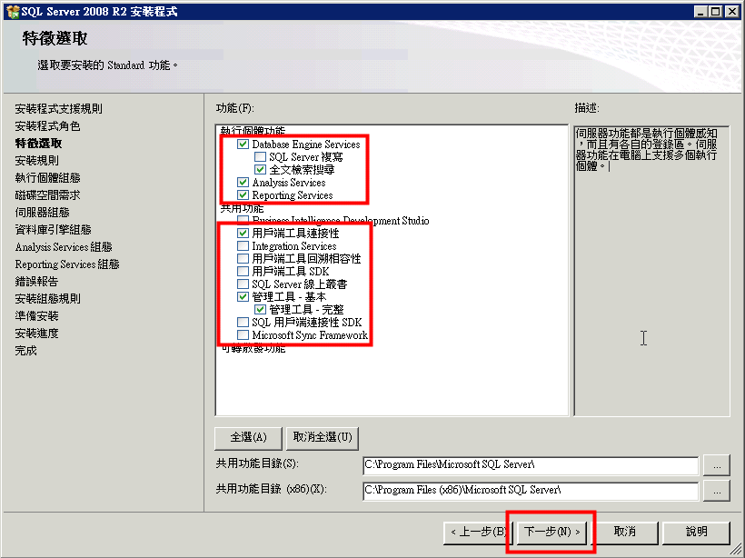
Windows Server install SQL Server

Slide 38
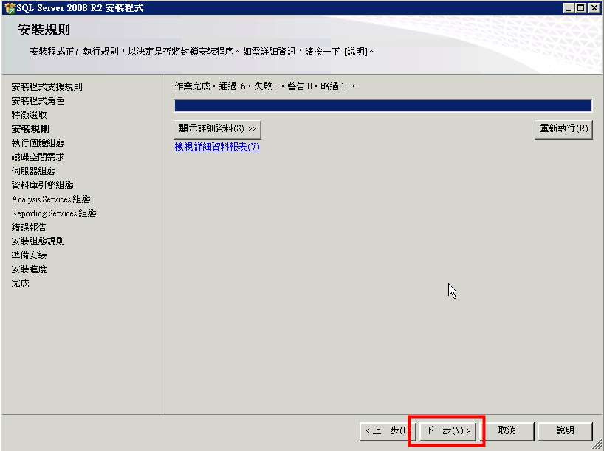
Windows Server install SQL Server

Slide 39
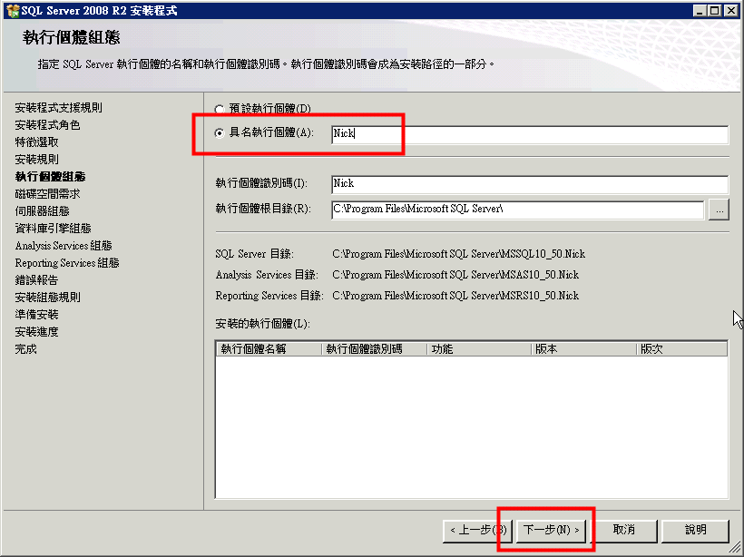
Windows Server install SQL Server

Slide 40
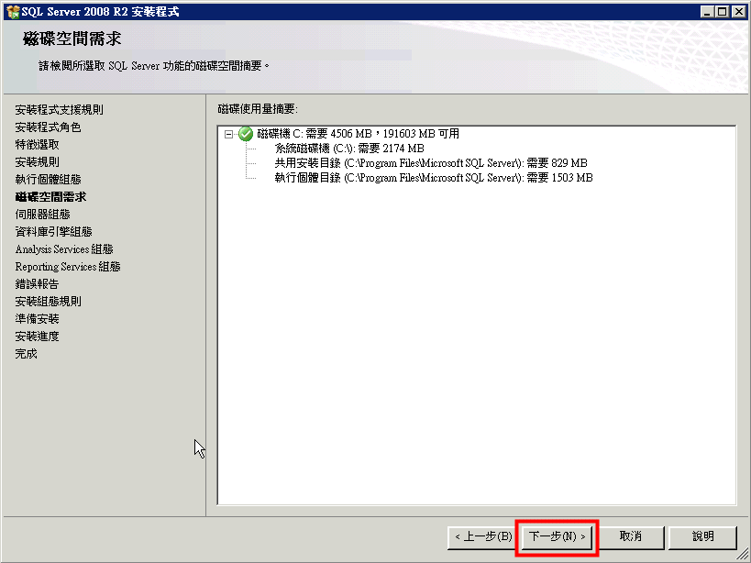
Windows Server install SQL Server

Slide 41
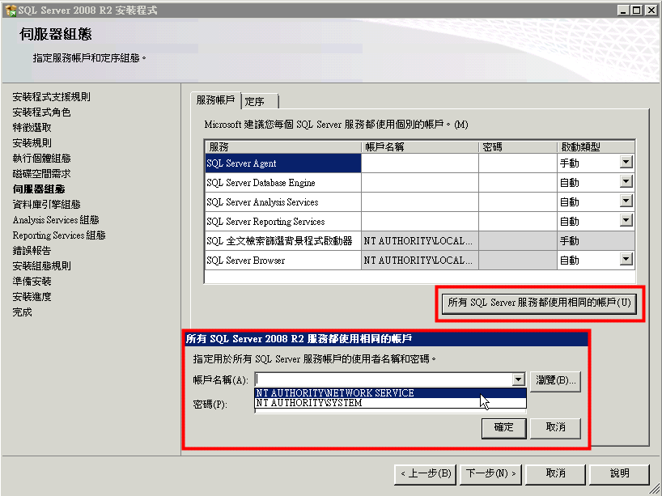
Windows Server install SQL Server

Slide 42
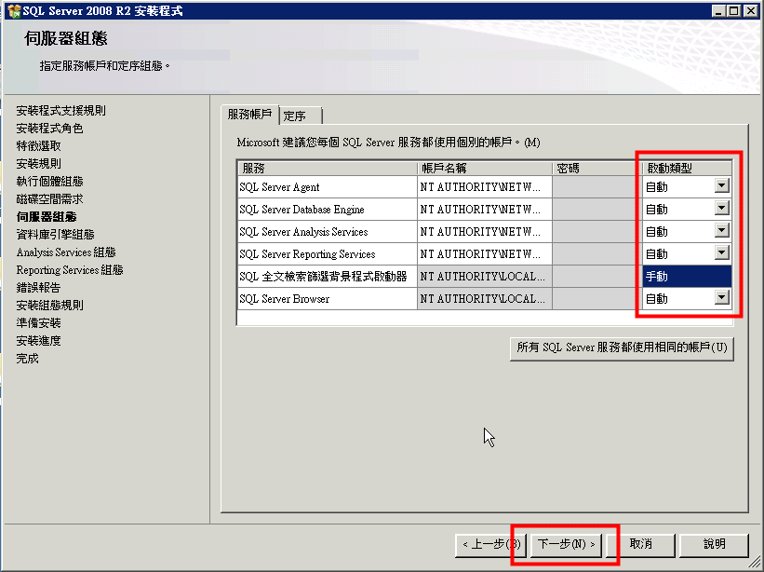
Windows Server install SQL Server

Slide 43
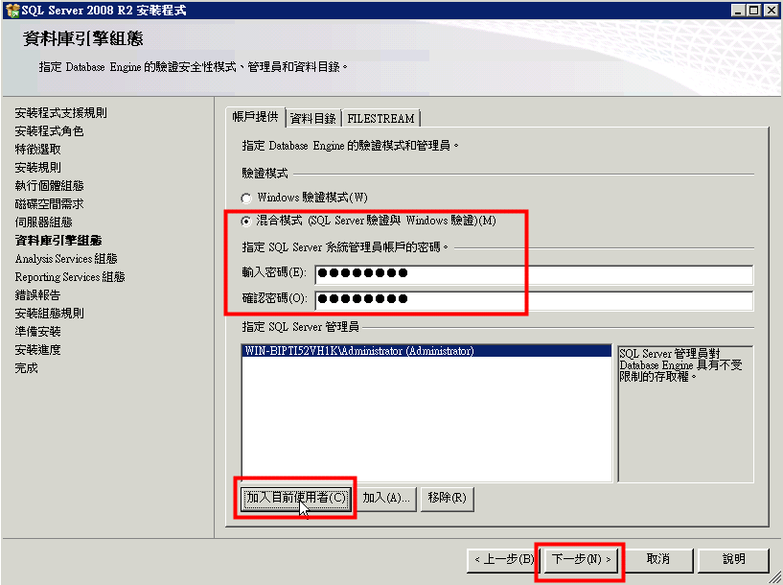
Windows Server install SQL Server

Slide 44
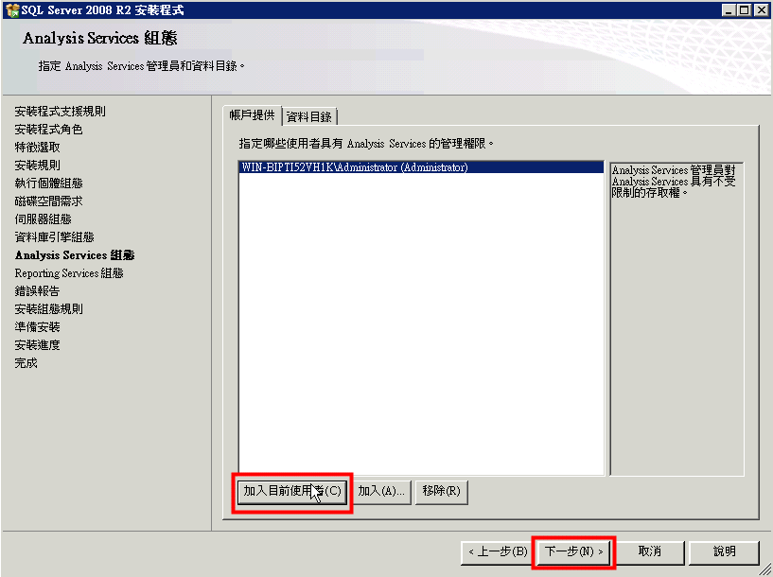
Windows Server install SQL Server

Slide 45
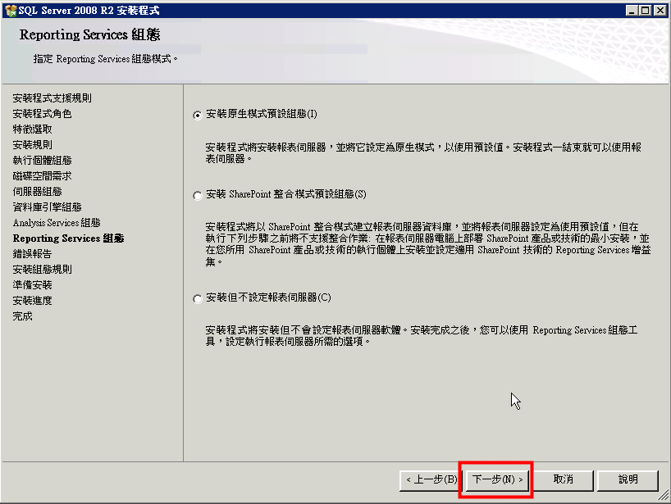
Windows Server install SQL Server

Slide 46
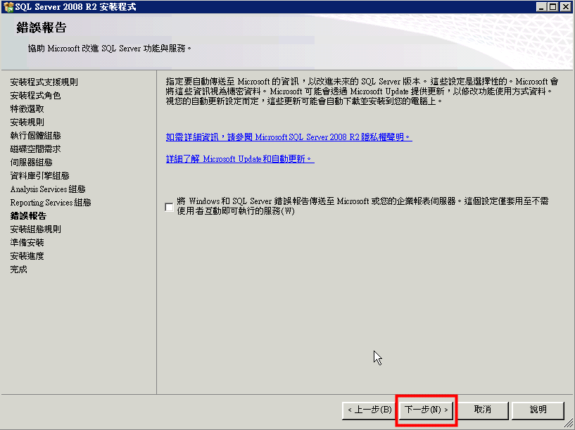
Windows Server install SQL Server

Slide 47
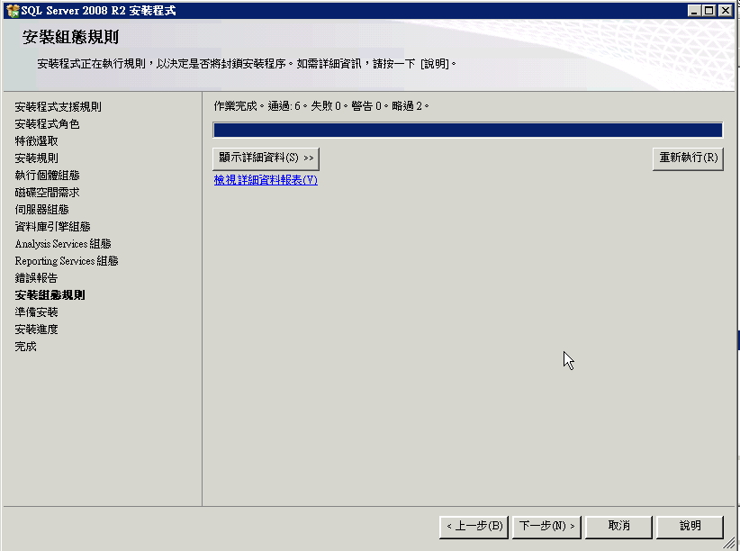
Windows Server install SQL Server

Slide 48
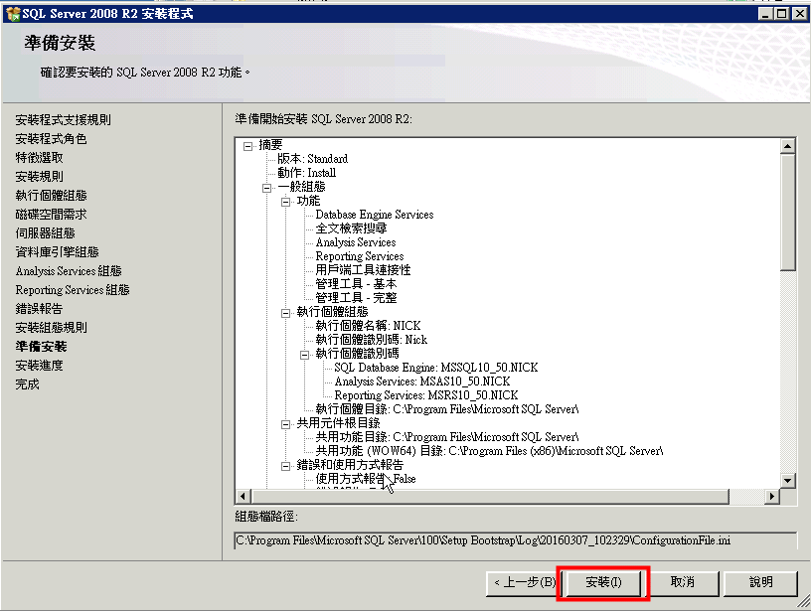
Windows Server install SQL Server

Slide 49
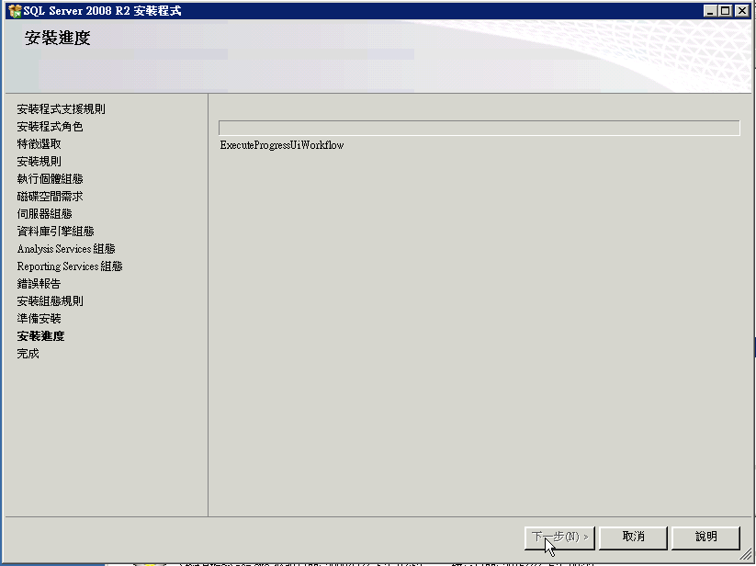
Windows Server install SQL Server

Slide 50
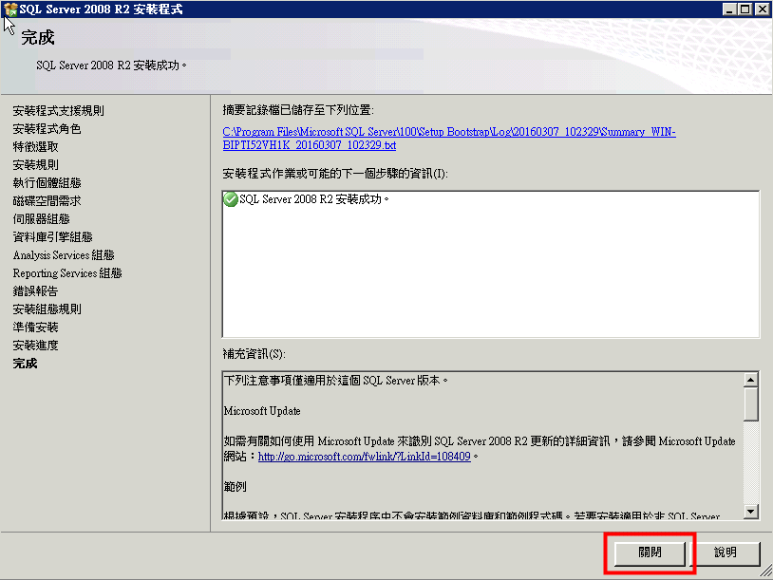
Windows Server install SQL Server

Slide 51
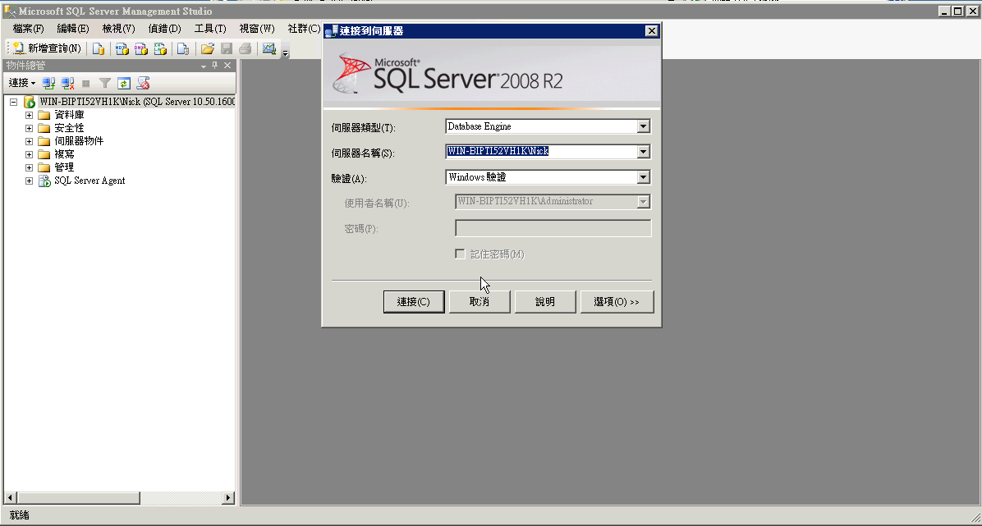
Windows Server install SQL Server

