Slide 1
程式範例

Slide 2
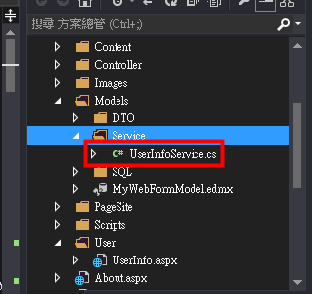
資料查詢1/3
在Models資料夾中建立UserInfoService class先將要使用的Db Entity class宣告
public class UserInfoService
{
private MyFormEntities
myFormEntities = new
MyFormEntities();
}

Slide 3
資料查詢(2/3)
UserInfoService建立一個getUserInfoList function來取得UserList
public List<USER_INFO> getUserInfoList()
{
List<USER_INFO> userInfoList =
myFormEntities.USER_INFO.ToList<USER_INFO>();
return userInfoList;
}

Slide 4
資料查詢(3/3)
建立一個新的WebForm userInfo.aspx並在userInfo.aspx.cs建立下列程式碼
protected void Page_Load(object sender, EventArgs e){
UserInfoService userInfoService = new UserInfoService ();
List<USER_INFO> userList = new List<USER_INFO>();
userList = userInfoService. getUserInfoList();
Foreach(USER_INFO userInfo in userList){
Response.Write(userInfo.USER_NAME);
}
}

Slide 5
資料新增(1/2)
UserInfoService建立一個Insert function來新增資料
public long Insert(USER_INFO userInfo)
{
USER_INFO afterUserInfo = new USER_INFO();
afterUserInfo = myFormEntities.USER_INFO.Add(userInfo);
myFormEntities.SaveChanges();
return afterUserInfo.USER_SEQNO;
}

Slide 6
資料新增(2/2)
在userInfo.aspx.cs 新增按鈕事件中建立下列程式碼
protected void LinkButton_Add_Click(object sender, EventArgs e)
{
UserInfoService userInfoService = new UserInfoService();
USER_INFO userInfo = new USER_INFO();
userInfo.USER_NAME = TextBox_User_Name.Text;
long seqno = userInfoService.Insert(userInfo);
}

Slide 7
資料修改(1/2)
UserInfoService建立一個Update function來新增資料
public long Update(USER_INFO userInfo)
{
USER_INFO updateUserInfo =
myFormEntities.USER_INFO.Where(c => c.USER_ID ==
userInfo.USER_ID).FirstOrDefault();
updateUserInfo.USER_NAME = userInfo.USER_NAME;
myFormEntities.SaveChanges();
return updateUserInfo.USER_SEQNO;
}

Slide 8
資料修改(2/2)
在userInfo.aspx.cs 修改按鈕事件中建立下列程式碼
protected void LinkButton_Edit_Click(object sender, EventArgs e)
{
UserInfoService userInfoService = new UserInfoService();
USER_INFO userInfo = new USER_INFO();
userInfo.USER_NAME = TextBox_User_Name.Text;
long seqno = userInfoService.Update(userInfo);
}

Slide 9
資料刪除(1/2)
UserInfoService建立一個Delete function來新增資料
public bool Update(string userId)
{
USER_INFO deleteUserInfo =
myFormEntities.USER_INFO.Where(c => c.USER_ID ==
userId).FirstOrDefault();
myFormEntities.USER_INFO.Remove(deleteUserInfo);
myFormEntities.SaveChanges();
return true;
}

Slide 10
資料刪除(2/2)
在userInfo.aspx.cs 刪除按鈕事件中建立下列程式碼
protected void LinkButton_Del_Click(object sender, EventArgs e)
{
UserInfoService userInfoService = new UserInfoService();
String userId = TextBox_User_Id.Text;
bool status = userInfoService.Delete(userId);
}

Slide 11
Repeater show Data(1/2)
<asp:Repeater ID="Repeater_View" runat="server">
<ItemTemplate>
<tr>
<td><%# HttpContext.Current.Server.HtmlEncode (Eval("USER_ID"))%> </td>
<td><%# HttpContext.Current.Server.HtmlEncode (Eval("USER_NAME"))%> </td>
<td><%# HttpContext.Current.Server.HtmlEncode (Eval("USER_BIRTHDAY"))%> </td>
<td>
<asp:LinkButton class=“button” ID=“LinkButton_Edit” ToolTip=“編輯”
OnClick="LinkButton_Edit_Click" runat="server" Text="修改"></asp:LinkButton>
<asp:LinkButton ID="LinkButton_Del" OnClick="LinkButton_Del_Click" CssClass="button green"
runat="server" ToolTip="刪除"
OnClientClick="return confirm(&quot;確認要刪除這筆資料嗎?&quot;)" Text="刪除"></asp:LinkButton>
<asp:HiddenField ID="HiddenField_cNo" runat="server" Value='<%#Eval("USER_ID") %>' />
</td>
</tr>
</ItemTemplate>
</asp:Repeater>

Slide 12
Repeater show Data(2/2)
private void BindData()
{
List<USER_INFO> userInfoList = new List<USER_INFO>();
userInfoList = userInfoService.getUserInfoList();
Repeater_View.DataSource = userInfoList;
Repeater_View.DataBind();
}

Slide 13
Web API(1/3)
在App_Start資料夾中加入WebApiConfig class
config.Routes.MapHttpRoute(
name: “apiName",
routeTemplate: "api/{controller}/{action}",
defaults: new { action = RouteParameter.Optional }
);
Global.asax.cs
void Application_Start(object sender, EventArgs e)加入
WebApiConfig.Register(GlobalConfiguration.Configuration);

Slide 14
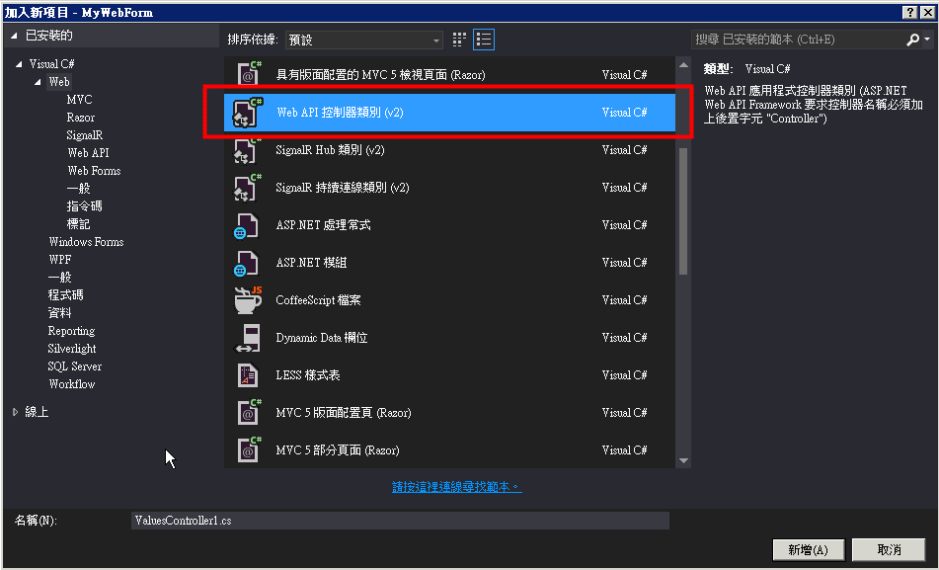
Web API(2/3)
建立Web Api的JsonController

Slide 15
Web API(2/3)
建立以下內容在JsonController
[HttpGet, HttpPost] // 讓此方法可同時接受 HTTP GET 和 POST 請求.
public HttpResponseMessage getUser(string status)
{
StringBuilder sb = new StringBuilder();
HttpContext context = HttpContext.Current;
sb.Append("[");
sb.Append("{");
//Json的內容
sb.Append("}");
sb.Append("]");
var result = new HttpResponseMessage(HttpStatusCode.OK);
result.Content = new StringContent(sb.ToString(), Encoding.UTF8, "application/json");
return result;
}

