Slide 1
G2M Case Study
Virtual Internship
7/18/2022
Kenneth Fields

Slide 2
G2M Business Mission
XYZ is a private firm in US. Due to remarkable growth in the Cab Industry in last few years and multiple key players in the market, it is planning for an investment in Cab industry and as per their Go-to-Market(G2M) strategy they want to understand the market before taking final decision.
Objective - Provide insight to help XYZ make an informed investment decision between two cab companies, Pink Cab and Yellow Cab.

Slide 3
Data Understanding
Data Provided includes 4 csv files
Cab Data - Transaction Id, Date of Travel, Distance, Price Charged, and Cost to Company
City Data - Data on each city the cab company operates in
Customer Data - Includes Customer ID, Age, and Income
Transaction Data - Documents each transaction price, time, and which customer
Total Data Points - 359,392
Size of Data - 25Mb

Slide 4
Hypothesis for Insight
Hypothesis 1: Does the season affect amount of Cab users?
Hypothesis 2: Does the city affect profit margins for Cab company?
Hypothesis 3: Does customer loyalty affect each Cab company profits?
Hypothesis 4: Does income of cab users affect the profit gained per trip?
Hypothesis 5: How does distance travelled for a ride impact the profit per ride?
We will use Data analytic tools to find insight in the data and answer these questions to provide a recommendation for investment.

Slide 5
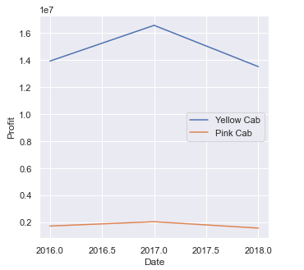
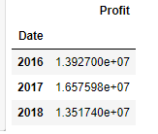
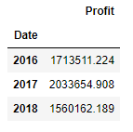
Company Analysis
Profits
Yearly Profit Yellow Cab Profit
Pink Cab Profits

Slide 6
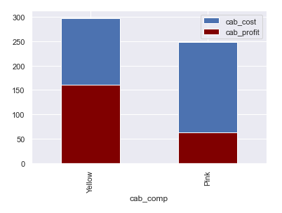

Company Analysis
Profits
Profits vs Cost of Trip
This graph shows the Yellow Cab company operates each individual ride at a significantly lower cost for each trip which increases their average profit of each trip by nearly 100.

Slide 7
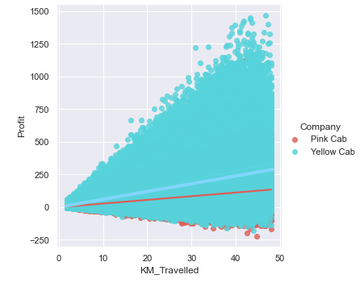
Company Analysis
Profits
Profits vs Distance Travelled
Yellow Cab company more effectively increases profits with longer distance trips.

Slide 8
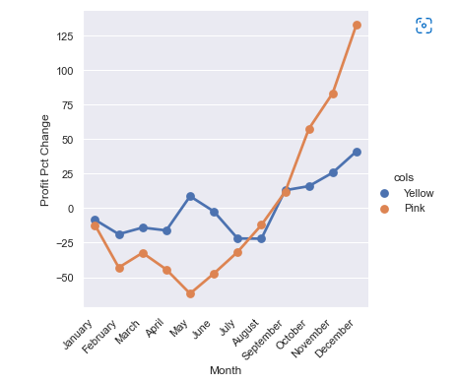
Company Analysis
Profits
Month to Month Profits vs Average Yearly Profit
This chart shows percent change in monthly profits vs each companies average for the entire year.
Pink Cab company utilizes the busy period more effectively than yellow cab, however, yellow cab is more consistent across the entire year, even during the slow period.

Slide 9
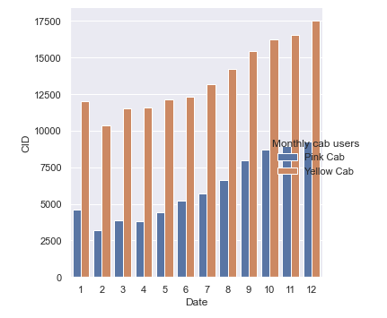
Company Analysis
Users
Monthly Users
Yellow Cab consistently has more monthly users. Each Company peaks in users during the holiday seasons (Months 10-12).

Slide 10
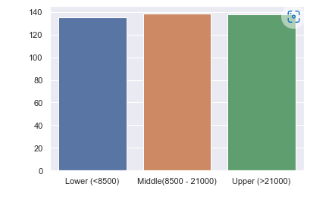
Company Analysis
Users
Profits for each Income Class User
Each class provides similar profit margins, with the middle class providing the most by a slim margin.

Slide 11
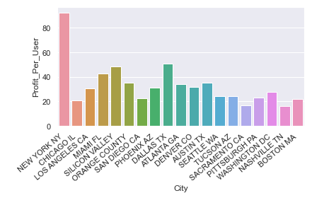
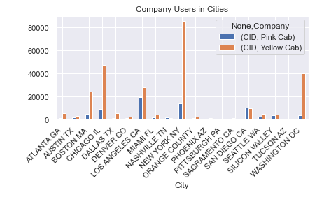
Company Analysis
Users
Profit per user in each city. Users for each company in each city.
New York city has the highest profit per user. The Yellow cab company has the most users in NYC.

Slide 12
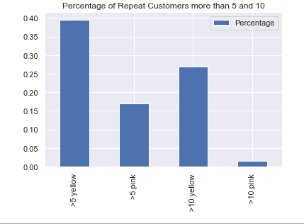
Company Analysis
Users
Loyalty
This chart shows the percentage of customers in each company that have used the same company more than 5 and 10 times.

Slide 13
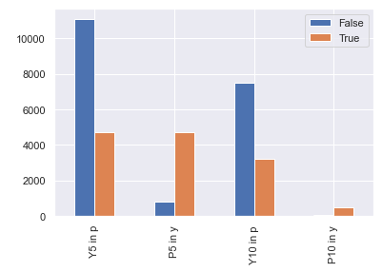
Company Analysis
Users
Loyalty Crossover
Do the loyal customers (customers with more than 5 and 10 trips with the same company) use the opposing company?
The False indicated that a loyal customer did not use the opposing company while True means that they did.
From this we can see Yellow customers generally do not use Pink while Loyal Pink customers still use Yellow Cab frequently.

Slide 14
Hypothesis Answers
Hypothesis 1: Does the season affect amount of Cab users?
Yes! Colder seasons have significantly higher cab usage. This is likely a combination of users not wanting to walk in the cold, while increase of tourists for the holiday season increasing demand.
Hypothesis 2: Does the city affect profit margins for Cab company?
Yes, the data shows that NYC Cab companies have an average of 80 profit per user while the rest of the country falls between 20 and 50 per user. Yellow Cab company has significantly more users in NYC which increases their profit margins considerably.
Hypothesis 3: Do customer loyalty affect each Cab company?
Yes, the Yellow Cab Company has shown that its customers overwhelmingly stick with the Yellow Cab company, while the Pink Cab company most frequent users also frequent the Yellow Cab company. The profits per user for Yellow Cab company are also significantly higher.
Hypothesis 4: Does income of cab users affect the profit gained per trip?
No. The data shows us that profit per user remains consistent with each income bracket of its users.
Hypothesis 5: How does distance travelled for a ride impact the profit per ride?
For both companies the average ride distance was similar, as was the tendency for profit to increase linearly with ride distance. However, the Yellow Cab company showed that it has significantly higher average profit per kilometer travelled than the Pink Cab Company. The Yellow Cab company utilizes distance travelled for profit much better than the Pink Cab Company

Slide 15
Recommendation
From the findings, XYZ should invest in the Yellow Cab Company for the following reasons:
- Profit margins per user are much higher (160 vs 63) while simultaneously having a much higher # of users
- The Yellow Cab Company operates in significantly more Cites
- The Yellow Cab company has a higher user loyalty rate with nearly 70% of their frequent users (users with more than 5 trips) using only the Yellow Cab company, while the Pink Cab Company has a loyalty rate of roughly 10%
- The most profitable city per user is NYC and the Yellow Cab company services over 85,000 users in NYC vs the Pink Cab company only servicing 16,000 users.

Slide 16
Thank You.

