Slide 1
PH2XX: WPRX Grade Brief

Slide 2
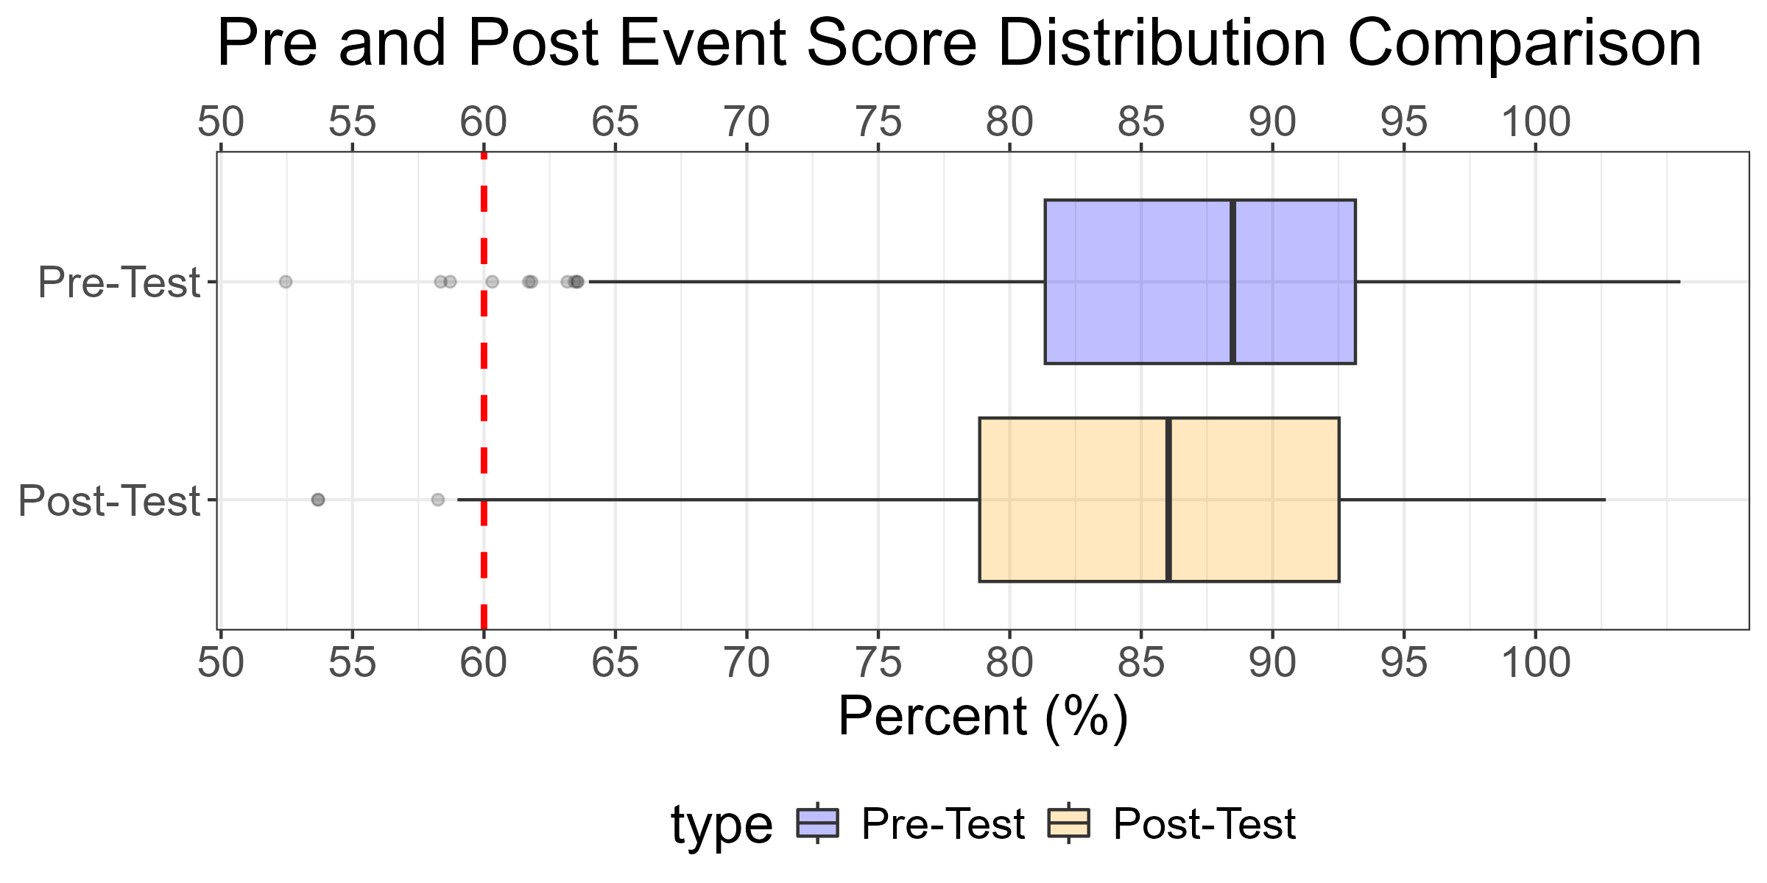
Pre/Post Course Score Comparisons
Grade | F | D | C- | C | C+ | B- | B | B+ | A- | A | A+
Pre Count | 3 | 9 | 8 | 29 | 48 | 126 | 77 | 64 | 73 | 125 | 33
Post Count | 6 | 27 | 18 | 32 | 56 | 101 | 73 | 60 | 83 | 108 | 31
Percent Change% | 100% | 200% | 125% | 10% | 17% | -20% | -5% | -6% | 14% | -14% | -6%
PRE D/F's: | PRE D/F's: | PRE D/F's: | 12 (2%) | 12 (2%) | 12 (2%) | PRE A's: | PRE A's: | PRE A's: | 231 (38.8%) | 231 (38.8%) | 231 (38.8%)
POST D/F's: | POST D/F's: | POST D/F's: | 33 (6%) | 33 (6%) | 33 (6%) | POST A's: | POST A's: | POST A's: | 222 (37%) | 222 (37%) | 222 (37%)
Type | Number | Average | Median | Min | Max
Pre | 595 | 86.5 | 88.5 | 52.5 | 105.5
Post | 595 | 84.6 | 86.0 | 53.7 | 102.7

Slide 3
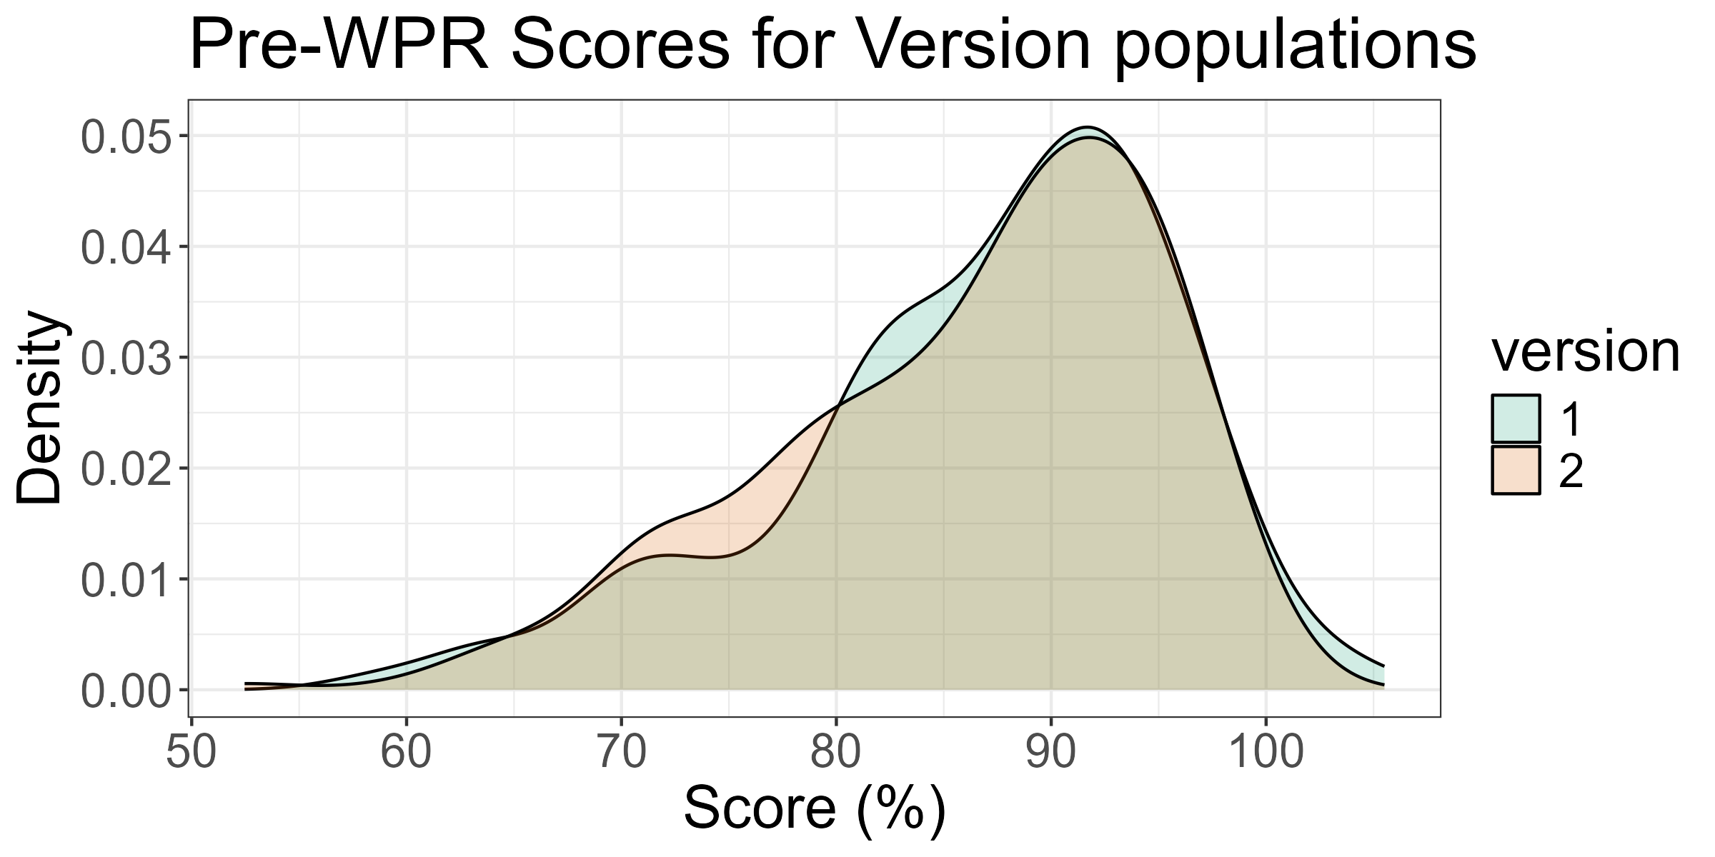
Pre Score Comparisons between versions
version | Count | Mean (%) | Median (%) | Std. Dev (%) | # D/F's | # A's
1 | 318 | 86.8 | 88.5 | 9.0 | 7 (2%) | 169 (53%)
2 | 277 | 86.1 | 88.5 | 9.0 | 4 (1%) | 146 (53%)
Method | result | t_value | p_value
Welch Two Sample t-test | difference in means between group 1 and group 2 | 0.832 | 4.06e-01

Slide 4
Cadets not accounted for in this brief
Cadet Name | Instructor | Section
Garcia, Manuel | MAJ Taylor Bruff | A1B1
Harris, Oliver | MAJ Taylor Bruff | A1B1
Yousefzadeh, Christian | LTC Jacob Capps | A1B1
Lyons, Gage | MAJ Taylor Bruff | A2B2
Mc Cann, Kota | LTC Jacob Capps | A2B2
Rhodes, Owen | CPT Erin Norton & Dr Michael Pfenning | A2B2
Curry, Ryan | MAJ David Simeroth | C1D1
Slivka, Bethany | MAJ David Simeroth | C1D1
McDermott, Benjamin | Dr Steven Vitale | C1D1
Vilfan, Rok | Dr Steven Vitale | C1D1
Choldin, David | MAJ William Schmidt | C2D2
Fradelizio, Frank | MAJ David Pert | C2D2
Williams, Christopher | MAJ David Pert | C2D2
Matlach, Amber | CPT Erin Norton & Dr Kraig Sheetz | C2D2
Coats, Natas | CPT Theodore Thomas | E1F1
Abalos, Leilani | CPT Kevin Filip | E1F1
Enman, Jake | CPT Kevin Filip | E1F1
Creedican, Grant | CPT Kevin Filip | E1F1
Chandler, Mary | MAJ David Simeroth | E1F1
Haney, William | MAJ David Simeroth | E1F1
Ingle, Brandon | MAJ David Pert | E1F1
Miller, Henry | MAJ David Pert | E1F1
Painter, John | MAJ David Pert | E1F1
Reilly, Samuel | MAJ David Pert | E1F1
Storch, Rebecca | CPT Charles Starke | E1F1
McKane, Angelina | CPT Richard Calvin | E1F1
Matthews, Iris | COL David Phillips & MAJ William Schmidt | E2F2
Nicholson, Thomas | Dr Steven Vitale | E2F2
Rothrock, Mercedes | CPT Richard Calvin | A1B1
Benson, Mairead | LTC Brian Holloway & Dr Michael Pfenning | A2B2
Eremita, Nicholas | LTC Brian Holloway & Dr Michael Pfenning | A2B2

Slide 5
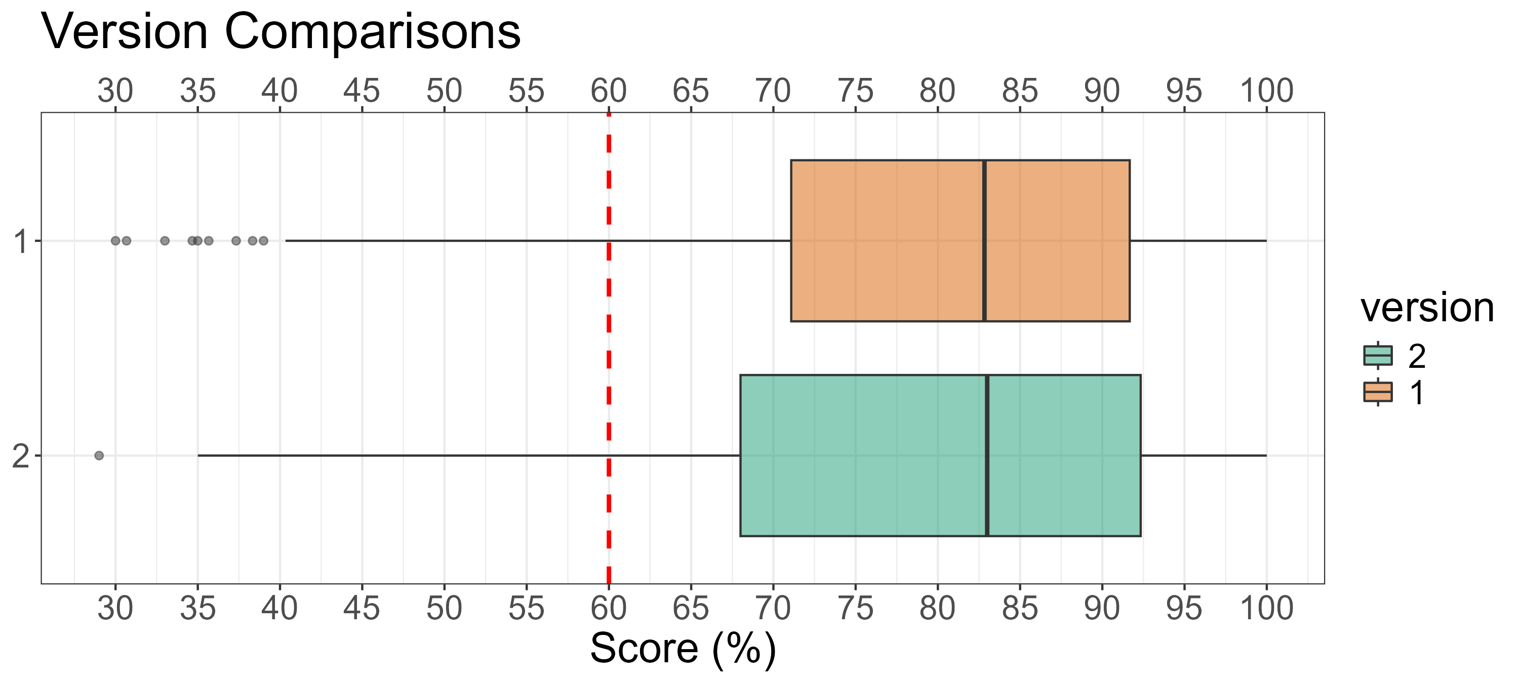
WPR Version Comparisons
version | Count | Mean (%) | Median (%) | Std. Dev (%) | Min (%) | Max (%) | # D/F's | # A's
1 | 318 | 79.5 | 82.8 | 15.8 | 30.0 | 100.0 | 50 (16%) | 126 (40%)
2 | 277 | 78.5 | 83.0 | 16.8 | 29.0 | 100.0 | 55 (20%) | 115 (42%)

Slide 6
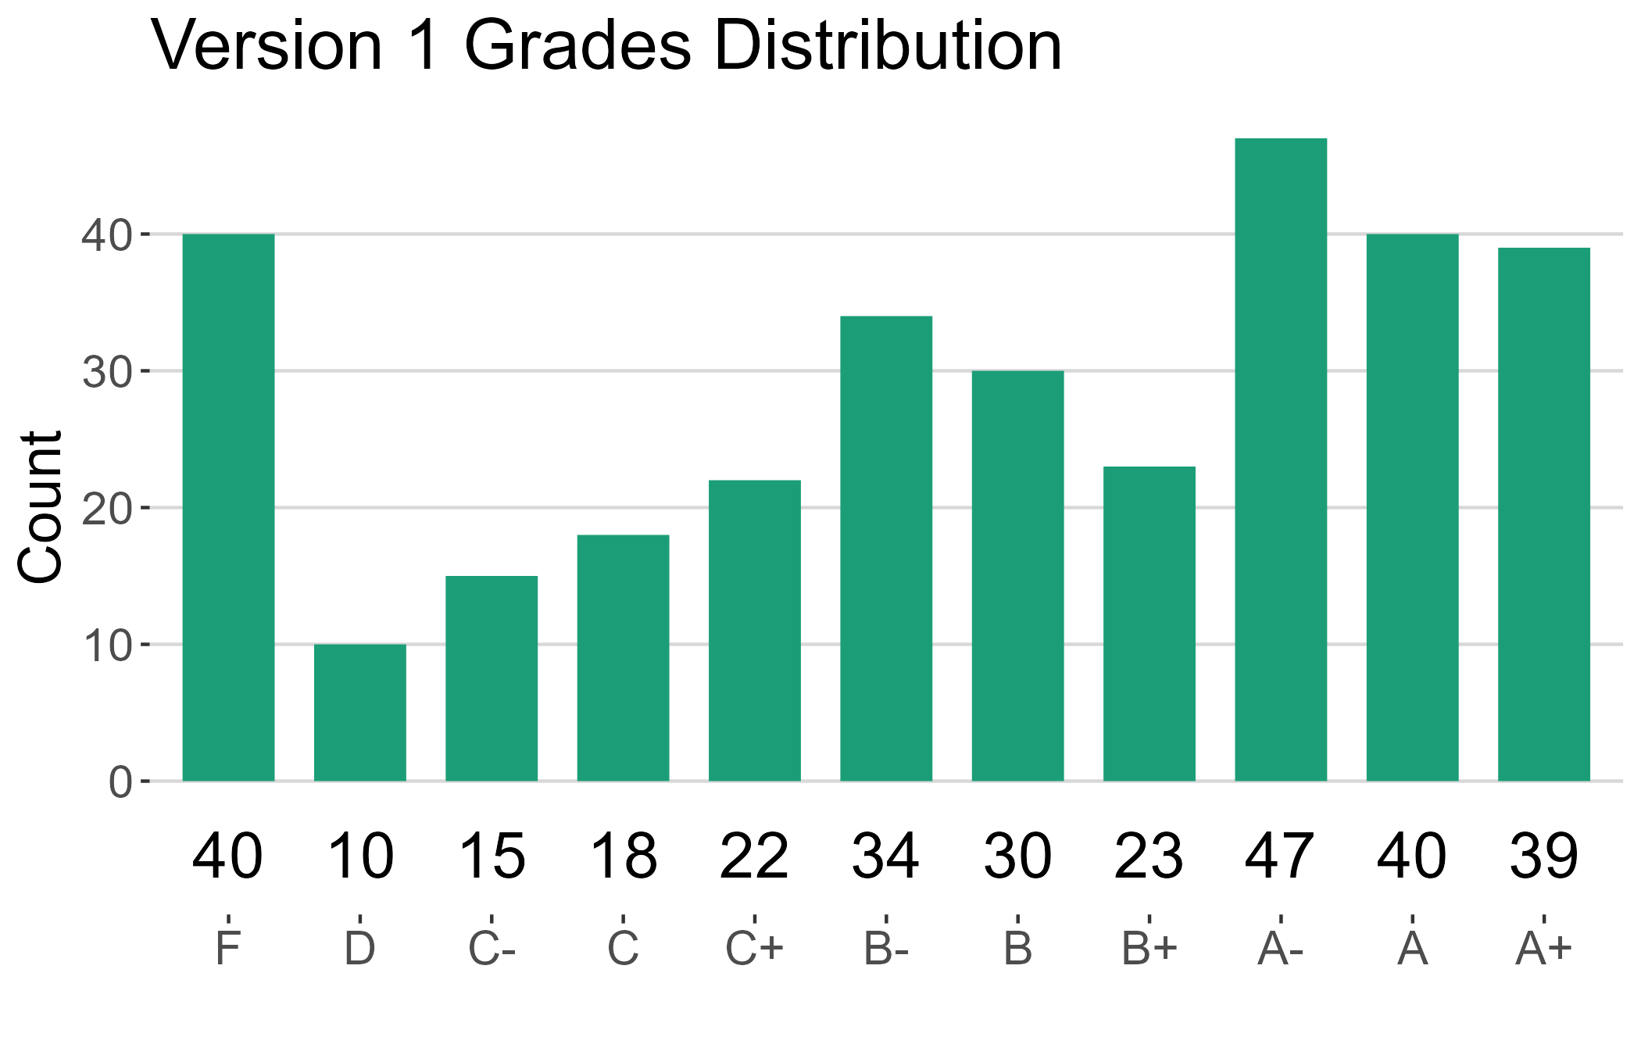
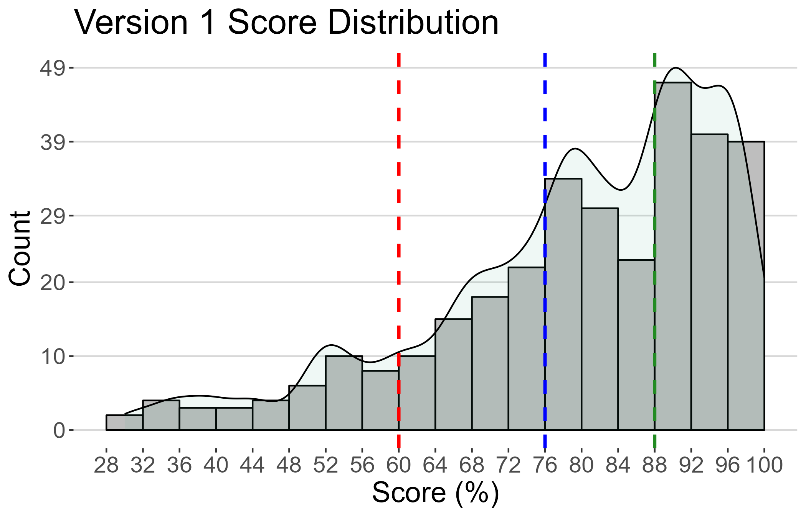
Version 1 Summary
version | Count | Mean (%) | Median (%) | Std. Dev (%) | Min (%) | Max (%) | # D/F's | # A's

Slide 7
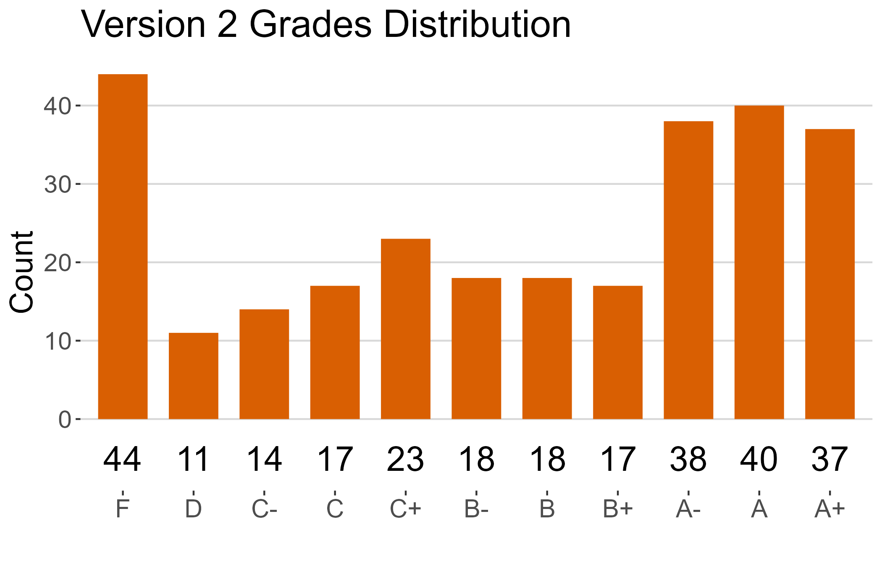
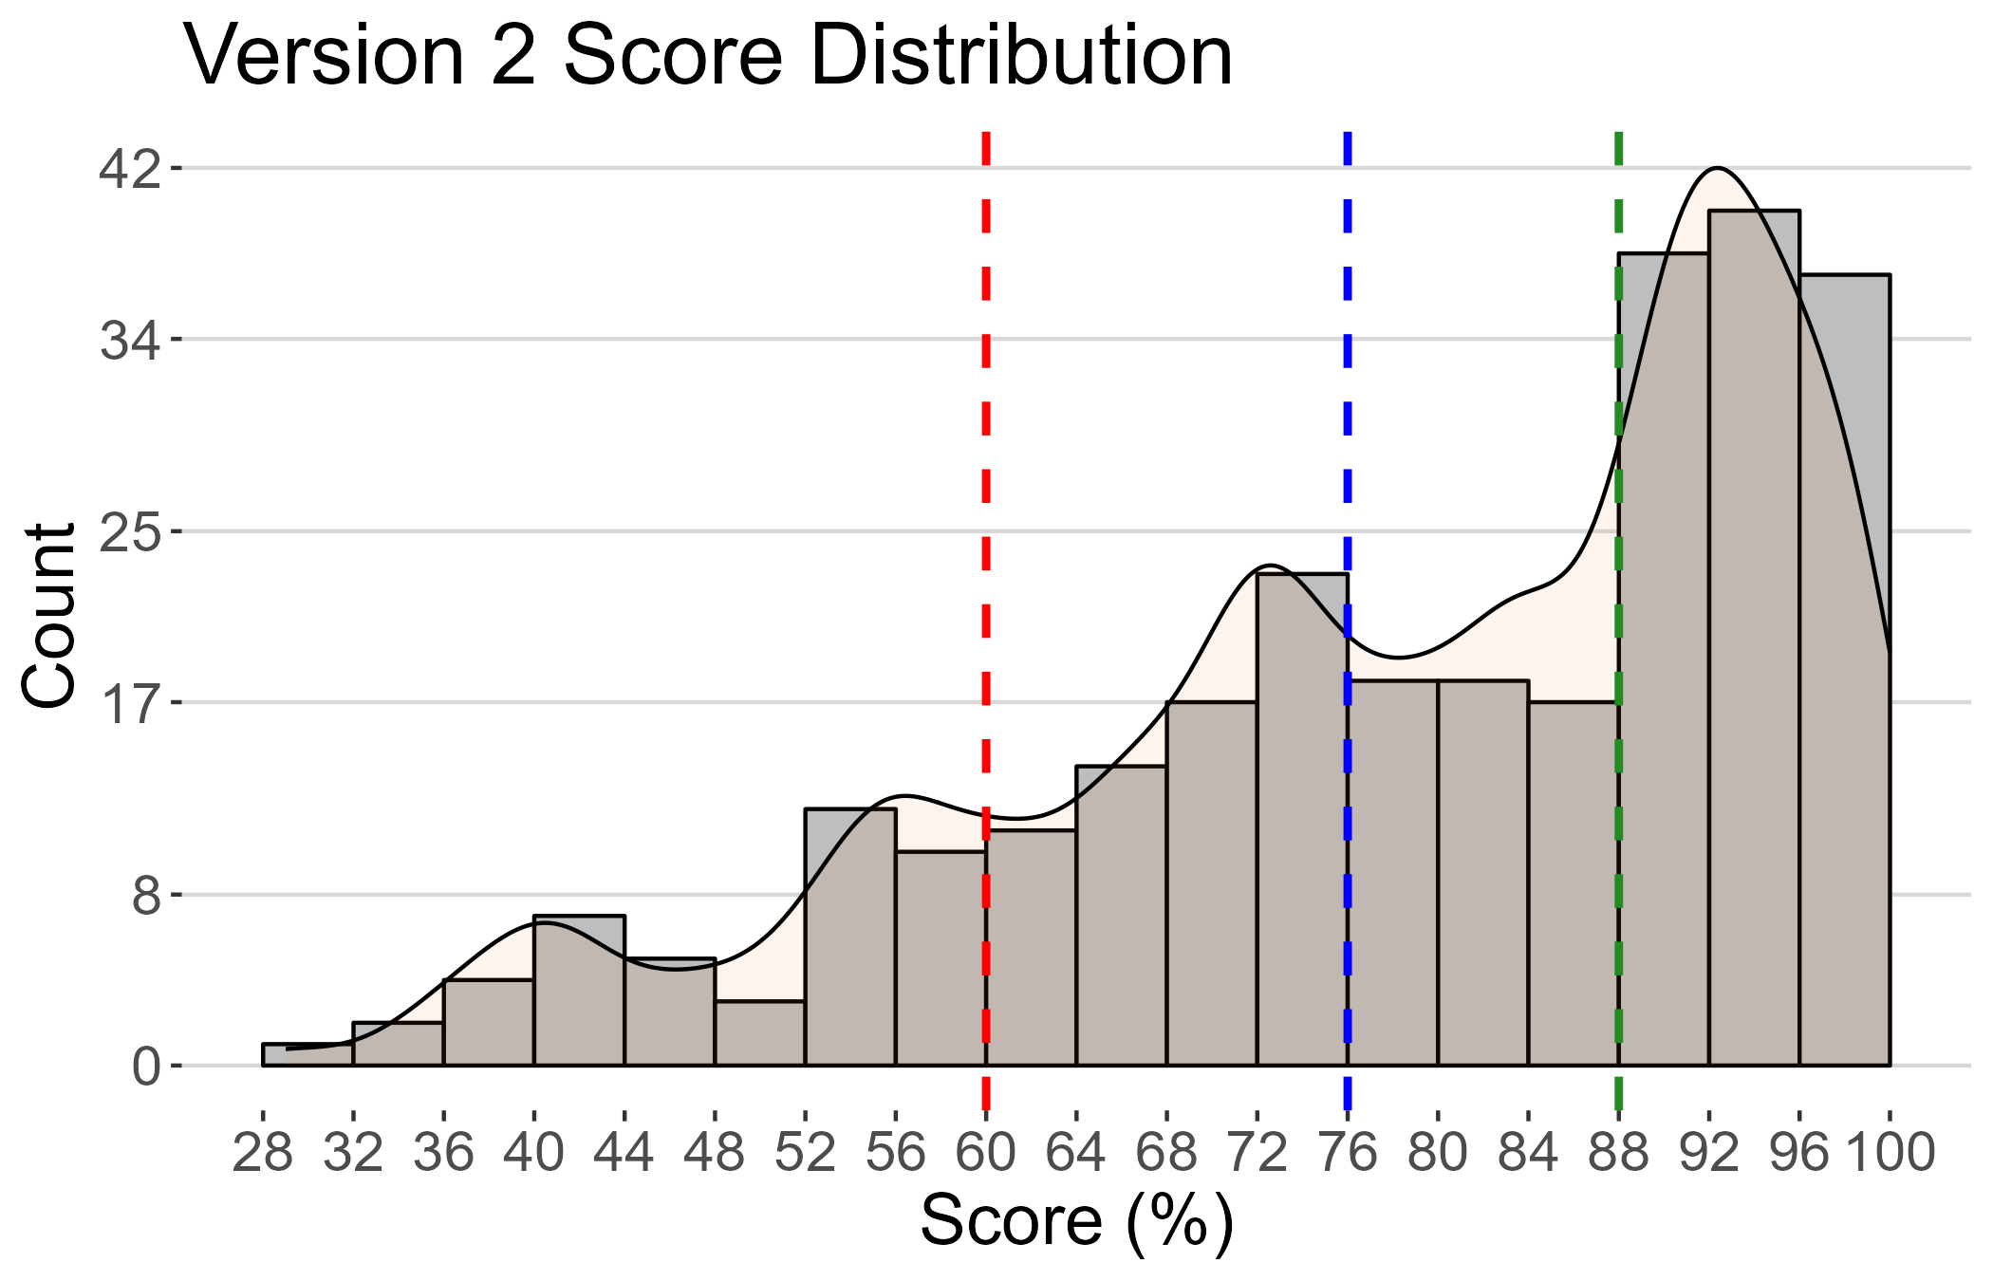
Version 2 Summary
version | Count | Mean (%) | Median (%) | Std. Dev (%) | Min (%) | Max (%) | # D/F's | # A's

Slide 8
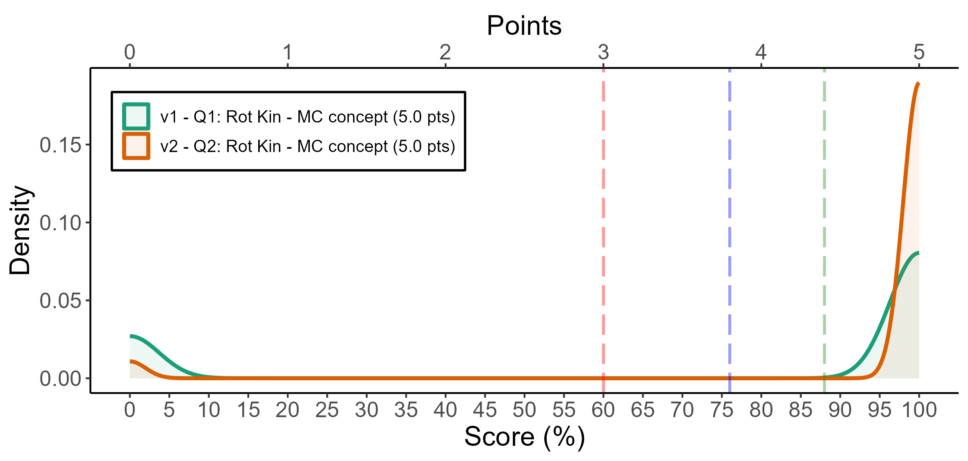
Rot. Kin. - MC Concept
 | F | D | C- | C | C+ | B- | B | B+ | A- | A | A+
v1 | 80 | 0 | 0 | 0 | 0 | 0 | 0 | 0 | 0 | 0 | 238
v2 | 15 | 0 | 0 | 0 | 0 | 0 | 0 | 0 | 0 | 0 | 262
# | Pts | Cut | Applied (%)
V2 - Q2 | 0 | Correct (D) | 95
V1 - Q2 | 0 | Correct (Option D) | 81
V1 - Q1 | 0 | Correct (Option C) | 75
V2 - Q1 | 0 | Correct (A) | 74
V1 - Q1 | 5 | Incorrect (Option A | 25
V2 - Q1 | 5 | Incorrect (B) | 18
version | Count | Mean | SD | # D/F's | # A's
v1 | 318 | 74.8 | 43.5 | 80 (25%) | 238 (75%)
v2 | 277 | 94.6 | 22.7 | 15 (5%) | 262 (95%)

Slide 9
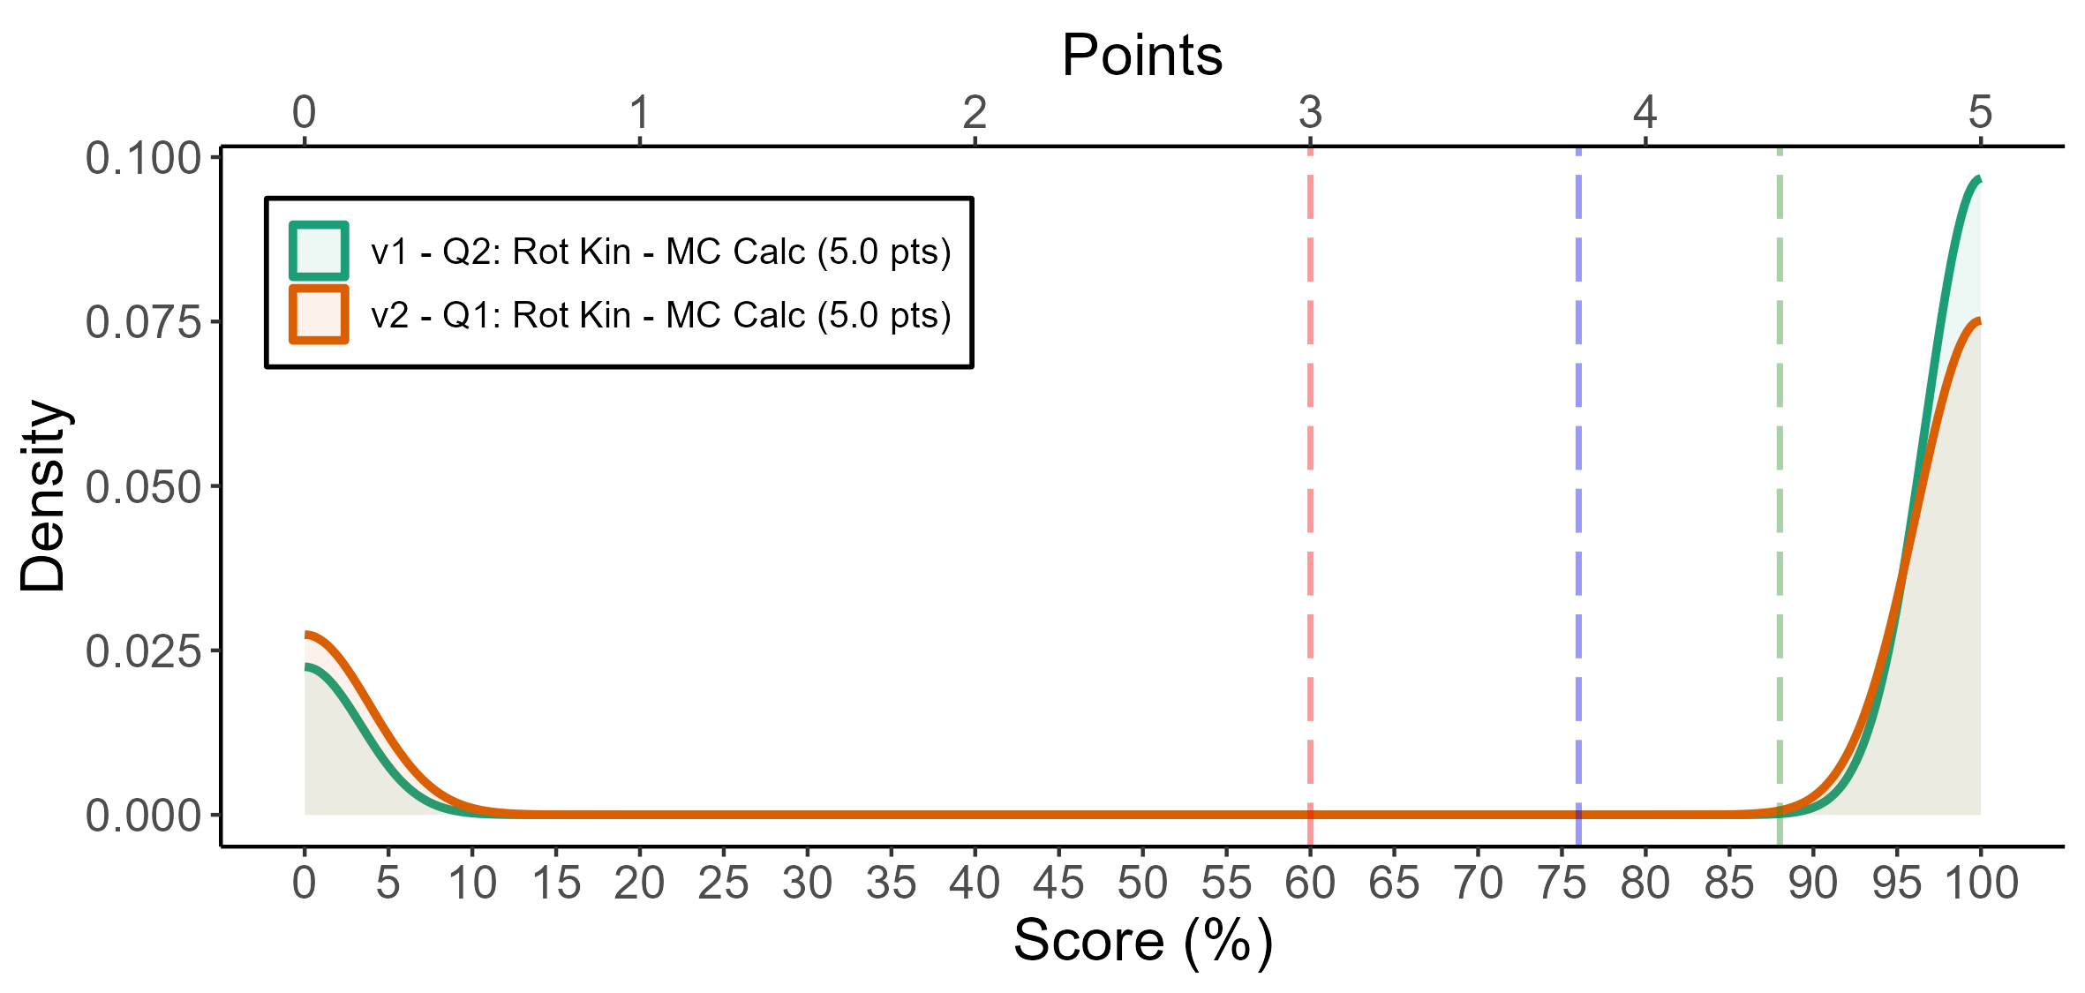
Rot. Kin. - MC Calc
 | F | D | C- | C | C+ | B- | B | B+ | A- | A | A+
v1 | 60 | 0 | 0 | 0 | 0 | 0 | 0 | 0 | 0 | 0 | 258
v2 | 74 | 0 | 0 | 0 | 0 | 0 | 0 | 0 | 0 | 0 | 203
# | Pts | Cut | Applied (%)
V1 - Q2 | 0 | Correct (Option D) | 81
V2 - Q1 | 0 | Correct (A) | 74
V2 - Q1 | 5 | Incorrect (B) | 18
version | Count | Mean | SD | # D/F's | # A's
v1 | 318 | 81.1 | 39.2 | 60 (19%) | 258 (81%)
v2 | 277 | 73.3 | 44.3 | 74 (27%) | 203 (73%)

Slide 10
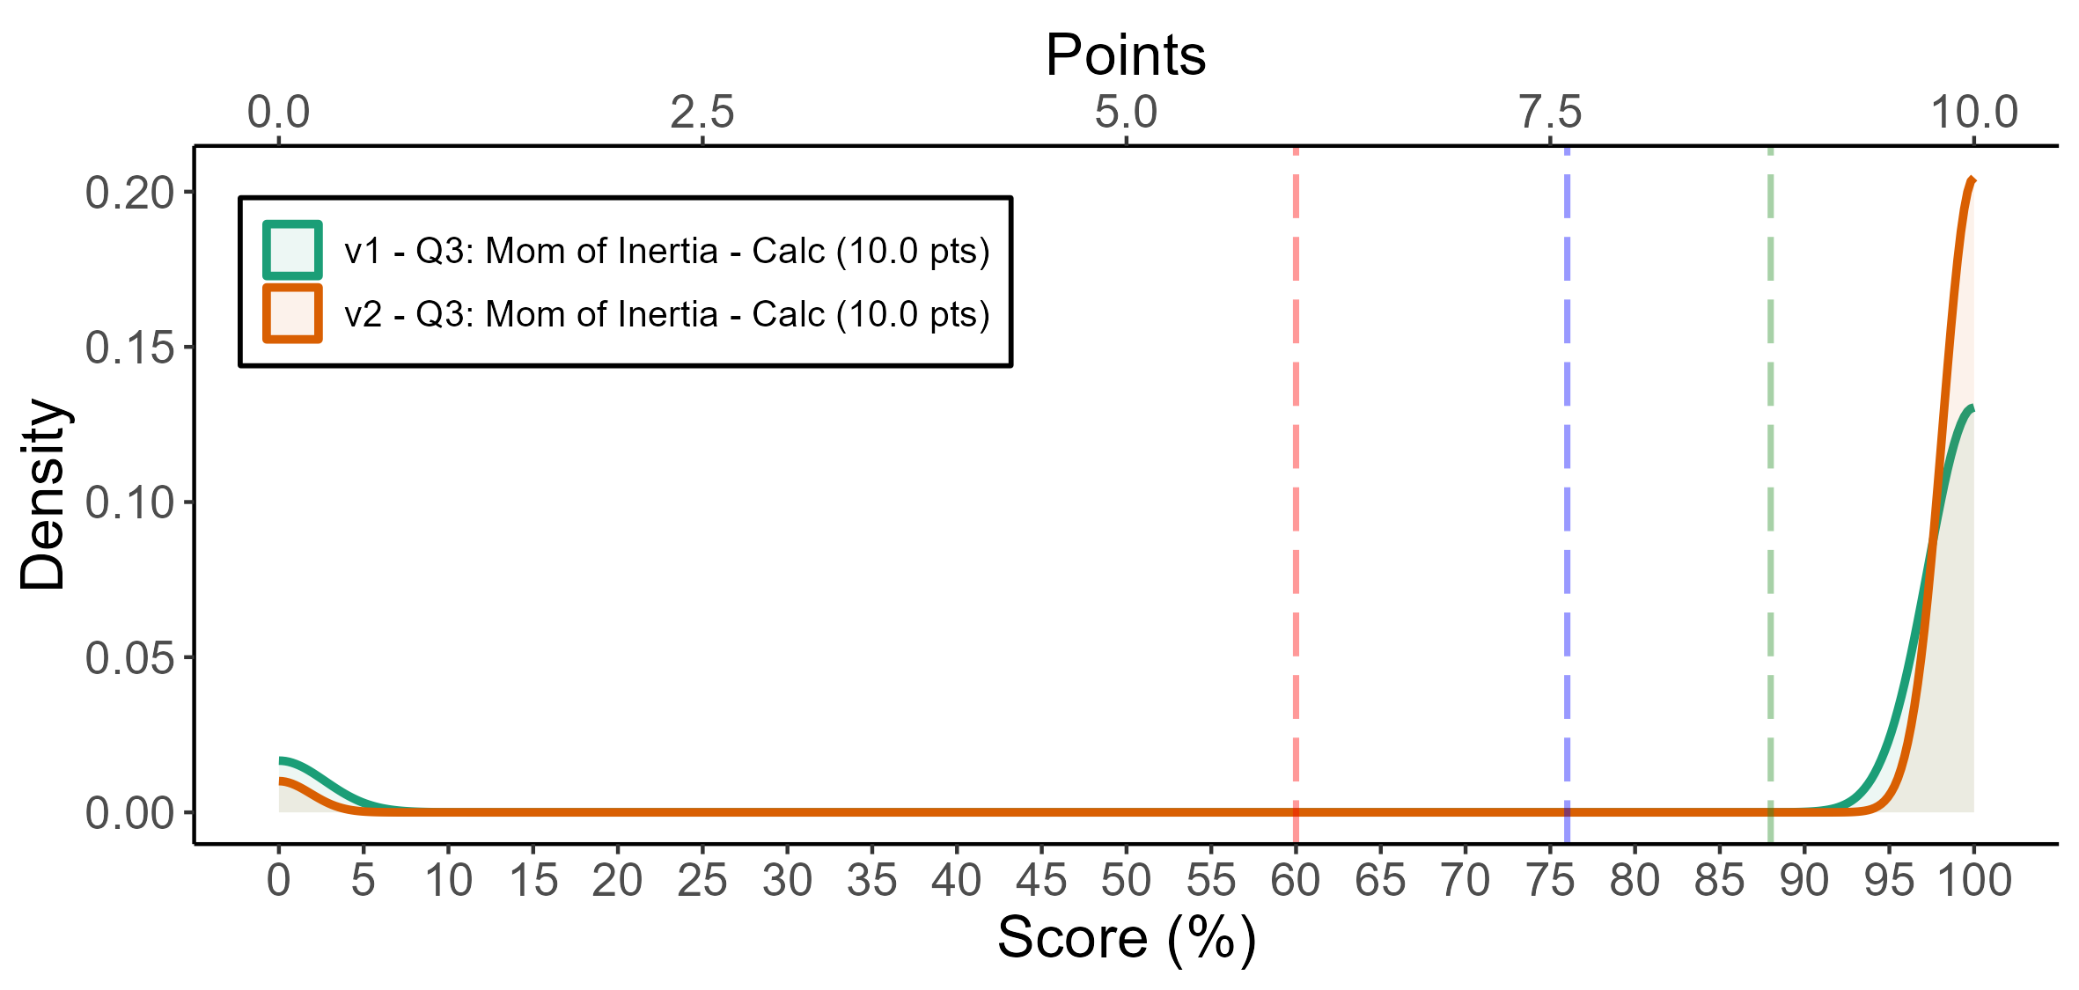
Moment of Inertia - MC Calc
 | F | D | C- | C | C+ | B- | B | B+ | A- | A | A+
v1 | 36 | 0 | 0 | 0 | 0 | 0 | 0 | 0 | 0 | 0 | 282
v2 | 13 | 0 | 0 | 0 | 0 | 0 | 0 | 0 | 0 | 0 | 264
# | Pts | Cut | Applied (%)
V2 - Q3 | 0 | Correct (C) | 96
V1 - Q3 | 0 | Correct (Option B) | 89
version | Count | Mean | SD | # D/F's | # A's
v1 | 318 | 88.7 | 31.7 | 36 (11%) | 282 (89%)
v2 | 277 | 95.3 | 21.2 | 13 (5%) | 264 (95%)

Slide 11
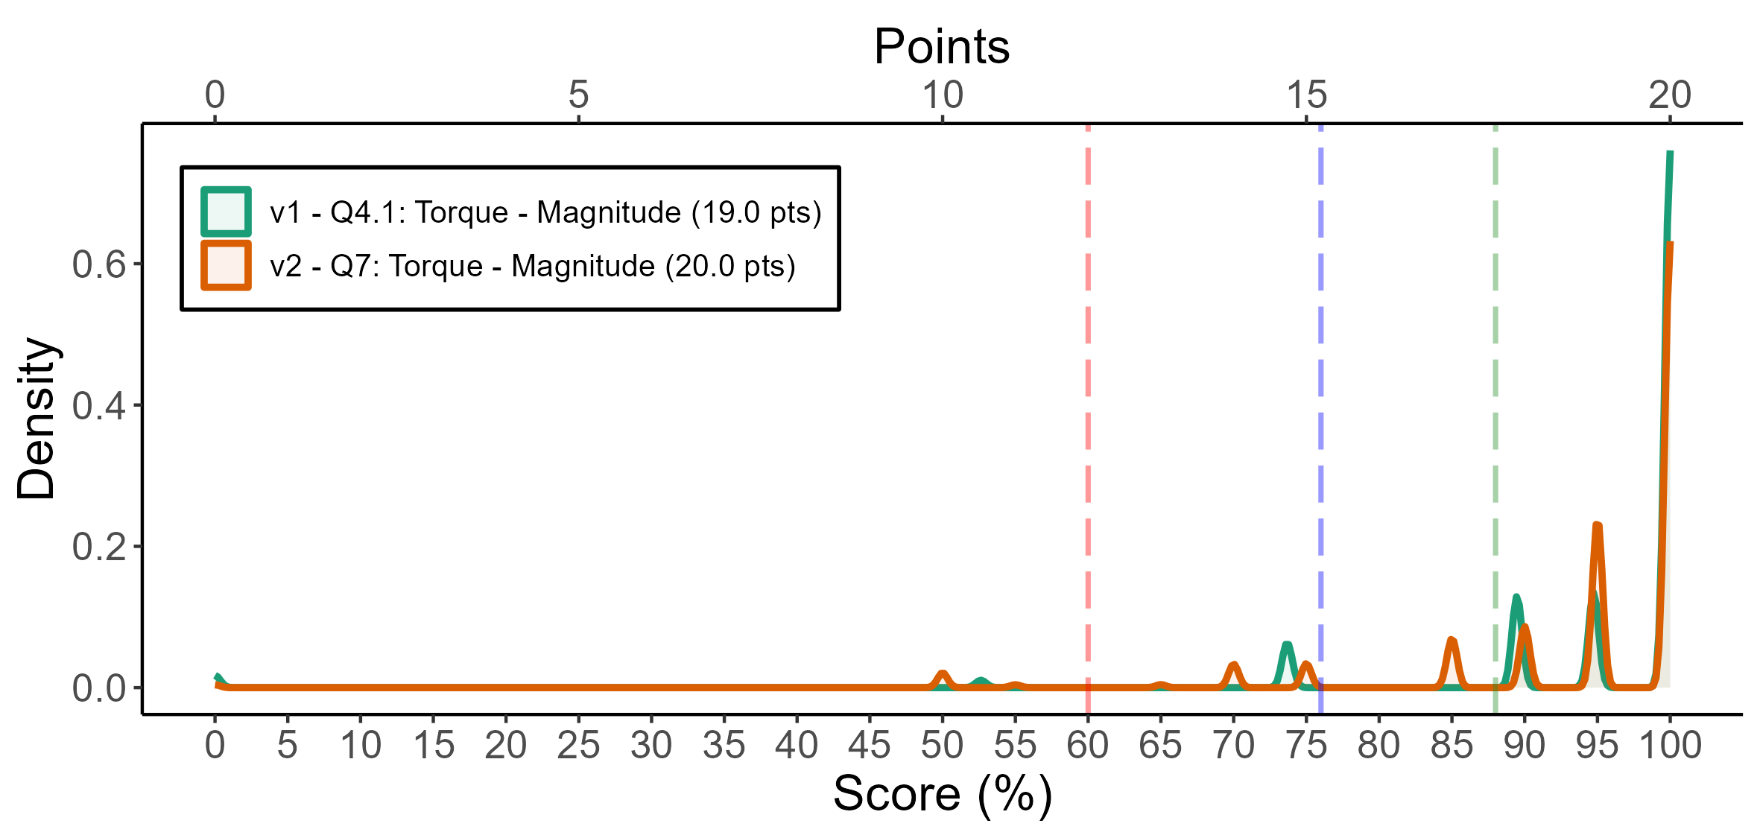
Torque - Magnitude
 | F | D | C- | C | C+ | B- | B | B+ | A- | A | A+
v1 | 8 | 0 | 0 | 0 | 18 | 0 | 0 | 0 | 36 | 37 | 219
v2 | 7 | 0 | 1 | 8 | 8 | 0 | 0 | 17 | 21 | 58 | 157
# | Pts | Cut | Applied (%)
V1 - Q4.1 | 0 | Correct Answer | 69
V2 - Q7 | 0 | Correct Answer | 57
V2 - Q7 | 1 | Incorrect units or SF | 33
V2 - Q7 | 2 | Incorrect Answer | 23
V1 - Q4.1 | 2 | Incorrect ANS | 20
version | Count | Mean | SD | # D/F's | # A's
v1 | 318 | 94.7 | 14.3 | 8 (3%) | 292 (92%)
v2 | 277 | 94.1 | 11.4 | 7 (3%) | 236 (85%)

Slide 12
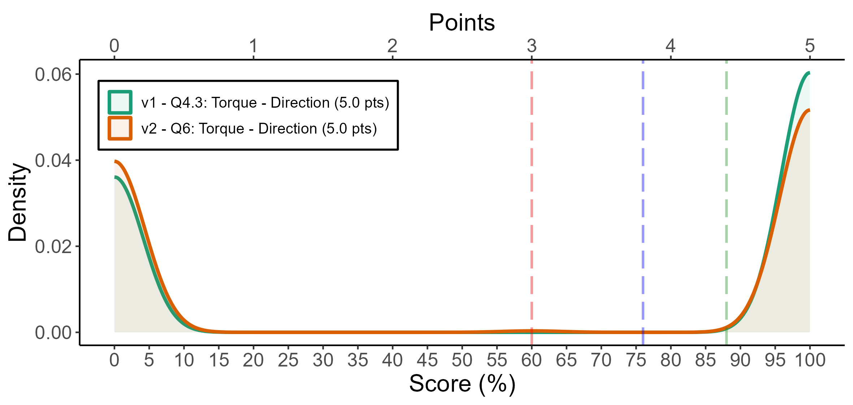
Torque - Direction
 | F | D | C- | C | C+ | B- | B | B+ | A- | A | A+
v1 | 119 | 0 | 0 | 0 | 0 | 0 | 0 | 0 | 0 | 0 | 199
v2 | 120 | 1 | 0 | 0 | 0 | 0 | 0 | 0 | 0 | 0 | 156
# | Pts | Cut | Applied (%)
V1 - Q4.3 | 0 | Correct Direction (out of page) | 63
V2 - Q6 | 0 | Correct Direction (out of page) | 57
V2 - Q6 | 5 | Incorrect direction (into page) | 44
V1 - Q4.3 | 5 | Incorrect Direction (all other options) | 19
V1 - Q4.3 | 5 | Incorrect Direction (into page) | 19
version | Count | Mean | SD | # D/F's | # A's
v1 | 318 | 62.6 | 48.5 | 119 (37%) | 199 (63%)
v2 | 277 | 56.5 | 49.6 | 121 (44%) | 156 (56%)

Slide 13
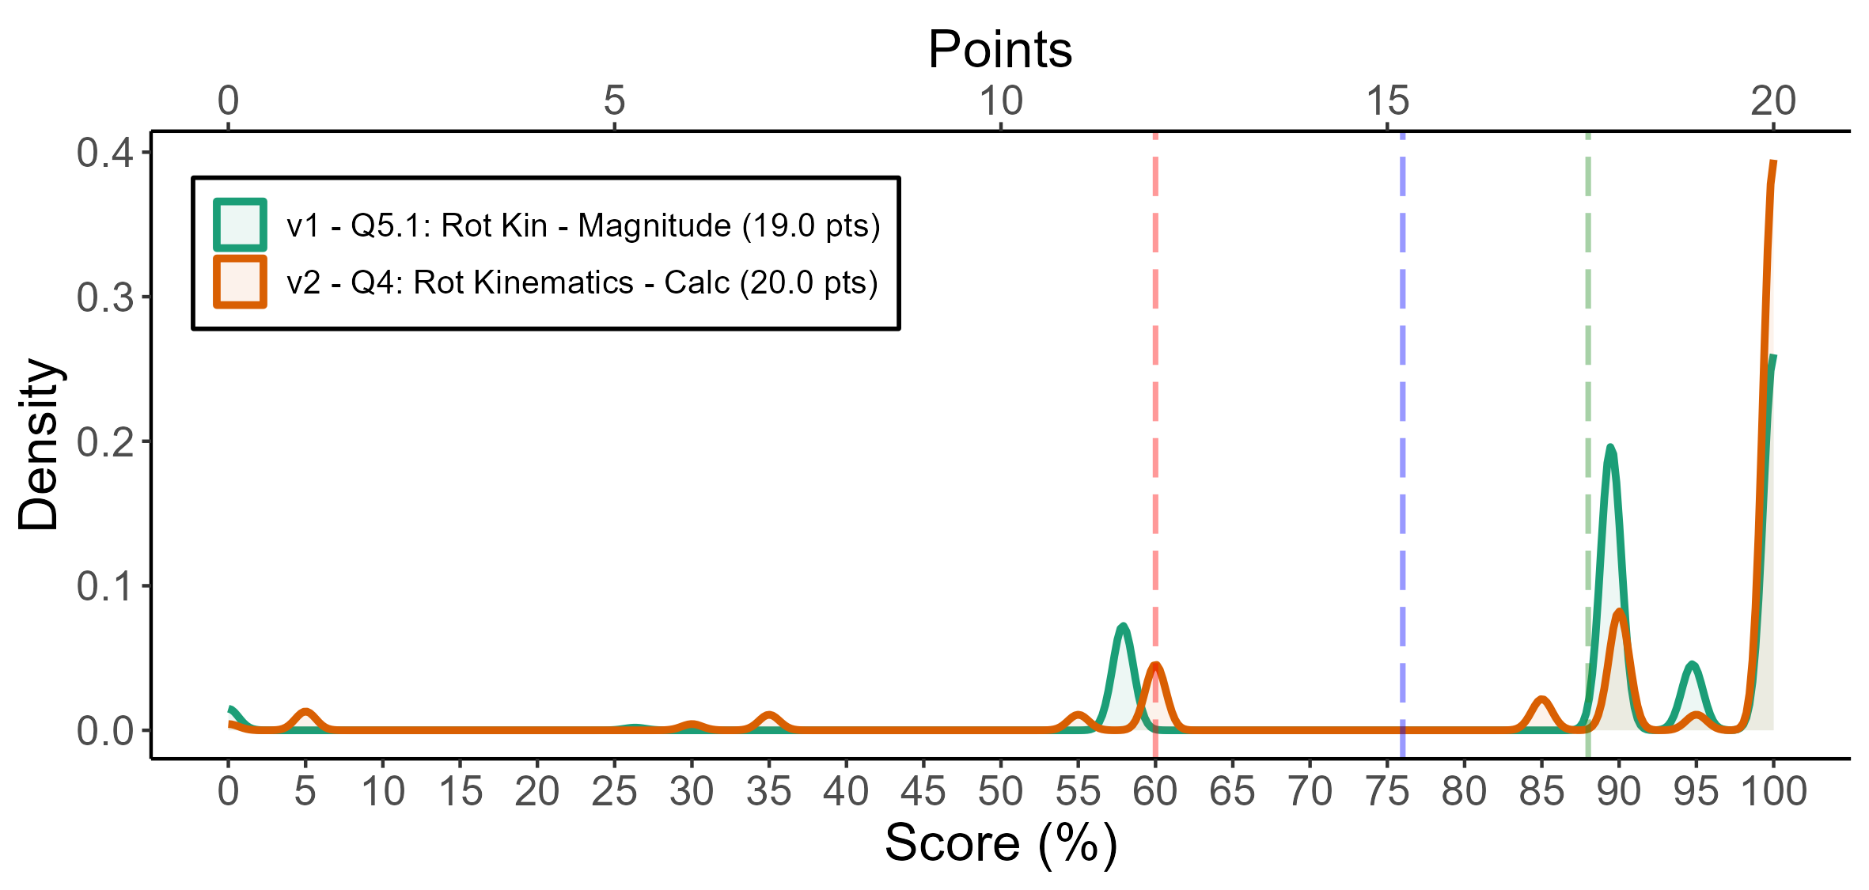
Rot. Kin. Med Calc
 | F | D | C- | C | C+ | B- | B | B+ | A- | A | A+
v1 | 48 | 0 | 0 | 0 | 0 | 0 | 0 | 0 | 106 | 25 | 139
v2 | 20 | 21 | 0 | 0 | 0 | 0 | 0 | 10 | 38 | 5 | 183
# | Pts | Cut | Applied (%)
V2 - Q4 | 0 | Correct Answer | 66
V1 - Q5.1 | 2 | Incorrect ANS | 49
V1 - Q5.1 | 0 | Correct Answer | 44
V2 - Q4 | 2 | Incorrect ANS | 32
version | Count | Mean | SD | # D/F's | # A's
v1 | 318 | 88.2 | 19.7 | 48 (15%) | 270 (85%)
v2 | 277 | 89.7 | 21.3 | 41 (15%) | 226 (82%)

Slide 14
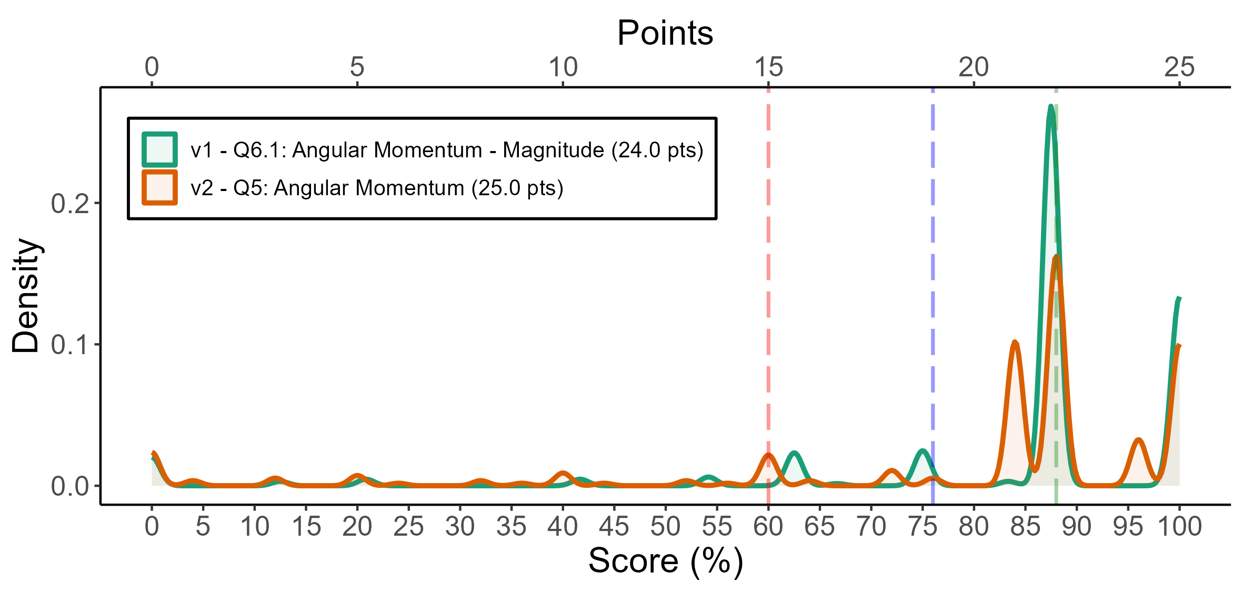
Ang. Mom. Point Particle
 | F | D | C- | C | C+ | B- | B | B+ | A- | A | A+
v1 | 25 | 15 | 1 | 0 | 16 | 0 | 2 | 173 | 0 | 0 | 86
v2 | 35 | 12 | 2 | 0 | 6 | 3 | 0 | 56 | 90 | 0 | 73
# | Pts | Cut | Applied (%)
V2 - Q5 | 3 | Incorrect Answer | 74
V1 - Q6.1 | 3 | Incorrect ANS | 73
V1 - Q6.2 | 0 | Correct Units ($$\frac{kg m}{s^2}$$) | 52
V1 - Q6.2 | 1 | Incorrect Units | 48
V2 - Q5 | 1 | Incorrect units or SF | 45
V1 - Q6.1 | 0 | Correct Answer | 27
V2 - Q5 | 0 | Correct Answer | 20
V2 - Q5 | 3 | Does not attempt algebraic solution | 17
V2 - Q5 | 3 | No Cross Product $$l = r p \sin(\theta)$$ | 16
version | Count | Mean | SD | # D/F's | # A's
v1 | 318 | 83.5 | 22.1 | 40 (13%) | 86 (27%)
v2 | 277 | 79.5 | 25.8 | 47 (17%) | 163 (59%)

Slide 15
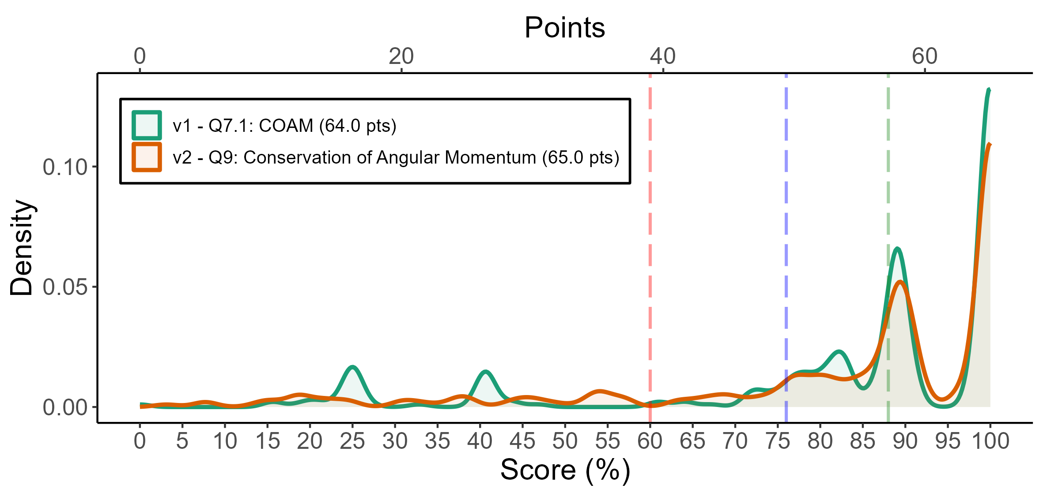
COAM
 | F | D | C- | C | C+ | B- | B | B+ | A- | A | A+
v1 | 42 | 2 | 3 | 5 | 6 | 21 | 26 | 14 | 65 | 0 | 134
v2 | 42 | 2 | 5 | 4 | 7 | 12 | 16 | 21 | 53 | 1 | 114
# | Pts | Cut | Applied (%)
V2 - Q5 | 3 | Incorrect Answer | 74
V2 - Q9 | 6 | Answer: Incorrect Answer | 57
V1 - Q7.1 | 6 | Answer: Incorrect Answer | 49
V2 - Q5 | 1 | Incorrect units or SF | 45
V2 - Q9 | 0 | Correct Answer | 39
V1 - Q7.1 | 0 | Correct Answer | 38
V2 - Q9 | 1 | Key Terms - Final State: Combined Objects: Incorrect | 30
V2 - Q9 | 1 | Key Terms - Initial State: Initial B: Incorrect sign | 29
V1 - Q7.1 | 1 | Key Terms - Initial State: Initial B: Incorrect sign | 26
V2 - Q9 | 2 | Answer: Incorrect Units or SF | 22
V1 - Q7.1 | 5 | Applications: Incorrect moment of inertia applied | 21
V2 - Q5 | 0 | Correct Answer | 20
V2 - Q9 | 5 | Applications: Incorrect moment of inertia applied | 19
V2 - Q9 | 1 | Key Terms - Initial State: Initial B: Incorrect term | 18
V1 - Q7.1 | 1 | Key Terms - Final State: Combined Objects: Incorrect | 18
V2 - Q9 | 1 | Key Terms - Final State: Combined Objects: Incorrect Sign | 18
V2 - Q9 | 1 | Key Terms - Initial State: Initial A: Incorrect term | 17
V2 - Q5 | 3 | Does not attempt algebraic solution | 17
V1 - Q7.1 | 1 | Answer: Incorrect SF 3SF | 16
V2 - Q9 | 2 | Key Terms - Final State: Combined Objects: Not Present | 16
V2 - Q5 | 3 | No Cross Product $$l = r p \sin(\theta)$$ | 16
version | Count | Mean | SD | # D/F's | # A's
v1 | 318 | 83.6 | 22.8 | 44 (14%) | 199 (63%)
v2 | 277 | 83.0 | 23.1 | 44 (16%) | 168 (61%)

Slide 16
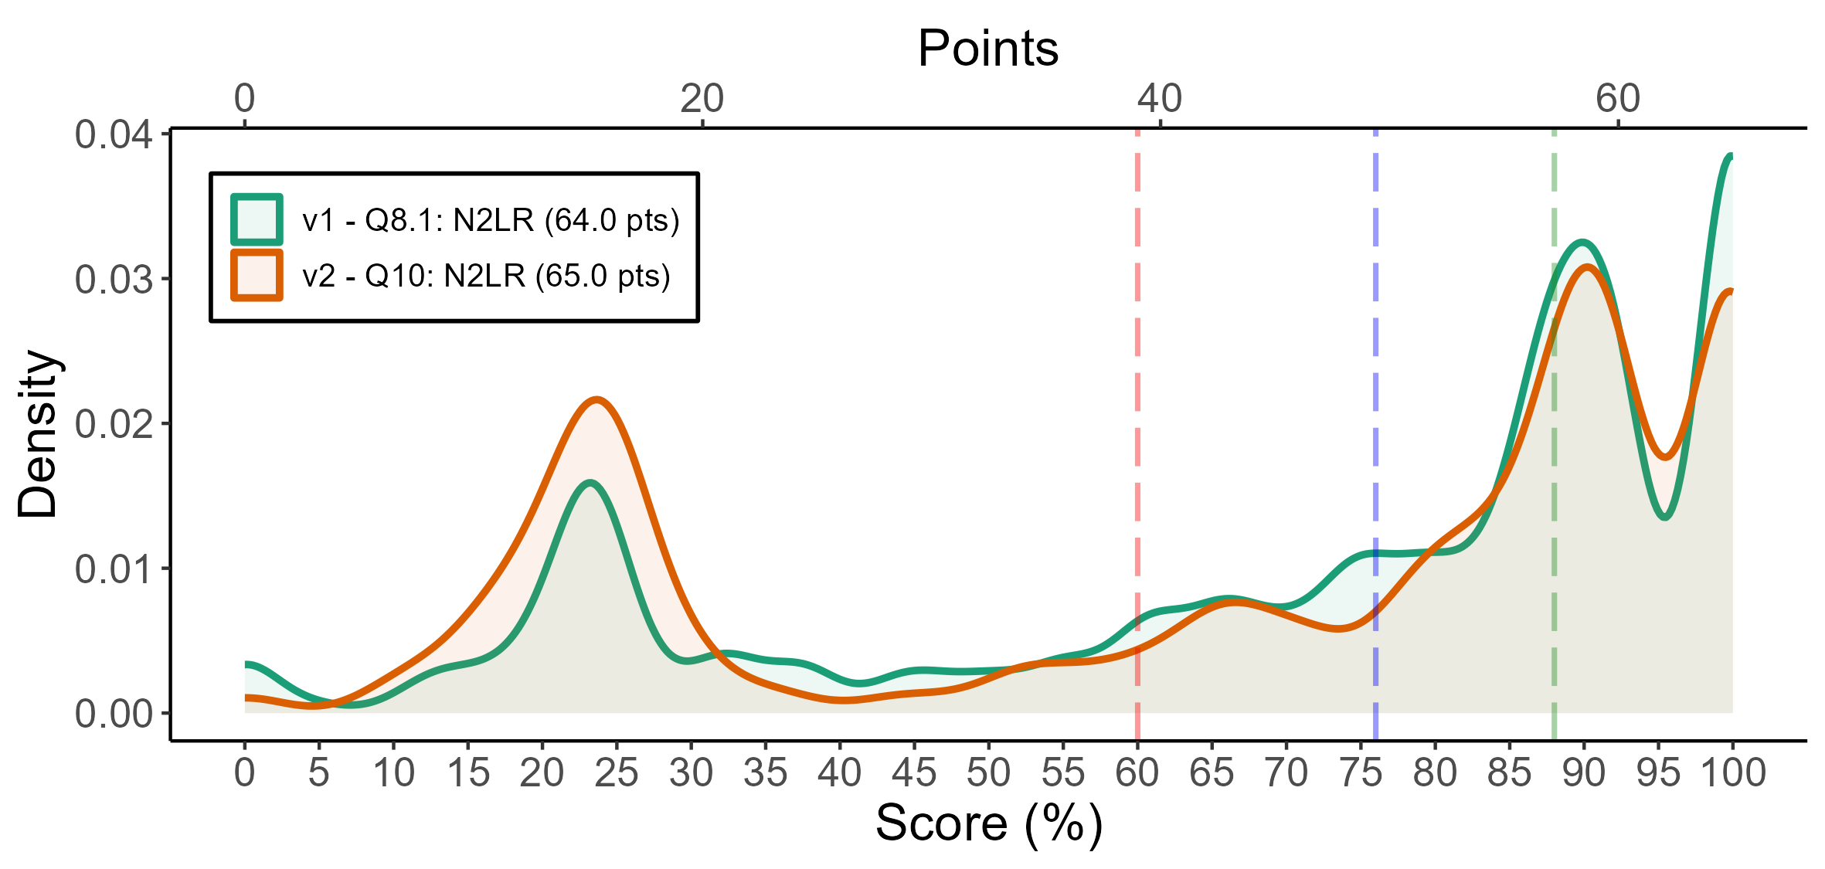
N2LR
 | F | D | C- | C | C+ | B- | B | B+ | A- | A | A+
v1 | 84 | 8 | 13 | 9 | 15 | 15 | 9 | 35 | 29 | 30 | 71
v2 | 90 | 6 | 11 | 5 | 6 | 9 | 16 | 19 | 33 | 26 | 56
# | Pts | Cut | Applied (%)
V2 - Q10 | 5 | Answer: Incorrect answer | 72
V1 - Q8.1 | 5 | Answer: Incorrect Answer | 68
V2 - Q10 | 1 | Key Terms - N2L - Rotation: Applied Force ($$R F_A$$) incorrect sign | 43
V2 - Q10 | 1 | Key Terms - N2L - Rotation: Tension ($$R T$$) incorrect sign | 40
V2 - Q10 | 2 | Key Terms - N2L - Rotation: Tension ($$R T$$) Incorrect | 39
V1 - Q8.1 | 2 | Key Terms - N2L - Rotation: Tension ($$R T$$) Incorrect | 36
V2 - Q10 | 2 | Key Terms - N2L - Rotation: Applied Force ($$R F_A$$) Incorrect | 36
V1 - Q8.1 | 1 | Key Terms - N2L - Rotation: Tension ($$R T$$) incorrect sign (- is correct) | 35
V1 - Q8.1 | 2 | Key Terms - N2L - Rotation: Applied Force ($$R F_A$$) Incorrect | 35
V2 - Q10 | 5 | Applications: Does not apply link equation | 33
V2 - Q10 | 3 | Applications: Does not substitute from N2L into N2L-R | 32
V2 - Q10 | 3 | Physics: No acceleration link equation ($$\alpha = \frac{a}{r}$$) | 30
V1 - Q8.1 | 1 | Key Terms - N2L - Rotation: Applied Force ($$R F_A$$) Incorrect sign (+ is correct) | 29
V1 - Q8.1 | 5 | Applications: Does not apply link equation | 26
V1 - Q8.1 | 3 | Applications: Incorrect moment of inertia applied | 26
V1 - Q8.1 | 3 | Applications: Does not substitute from N2L into N2L-R | 25
V2 - Q10 | 7 | Physics: No torque ($$\tau = \vec{r} \times \vec{F}$$) | 24
V2 - Q10 | 1 | Answer: Incorrect SF | 22
V1 - Q8.1 | 0 | Correct Answer | 21
V2 - Q10 | 17 | Physics: No N2L-Rotation ($$\Sigma \tau = I \alpha$$) | 21
V2 - Q10 | 1 | Answer: Incorrect Units (N) | 20
V2 - Q10 | 2 | Key Terms - N2L: Tension - Not Present | 20
V1 - Q8.1 | 1 | Answer: Incorrect SF (3SF) | 20
V2 - Q10 | 3 | Applications: Incorrect moment of inertia applied | 19
V2 - Q10 | 0 | Correct answer | 19
V1 - Q8.1 | 3 | Physics: No acceleration link equation ($$\alpha = \frac{a}{r}$$) | 19
V1 - Q8.1 | 7 | Physics: No torque ($$\tau = \vec{r} \times \vec{F}$$) | 18
V2 - Q10 | 1 | Key Terms - N2L: gravity present with incorrect trig - RLC (sub-cut) | 17
version | Count | Mean | SD | # D/F's | # A's
v1 | 318 | 72.1 | 28.9 | 92 (29%) | 130 (41%)
v2 | 277 | 67.9 | 31.3 | 96 (35%) | 115 (42%)

Slide 17
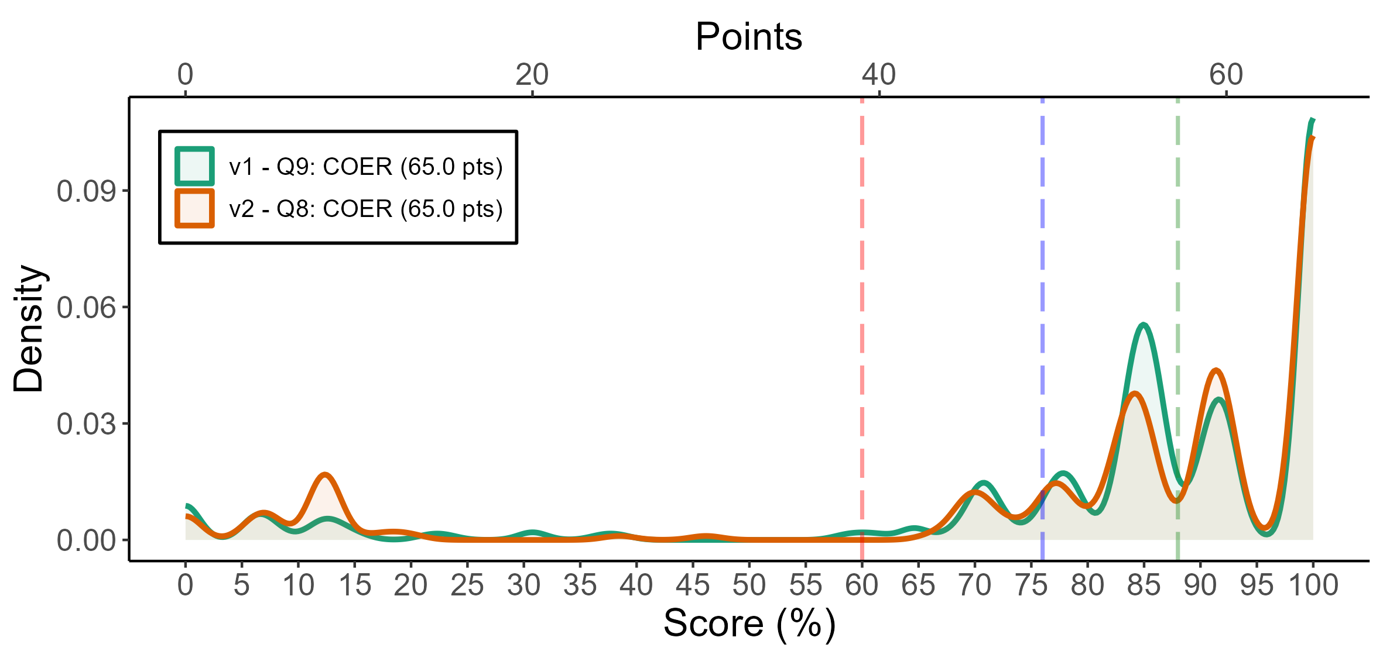
COER
 | F | D | C- | C | C+ | B- | B | B+ | A- | A | A+
v1 | 32 | 2 | 4 | 15 | 6 | 20 | 16 | 64 | 23 | 25 | 111
v2 | 36 | 0 | 2 | 13 | 6 | 15 | 21 | 30 | 29 | 22 | 103
# | Pts | Cut | Applied (%)
V1 - Q9 | 5 | Answer: Incorrect Answer | 58
V2 - Q8 | 5 | Answer: Incorrect answer | 57
V2 - Q8 | 0 | Correct answer | 37
V1 - Q9 | 0 | Correct Answer | 35
V2 - Q8 | 5 | Application: Does not apply link eqn | 34
V1 - Q9 | 5 | Application: Does not apply link equation | 32
V2 - Q8 | 1 | COE Key Terms: $$U_g$$: $$U_g$$ incorrect | 32
V1 - Q9 | 4 | Application: Does not apply correct moment of inertia | 23
V1 - Q9 | 1 | COE Key Terms: $$U_g$$: $$U_g$$ incorrect | 20
version | Count | Mean | SD | # D/F's | # A's
v1 | 318 | 82.1 | 25.5 | 34 (11%) | 159 (50%)
v2 | 277 | 80.5 | 28.5 | 36 (13%) | 154 (56%)

Slide 18
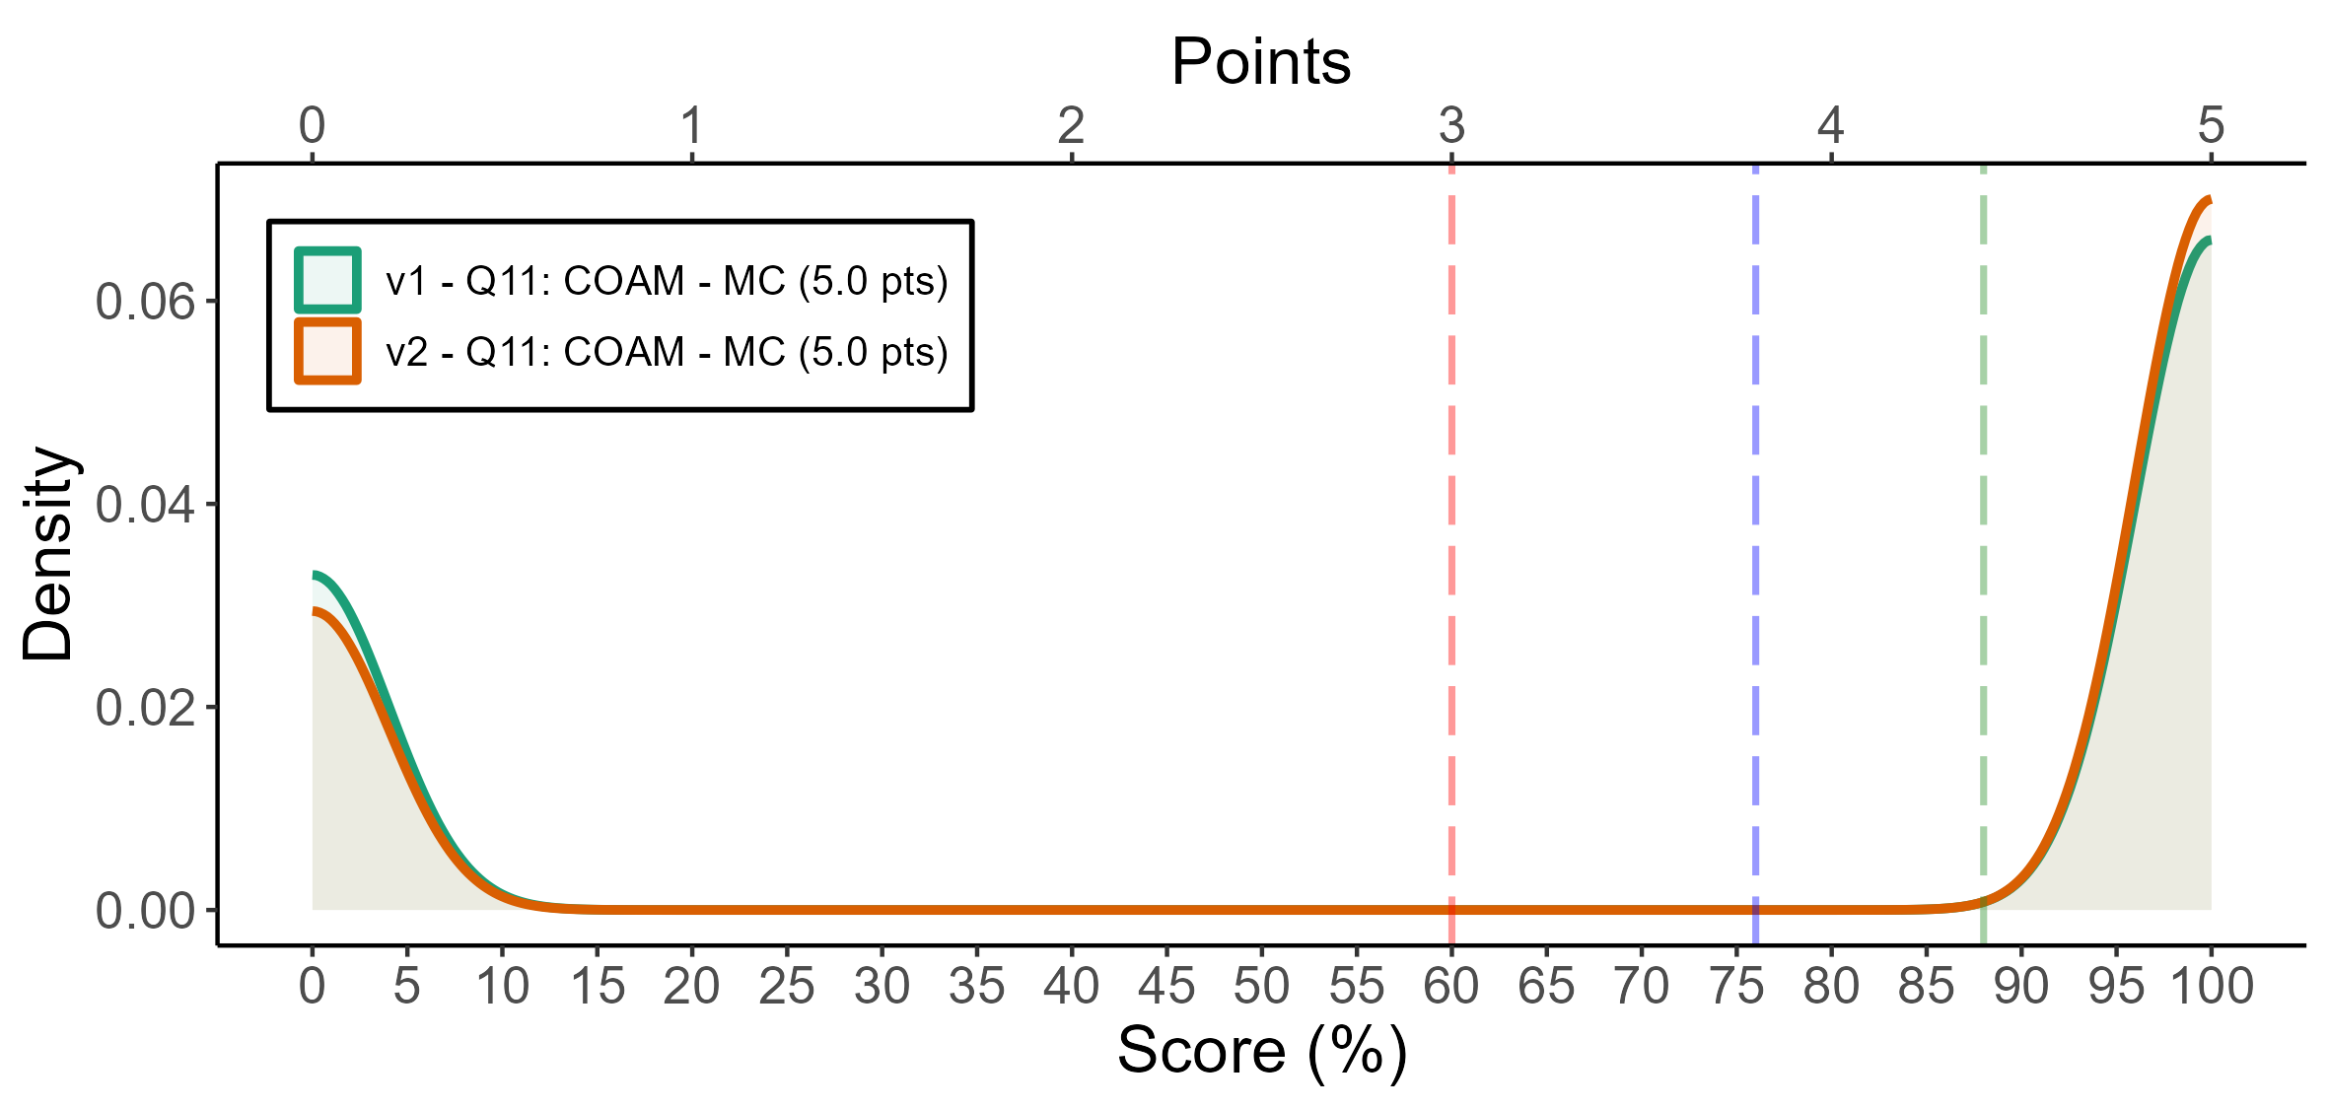
COAM - MC
 | F | D | C- | C | C+ | B- | B | B+ | A- | A | A+
v1 | 106 | 0 | 0 | 0 | 0 | 0 | 0 | 0 | 0 | 0 | 212
v2 | 82 | 0 | 0 | 0 | 0 | 0 | 0 | 0 | 0 | 0 | 195
# | Pts | Cut | Applied (%)
V2 - Q11 | 0 | Correct answer (C) | 71
V1 - Q11 | 0 | Correct (Option A) | 67
V1 - Q7.1 | 6 | Answer: Incorrect Answer | 49
V1 - Q7.1 | 0 | Correct Answer | 38
V1 - Q11 | 5 | Incorrect (Option C) | 28
V1 - Q7.1 | 1 | Key Terms - Initial State: Initial B: Incorrect sign | 26
V1 - Q7.1 | 5 | Applications: Incorrect moment of inertia applied | 21
V2 - Q11 | 5 | Incorrect (A) | 21
V1 - Q7.1 | 1 | Key Terms - Final State: Combined Objects: Incorrect | 18
V1 - Q7.1 | 1 | Answer: Incorrect SF 3SF | 16
version | Count | Mean | SD | # D/F's | # A's
v1 | 318 | 66.7 | 47.2 | 106 (33%) | 212 (67%)
v2 | 277 | 70.4 | 45.7 | 82 (30%) | 195 (70%)

Slide 19
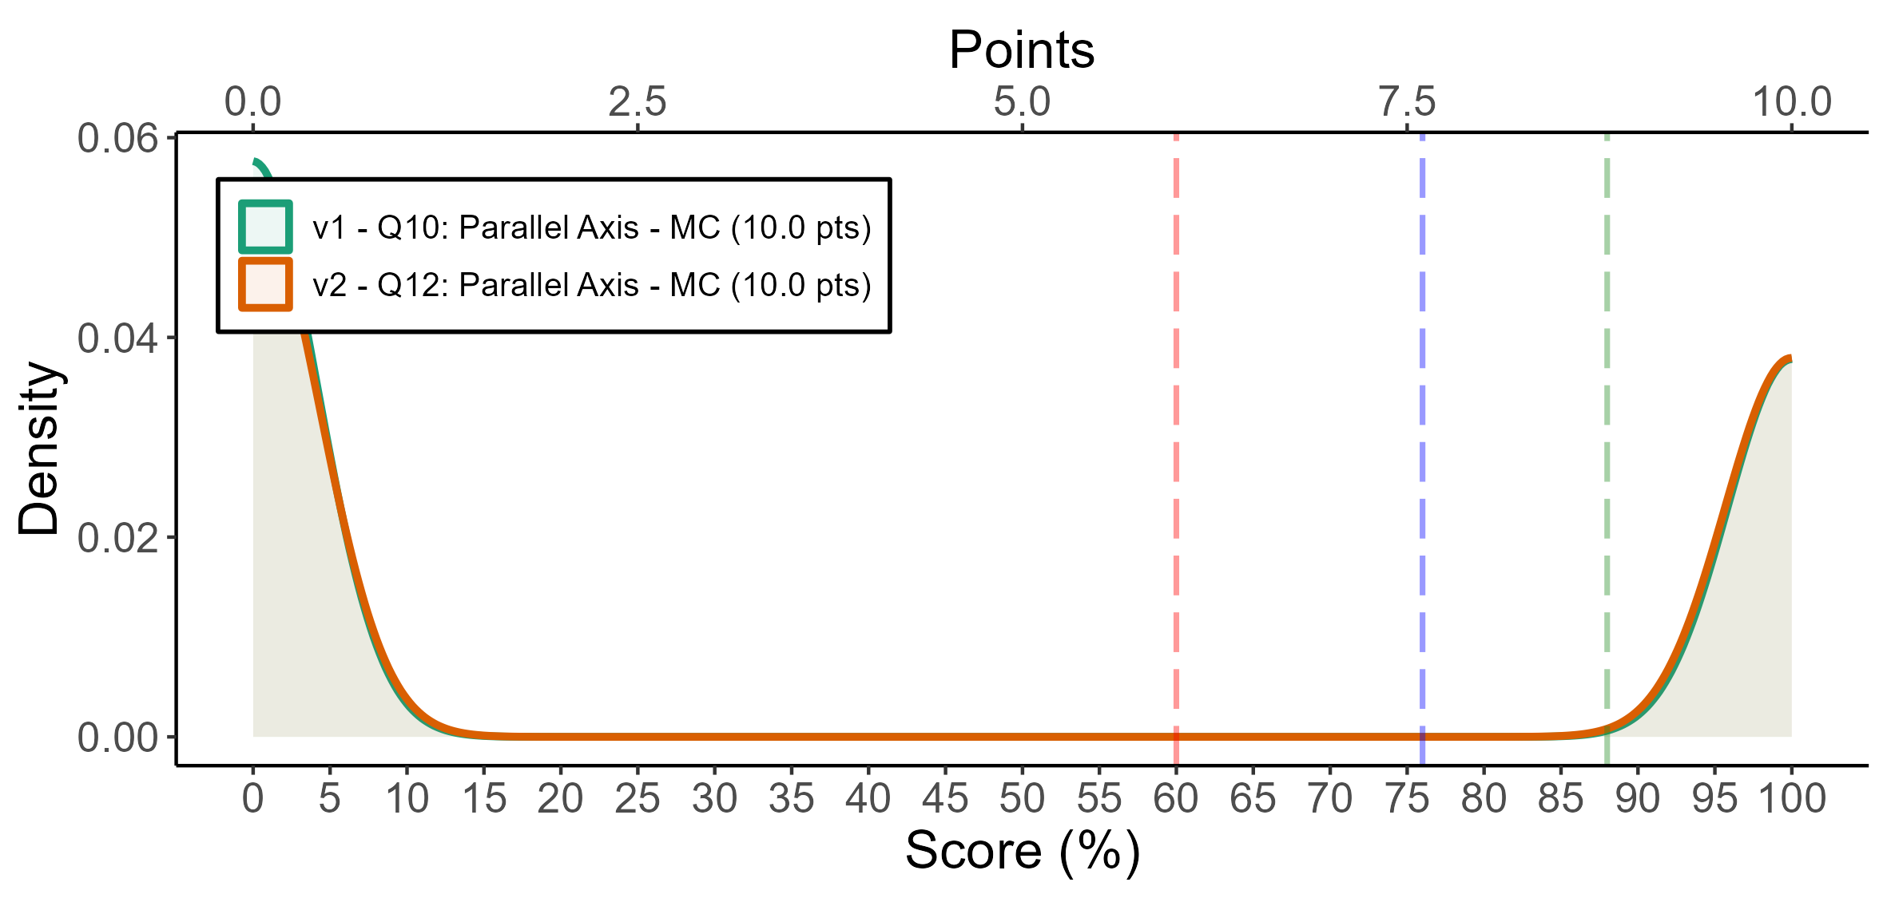
Parallel Axis Thm - MC
 | F | D | C- | C | C+ | B- | B | B+ | A- | A | A+
v1 | 192 | 0 | 0 | 0 | 0 | 0 | 0 | 0 | 0 | 0 | 126
v2 | 163 | 0 | 0 | 0 | 0 | 0 | 0 | 0 | 0 | 0 | 114
# | Pts | Cut | Applied (%)
V2 - Q12 | 0 | Correct (D) | 41
V1 - Q10 | 0 | Correct (Option C) | 40
V1 - Q10 | 10 | Incorrect (Option A) | 24
V1 - Q10 | 10 | Incorrect (Option B) | 22
V2 - Q12 | 10 | Incorrect E | 21
V2 - Q12 | 10 | Incorrect (B) | 20
V2 - Q12 | 10 | Incorrect (A) | 16
version | Count | Mean | SD | # D/F's | # A's
v1 | 318 | 39.6 | 49.0 | 192 (60%) | 126 (40%)
v2 | 277 | 41.2 | 49.3 | 163 (59%) | 114 (41%)

Slide 20
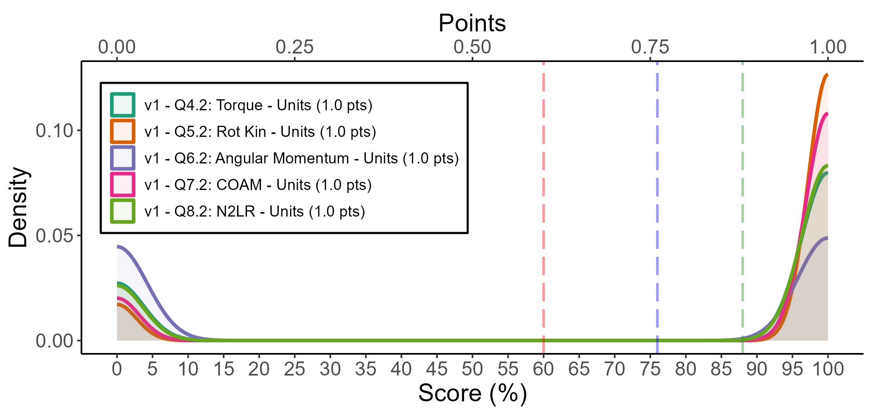
Units
 | F | D | C- | C | C+ | B- | B | B+ | A- | A | A+
v1 | 397 | 0 | 0 | 0 | 0 | 0 | 0 | 0 | 0 | 0 | 1,193
# | Pts | Cut | Applied (%)
V1 - Q5.2 | 0 | Correct units (rad) | 88
V1 - Q7.2 | 0 | Correct Units (kgm/s^2) | 85
V1 - Q8.2 | 0 | Correct (N) | 76
V1 - Q4.2 | 0 | Correct Units (Nm) | 75
V2 - Q5 | 3 | Incorrect Answer | 74
V1 - Q6.1 | 3 | Incorrect ANS | 73
V2 - Q10 | 5 | Answer: Incorrect answer | 72
V2 - Q11 | 0 | Correct answer (C) | 71
V1 - Q8.1 | 5 | Answer: Incorrect Answer | 68
V1 - Q11 | 0 | Correct (Option A) | 67
V1 - Q6.2 | 0 | Correct Units ($$\frac{kg m}{s^2}$$) | 52
V1 - Q7.1 | 6 | Answer: Incorrect Answer | 49
V1 - Q6.2 | 1 | Incorrect Units | 48
V2 - Q5 | 1 | Incorrect units or SF | 45
V2 - Q10 | 1 | Key Terms - N2L - Rotation: Applied Force ($$R F_A$$) incorrect sign | 43
V2 - Q10 | 1 | Key Terms - N2L - Rotation: Tension ($$R T$$) incorrect sign | 40
V2 - Q10 | 2 | Key Terms - N2L - Rotation: Tension ($$R T$$) Incorrect | 39
V1 - Q7.1 | 0 | Correct Answer | 38
V1 - Q8.1 | 2 | Key Terms - N2L - Rotation: Tension ($$R T$$) Incorrect | 36
V2 - Q10 | 2 | Key Terms - N2L - Rotation: Applied Force ($$R F_A$$) Incorrect | 36
V1 - Q8.1 | 1 | Key Terms - N2L - Rotation: Tension ($$R T$$) incorrect sign (- is correct) | 35
V1 - Q8.1 | 2 | Key Terms - N2L - Rotation: Applied Force ($$R F_A$$) Incorrect | 35
V2 - Q10 | 5 | Applications: Does not apply link equation | 33
V2 - Q10 | 3 | Applications: Does not substitute from N2L into N2L-R | 32
V2 - Q10 | 3 | Physics: No acceleration link equation ($$\alpha = \frac{a}{r}$$) | 30
V1 - Q8.1 | 1 | Key Terms - N2L - Rotation: Applied Force ($$R F_A$$) Incorrect sign (+ is correct) | 29
V1 - Q11 | 5 | Incorrect (Option C) | 28
V1 - Q6.1 | 0 | Correct Answer | 27
V1 - Q8.1 | 5 | Applications: Does not apply link equation | 26
V1 - Q4.2 | 1 | Incorrect Units | 26
V1 - Q7.1 | 1 | Key Terms - Initial State: Initial B: Incorrect sign | 26
V1 - Q8.1 | 3 | Applications: Incorrect moment of inertia applied | 26
V1 - Q8.1 | 3 | Applications: Does not substitute from N2L into N2L-R | 25
V1 - Q8.2 | 1 | Incorrect | 24
V2 - Q10 | 7 | Physics: No torque ($$\tau = \vec{r} \times \vec{F}$$) | 24
V2 - Q10 | 1 | Answer: Incorrect SF | 22
V1 - Q7.1 | 5 | Applications: Incorrect moment of inertia applied | 21
V1 - Q8.1 | 0 | Correct Answer | 21
V2 - Q11 | 5 | Incorrect (A) | 21
V2 - Q10 | 17 | Physics: No N2L-Rotation ($$\Sigma \tau = I \alpha$$) | 21
V2 - Q10 | 1 | Answer: Incorrect Units (N) | 20
V2 - Q5 | 0 | Correct Answer | 20
V2 - Q10 | 2 | Key Terms - N2L: Tension - Not Present | 20
V1 - Q8.1 | 1 | Answer: Incorrect SF (3SF) | 20
V2 - Q10 | 3 | Applications: Incorrect moment of inertia applied | 19
V2 - Q10 | 0 | Correct answer | 19
V1 - Q8.1 | 3 | Physics: No acceleration link equation ($$\alpha = \frac{a}{r}$$) | 19
V1 - Q8.1 | 7 | Physics: No torque ($$\tau = \vec{r} \times \vec{F}$$) | 18
V1 - Q7.1 | 1 | Key Terms - Final State: Combined Objects: Incorrect | 18
V2 - Q10 | 1 | Key Terms - N2L: gravity present with incorrect trig - RLC (sub-cut) | 17
V2 - Q5 | 3 | Does not attempt algebraic solution | 17
V1 - Q7.1 | 1 | Answer: Incorrect SF 3SF | 16
V1 - Q7.2 | 1 | Incorrect Units | 16
V2 - Q5 | 3 | No Cross Product $$l = r p \sin(\theta)$$ | 16
version | Count | Mean | SD | # D/F's | # A's
v1 | 1,590 | 75.0 | 43.3 | 397 (25%) | 1193 (75%)

