Slide 1
PH2X1: WPR1 Grade Brief

Slide 2
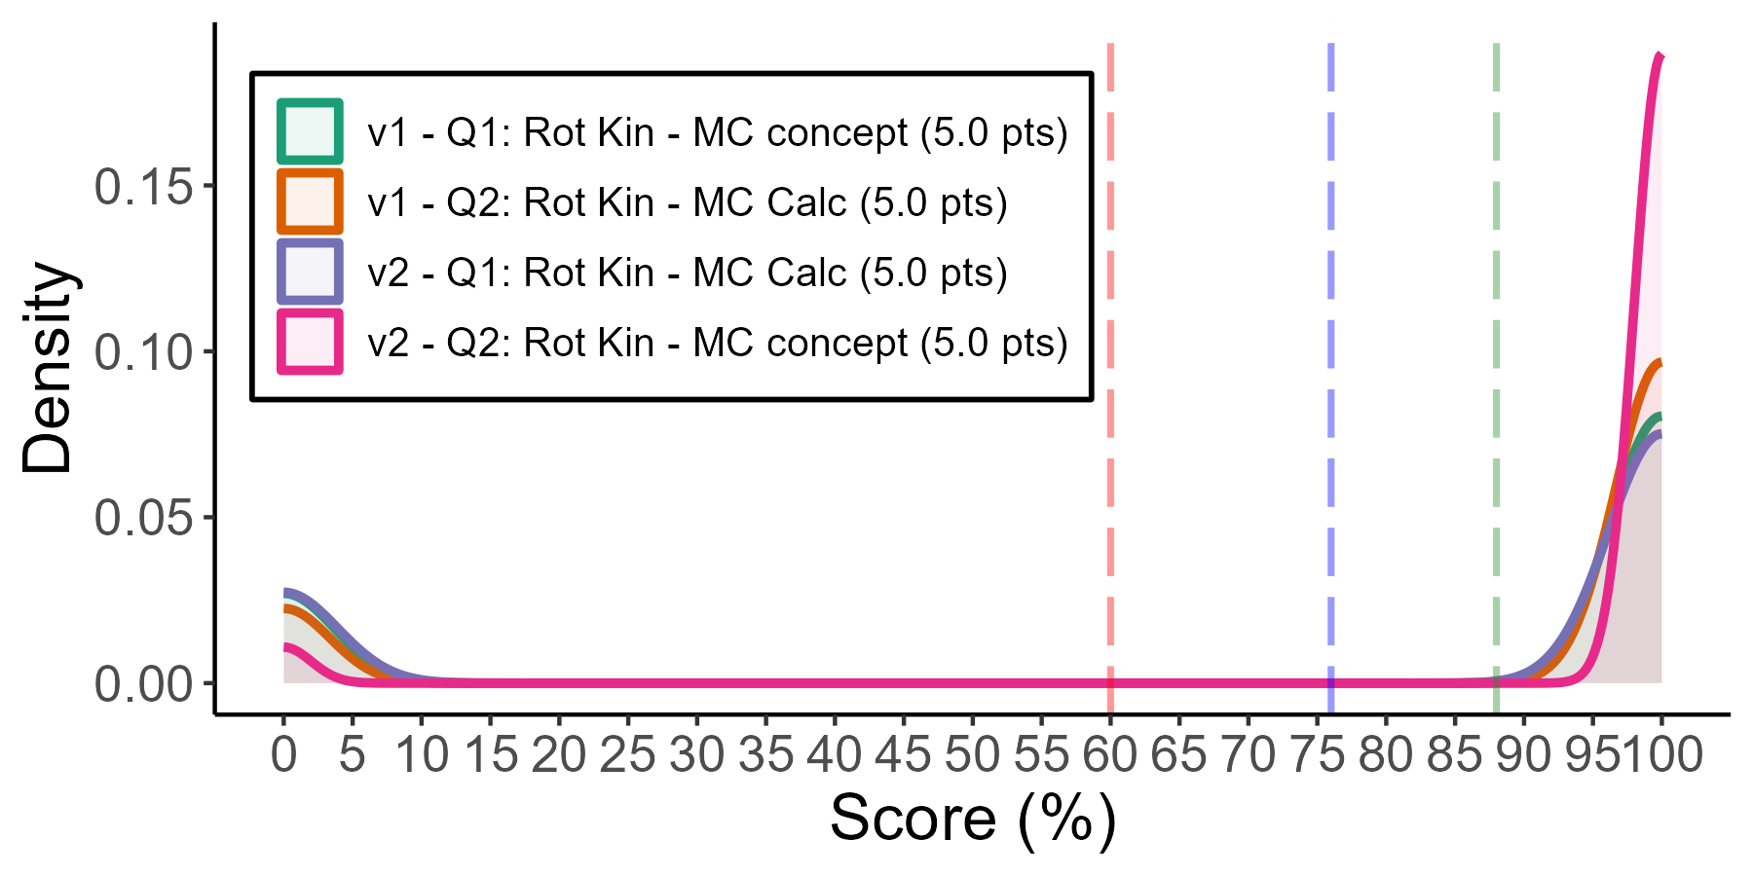
Rot-Kin - Multiple Choice
# | Pts | Cut | Applied (%)
V2 - Q2 | 0 | Correct (D) | 95
V1 - Q2 | 0 | Correct (Option D) | 81
V1 - Q1 | 0 | Correct (Option C) | 75
V2 - Q1 | 0 | Correct (A) | 74
V1 - Q1 | 5 | Incorrect (Option A | 25
V2 - Q1 | 5 | Incorrect (B) | 18
 | F | D | C- | C | C+ | B- | B | B+ | A- | A | A+
v1 | 140 | 0 | 0 | 0 | 0 | 0 | 0 | 0 | 0 | 0 | 496
v2 | 89 | 0 | 0 | 0 | 0 | 0 | 0 | 0 | 0 | 0 | 465
version | Count | Mean | SD | # D/F's | # A's
v1 | 636 | 78.0 | 41.5 | 140 (22%) | 496 (78%)
v2 | 554 | 83.9 | 36.8 | 89 (16%) | 465 (84%)

Slide 3
Rot-Kin - Multiple Choice
 | F | D | C- | C | C+ | B- | B | B+ | A- | A | A+
v1 | 140 | 0 | 0 | 0 | 0 | 0 | 0 | 0 | 0 | 0 | 496
v2 | 89 | 0 | 0 | 0 | 0 | 0 | 0 | 0 | 0 | 0 | 465
version | Count | Mean | SD | # D/F's | # A's
v1 | 636 | 78.0 | 41.5 | 140 (22%) | 496 (78%)
v2 | 554 | 83.9 | 36.8 | 89 (16%) | 465 (84%)

Slide 4
Rot-Kin - Multiple Choice
# | Pts | Cut | Applied (%)
V2 - Q2 | 0 | Correct (D) | 95
V1 - Q2 | 0 | Correct (Option D) | 81
V1 - Q1 | 0 | Correct (Option C) | 75
V2 - Q1 | 0 | Correct (A) | 74
V1 - Q1 | 5 | Incorrect (Option A | 25
V2 - Q1 | 5 | Incorrect (B) | 18
 | F | D | C- | C | C+ | B- | B | B+ | A- | A | A+
v1 | 140 | 0 | 0 | 0 | 0 | 0 | 0 | 0 | 0 | 0 | 496
v2 | 89 | 0 | 0 | 0 | 0 | 0 | 0 | 0 | 0 | 0 | 465
version | Count | Mean | SD | # D/F's | # A's
v1 | 636 | 78.0 | 41.5 | 140 (22%) | 496 (78%)
v2 | 554 | 83.9 | 36.8 | 89 (16%) | 465 (84%)

Slide 5
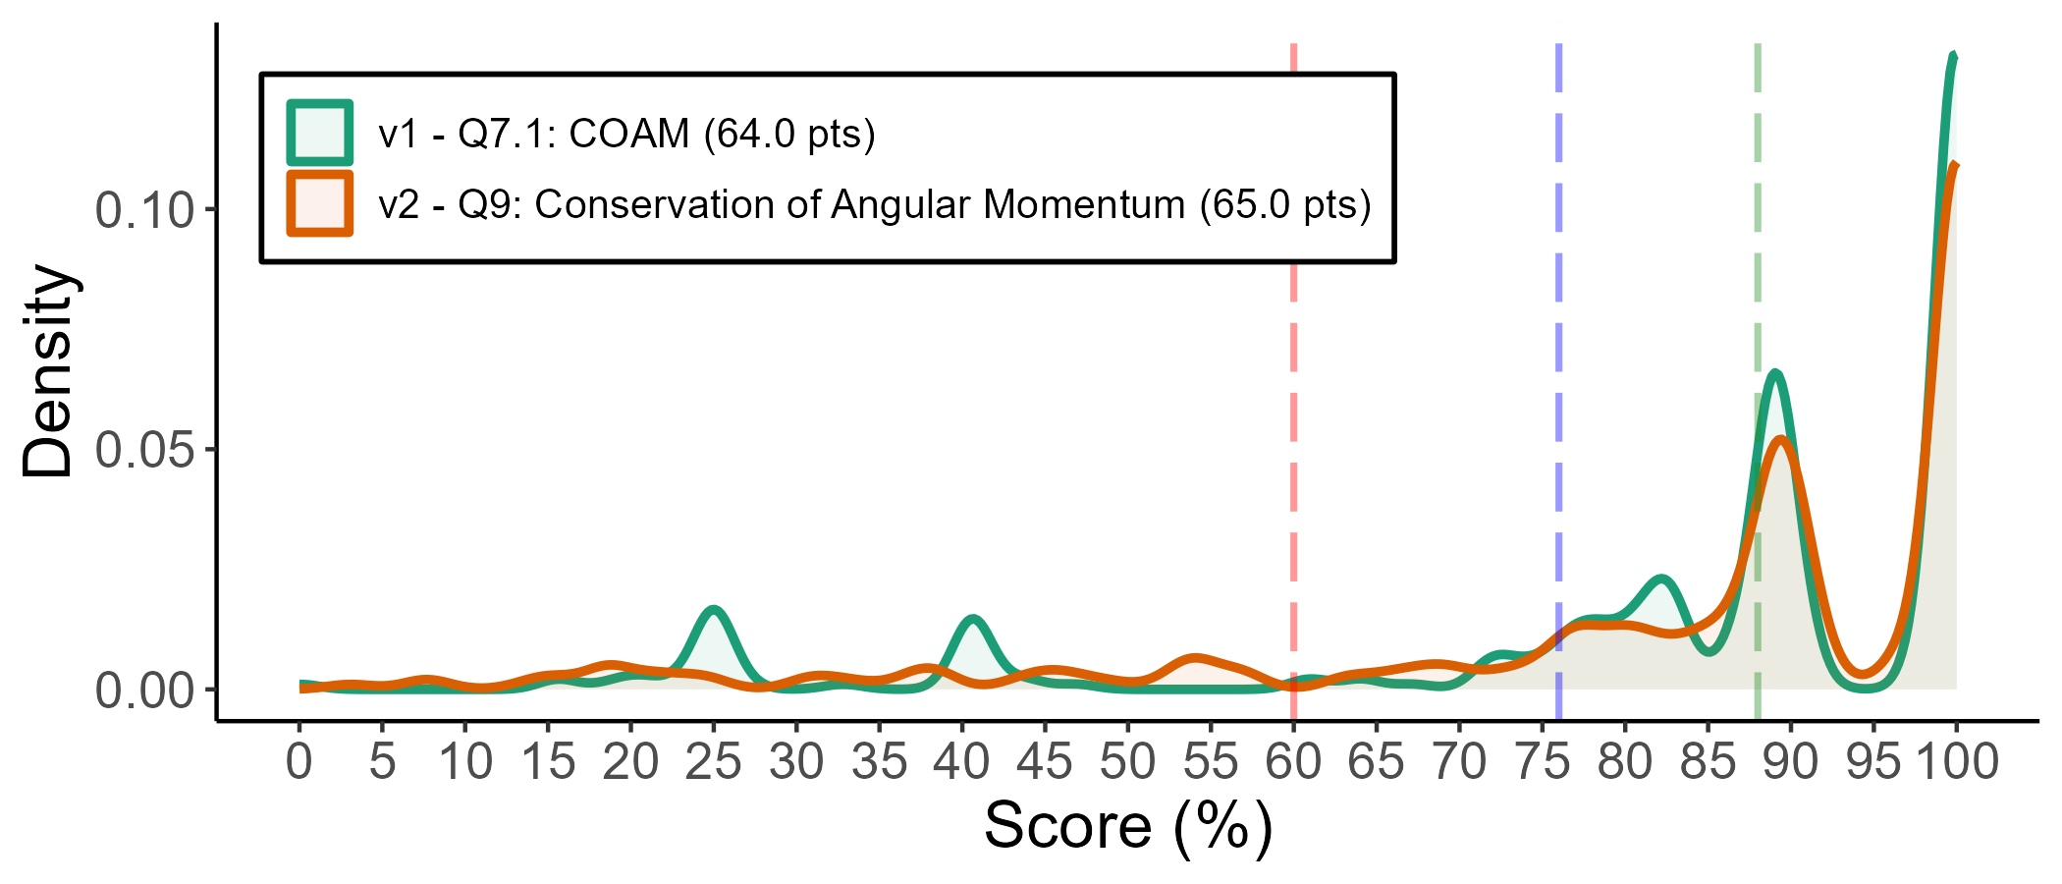
COAM
# | Pts | Cut | Applied (%)
V2 - Q5 | 3 | Incorrect Answer | 74
V2 - Q9 | 6 | Answer: Incorrect Answer | 57
V1 - Q7.1 | 6 | Answer: Incorrect Answer | 49
V2 - Q5 | 1 | Incorrect units or SF | 45
V2 - Q9 | 0 | Correct Answer | 39
V1 - Q7.1 | 0 | Correct Answer | 38
V2 - Q9 | 1 | Key Terms - Final State: Combined Objects: Incorrect | 30
V2 - Q9 | 1 | Key Terms - Initial State: Initial B: Incorrect sign | 29
V1 - Q7.1 | 1 | Key Terms - Initial State: Initial B: Incorrect sign | 26
V2 - Q9 | 2 | Answer: Incorrect Units or SF | 22
V1 - Q7.1 | 5 | Applications: Incorrect moment of inertia applied | 21
V2 - Q5 | 0 | Correct Answer | 20
V2 - Q9 | 5 | Applications: Incorrect moment of inertia applied | 19
V2 - Q9 | 1 | Key Terms - Initial State: Initial B: Incorrect term | 18
V1 - Q7.1 | 1 | Key Terms - Final State: Combined Objects: Incorrect | 18
V2 - Q9 | 1 | Key Terms - Final State: Combined Objects: Incorrect Sign | 18
V2 - Q9 | 1 | Key Terms - Initial State: Initial A: Incorrect term | 17
V2 - Q5 | 3 | Does not attempt algebraic solution | 17
V1 - Q7.1 | 1 | Answer: Incorrect SF 3SF | 16
V2 - Q9 | 2 | Key Terms - Final State: Combined Objects: Not Present | 16
V2 - Q5 | 3 | No Cross Product $$l = r p \sin(\theta)$$ | 16
 | F | D | C- | C | C+ | B- | B | B+ | A- | A | A+
v1 | 42 | 2 | 3 | 5 | 6 | 21 | 26 | 14 | 65 | 0 | 134
v2 | 42 | 2 | 5 | 4 | 7 | 12 | 16 | 21 | 53 | 1 | 114
version | Count | Mean | SD | # D/F's | # A's
v1 | 318 | 83.6 | 22.8 | 44 (14%) | 199 (63%)
v2 | 277 | 83.0 | 23.1 | 44 (16%) | 168 (61%)

