Slide 1
PH2X1: WPR 2 Grade Brief

Slide 2
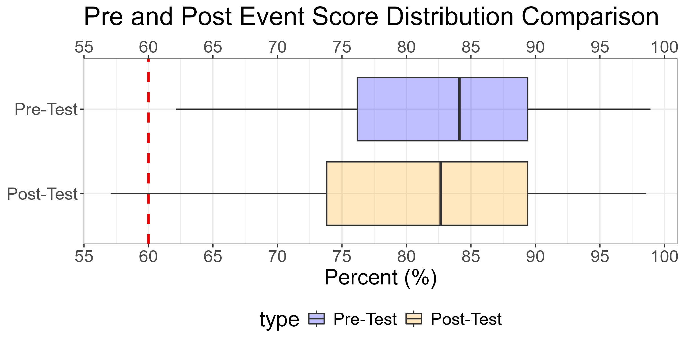
Pre/Post Course Score Comparisons
Grade | F | D | C- | C | C+ | B- | B | B+ | A- | A | A+
Pre Count | 0 | 2 | 17 | 15 | 22 | 19 | 32 | 8 | 33 | 40 | 16
Post Count | 2 | 10 | 13 | 19 | 19 | 16 | 28 | 8 | 36 | 36 | 17
Percent Change% | Inf% | 400% | -24% | 27% | -14% | -16% | -12% | 0% | 9% | -10% | 6%
PRE D/F's: | PRE D/F's: | PRE D/F's: | 2 (1%) | 2 (1%) | 2 (1%) | PRE A's: | PRE A's: | PRE A's: | 89 (43.6%) | 89 (43.6%) | 89 (43.6%)
POST D/F's: | POST D/F's: | POST D/F's: | 12 (6%) | 12 (6%) | 12 (6%) | POST A's: | POST A's: | POST A's: | 89 (44%) | 89 (44%) | 89 (44%)
Type | Number | Average | Median | Min | Max
Pre | 204 | 82.7 | 84.1 | 62.1 | 98.9
Post | 204 | 81.2 | 82.7 | 57.1 | 98.6

Slide 3
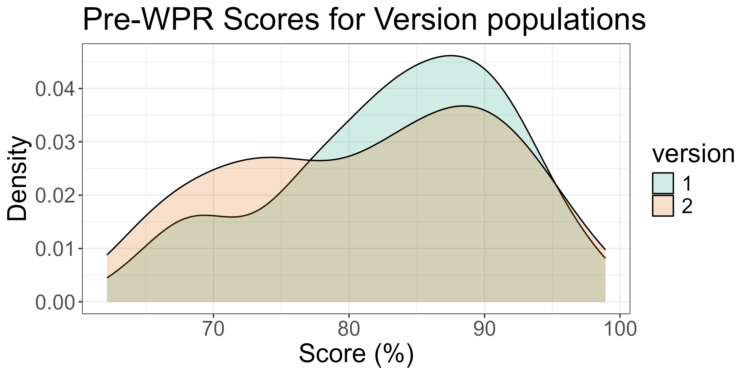
Pre Score Comparisons between versions
version | Count | Mean (%) | Median (%) | Std. Dev (%) | # D/F's | # A's
1 | 133 | 83.3 | 84.4 | 8.5 | 1 (1%) | 46 (35%)
2 | 71 | 81.6 | 82.8 | 9.6 | 1 (1%) | 24 (34%)
Method | result | t_value | p_value
Welch Two Sample t-test | difference in means between group 1 and group 2 | 1.282 | 2.02e-01

Slide 4
Cadets not accounted for in this brief
Cadet Name | Instructor | Section
Garcia, Manuel | MAJ Taylor Bruff | A1B1
Harris, Oliver | MAJ Taylor Bruff | A1B1
Yousefzadeh, Christian | LTC Jacob Capps | A1B1
Lyons, Gage | MAJ Taylor Bruff | A2B2
Mc Cann, Kota | LTC Jacob Capps | A2B2
Rhodes, Owen | CPT Erin Norton & Dr Michael Pfenning | A2B2
Curry, Ryan | MAJ David Simeroth | C1D1
Slivka, Bethany | MAJ David Simeroth | C1D1
Abalos, Leilani | CPT Kevin Filip | E1F1
Enman, Jake | CPT Kevin Filip | E1F1
Creedican, Grant | CPT Kevin Filip | E1F1
Benson, Mairead | LTC Brian Holloway & Dr Michael Pfenning | A2B2
Eremita, Nicholas | LTC Brian Holloway & Dr Michael Pfenning | A2B2

Slide 5
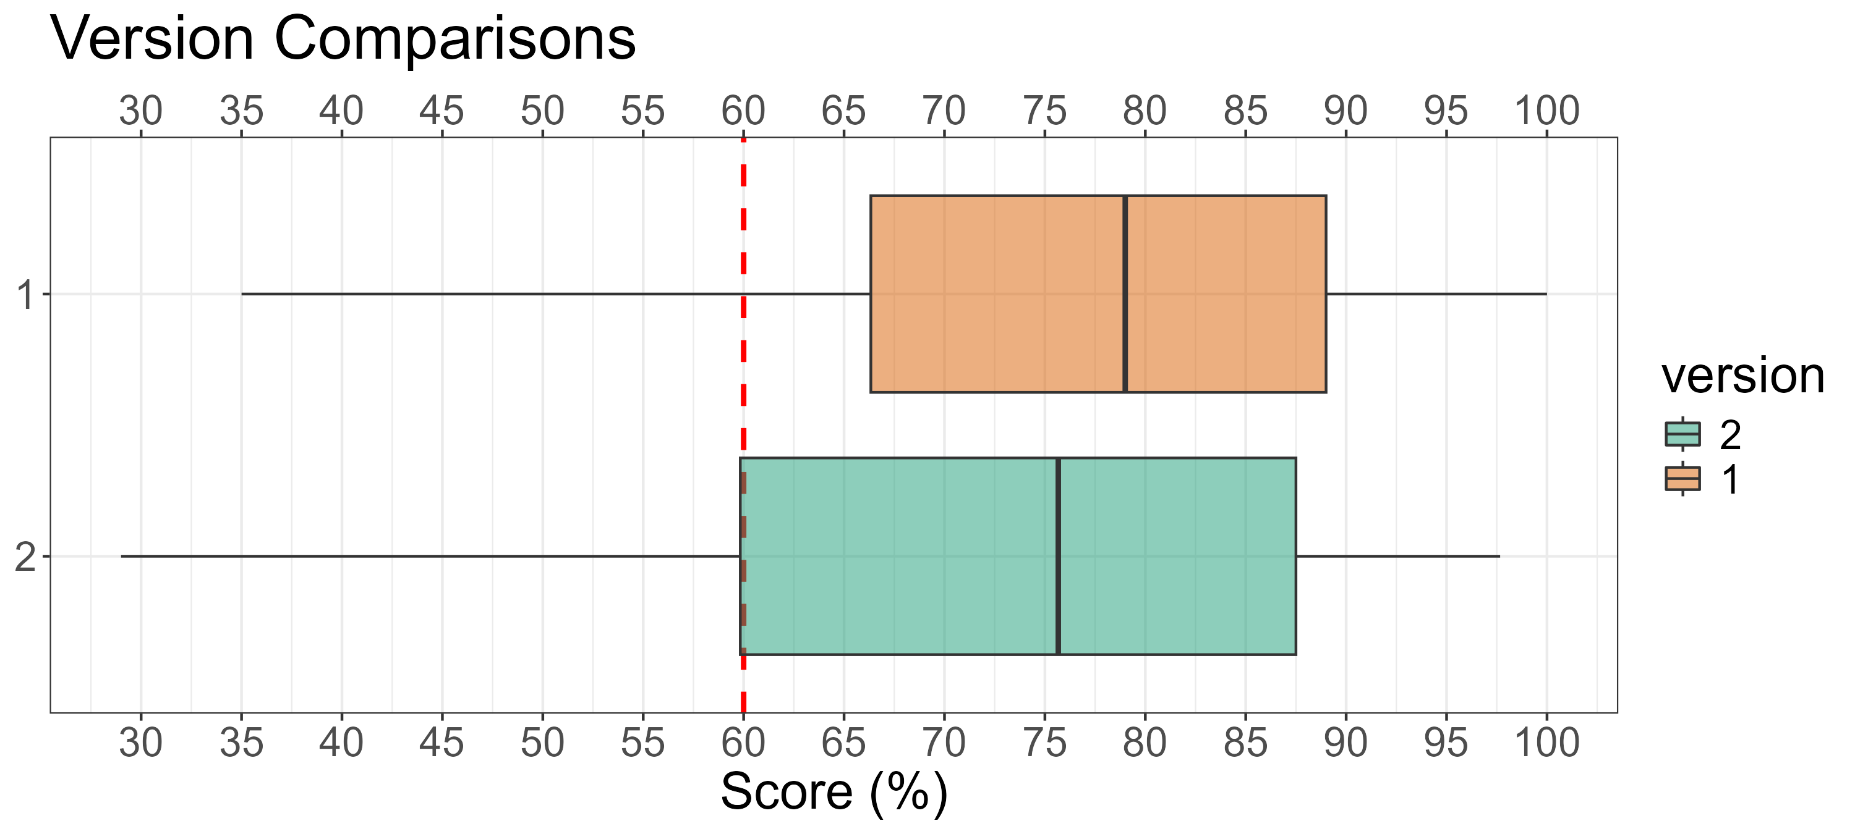
WPR 2 Version Comparisons
version | Count | Mean (%) | Median (%) | Std. Dev (%) | Min (%) | Max (%) | # D/F's | # A's
1 | 133 | 76.1 | 79.0 | 15.8 | 35.0 | 100.0 | 31 (23%) | 38 (29%)
2 | 71 | 71.7 | 75.7 | 18.0 | 29.0 | 97.7 | 21 (30%) | 18 (25%)

Slide 6
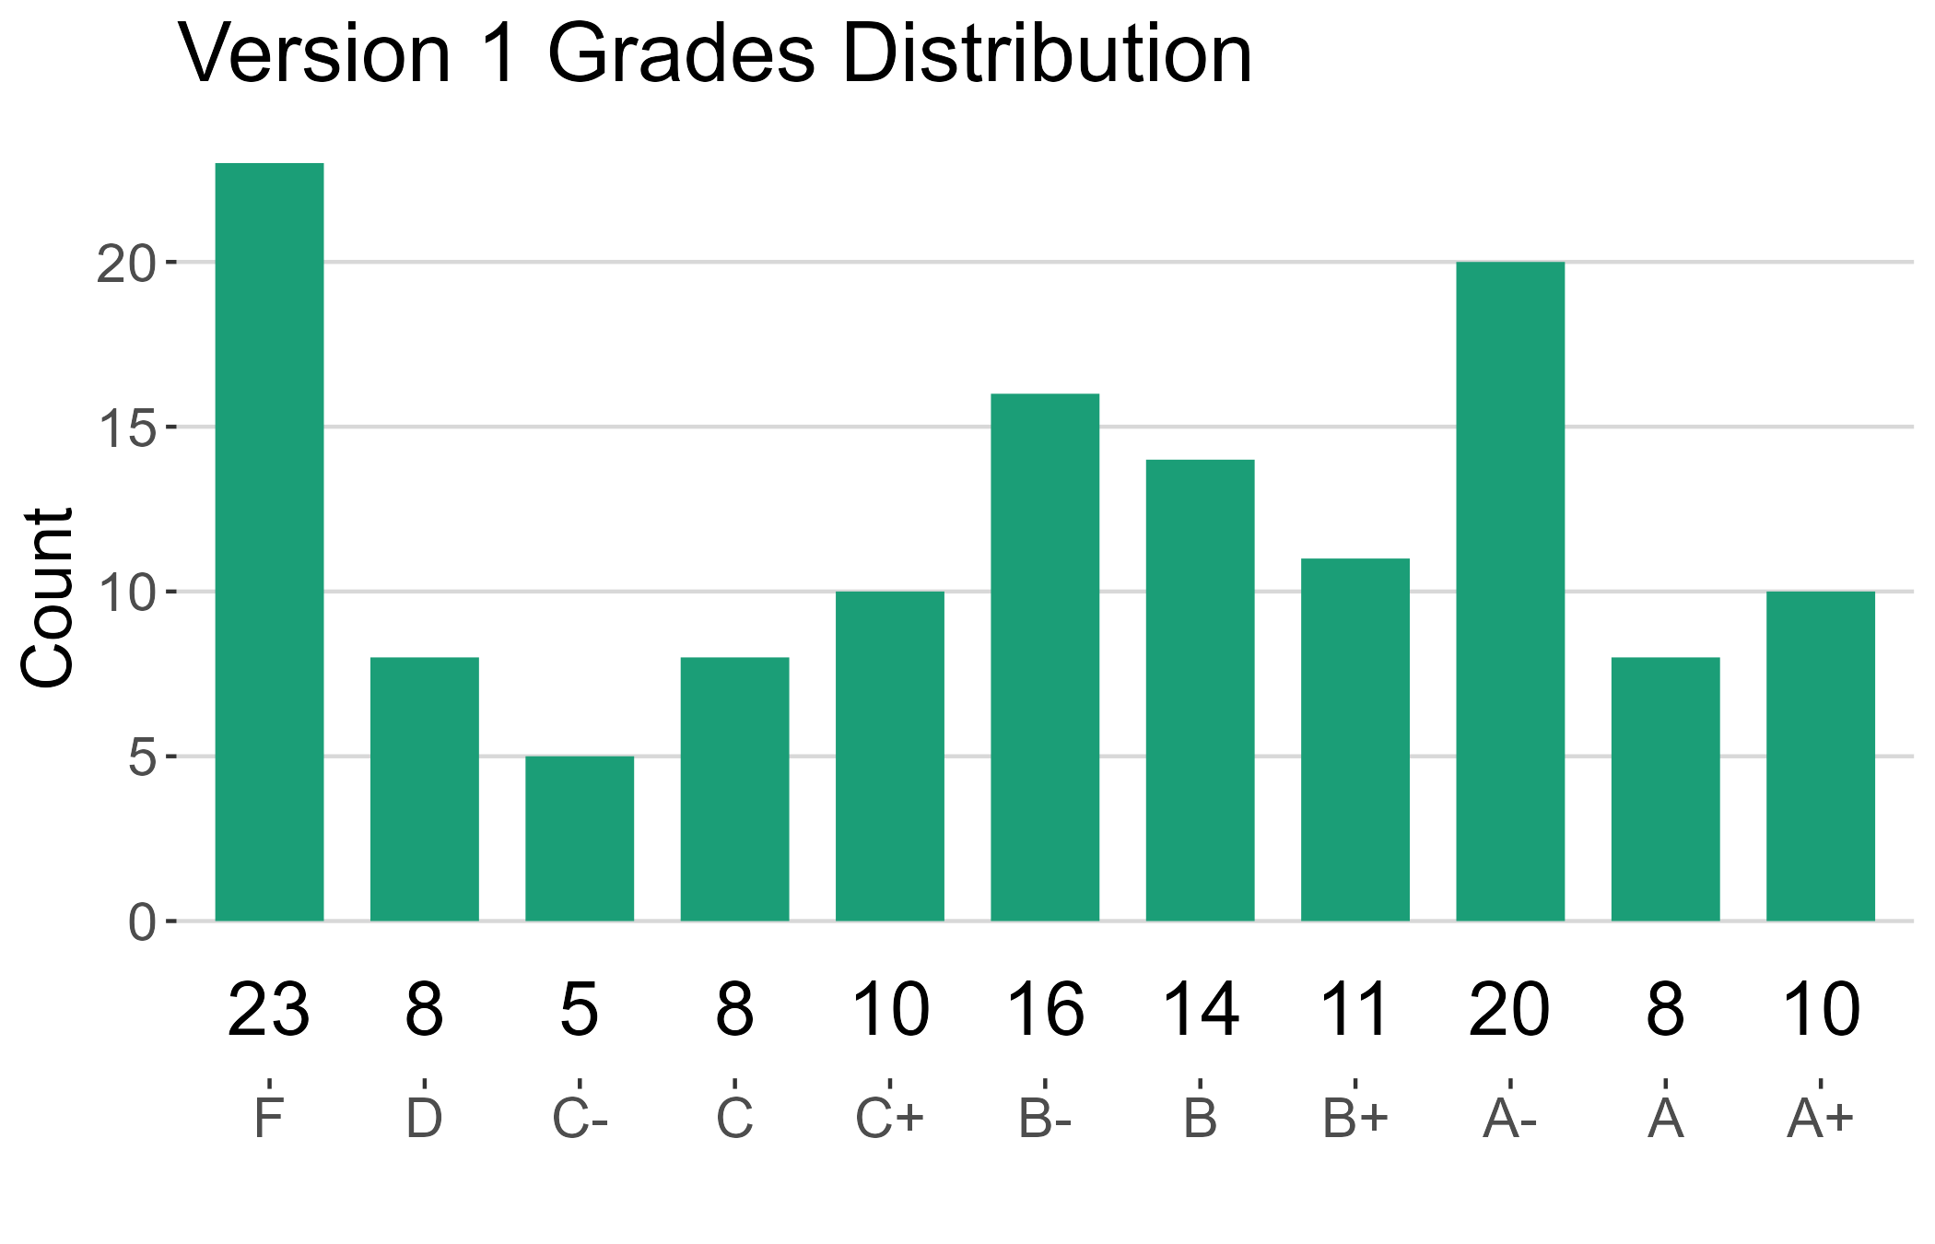
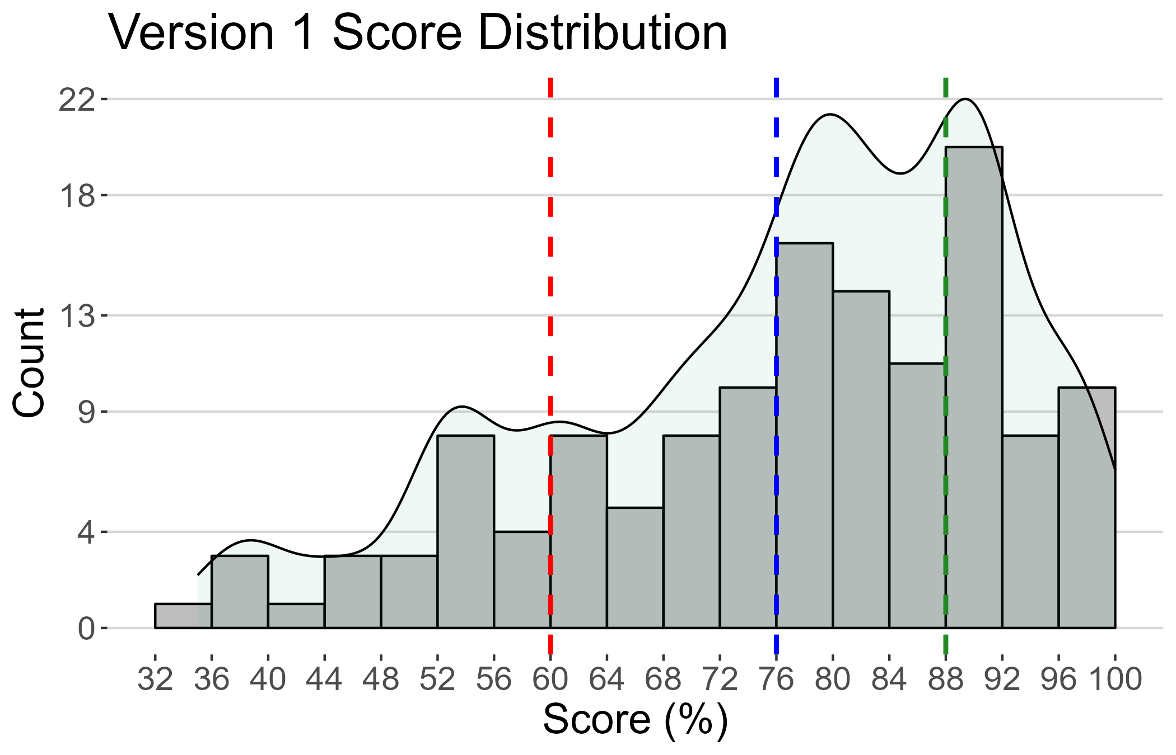
Version 1 Summary
version | Count | Mean (%) | Median (%) | Std. Dev (%) | Min (%) | Max (%) | # D/F's | # A's

Slide 7
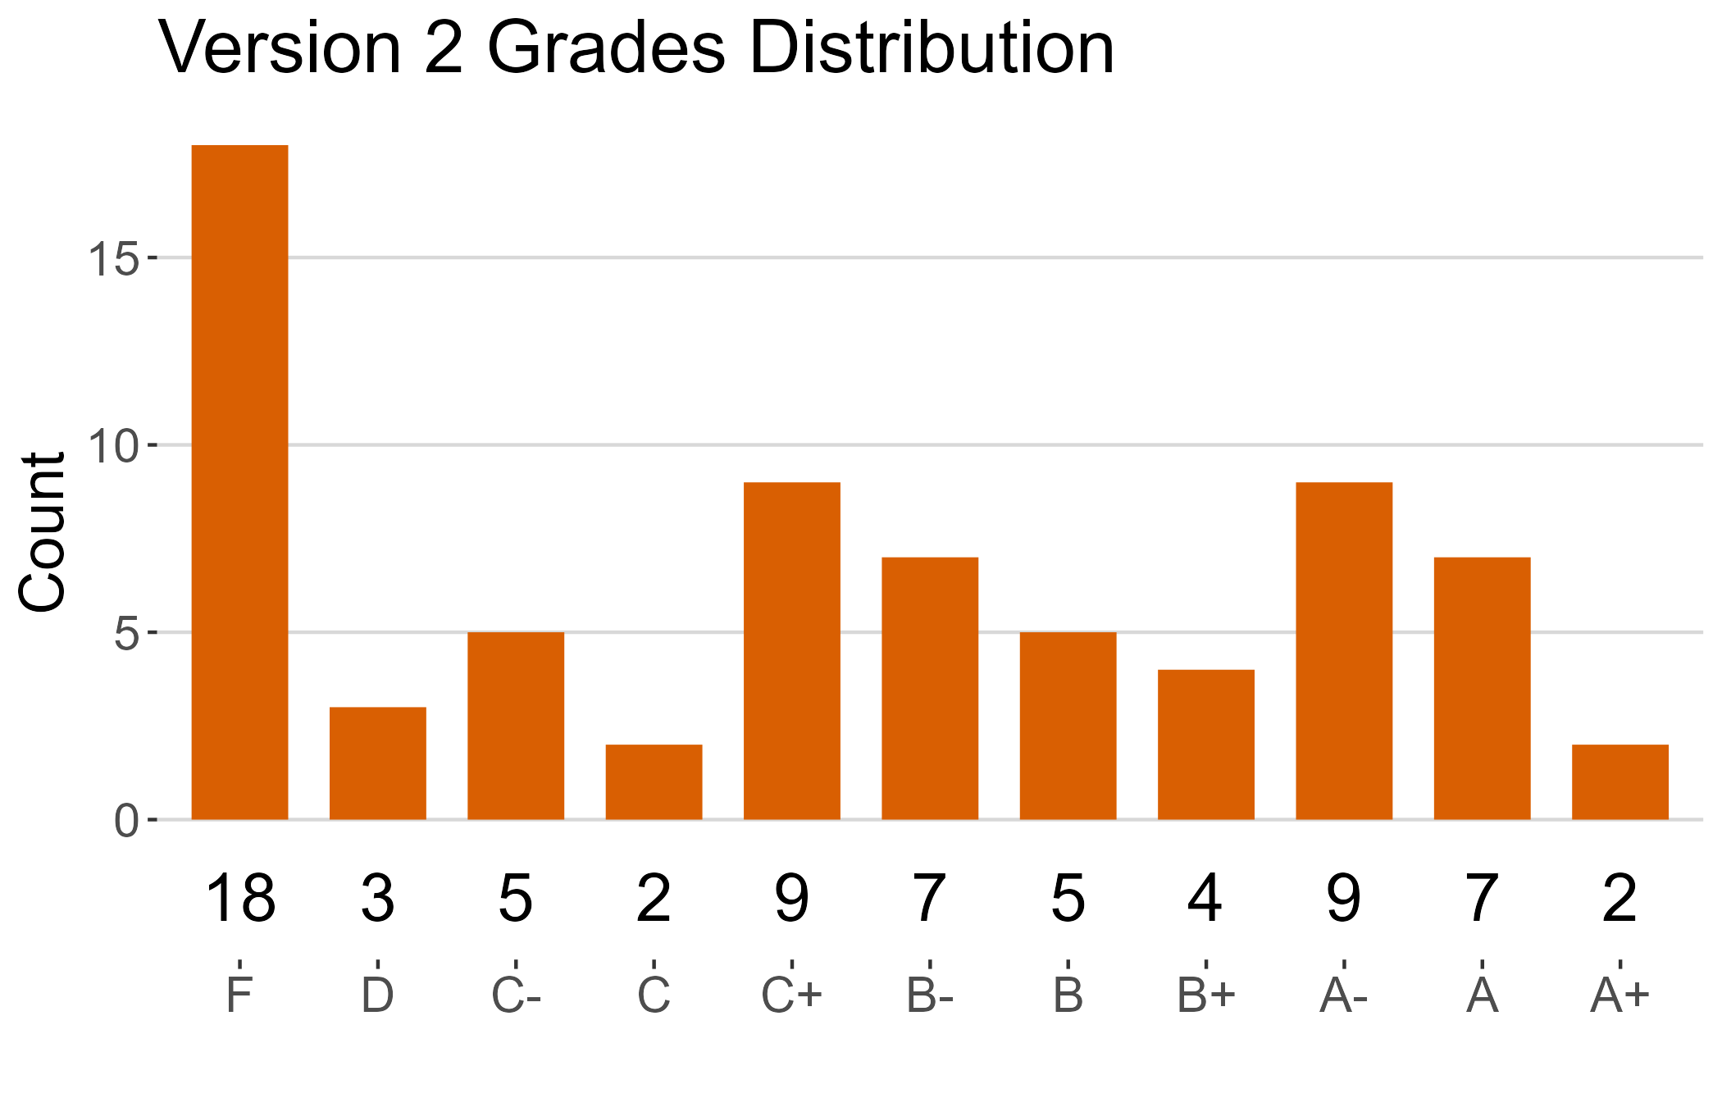
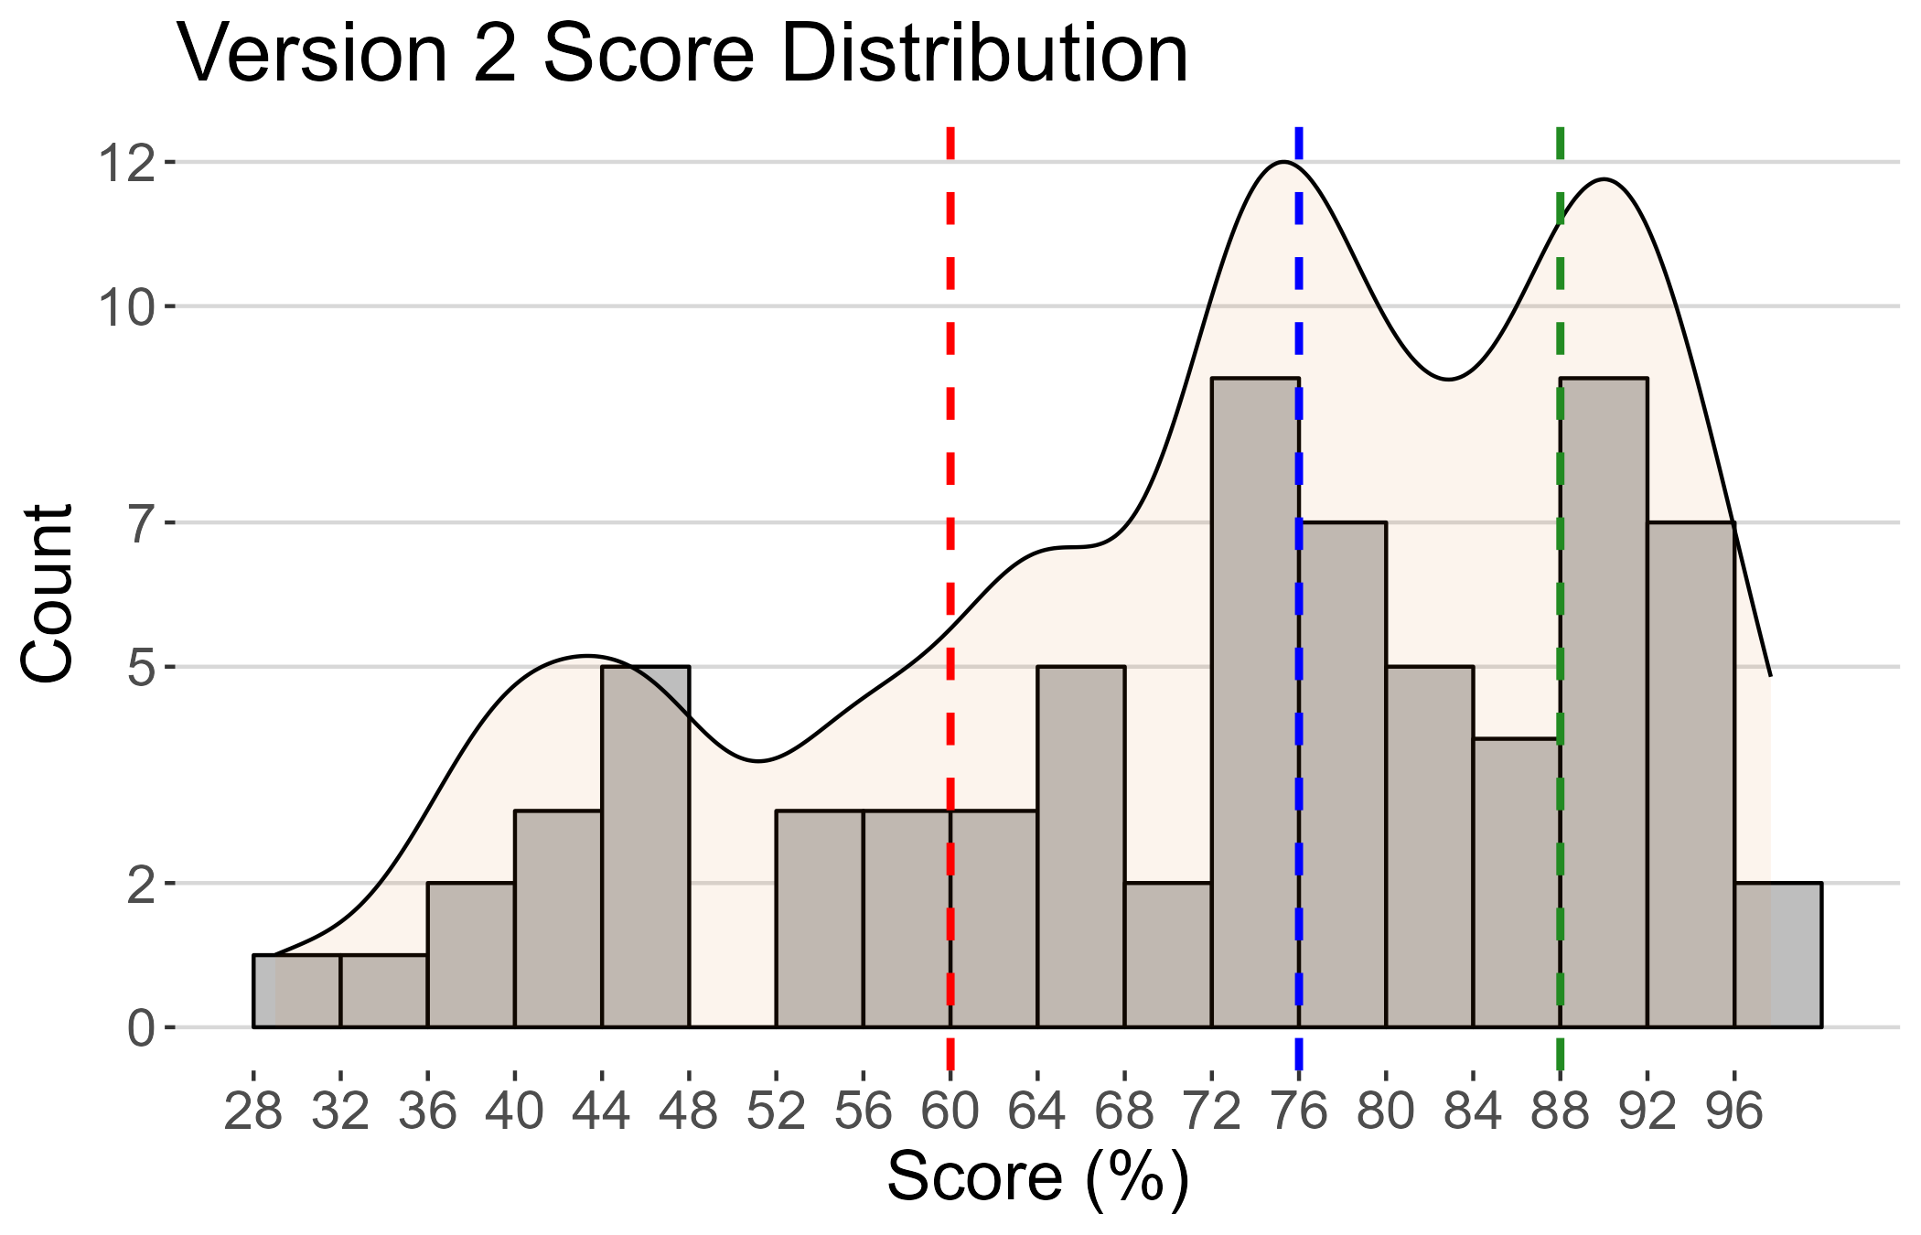
Version 2 Summary
version | Count | Mean (%) | Median (%) | Std. Dev (%) | Min (%) | Max (%) | # D/F's | # A's

Slide 8
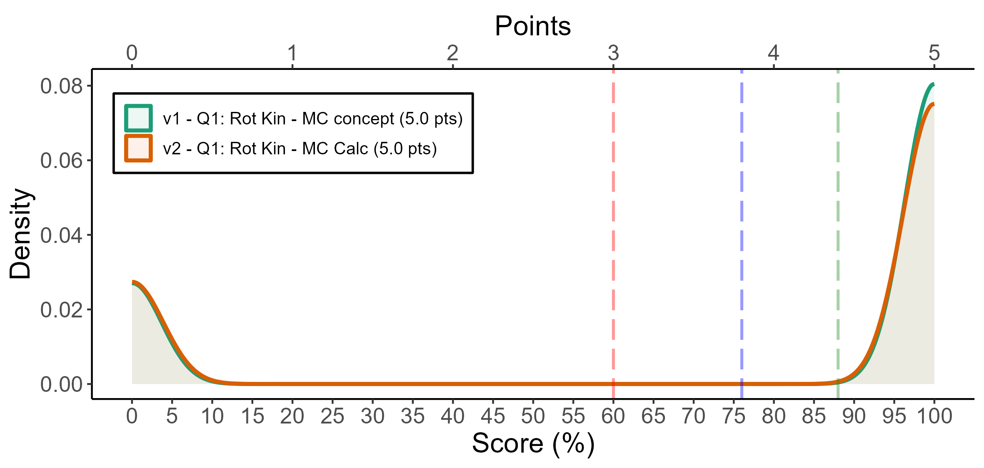
1
 | F | D | C- | C | C+ | B- | B | B+ | A- | A | A+
v1 | 80 | 0 | 0 | 0 | 0 | 0 | 0 | 0 | 0 | 0 | 238
v2 | 74 | 0 | 0 | 0 | 0 | 0 | 0 | 0 | 0 | 0 | 203
# | Pts | Cut | Applied (%)
V2 - Q2 | 0 | Correct (D) | 95
V1 - Q2 | 0 | Correct (Option D) | 81
V1 - Q1 | 0 | Correct (Option C) | 75
V2 - Q1 | 0 | Correct (A) | 74
V1 - Q1 | 5 | Incorrect (Option A | 25
V2 - Q1 | 5 | Incorrect (B) | 18
version | Count | Mean | SD | # D/F's | # A's
v1 | 318 | 74.8 | 43.5 | 80 (25%) | 238 (75%)
v2 | 277 | 73.3 | 44.3 | 74 (27%) | 203 (73%)

Slide 9
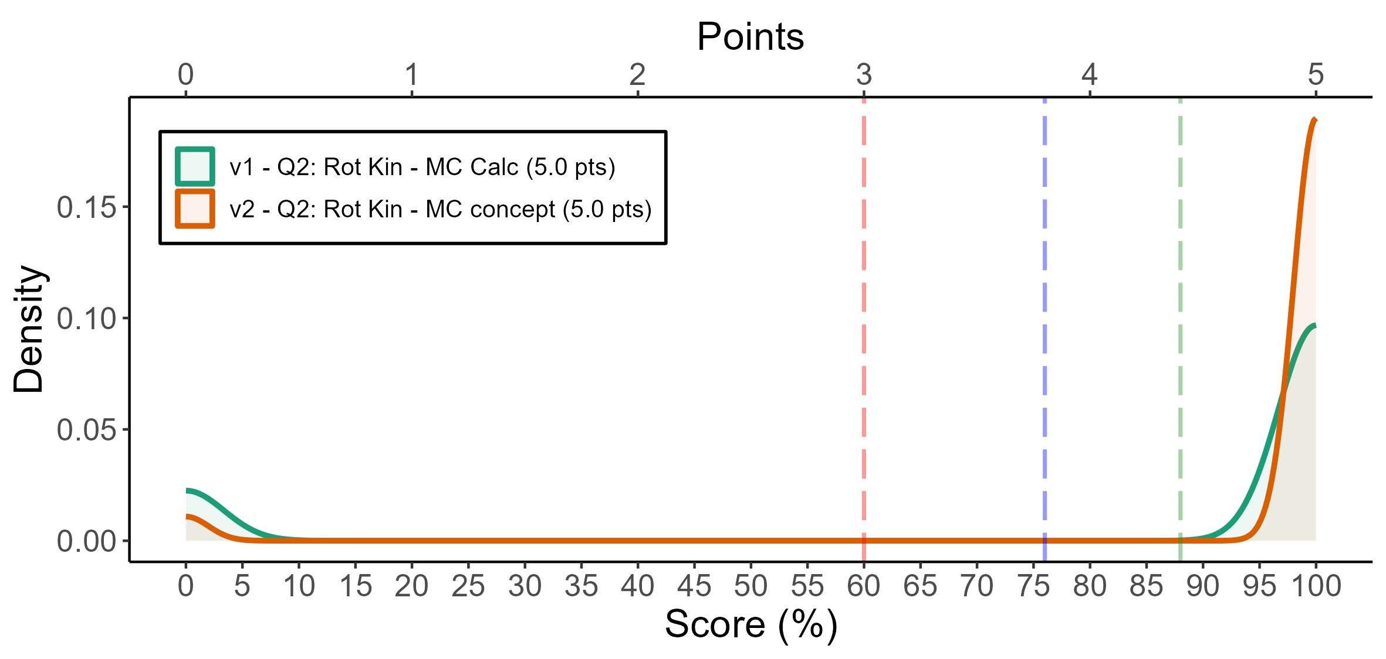
2
 | F | D | C- | C | C+ | B- | B | B+ | A- | A | A+
v1 | 60 | 0 | 0 | 0 | 0 | 0 | 0 | 0 | 0 | 0 | 258
v2 | 15 | 0 | 0 | 0 | 0 | 0 | 0 | 0 | 0 | 0 | 262
# | Pts | Cut | Applied (%)
V2 - Q2 | 0 | Correct (D) | 95
V1 - Q2 | 0 | Correct (Option D) | 81
V1 - Q1 | 0 | Correct (Option C) | 75
V2 - Q1 | 0 | Correct (A) | 74
V1 - Q1 | 5 | Incorrect (Option A | 25
V2 - Q1 | 5 | Incorrect (B) | 18
version | Count | Mean | SD | # D/F's | # A's
v1 | 318 | 81.1 | 39.2 | 60 (19%) | 258 (81%)
v2 | 277 | 94.6 | 22.7 | 15 (5%) | 262 (95%)

