Slide 1

Trapping Rain Water
Calculate the total amount of water that can be trapped between the bounds.
Kfir Presenting:

Slide 2


Trapping Rain Water
Calculate the total amount of water that can be trapped between the bounds.

Slide 3

Trapping Rain Water
Calculate the total amount of water that can be trapped between the bounds.
https://leetcode.com/problems/trapping-rain-water/description/

Slide 4

Trapping Rain Water
Calculate the total amount of water that can be trapped between the bounds.

Slide 5
Description..
written left to right.
Given the input list of heights,
Calculate how much water can be trapped
in between the bars.
And do it in O(n) time complexity.

Slide 6

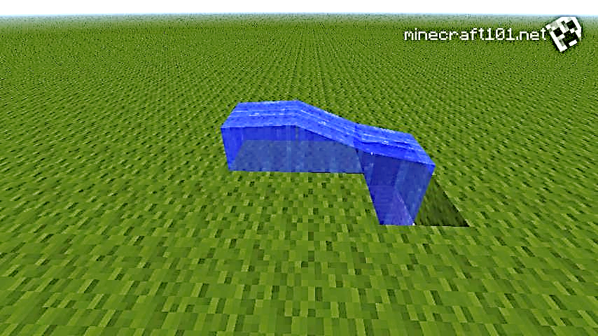
The Idea
From real life
First let’s think about how water works in real life…
In real life water would spill over edges,
but if there is a bounded area,
the water will get trapped in it.

Slide 7
The Idea
From real life
First let’s think about how water works in real life…
In real life water would spill over edges,
but if there is a bounded area,
the water will get trapped in it.
If we pure water from the left of the scene.
The water will fill the deepest regions first,
then the water will fill up to the top.
When the water level reaches the bound.
the water will spill over and will continue to the right.

Slide 8
The Idea
From real life
If we pure water from the left of the scene.
The water will fill the deepest regions first,
then the water will fill up to the top.
When the water level reaches the bound.
the water will spill over and will continue to the right.
First let’s think about how water works in real life…
In real life water would spill over edges,
but if there is a bounded area,
the water will get trapped in it.

Slide 9
Example of a puddle
Next is an example on the input: [5,2,1,3,6]

Slide 10
6
5
3
Right
bound
2
Left
bound
1
Floor
Trapped Water accumulator
0

Slide 11
6
5
3
Right
bound
2
Left
bound
1
Floor
Trapped Water accumulator
0

Slide 12
6
5
3
Right
bound
2
Left
bound
1
1
Floor
Trapped Water accumulator
1

Slide 13
6
5
Left
bound
2
3
Right
bound
2
Floor
1
Trapped Water accumulator
3

Slide 14
6
Right
bound
5
Left
bound
6
3
Floor
2
1
Trapped Water accumulator
9

Slide 15
Example of a spill: [4,5,6,3,2]

Slide 16
Example of a spill: [4,5,6,3,2]
6
5
4
3
2

Slide 17
Example of a spill: [4,5,6,3,2]
6
5
4
3
2

Slide 18
Example of a spill: [4,5,6,3,2]
6
5
4
3
2

Slide 19
The Algorithm (C++)

Slide 20
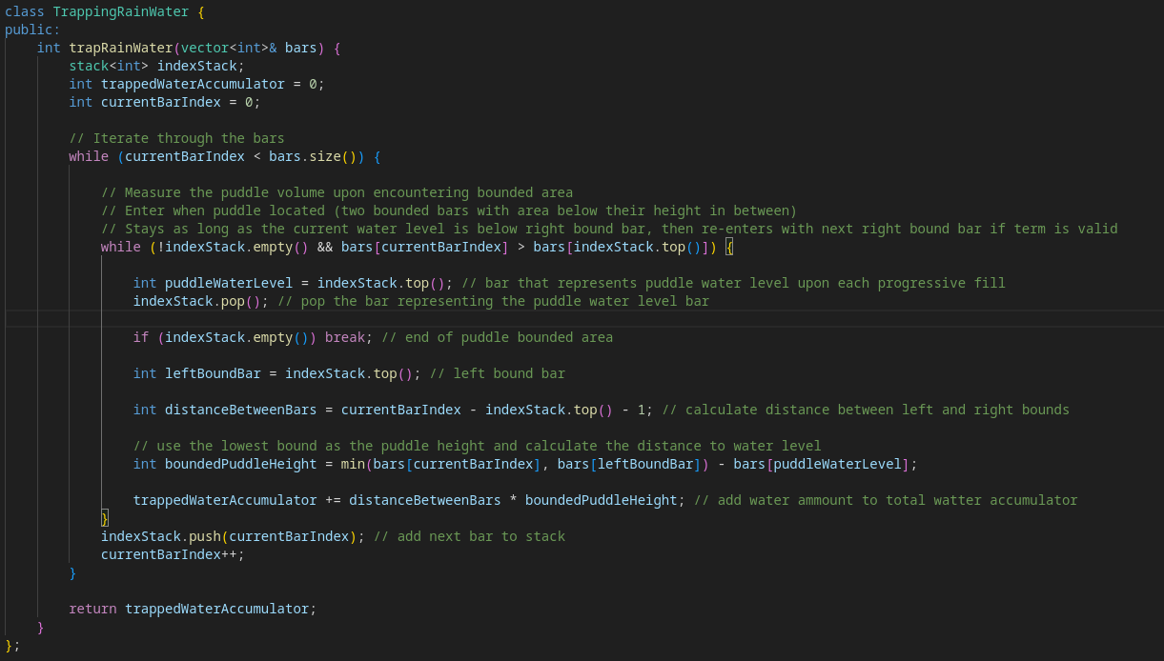

Slide 21
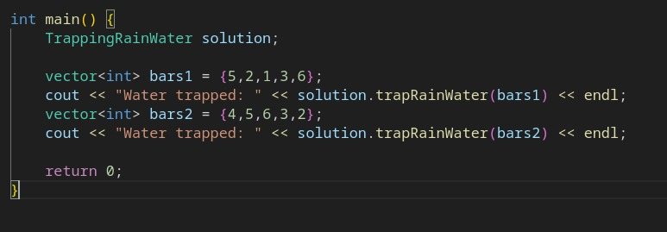


Slide 22
Complexity
The algorithm runs at O(n)
since it performs a limited number of linear actions as the inner while loop is progressing with the outer index iterator while loop.
for each number in the array, we push it once, and pop it ones.
Notes:
על כל עמודה, עושים לה פוש פעם אחת, מחשבים מהגובה שלה שטח מים פעם אחת, ומוציאים אתה פעם אחת.
אז האלגוריתם ליניארי

