Slide 1
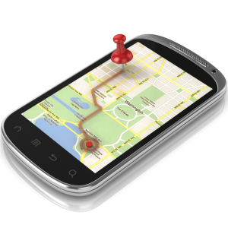
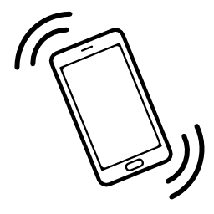
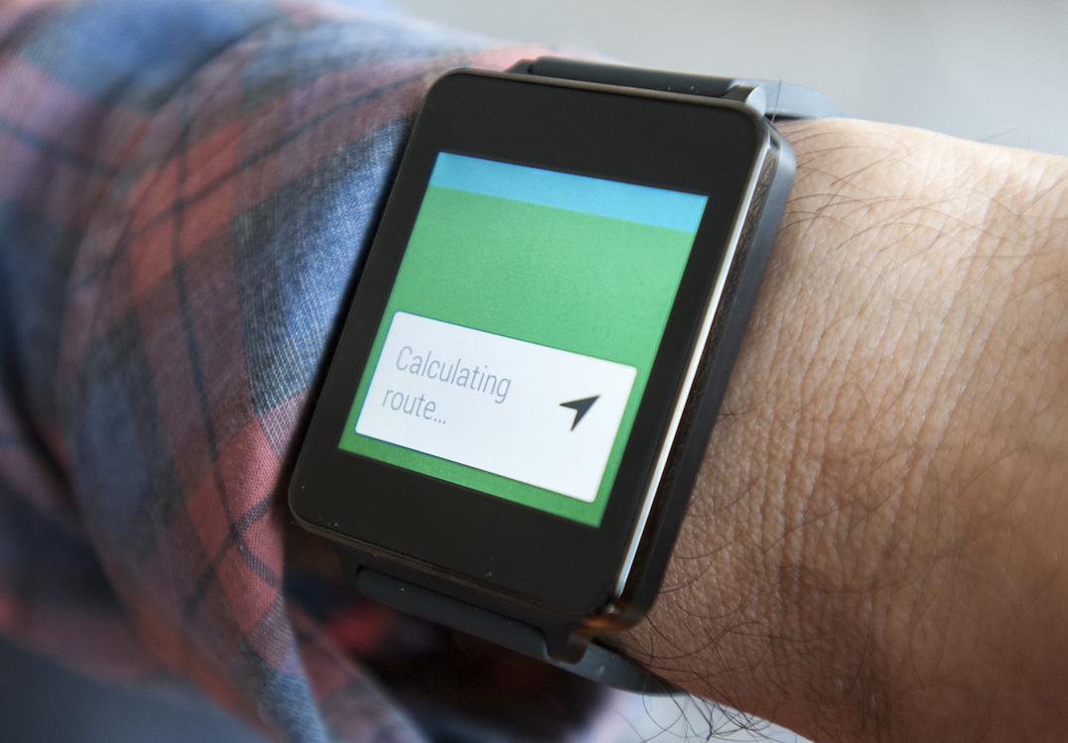
Navigation By Touch
מנחה הפרוייקט: כפיר לב-ארי

Slide 2

Our Team
Hamam Massarweh
Omar Massarweh

Slide 3
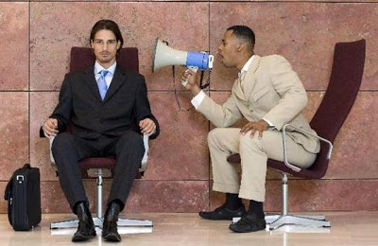
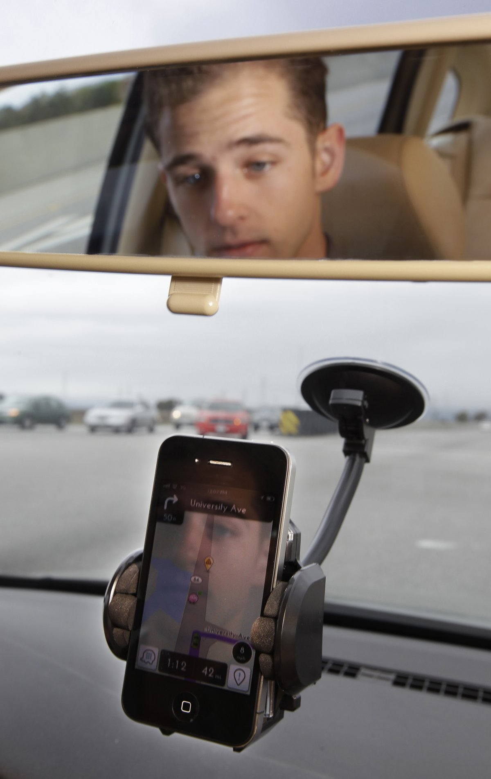
Motivation
Current navigation limitations :
Can’t help deaf people
Distracting
Disturbs conversations
Can’t be used in rainy days

Slide 4
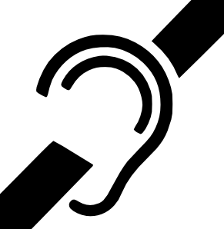

Usages
Usage examples:
Help Deaf people.
keep the phone dry in rainy days.
Communicate freely with other passengers

Slide 5

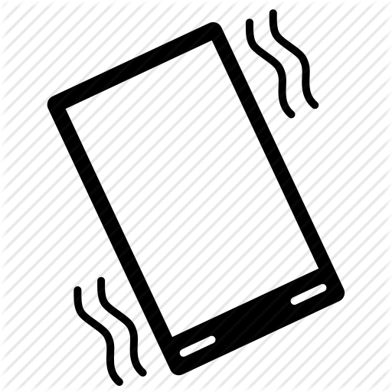

Solution
translates general navigation directives into simple left or right directives.
transmit those directives to vibrated components.
user will be able to navigate by relying on the sense of touch.

Slide 6
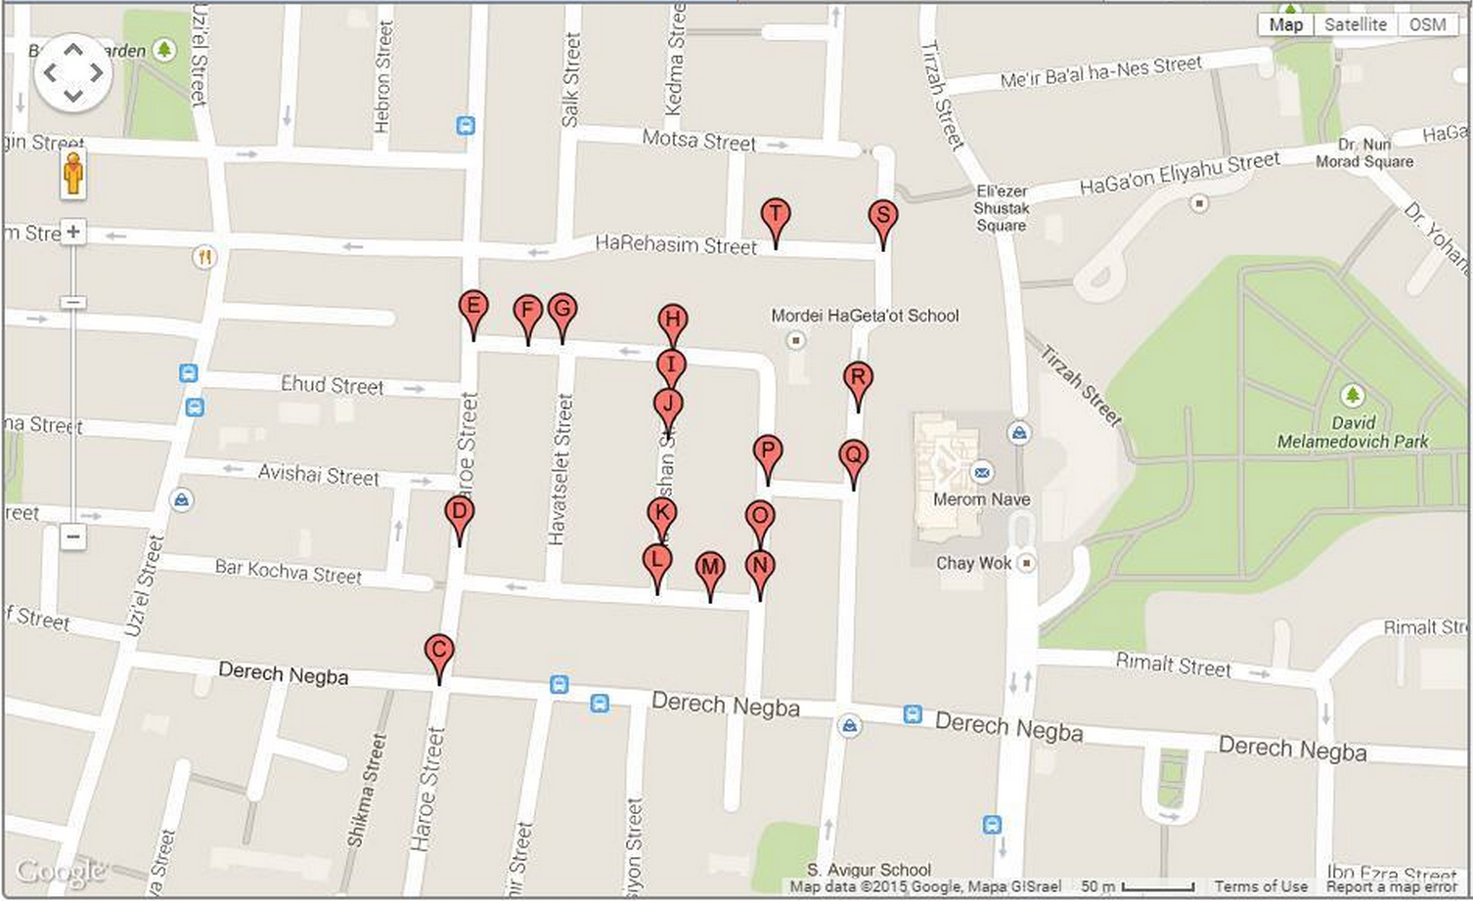
Demo!

Slide 7
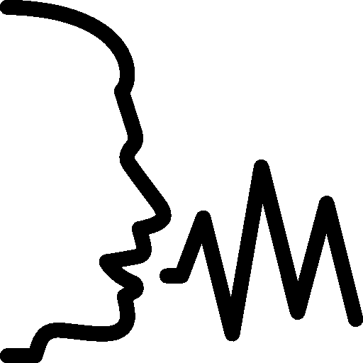
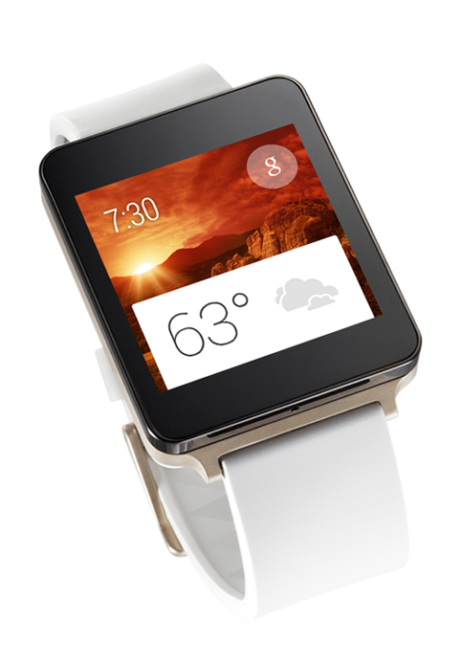
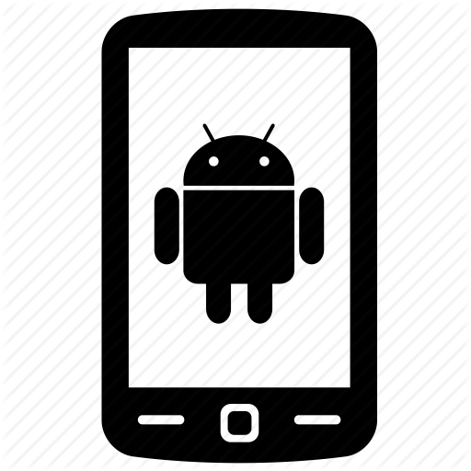
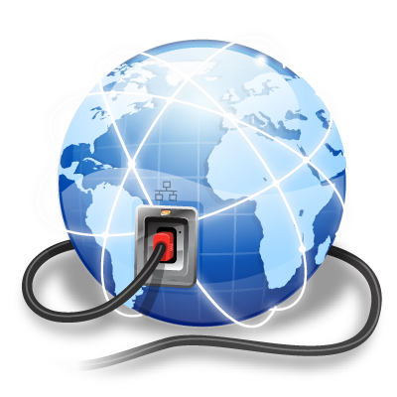
High level design
GPS
calculate path
destination
destination
distance and vibration signals
path
vibrations
calculate distance
Notes:
// TODO(Hamam): add here icons and animation describing how our application works:
The user tells where to go to the Watch
The watch send this to the phone
The phone connects to the internet and calculates the path
The phone keeps receiving GPS location updates, calculates the distance, and sends to Watch
The watch shows the distance, and if it is small it vibrates

Slide 8
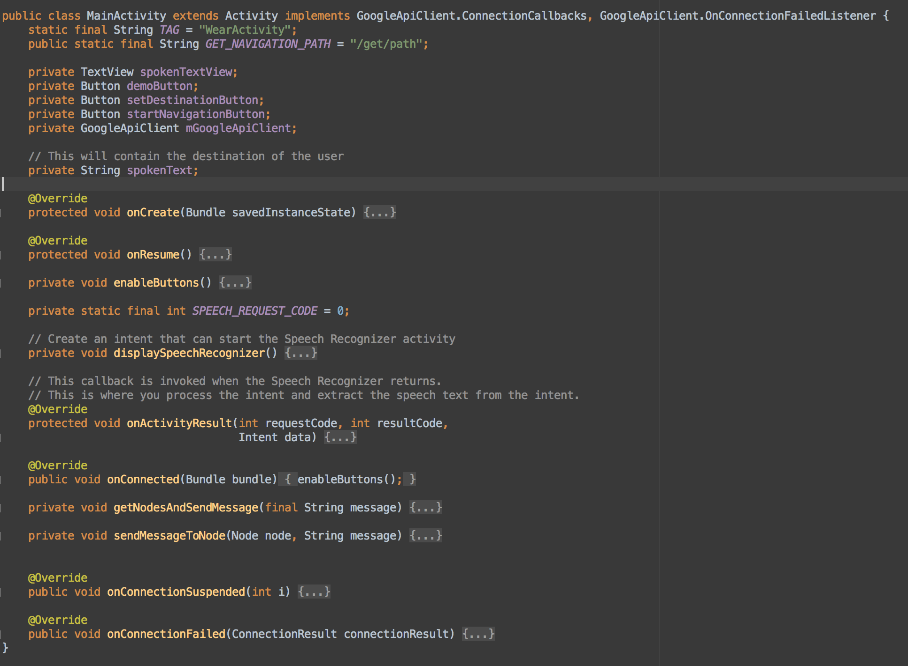
Watch Voice input + sends to the phone
Enable voice input in the wear device
Receive the voice text
Connect to the device and send the voice text

Slide 9
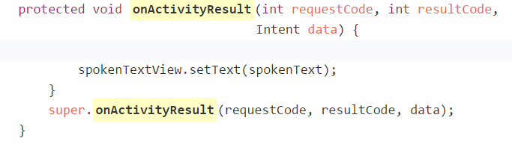
Enables voice input in the wear device :
Receive the voice text :

Slide 10
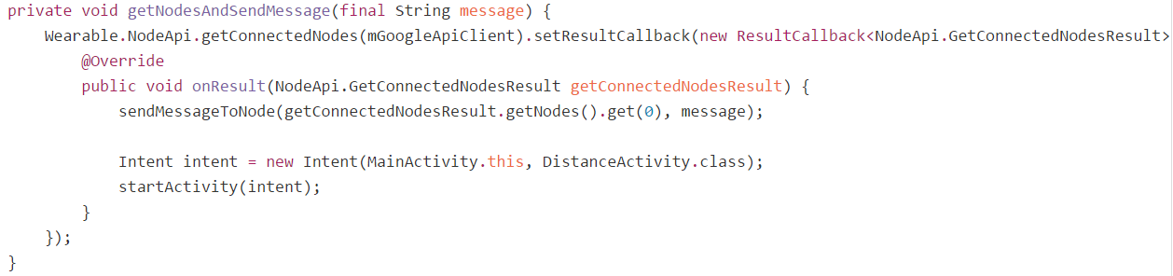
Connect to the device and send the voice text :

Slide 11
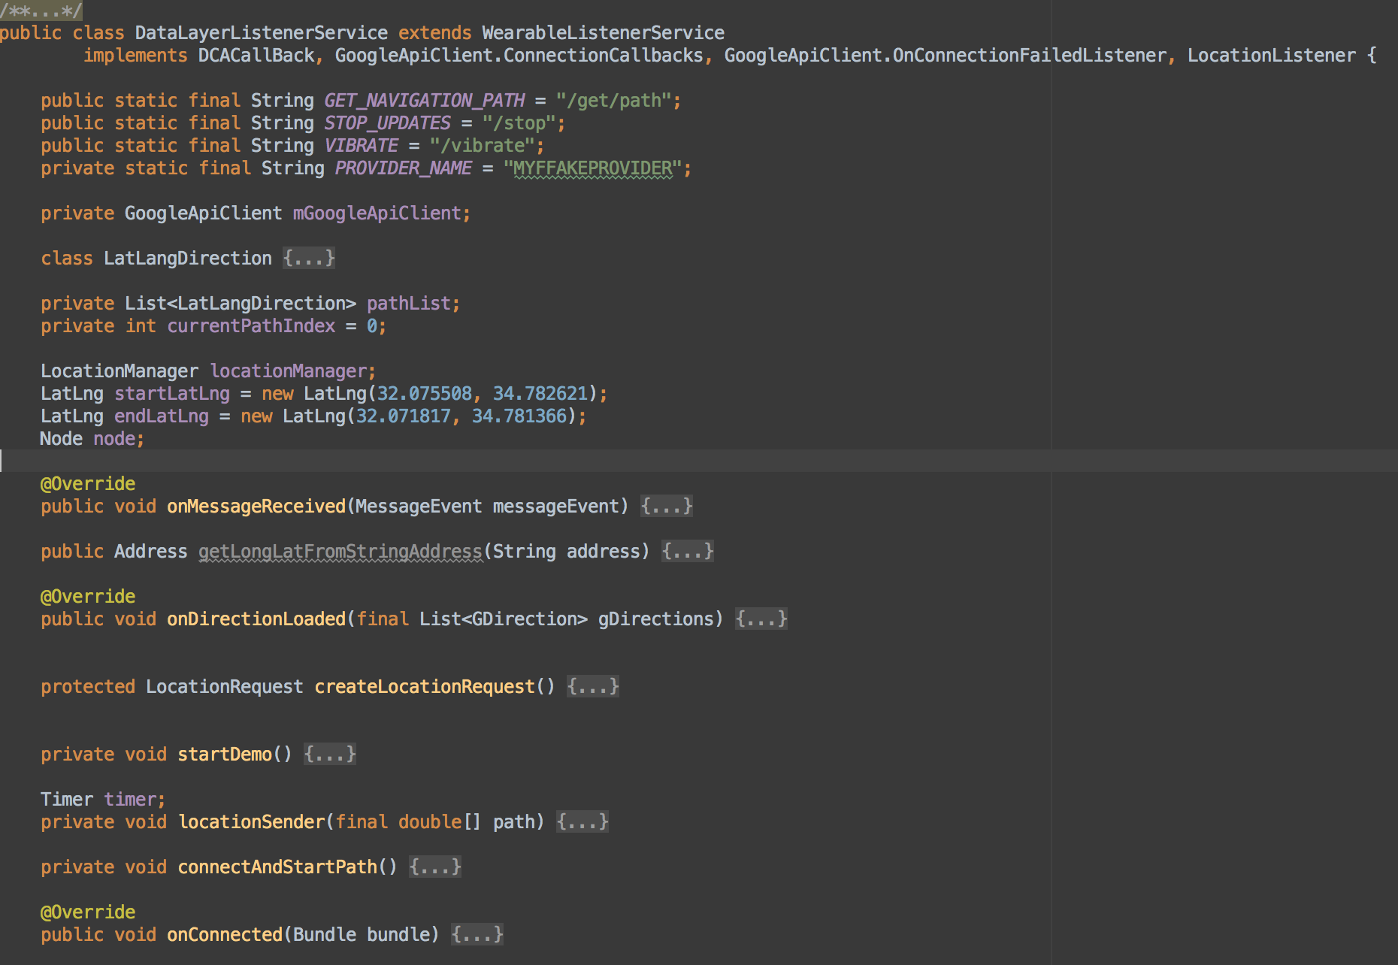
Phone Receive the input and get path
The phone receives the voice text
Path received
Request location updates to receive the location
Connect to the internet and request path

Slide 12
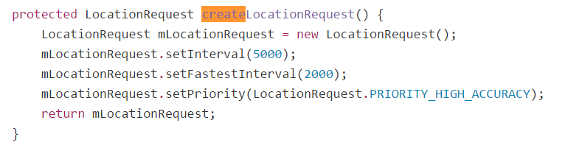
The phone receives the voice text :
Connect to the internet and request path :
Path received :
Request location updates to receive the location :

Slide 13
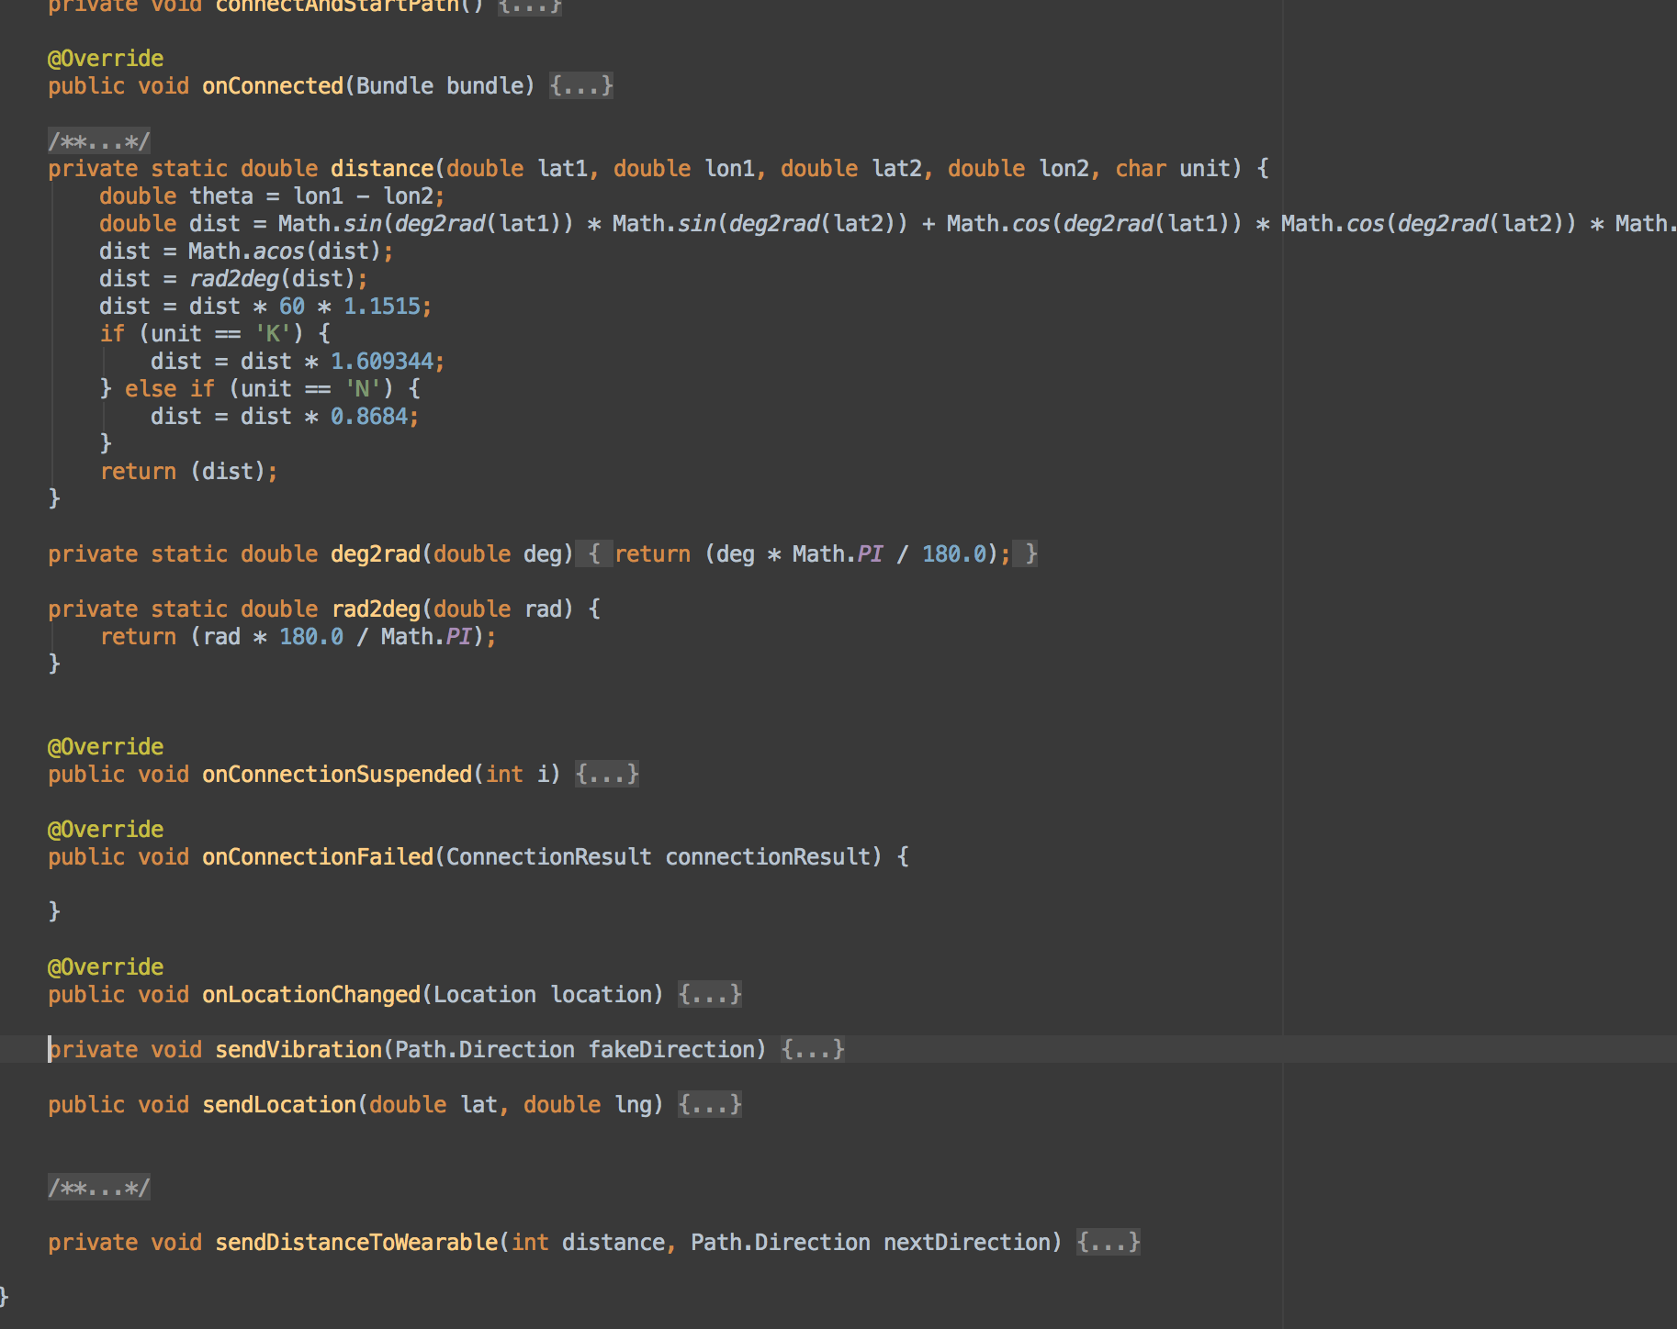
Phone Get current location and send vibrations
Calculate the distance between 2 locations
When the user moves, this gets called with the new location
Sends the vibration to wear
Sends the distance until the next turn to wear

Slide 14
Calculate the distance between two locations :
Sends the vibration to the watch :
Sends the distance until the next turn to wear :

Slide 15
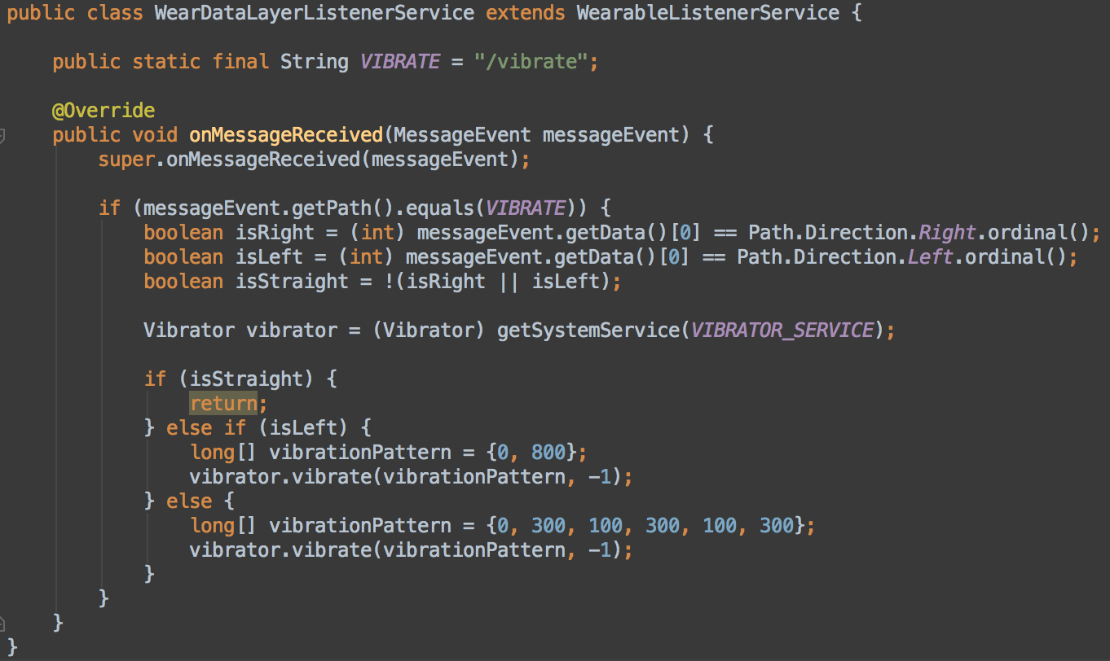
Watch Receive message from phone and vibrate
Determine The next turn
vibrate for 800 milliseconds
vibrate for 300 ms, then stop 100 ms, then vibrate 300 ms, then….

Slide 16
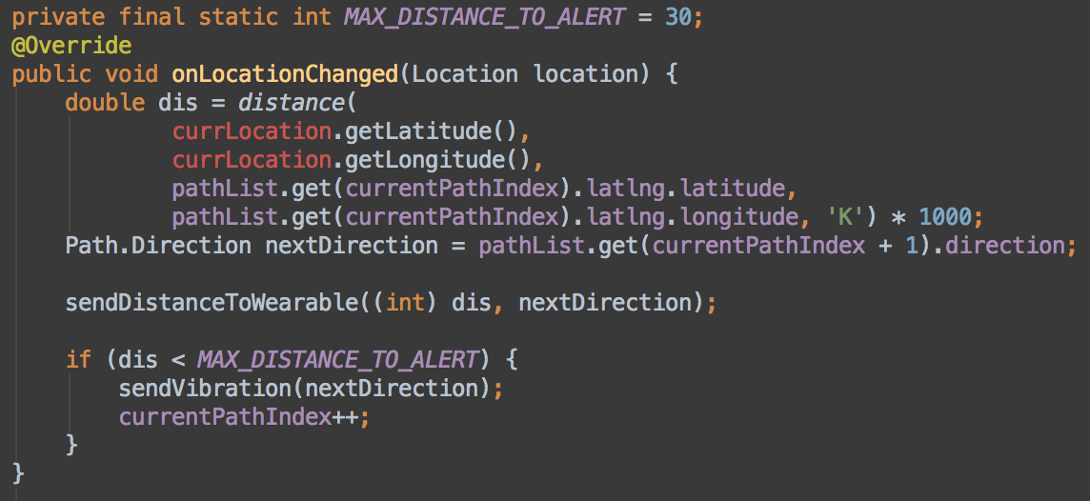
Location code
Calculates the distance between the current user location and the next turn
Update the distance on the wear device
if the distance is below 30, send vibration

Slide 17
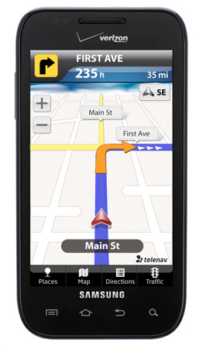
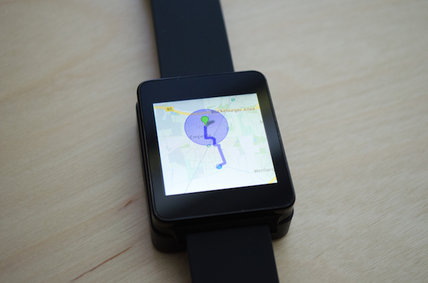
Whats next?
Improve UI of the app (show Google Maps in our app)
Path correction notification

Slide 18
Technologies
Android studio
Java
Google maps for android API
Android wear API
Github

