Slide 1




Scala from the Trenches
Introduction to TDD and clean code
Kfir Bloch
Head of Backend Engineering @ Wix
@kfirondev

Slide 2





Kfir Bloch
Head of backend engineering @ Wix
17 years experience as hands-on developer
Joined Wix 5 years ago
Your pic here
kfirb@wix.com
linkedin/in/blochkfir
@kfirondev
github.com/kfiron

Slide 3
01
Definitions
Notes:
The first case is desgradation of service

Slide 4
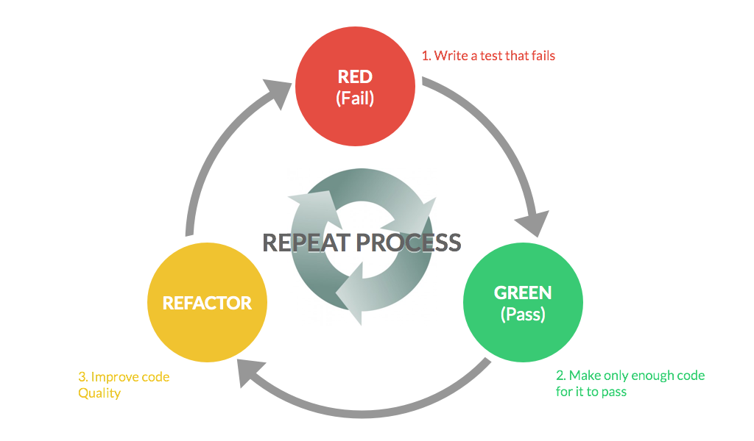
The essence of TDD
@kfirondev

Slide 5

Great software is something to marvel at: powerful, elegant, functional, a pleasure to work with as both a developer and as a user. Great software isn’t written by machines. It is written by professionals with an unshakable commitment to craftsmanship
@kfirondev

Slide 6

TDD & Clean code “Buzzwords”
Collaborators
Unit Test
Integration
Tests
Mocks
Stubs
Fakes
Matchers
Refactoring
Contract
tests
@kfirondev
www.maplecityrubber.com
Notes:
Microservices has many aspects, I am not going to speak about them.
It is not part of my talk, but I will be around and would to disucus any of this items, or you can tweet me

Slide 7
02
Use Case
Notes:
The first case is desgradation of service

Slide 8

Database
Quiz
Prize server
Database
Get - prize
Get - prize
OK
OK
Get - prize
Get - prize
Already played
Already played
Get - prize
Get - prize
Get - prize
Get - prize
Get - prize
Get - prize
Get - prize
Get - prize
Get - prize
Already p.
Get - prize
Already p.
Already p.
Already p.
Already p.
Already p.
Already p.
Already p.
Already p.
Already p.

Slide 9
Fail fast pattern
Quiz
Prize server
Database
T
H
R
O
T
T
L
E
R
Get - prize
Get - prize
OK
OK
Get - prize
Already played
Get - prize
Get - prize
Get - prize
Rolling window key (IP) Throttler
Get - prize
Get - prize
Already p.
Already p.
Already p.
Already p.
Already p.

Slide 10
03
Live Coding
Notes:
The first case is desgradation of service

Slide 11
Kfir Bloch
kfirb@wix.com
linkedin/in/blochkfir
@kfirondev
github.com/kfiron

Slide 12
Wix Engineering Blog http://engineering.wix.com/
We are hiring http://jobs.wix.com
email jobs@wix.com
Kfir Bloch
@kfirondev

