Slide 1



Scala from the Trenches
Introduction to TDD and clean code
Kfir Bloch
Head of Backend Engineering @ Wix
@kfirondev
Notes:
Good morning Kiev
I have been working as a developer for the past 17 year
Past 5 years
In this talk I will share with you the aspects of when to break your monolith and how to mitigate the risks
You may contact me on my twitter

Slide 2
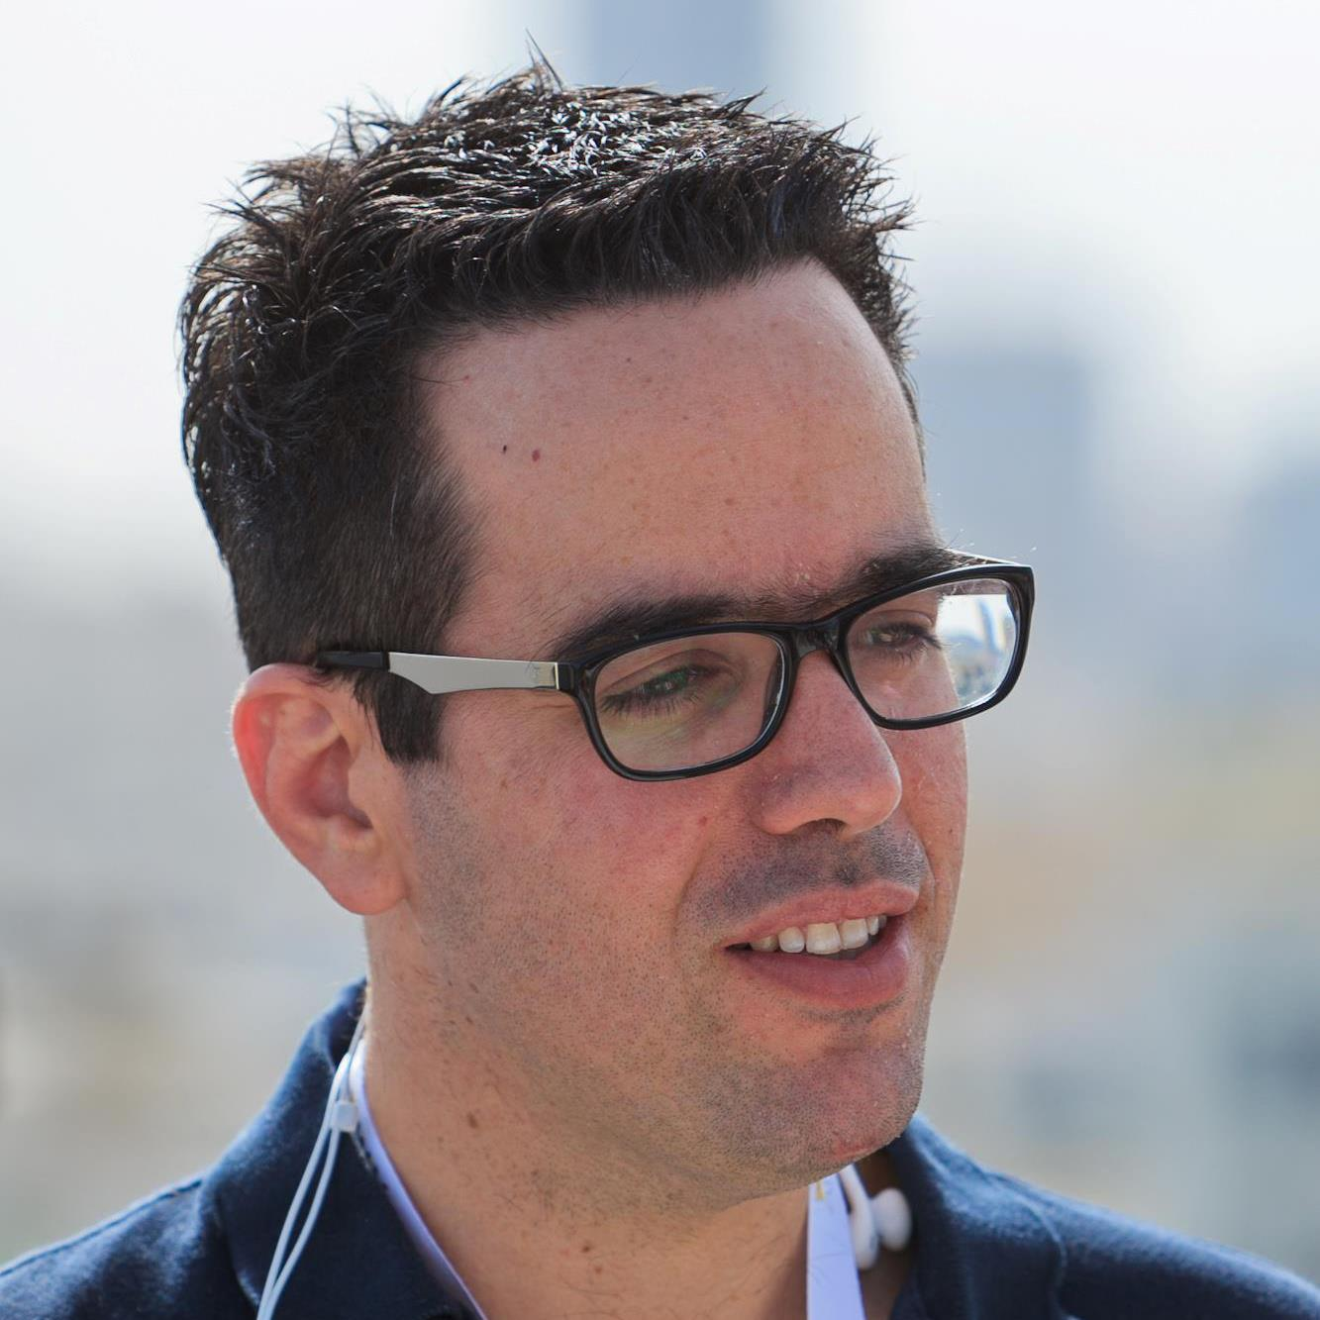




Kfir Bloch
Head of backend engineering @ Wix
17 years experience as hands-on developer
Joined Wix 5 years ago
Your pic here
kfirb@wix.com
linkedin/in/blochkfir
@kfirondev
github.com/kfiron

Slide 3
01
Definitions
Notes:
The first case is desgradation of service

Slide 4


Test-driven development (TDD) is a software development process that relies on the repetition of a very short development cycle: first the developer writes an (initially failing) automated test case that defines a desired improvement or new function, then produces the minimum amount of code to pass that test, and finally refactors the new code to acceptable standards. Kent Beck, who is credited with having developed or rediscovered the technique, stated in 2003 that TDD encourages simple designs and inspires confidence. Test-driven development is related to the test-first programming concepts of extreme programming, begun in 1999,[3] but more recently has created more general interest in its own right.
TDD
@kfirondev
Notes:
However, microservices does not nsasarili small

Slide 5

Clean code
Easy to understand
Easy to modify
Easy to test
Works correctly (Kent Back)
Code I’m not afraid to modify
Code that doesn’t require comments to be easily understood
Code which doesn't break in multiple places when you make a single, seemingly insignificant change. It is also easy to follow the control path of the program.
@kfirondev

Slide 6

TDD & Clean code “Buzzwords”
Collaborators
Unit Test
Integration
Tests
Mocks
Stubs
Fakes
Matchers
Refactoring
Contract
tests
@kfirondev
www.maplecityrubber.com
Notes:
Microservices has many aspects, I am not going to speak about them.
It is not part of my talk, but I will be around and would to disucus any of this items, or you can tweet me

Slide 7
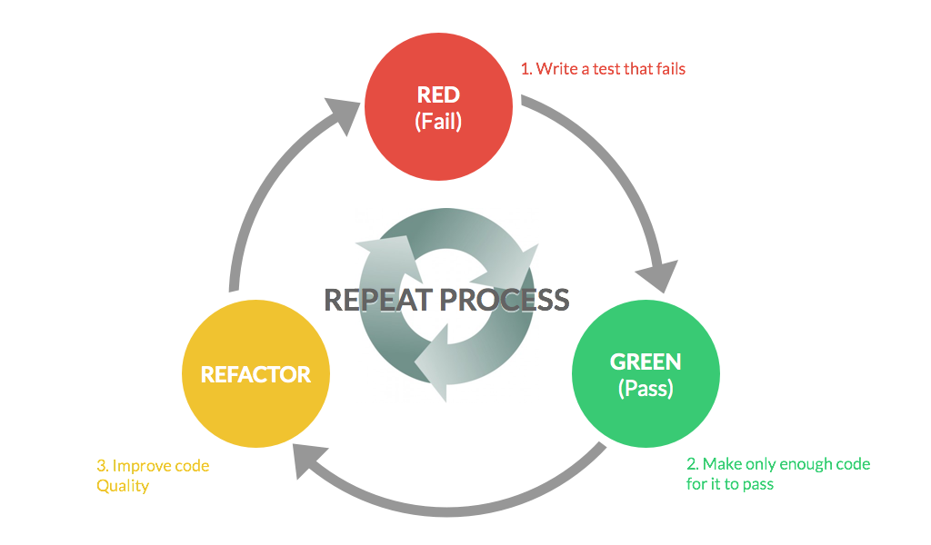
@kfirondev

Slide 8
02
Use Case
Notes:
The first case is desgradation of service

Slide 9
Client Web
SuperBowl Quiz
Prize server
Play / Prize
Prizes
DB
@kfirondev
Notes:
In this use case we have an online shop items catalog with 2 APIs
Items – add/del
Load files – images for my producs
So we have network issue to the external file storage…
Non critical affect the critical
The site owner cannot change the inventory which is critical because he does not have the
Items
The upload of the items is not critical,

Slide 10
Client Web
T
H
R
O
T
T
L
E
R
SuperBowl Quiz
Prize server
Play / Prize
Prizes
DB
Rolling window key (IP) Throttler
@kfirondev
Notes:
In this use case we have an online shop items catalog with 2 APIs
Items – add/del
Load files – images for my producs
So we have network issue to the external file storage…
Non critical affect the critical
The site owner cannot change the inventory which is critical because he does not have the
Items
The upload of the items is not critical,

Slide 11
03
Live Coding
Notes:
The first case is desgradation of service

Slide 12
Kfir Bloch
kfirb@wix.com
linkedin/in/blochkfir
@kfirondev
github.com/kfiron

Slide 13
Wix Engineering Blog http://engineering.wix.com/
We are hiring http://jobs.wix.com
email jobs@wix.com
Kfir Bloch
@kfirondev

