Slide 1



Slide 2
Agenda
Intro to Quantum Machine learning
Intro to penny lane
Penny lane QML benefits
Penny lane “Hello world”
Penny lane use cases demostrations
Variational classifier
Quanvolutional Neural Network
Quantum transfer learning

Slide 3
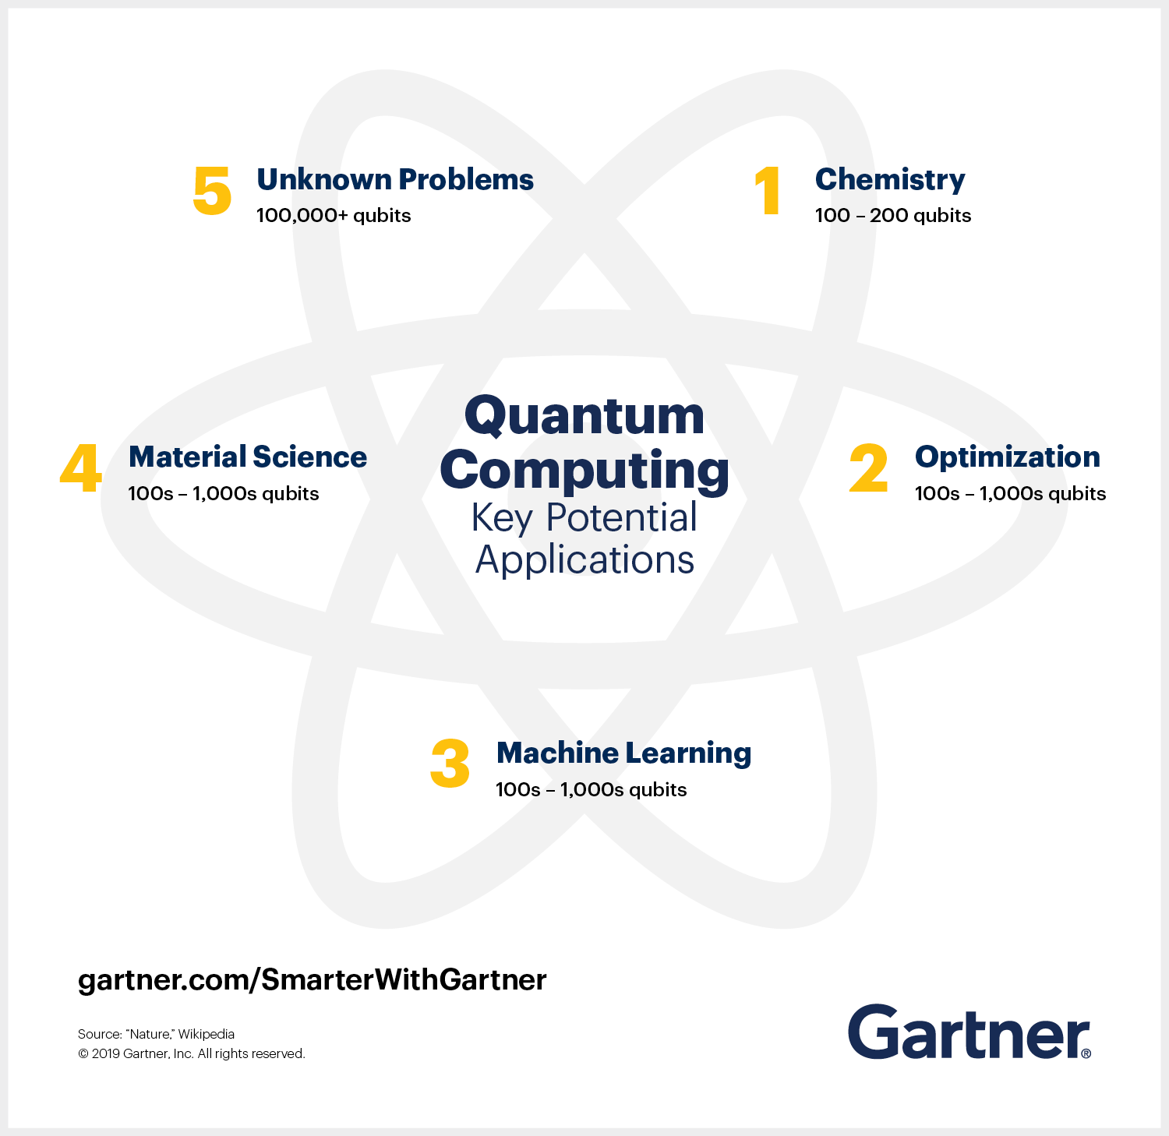
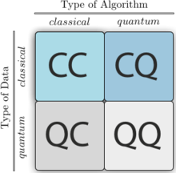
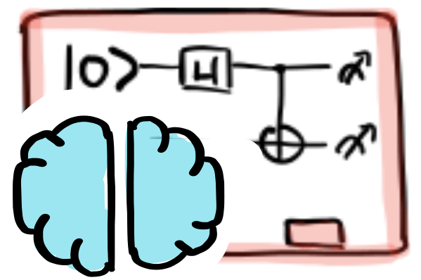
What is Quantum Machine Learning?
Research area that explores the interplay of ideas from quantum computing and machine learning.

Slide 4
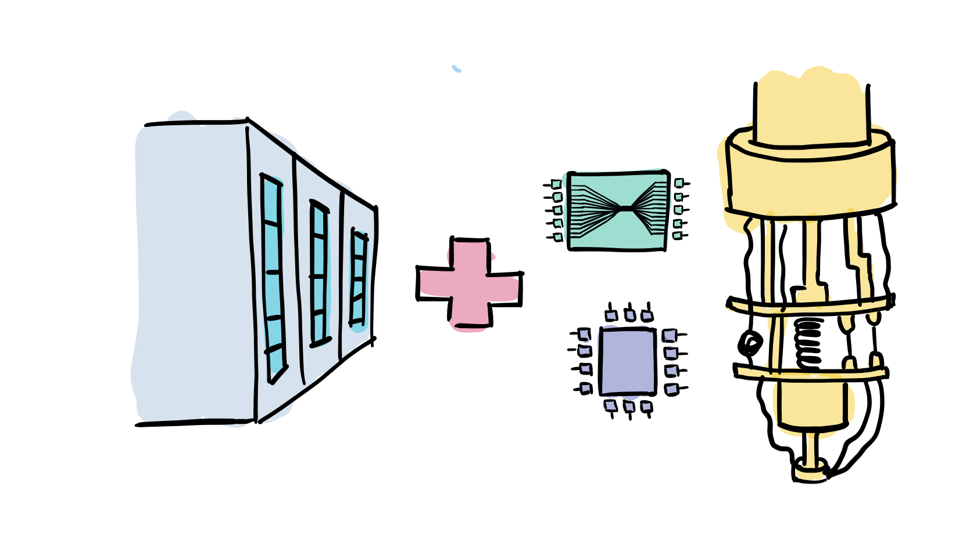
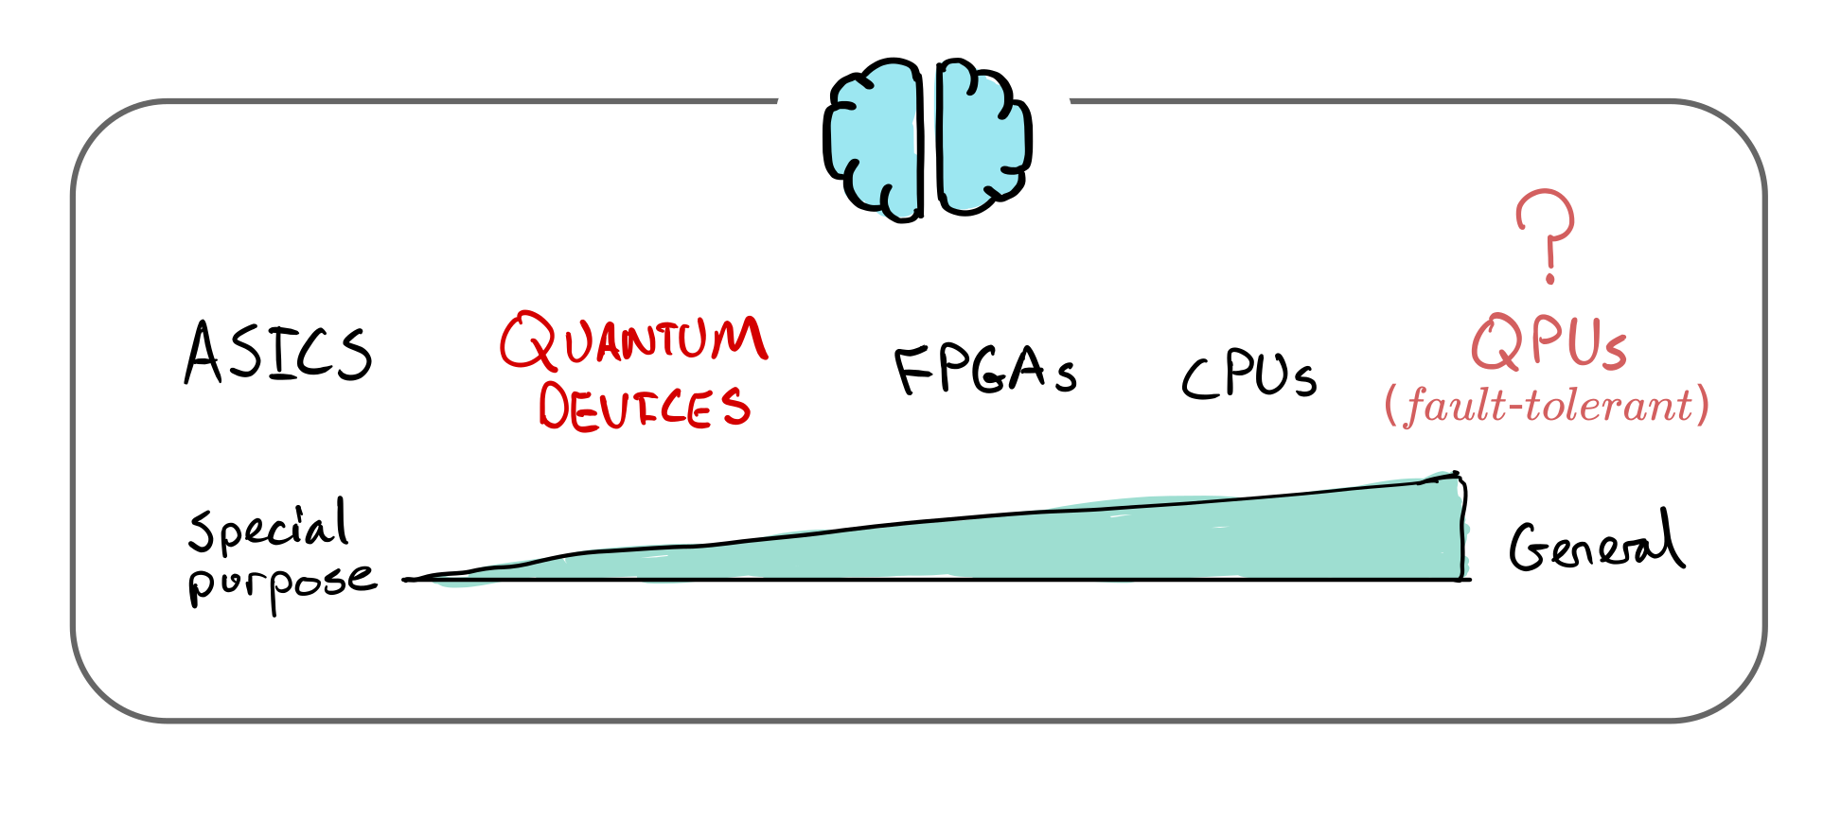
Quantum computing -> Machine learning
Quantum machine learning extends the pool of hardware for machine learning by an entirely new type of computing device—the quantum computer.
Quantum computers as speed up for training and evaluation of ML models

Slide 5
Machine learning -> Quantum computing
leverage techniques from machine learning to uncover
quantum error-correcting codes
estimate the properties of quantum systems
develop new quantum algorithms
NOT COVERED HERE

Slide 6

Open source Python framework for differentiable programming of quantum computers.
Includes tools for quantum machine learning, quantum computing, hybrid quantum-classical computing and quantum chemistry.
Key Features:
Device independent. Access quantum hardware and simulators from Xanadu Strawberry Fields, IBM Q, Google Cirq, Rigetti Forest, and Microsoft QDK.
Best of both worlds. Build hybrid models by connecting quantum hardware to PyTorch, TensorFlow, Keras, and NumPy.
Follow the gradient. Hardware-friendly automatic differentiation of quantum circuits.
Built-in tools for quantum machine learning, optimization, and quantum chemistry.

Slide 7
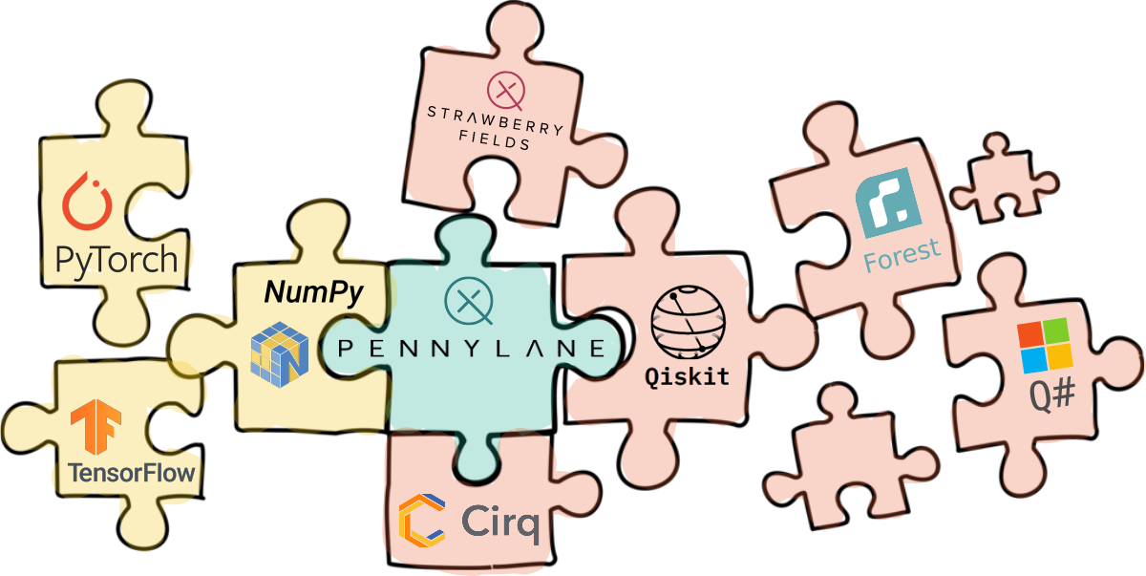
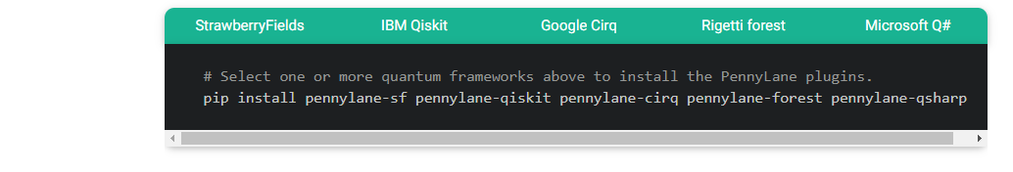
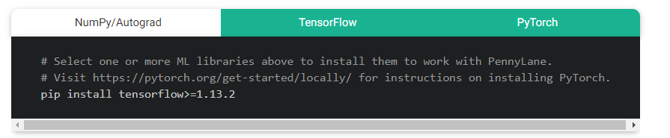
Penny lane benefits
Plugin to many quantum echo systems.

Slide 8
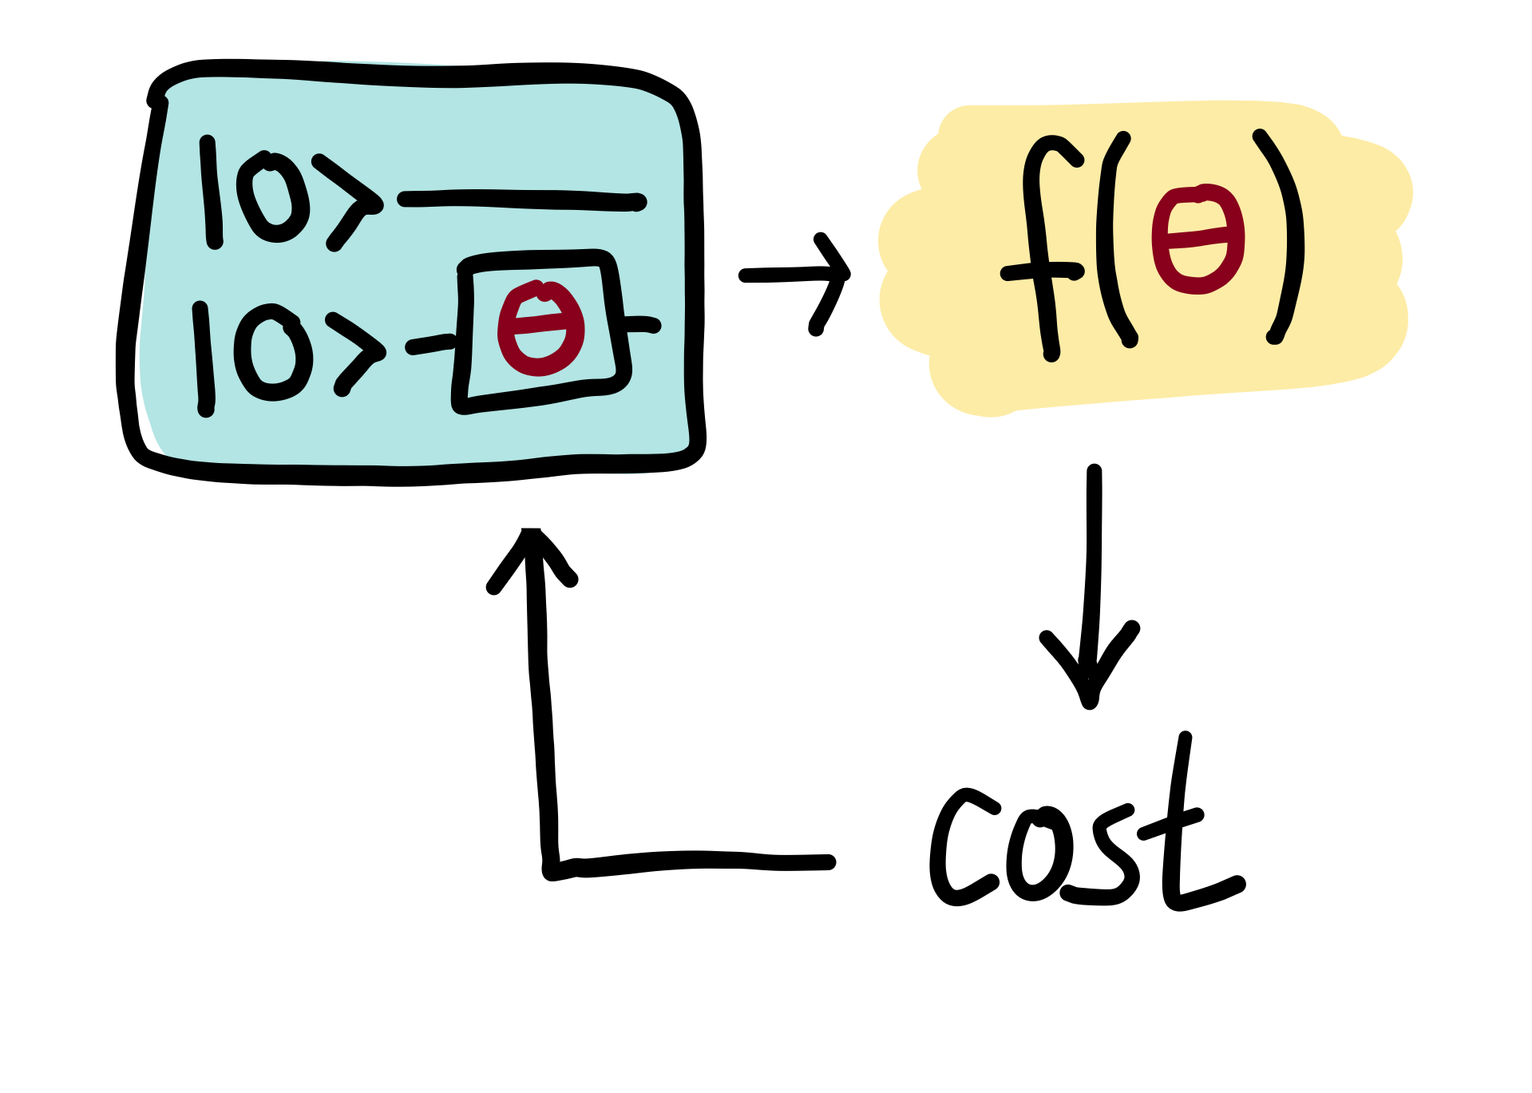
Penny lane benefits - Variational circuits
Variational or parametrized quantum circuits are quantum algorithms that depend on free parameters. Like standard quantum circuits, they consist of three ingredients:
Preparation of a fixed initial state
A quantum circuit U(θ)U(θ), parameterized by a set of free parameters θθ.
Measurement of an observable ^BB^ at the output. This observable may be made up from local observables for each wire in the circuit, or just a subset of wires.
The intriguing idea of variational circuit for near-term devices is to merge this two-step procedure into a single step by “learning” the circuit on the noisy device for a given task. This way, the “natural” tunable gates of a device can be used to formulate the algorithm, without the detour via a fixed elementary gate set. Furthermore, systematic errors can automatically be corrected during optmization.

Slide 9
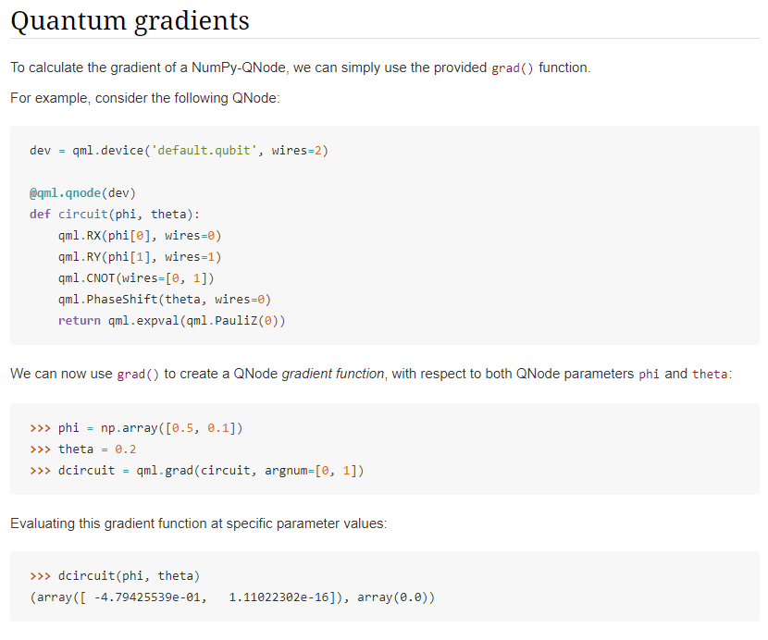

Slide 10
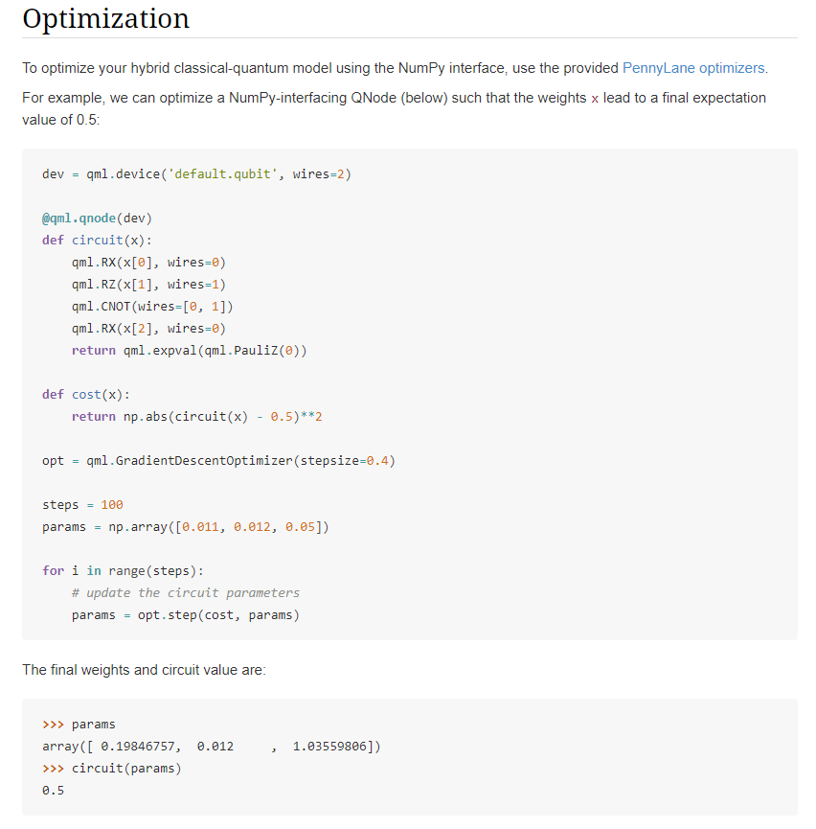

Slide 11


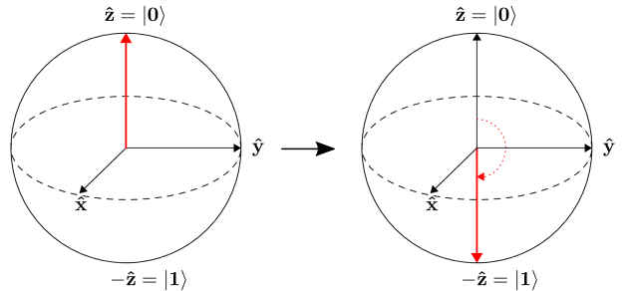
Basic tutorial : qubit rotation
https://github.com/kfiry77/pennylane/blob/master/tutorial_qubit_rotation.ipynb

Slide 12
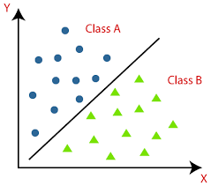
Use case 1 : Variational classifier
https://github.com/kfiry77/pennylane/blob/master/tutorial_variational_classifier.ipynb

Slide 13
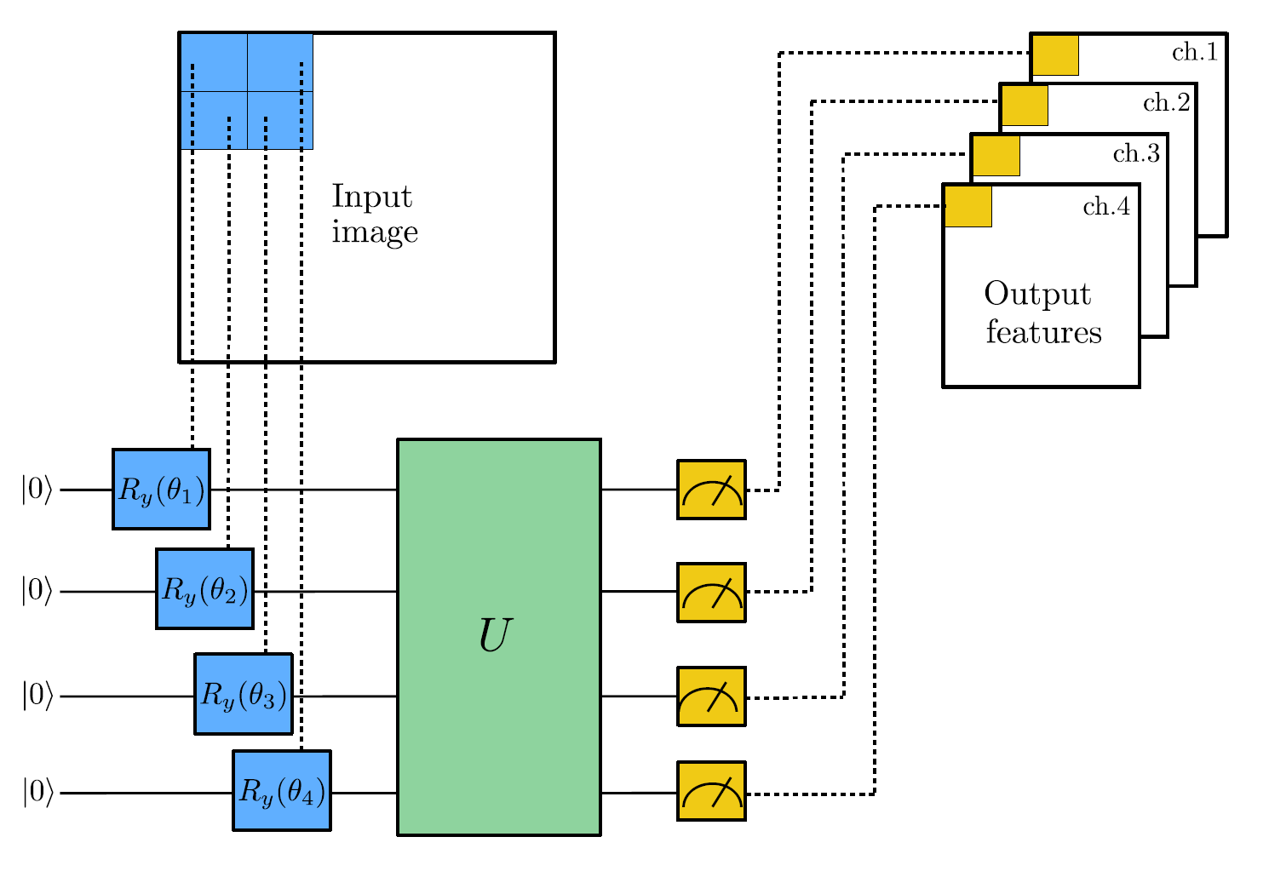
Use case 2 : Quanvolutional Neural Network
https://github.com/kfiry77/pennylane/blob/master/tutorial_quanvolution.ipynb

Slide 14
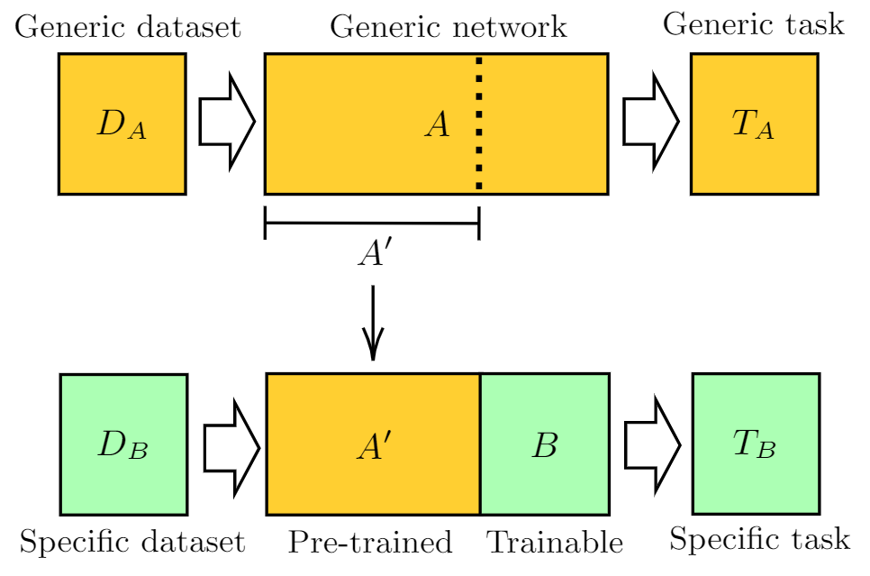
Use case 3 : Quantum transfer learning
https://github.com/kfiry77/pennylane/blob/master/tutorial_quantum_transfer_learning.ipynb

Slide 15
Criticism
Positive:
- One stop shop : There are many quantum computers and frameworks out there, penny lane is a good place that unifies all into a single consolidated interfaces.
Differential circuit and quantum optimizers, which is usable for Machine Learning.
User friendly, very detailed end-end examples, excellent documentation for fast kick-off.
Near term QML solution, whilst the entire industry tries to understand it, pennylane gives a ready solution.

Slide 16
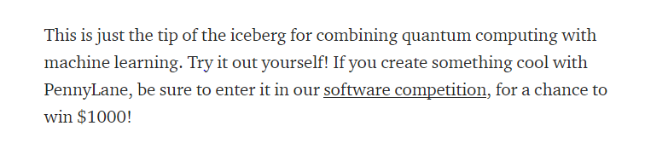
Criticism
Negative:
A well polished branded product, Not sure that is truly a promise is fulfilled.
Looks like an attempt to conquer the two hyped technologies of AI and Machine learning.
The QML concept seems like ahead of it’s time.
Mark Twain : “To a man with a hammer, everything looks like a nail.”
Medium /Xanando :

Slide 17
Question?

Slide 18
Thanks

