Slide 1
CprE 488 – Embedded Systems Design MP4 – Quad Tracking System
Joseph Zambreno and Phillip Jones
Electrical and Computer Engineering
Iowa State University
www.ece.iastate.edu/~zambreno www.ece.iastate.edu/~phjones
rcl.ece.iastate.edu
If everything seems under control, you’re just not going fast enough. – Mario Andretti

Slide 2

GPS server: Quick guide
Server should always be running, but if there is a problem you can kill it, and or restart it.
Resides on Linux machine in the back of Coover 2041 (co2041-linux.ece.iastate.edu)
User name: cpre488_user (See Blackboard post for password)
Application location: ~/Desktop/MP-4-utils/getGPS-server
Application command: getGPS-server 4560
Server will not start tracking the tracking marker (i.e. 3 red balls in a triangle) until:
Tracking marker is placed in the camera’s field of view
A client is requesting GPS information from the server
Running the client (see MP4 assignment write up)

Slide 3
GPS server -> GPS client -> Zedboard
The Server sends the client X,Y,Z,Yaw information as doubles (8-bytes per value)
When the Client receives an ‘S’ or ‘D’ command from the Zedboard, it forwards the X,Y,Z,Yaw information to the Zedboard as doubles over the UART.
After the Zedboard sends a ‘S’ or ‘D’ message to the GPS client, is should then wait for the client to respond with 16-bytes (4-bytes for each X,Y,Z,Yaw)
For testing, make sure to echo back to the Client in the form of a Debug message the received X,Y,Z,Yaw to verify you have your byte-order correct (as indicated in the MP4 assignment write up).

Slide 4
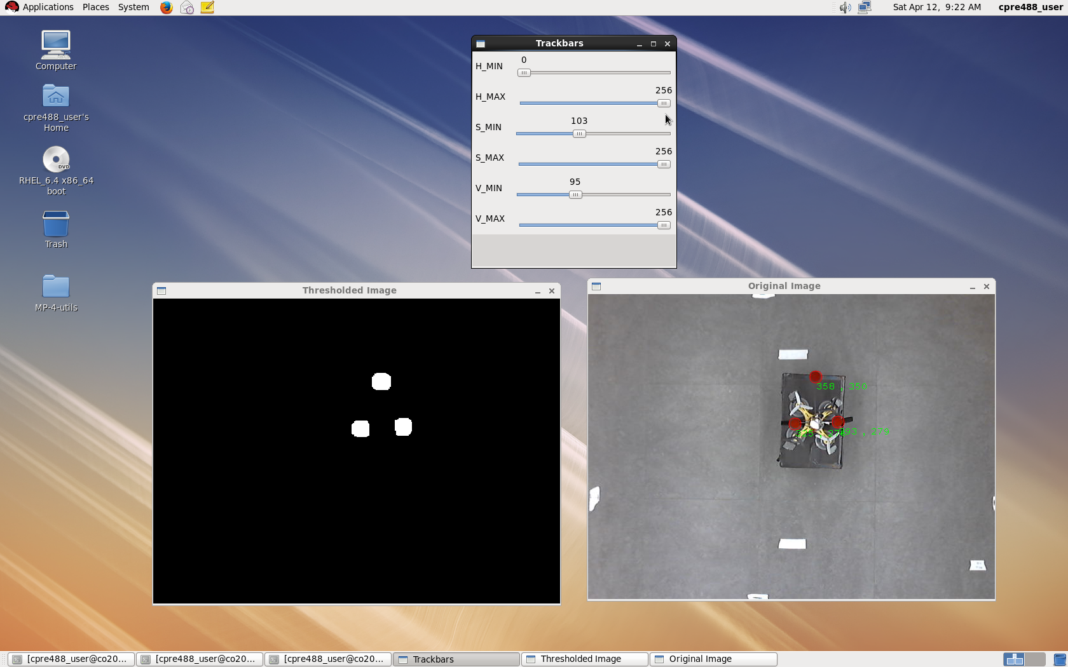
Good color calibration
When the only white blobs in the “Threshold Image” are caused by the red balls, then good calibration
A few other blobs can appears. As long as they are smaller than the 3 red balls it should be good enough
Slide bars to adjust
Threshold Image

Slide 5
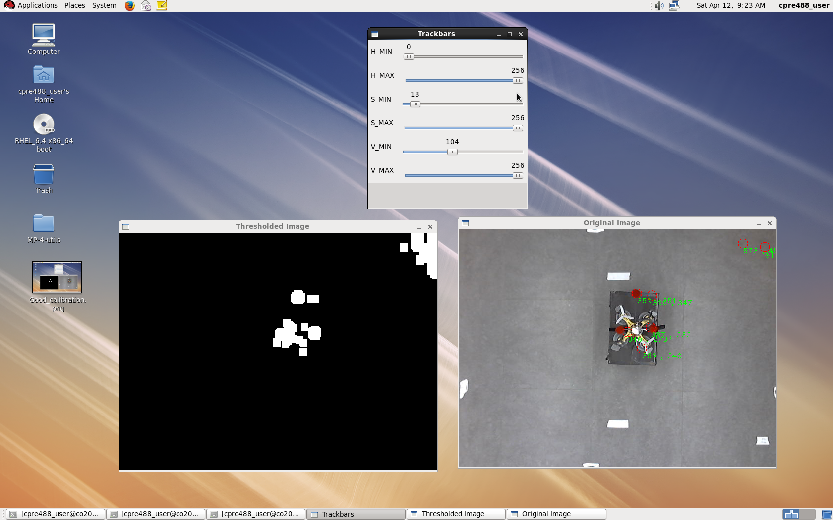
Bad color calibration
“Threshold Image” contains too many white blobs.
Slide bars to adjust
Threshold Image

Slide 6

Tracking system setup in Coover 2041
I-Robot
I-Robot
I-Robot
I-Robot
Camera field of view
GPS Server
0º
Door
50º
-50º
Windows
Important: Keep Quad between
50 and -50 degrees. Or tracking system
will have issues
Y
(0,0)
X
Dry-erase board

