Slide 1
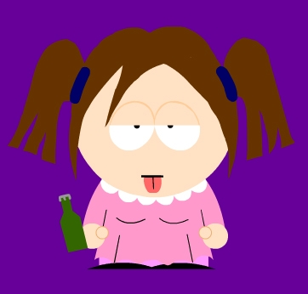
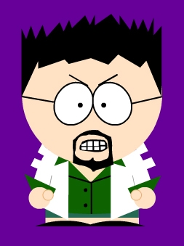
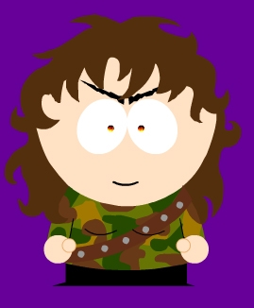
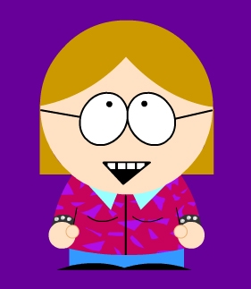
Hermaphroditism and You:
The Left Hand of Darkness
Presentation By:
Susan Caplow
Josh Geilhufe
Colleen O’Rourke
Liz Pardue

Slide 2

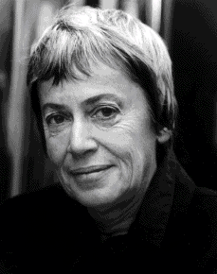
Ursula K. Le Guin
Born in 1929 in Berkeley, CA
Daughter of a writer and an anthropologist
Has three older brothers
B.A.: Radcliffe College
M.A.: Columbia University
Married with 3 children and 3 grandchildren
Is Taoist
Lives in Oregon
Prolific writer

Slide 3


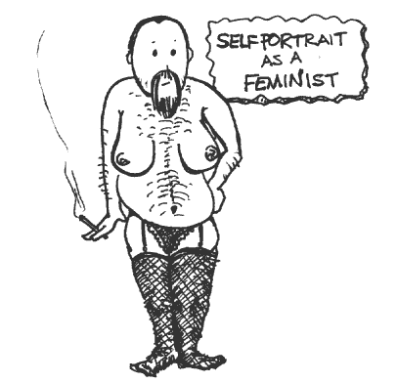
Feminism and Le Guin
Science fiction was mostly male-dominated until the 1960’s
In the 60’s and 70’s many more women fell into writing Science Fiction
Le Guin’s early work was male-centered
She considers herself a disciple of “thoughtful feminism”.

Slide 4
Thoughts on and Criticism of The Left Hand of Darkness
Sources for Quotations
Biographical information, adapted from Wikipedia. http://www.malaspina.com/site/person_752.html
Interview with Ursula Le Guin. http://www.sfsite.com/03a/ul123.htm
Interview with Ursula Le Guin. http://www.geocities.com/Area51/2593/fuliv.htm

Slide 5
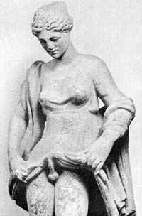
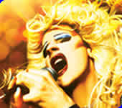
A Brief History
Hermaphrodites have arisen occasionally throughout human history
  Viewed as monsters or signs from God
Plato’s Symposium – description of hermaphrodite as original condition of the sexes
  “humans” were a double creature with four arms, four legs, two faces, etc…
  Zeus got mad and split them into two
  Spend rest of existence trying to become one again
  (See also: Hedwig and the Angry Inch)

Slide 6
Philosophy
“Androgyny” not just physical but mental state
  1974: Sandra Bem, Stanfurd University psychologist, developed concept and coined word “androgyny”
  Androgynous people exhibit both “male” and “female” traits
    Male: Competence traits (aggressive, independent, dominant, ambitious)
    Female: Expressive traits (tactful, quiet, easily express feelings, need security)
  Androg. Females more assertive and independent; Androg. Males more nurturing and empathic

Slide 7
Philosophy Cont.
1970 Case Study
  80 professionals (psychiatrists, social workers, etc) asked to describe traits of three people: Normal Adult Male, Normal Adult Female, Normal Adult Person
    Male AND Female participants saw Healthy Male and Healthy Person as having the same characteristics
    Healthy Female seen as more submissive, excitable, preoccupied with appearance
      Matched traits of an immature person

Slide 8
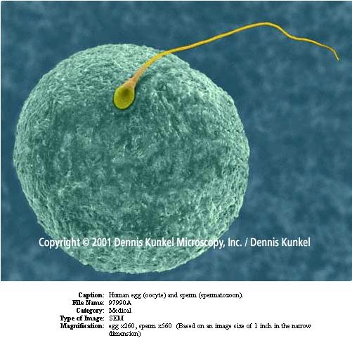
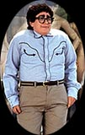
Reasons the Biology is WRONG
Darwin’s theory of Natural Selection
Specialization = Good
Capacity to produce both sperm and egg = Not Good

Slide 9

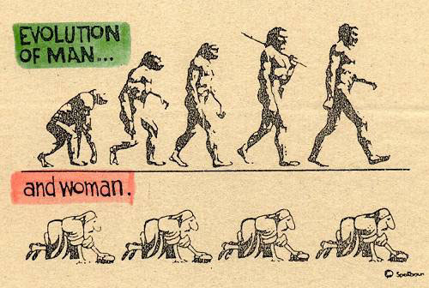
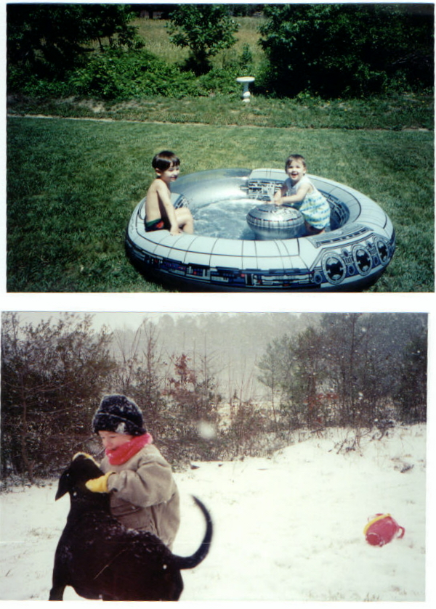
Still More Problems
Heredity: Genes are linked
Evolution Happens: Winter and Summer = Different

Slide 10
Discussion Questions
How does Le Guin use misogyny to convey a feminist message?
How does she use/combine the ideas of race, nationality, species, and aliens?
Do Gethenians gain liberty through the loss of gender roles? How does this relate to war?
What are your interpretations of the combination of hermaphroditism with incest?

Slide 11

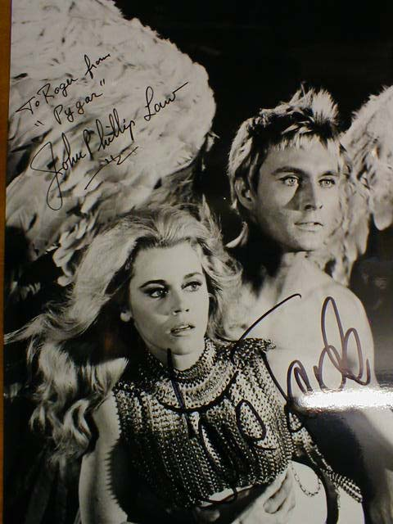

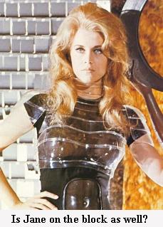

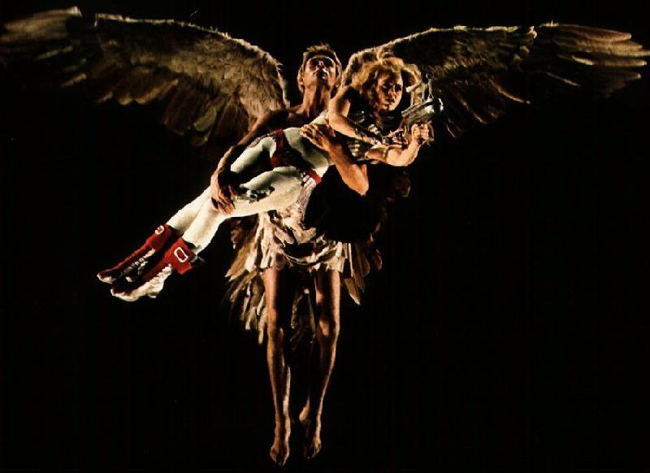
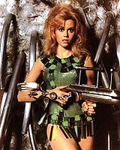
Acknowledgements
Professor Fitzpatrick
Barbarella

