Slide 1
MAT123 (Mathematics I)
Lecture 1

Slide 2
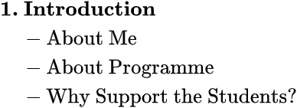
Presentation

Slide 3
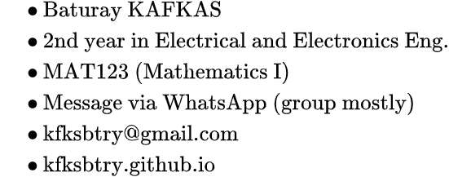
About Me

Slide 4
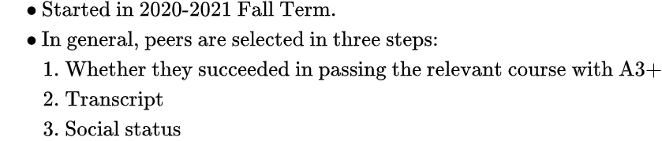
About Programme

Slide 5
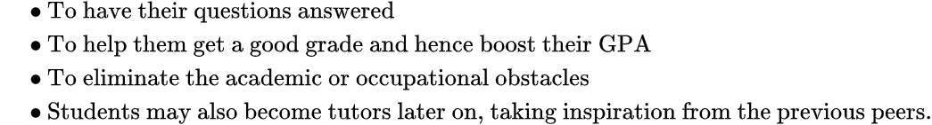
Why Support the Students?

Slide 6
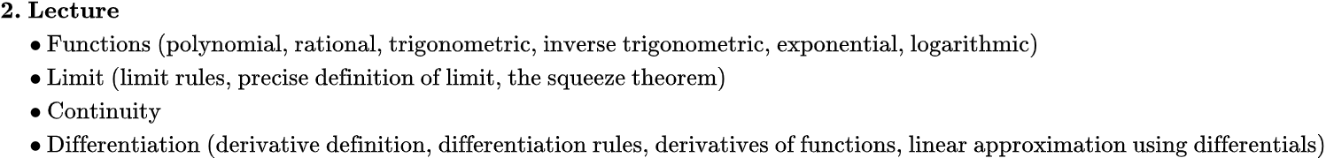
Presentation

Slide 7
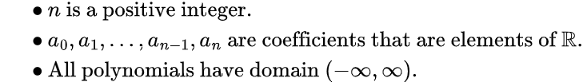
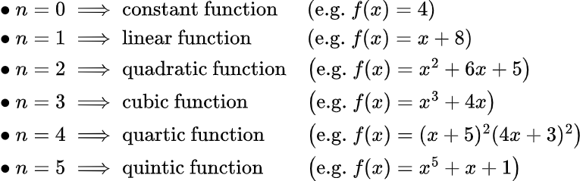
Polynomial Functions

Slide 8
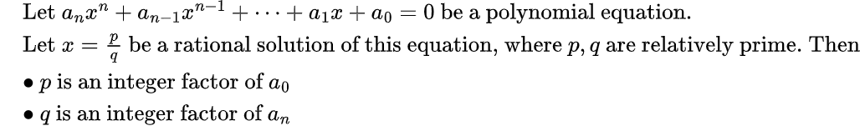
The Rational Root Theorem

Slide 9


Rational Functions

Slide 10
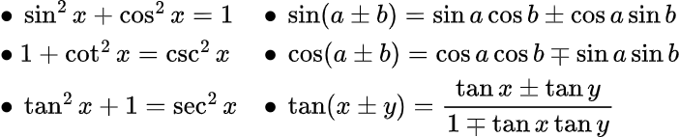
Trigonometric Functions

Slide 11
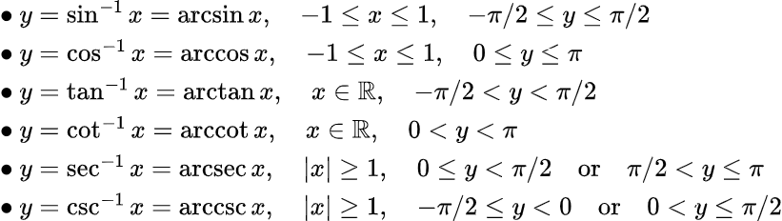

Inverse Trigonometric Functions

Slide 12
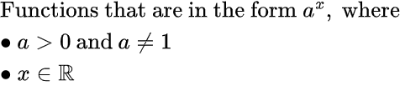
Exponential Functions

Slide 13
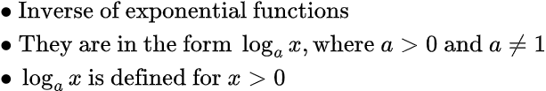
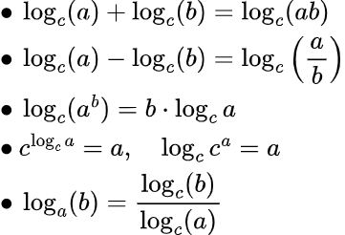
Logarithmic Functions

Slide 14
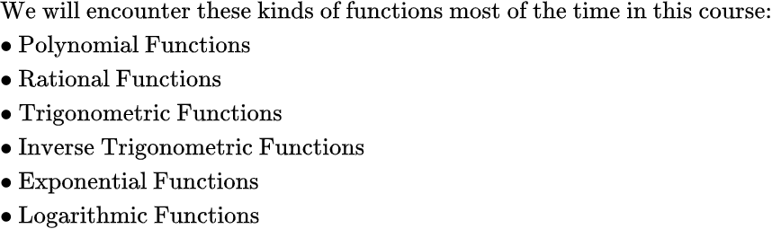
Summary of Functions

Slide 15
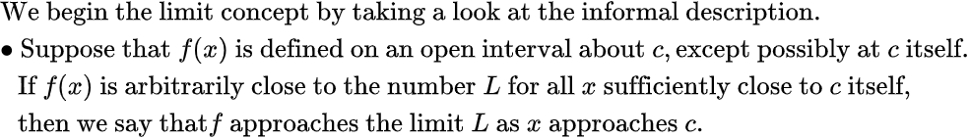

Limit

Slide 16
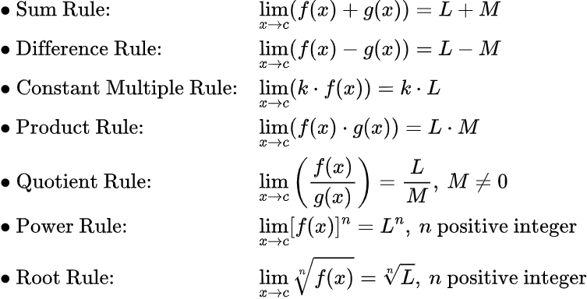
Limit Rules

Slide 17


The Squeeze (Sandwich) Theorem

Slide 18
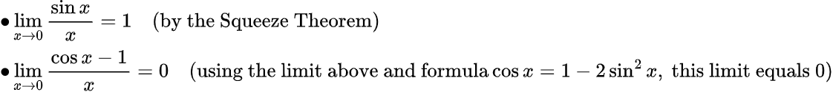
Two Important Limits

Slide 19

The Delta-Epsilon Definition

Slide 20
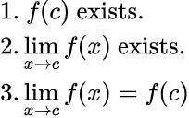
Continuity

Slide 21
Intermediate Value Theorem

Slide 22


Definition of Derivative

Slide 23
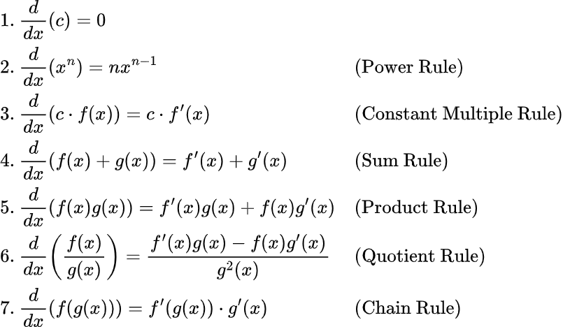
Differentiation Rules

Slide 24
Differentiation Rules

Slide 25
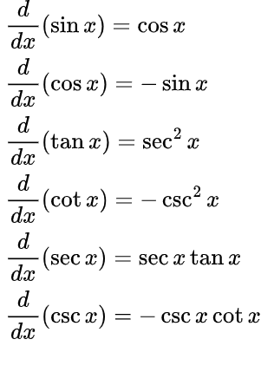
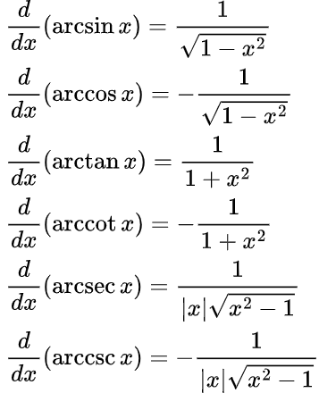
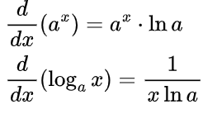
Derivatives of Common Functions

Slide 26
Linear Approximation and Differentials

Slide 27
Linear Approximation and Differentials

Slide 28
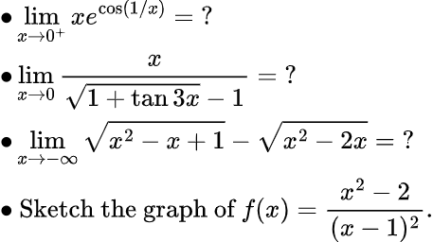
Exercises

