Slide 1
MAT123 (Mathematics I)
Lecture 2

Slide 2

Questions

Slide 4
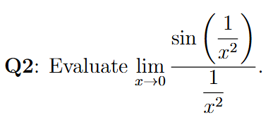
Questions

Slide 6

Questions

Slide 8

Questions

Slide 10
Questions

Slide 12

Questions

Slide 14
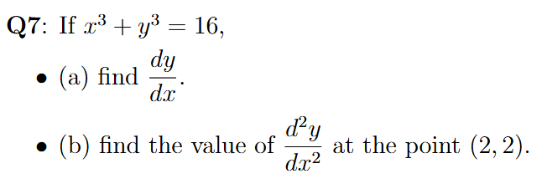
Questions

Slide 16

Questions

Slide 18

Questions

Slide 20

Questions

Slide 22

Questions

Slide 24

Questions

Slide 26
Questions

