Slide 1
MAT123 (Mathematics I)
Lecture 5

Slide 2

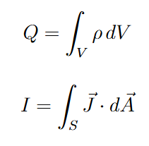

Definition of Integral

Slide 3
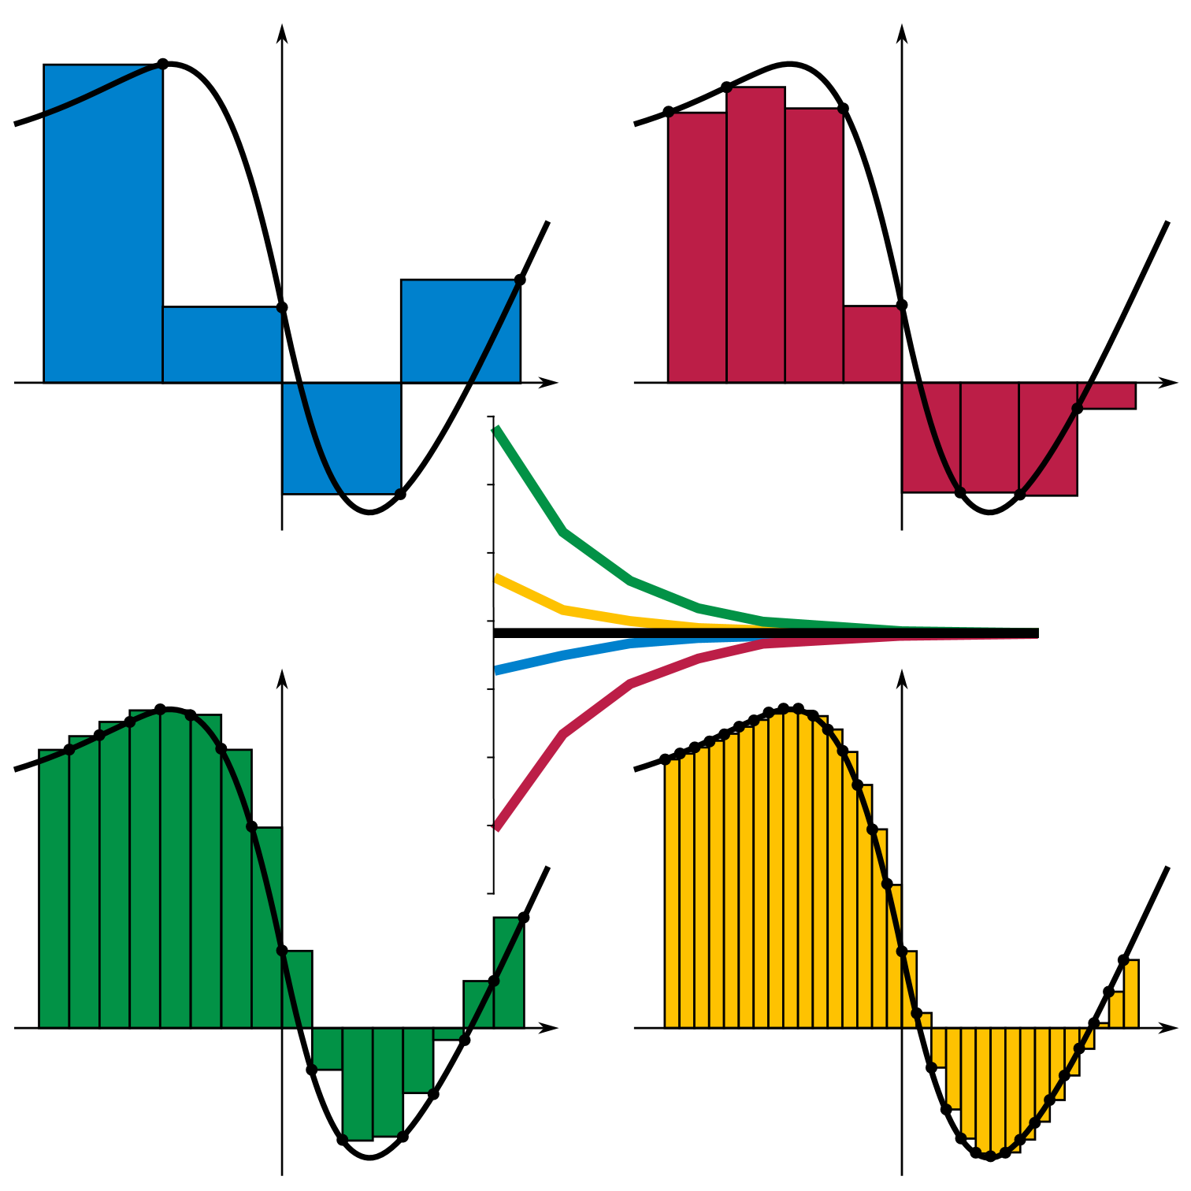
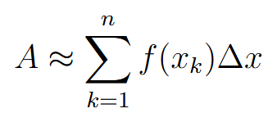

Riemann Sum and Riemann Integral

Slide 4
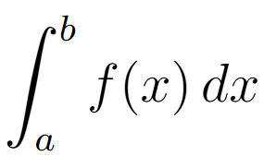
Terminology

Slide 5

Indefinite Integrals

Slide 6

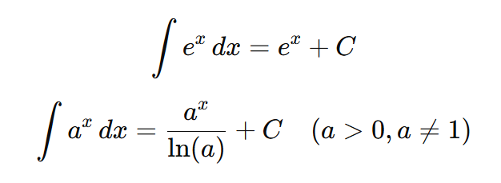
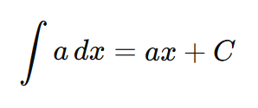



Common Indefinite Integrals

Slide 7
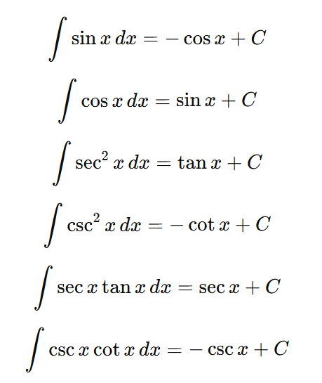
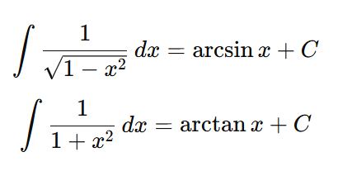

Common Indefinite Integrals

Slide 8
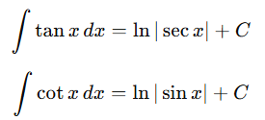
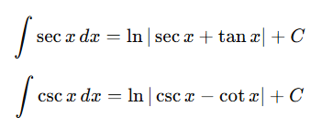
Other Indefinite Integrals

Slide 9




Definite Integrals

Slide 10



Definite Integrals

Slide 11

The Fundamental Theorem of Calculus, Part I

Slide 12

The Fundamental Theorem of Calculus, Part II

Slide 13
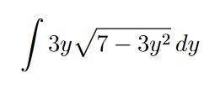
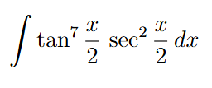

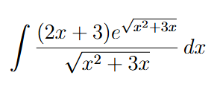
Integration Techniques (u-substitution)

Slide 14

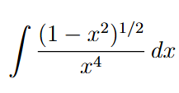
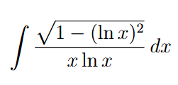
Integration Techniques (trigonometric-substitutions)

Slide 15

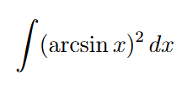
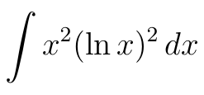
Integration Techniques (Integration by Parts)

Slide 16
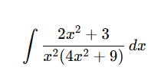
Integration Techniques (Partial Fraction Decomposition)

Slide 17
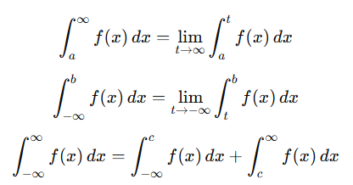
Type I Improper Integral

Slide 18


Type II Improper Integral

Slide 19

Exercise

Slide 20

Exercise

Slide 21

Exercise

Slide 22

Exercise

