Slide 1
MAT123 (Mathematics I)
Lecture 6

Slide 2
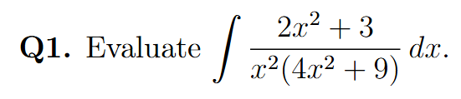
Questions

Slide 4
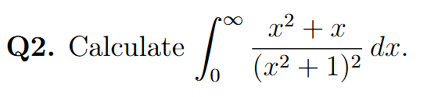
Questions

Slide 6
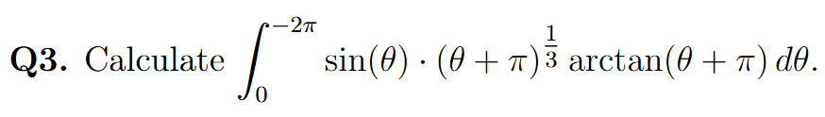
Questions

Slide 8
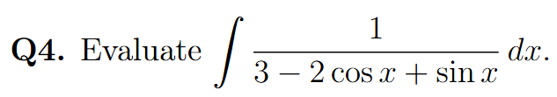
Questions

Slide 10
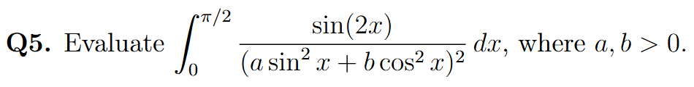
Questions

Slide 12
Questions

Slide 14
Questions

Slide 16
Questions

Slide 18
Questions

Slide 20
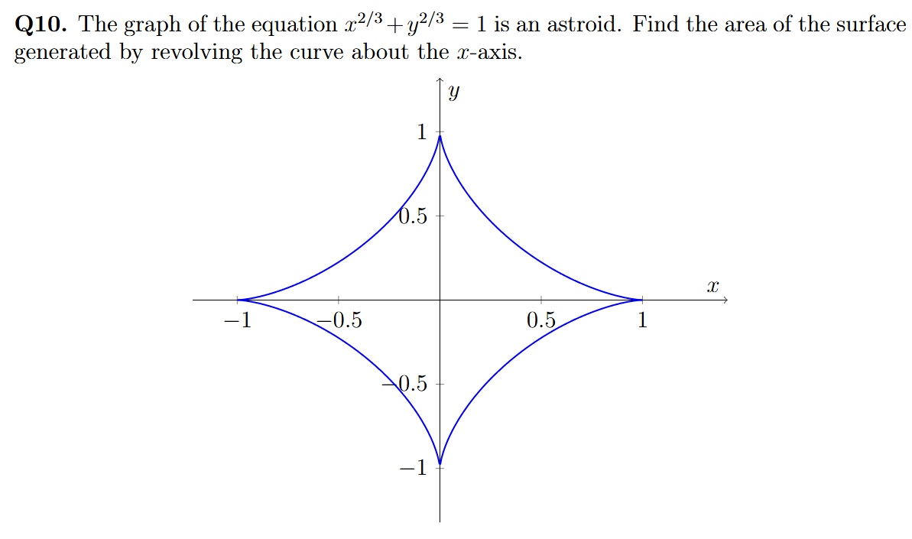
Questions

