Slide 1
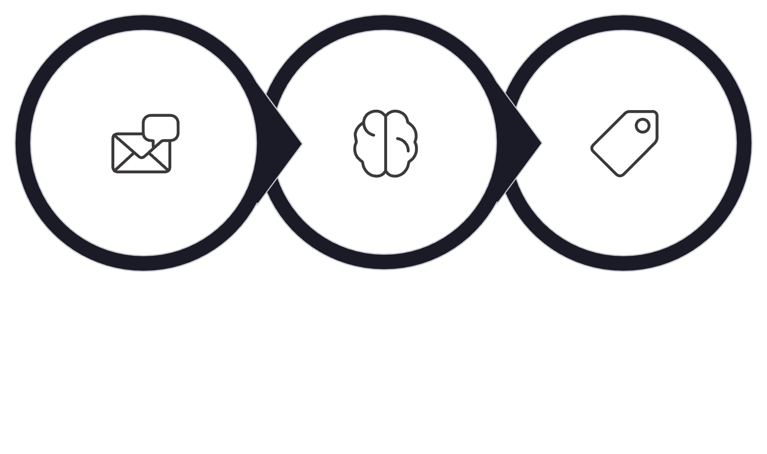

How Intent Detection Works
From raw user message to classified intent — end to end
Intent Detection
Classified Intent
Raw Message
Solving the core problem: routing any user message to the right response handler, reliably, across every business profile.
This deck is a technical deep-dive into the intent detection pipeline — from scope resolution through post-classification overrides. Every function name, code snippet, and example is drawn verbatim from the codebase.

Slide 2

The Big Picture: 8-Step Pipeline
Every incoming message travels through the same deterministic pipeline before a single token of reply is generated.
SETUP · 1
SETUP · 2
Scope Resolution
Mode Selection
Tenant, profile, KB
AI or local?
SETUP · 3
CLASSIFY · 4
Context Assembly
Dialogue Act Pre-check
History + constraints
Greeting or ack?
CLASSIFY · 5
CLASSIFY · 6
Classification
Allowed-Intent Gate
LLM or keyword rules
Reject out-of-profile
CLASSIFY · 7
OUTPUT · 8
Post-Classification Overrides
Category Derivation
Business logic wins
Deterministic from intent
Steps 1–3 are Setup. Steps 4–7 are Classification. Step 8 is deterministic Output. No step is skipped — the pipeline is fully sequential.

Slide 3

Intent Taxonomy: What We're Classifying
19 intents, pre-defined, grouped into four clusters. The model picks one — the system derives everything else.
Cluster
Intents
📚 Course Info
course_list, course_details, course_pricing_payment, course_projects, course_schedule_duration, career_certificate_outcomes
🎯 Fit & Eligibility
prerequisite_fit, beginner_friendliness, background_fit, career_guidance
🛎 Support & Action
demo_trial_counseling, enrollment_admission, student_support_redirect, instructor_info, recording_access, missed_class_recovery
⚙️ System States
neutral, irrelevant, unknown
The model classifies into one of these 19 intents. Category is NEVER a model output — it is derived deterministically after classification.

Slide 4
Intent → Category: Deterministic Derivation
Key Insight
intent_taxonomy.py
Category is NEVER predicted by AI — it is derived deterministically from intent via the INTENT_TO_CATEGORY map. The model has no category output. The backend computes it.
def category_for_intent(intent: str) -> str:
return INTENT_TO_CATEGORY.get(
intent,
"unknown"
)
# e.g.
# "course_pricing_payment" → "relevant"
# "neutral" → "neutral"
# "irrelevant" → "irrelevant"
course_pricing_payment
neutral
→ "relevant"
→ "neutral"
irrelevant
→ "irrelevant"
The INTENT_TO_CATEGORY map is a static dictionary. No inference, no model call — a pure dictionary lookup. This makes category derivation auditable, testable, and zero-latency.

Slide 5
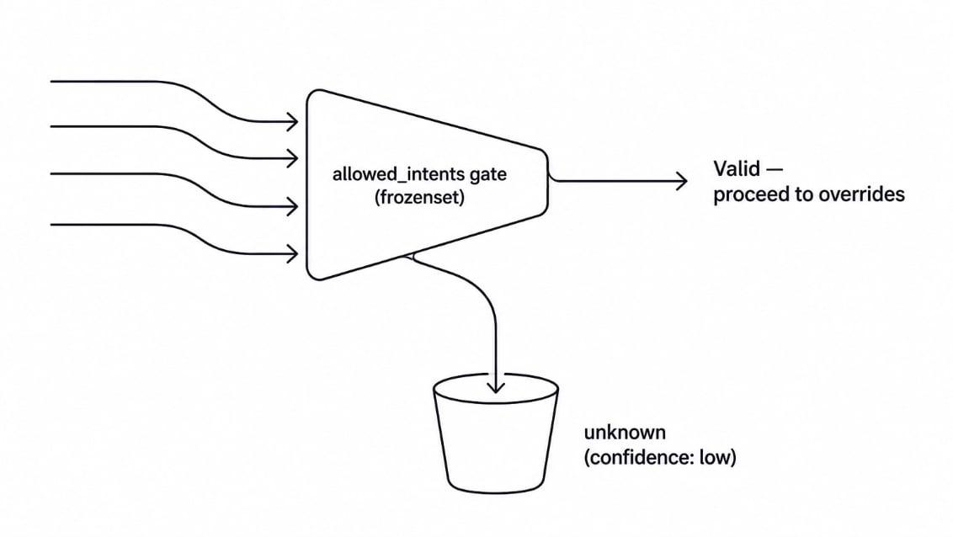
Scope Resolution & The Allowed-Intent Gate
Before any AI runs, the system resolves who is asking and what they're allowed to ask. The model is constrained before it ever sees the message.
business_profiles.py — EDTECH_PROFILE (condensed)
Gate Filter: How It Works
EDTECH_PROFILE = BusinessTypeProfile(
business_type="edtech",
allowed_intents=frozenset({
"course_list",
"prerequisite_fit",
"course_pricing_payment",
"career_guidance",
"enrollment_admission",
"demo_trial_counseling",
... # 16 domain intents total
}),
platform_intents=frozenset({
"neutral", "unknown", "irrelevant"
}),
)
The model can only return intents the business profile permits. Anything outside the frozenset is hard-rejected to unknown.
chat_orchestrator.py — The Gate
if outcome.result.intent \
not in profile.all_intents:
outcome = replace(outcome,
result=IntentClassification(
intent="unknown",
confidence="low",
reason=f"Intent "
f"{outcome.result.intent}"
f" is outside the "
f"trusted profile.",
))

Slide 6
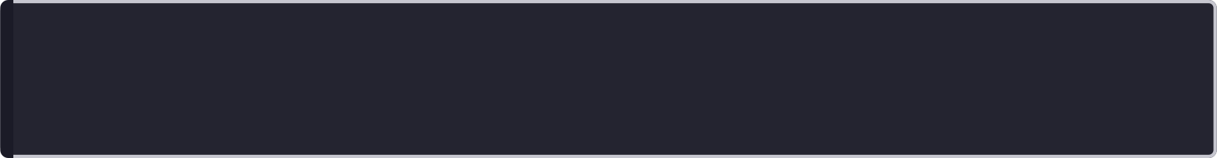


AI Classification Path: The Happy Path
When AI is available, the LLM classifies against a runtime-scoped JSON schema — the enum is built from the active profile, not hardcoded.
main.py — classify_intent_with_llm() (key parts)
Design Guarantees
# 1. Scope enum to only allowed intents
active_intents = tuple(
i for i in INTENTS
if i in allowed_intents
)
# 2. Build JSON schema at runtime
schema = {
"properties": {
"intent": {
"type": "string",
"enum": list(active_intents)
},
"confidence": {
"enum": ["high", "medium", "low"]
},
"reason": {
"type": "string",
"maxLength": 160
},
},
"additionalProperties": False,
}
# 3. System prompt — strict
system = (
"Classify the user's message using "
"the supported intent taxonomy. "
"Do not answer the user. "
"Do not predict a separate "
"relevance/category label — "
"the backend derives that "
"deterministically from the "
"chosen intent. "
"Use unknown when no supported "
"intent precisely covers the message."
)
# 4. Low confidence → force unknown
if parsed.confidence == "low":
return IntentClassification(
intent="unknown",
confidence="low", ...
)
Structural Constraint
JSON schema enum is built at runtime from the active profile — the model structurally cannot hallucinate out-of-taxonomy intents.
No Category Prediction
System prompt explicitly forbids category output. Backend derives it deterministically.
Low Confidence → unknown
A shaky prediction is never trusted. Forced to unknown before the gate.
Running Example
"ML course er price koto?"
→ intent: course_pricing_payment
→ confidence: high

Slide 7


Fallback Chain: When AI Fails
Two failure modes, two fallback levels. A valid AI unknown is not a failure — it is preserved as-is.
main.py — classify_intent() fallback chain
Sample EDTECH_INTENT_KEYWORDS Rules
async def classify_intent(
text,
allowed_intents=None
):
# Level 1: No API key → local immediately
if not OPENAI_API_KEY:
return local_fallback_outcome(
text,
"No API key",
allowed_intents
)
try:
result = await classify_intent_with_llm(
text, allowed_intents
)
return ClassificationOutcome(
result=result,
source="ai",
status="success"
)
except Exception as exc:
# Level 2: Exception → local if enabled
if intent_fallback_enabled():
return local_fallback_outcome(
text, str(exc), allowed_intents
)
return ClassificationOutcome(
result=fallback_classification(
str(exc)
),
source="ai",
status="failed"
)
Intent
Trigger Keywords
demo_trial_counseling
"human", "counselor", "call me", "phone"
course_pricing_payment
"price", "fee", "cost", "payment", "installment"
recording_access
"record", "recording", "recorded", "lms"
course_schedule_duration
"schedule", "batch", "duration", "class kobe"
Local classification is deterministic, zero-cost, and always available — it is the safety net, not the primary path.
Level 1: No API Key
Direct to local keyword classifier
Two‑Level Fallback Flow
Valid AI Unknown
Level 2: AI Exception
Preserve unchanged as valid unknown
Fallback enabled routes locally

Slide 8


Post-Classification Overrides
After the model classifies, business logic gets the final word. Three override rules, applied in sequence, always win over model output.
chat_orchestrator.py — inside plan_reply(), after classification
Override Layer Flow
# Override 1: Acknowledgement → force neutral
if dialogue_act == "acknowledgement" \
and "neutral" in profile.all_intents:
outcome = replace(outcome,
result=IntentClassification(
intent="neutral",
confidence="high",
reason="Acknowledgement dialogue act."
))
# Override 2: Explicit course list → force course_list
if is_explicit_course_list_request(text) and \
outcome.result.intent in {
"course_list", "career_guidance",
"neutral", "unknown"
}:
outcome = replace(outcome,
result=IntentClassification(
intent="course_list",
confidence="high",
reason="Explicit catalog request."
))
# Override 3: Confused/hesitant → career_guidance
if constraint_update.state \
.decision_support_state in {
"confused", "hesitant"
} and outcome.result.intent in {
"neutral", "unknown"
}:
outcome = replace(outcome,
result=IntentClassification(
intent="career_guidance",
confidence="high",
reason="Customer requested "
"decision support."
))
Classifier Output Enters
Raw intent from AI or local fallback
Override 1: Ack → neutral
Dialogue act = acknowledgement
Override 2: Catalog → course_list
Explicit course list request detected
Override 3: Confused → career_guidance
Decision support state = confused/hesitant
Final Intent Exits
Business logic always wins
Overrides are business logic, not model logic. They run after classification and always win.

Slide 9
End-to-End: One Message In, One Intent Out
Running example: "ML course er price koto?" — traced through every pipeline step.
Full Trace
5 Key Design Rules
User: "ML course er price koto?"
│
├─ resolve scope
│ → BusinessTypeProfile(edtech)
│ → KnowledgeBaseBundle
│
├─ detect dialogue act
│ → None (not greeting/acknowledgement)
│
├─ classifier(
│ "ML course er price koto?",
│ mode="ai",
│ allowed=edtech_allowed_intents
│ )
│ ├─ classify_intent_with_llm()
│ │ → JSON schema {
│ │ intent: enum[intents],
│ │ confidence, reason
│ │ }
│ │ → response: {
│ │ intent: "course_pricing_payment",
│ │ confidence: "high"
│ │ }
│ └─ returns IntentClassification(
│ intent="course_pricing_payment"
│ )
│
├─ allowed-intent gate
│ → course_pricing_payment
│ ∈ edtech_allowed_intents ✓
│
├─ post-classification overrides
│ → none triggered
│
└─ outcome: ClassificationOutcome(
result=intent="course_pricing_payment",
source="ai",
status="success"
)
│
▼ [CourseQueryResolver + CatalogMatcher
+ ReplyGenerator]
→ "ML for NLP course er price hocche
50,000 BDT. ..."
Rule
Enforcement
Category derived from intent, never predicted
normalize_prediction_category(intent, None) discards model category
AI-first, local is fallback only
intent_mode=ai tries LLM first; local only on operational failure
Valid AI unknown is NOT overwritten
Only intent_fallback_enabled() on exceptions, not on valid unknown
Business profile gates all intents
allowed_intents passed to classifier; rejected intents → unknown
Single classification per message
Orchestrator calls classifier once; answer strategies consume the result
Every rule is enforced structurally — by code, not convention. The pipeline cannot violate these constraints at runtime.

Slide 10





Architecture Summary: Why It's Built This Way
Each design decision in the pipeline exists to eliminate a specific failure mode. The architecture is defensive by construction.
Structural Hallucination Prevention
Runtime JSON schema enum built from active profile. The model cannot output an intent that isn't in the frozenset — structurally impossible, not just prompted away.
Deterministic Category Derivation
INTENT_TO_CATEGORY map is a static dictionary lookup. Zero inference, zero latency, fully auditable. Category is never a model concern.
Profile-Scoped Gating
The allowed-intent gate runs after every classification. Out-of-profile intents are hard-rejected to unknown regardless of model confidence.
Graceful Degradation
Two-level fallback chain ensures classification always returns a result. Local keyword rules are deterministic, zero-cost, and always available.
Business Logic Separation
Post-classification overrides are pure business logic, applied after the model. They are auditable, testable, and independent of model behavior.

Slide 11
One message in. One intent out. Every time.
19 Intents
1 Gate
3 Overrides
Pre-defined taxonomy. Model picks one.
Profile-scoped. Hard rejection on violation.
Business logic. Always wins over model.
0 Category Predictions
2 Fallback Levels
Derived deterministically. Never inferred.
Local is always available. Zero-cost safety net.
The pipeline is deterministic by design. Every constraint is structural — enforced by code, not convention. The model classifies. The system decides.

