Slide 1
Digital Forensics Agent System (DFAS) Intelligent Agents Module
BDI-Inspired Multi-Agent Framework
Koulthoum Flamerzi
Date: 13/10/2025

Slide 2
Overview & Objectives
Automated digital evidence collection & triage
Standards-aligned: ISO 27037, NIST SP 800-86, ACPO
Goals:
Integrity with SHA-256
Confidentiality with AES-GCM
Auditability via tamper-evident logs
Python 3.11 chosen for portability and DFIR ecosystem

Slide 3
System Requirements
Runtime: Windows, Ubuntu, macOS;
Python 3.11+
Core Libraries: watchdog, yara-python, python-magic, cryptography, SQLAlchemy, sqlite3
Optional: Sleuth Kit, Autopsy (GUI review)
Why Python?
Widely used, rich libraries, portability

Slide 4
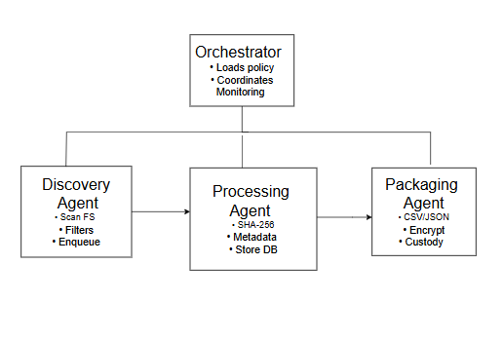
Agent Architecture
BDI Model: Beliefs → Desires → Intentions
Agents:
Discovery – finds target files
Processing – hashing, metadata extraction
Packaging – encryption & reporting
Transport – upload securely ( can be used s3 )
Orchestrator – coordinates agents

Slide 5
Processing Pipeline
1. Plan: Load policy
2. Discover: Scan paths, apply filters
3. Process: Hash, extract metadata, YARA
4. Package: CSV/JSON reports + encrypted archive
5. Transmit: Secure upload + checksum verification

Slide 6
Security & Compliance
Immutability: Read-only acquisition
Integrity: SHA-256 with multi-stage verification
Confidentiality: AES-GCM encryption & key rotation
Auditability: Append-only hash-chained logs
Compliance: ISO 27037/42/43, NIST SP 800-86, ACPO

Slide 7
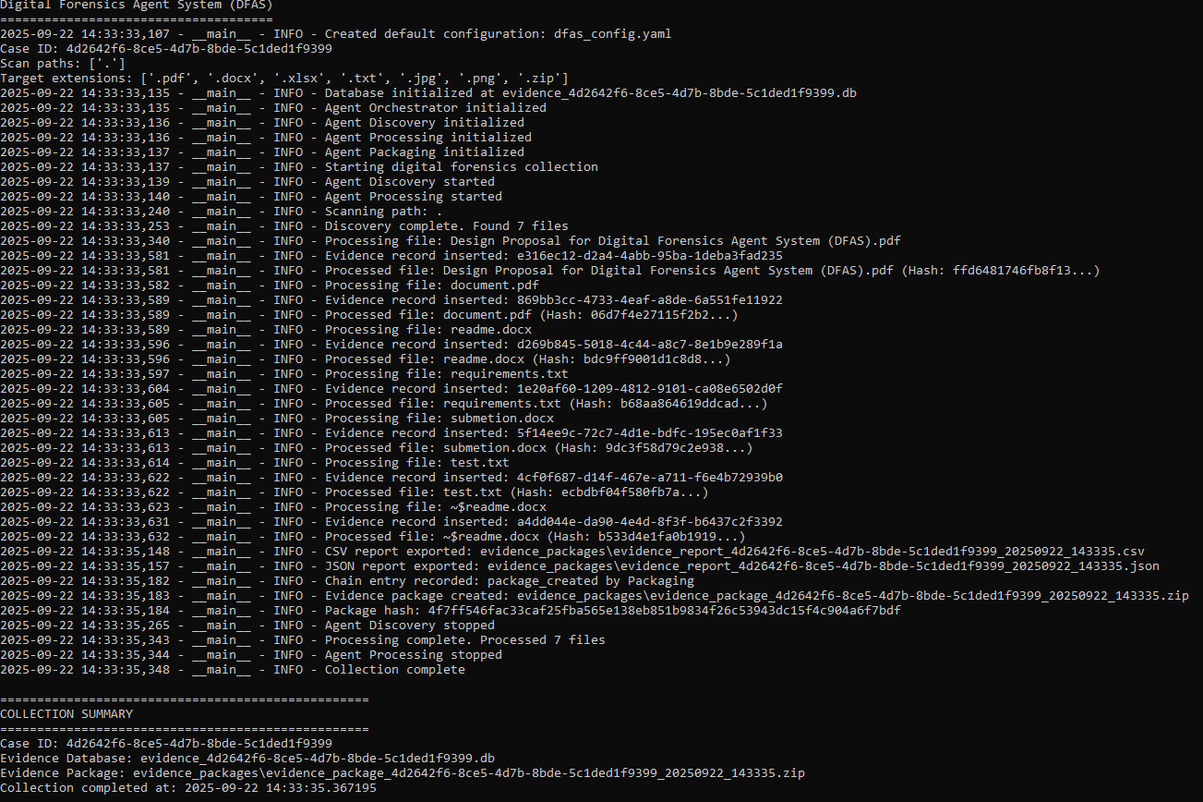
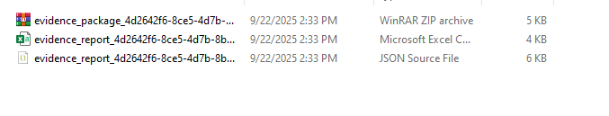
Implementation Evidence
Log evidence: discovery, processing, packaging
Example log entries:
– Found 7 files
– Processed: Design Proposal… (Hash: ffd64817…)
– Evidence package created (hash: 4f7ff546…)
Outputs: CSV + JSON reports, SQLite DB

Slide 8
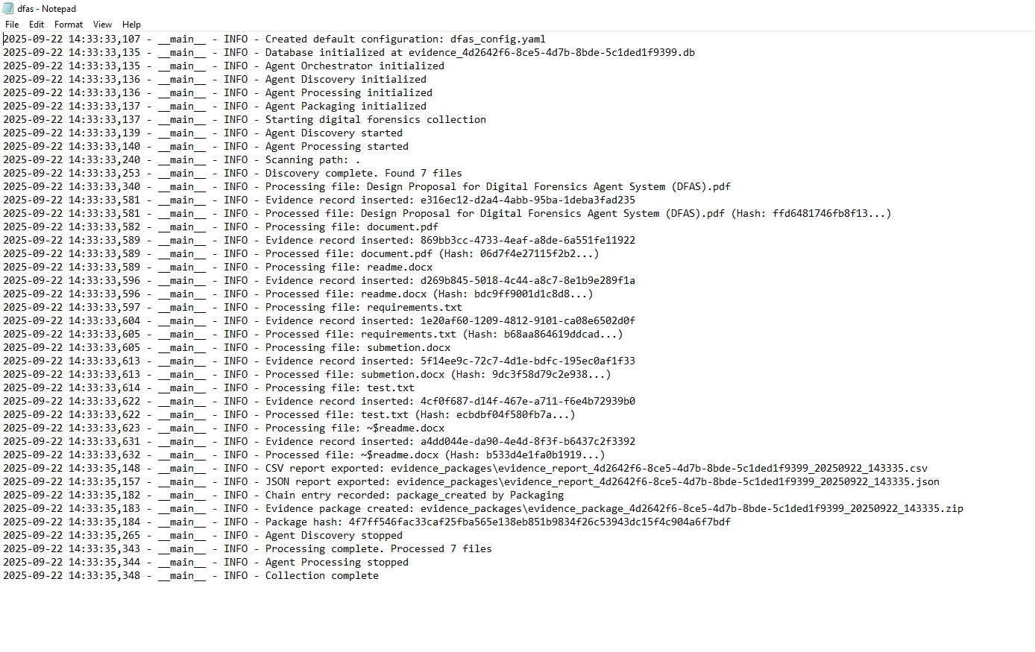
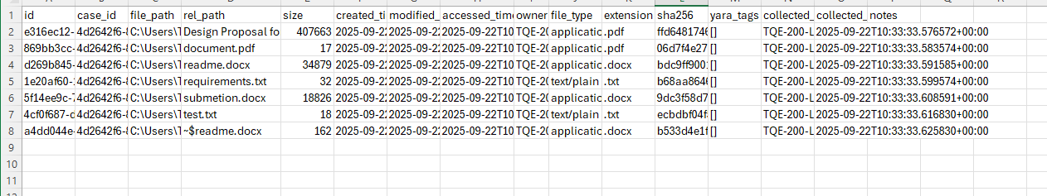

Slide 9
Testing & Validation
Unit tests: hashing, file typing, archive integrity
Integration: end-to-end validation on corpus
Repeatable results: same inputs → same hashes
Outputs verified: CSV/JSON validated, package integrity checked

Slide 10
Strengths & Challenges
Strengths:
Standards-compliant evidence handling
Modular, agent-based, portable
Challenges:
File spoofing – mitigated with libmagic + YARA
Large data volumes – filters, multiprocessing
Evidence security – AES-GCM, key rotation

Slide 11
Conclusion
DFAS enables reliable, auditable digital evidence collection
Produces encrypted, standards-aligned outputs
Supports defensible analysis and reporting
Future scope: live monitoring, dashboards, DB scaling

