Slide 1
Talent Trail
Final Team Presentation

Slide 2
A Career Gap Analysis Tool
Sarah Suliman:
Mark Olmscheid
Kassidy Flick
Lisa Wilder
Sarah Suliman
Course:
Software Development Tools & Methods

Slide 3
Problem Motivation
Lisa Wilder:
Many people struggle to accurately evaluate their skills and readiness for a desired career
Determining the steps needed to reach a dream job can feel overwhelming
Online information is often inconsistent and difficult to navigate
Goal:
Leverage real-world data from O*NET to compare a user’s current skills with career requirements and generate a clear report identifying skill gaps and actionable steps toward potential careers.

Slide 4
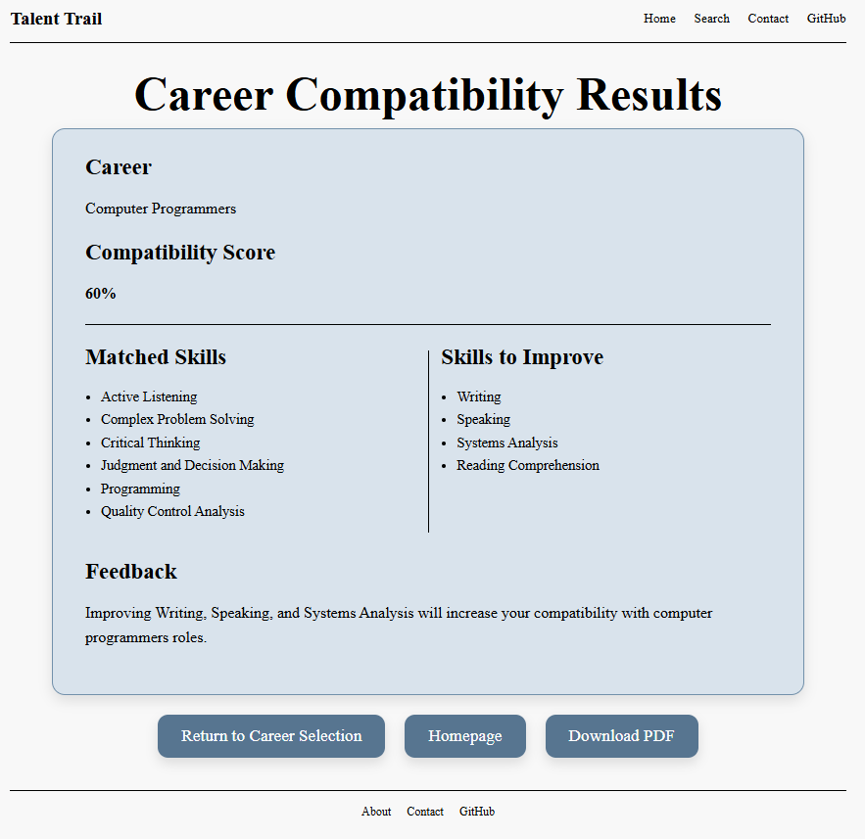
Sarah Suliman:
Talent Trail enables users to:
Select a desired career
Self-assess their skills relevant to that career
Receive a match percentage
Compare their current skills to O*NET skill expectations
Generate a report highlighting skill gaps and areas for improvement

Slide 5
Demo Flow Overview
Mark Olmscheid:
User lands on the homepage
User navigates to career selection
User selects a career from a dropdown menu
The system retrieves:
Career title
Top importance-ranked skills for the selected career
User completes a skills survey (rated on a 0–7 scale)
5. The system:
Calculates a compatibility score
Identifies skill gaps
6. Results page displays:
Compatibility score (percentage)
Matched skills
Skills to Improve
7. User clicks a button to generate a
PDF report
8. PDF report is generated and
downloaded

Slide 6


Slide 7
System Architecture Overview
Lisa Wilder:
Frontend: HTML, CSS
Backend: Python, Flask
Database: SQLite, O*NET
User
Frontend (HTML/CSS)
Backend (Python, Flask)
PDF Generation (HTML → PDF)
User Download
SQLite Database (O*NET Data)

Slide 8
Tools Used
Mark Olmscheid:
Tool | Purpose | Evaluation
Python | Backend logic, API, skill gap calculations | Excellent: Flexible, well-supported
Flask | Web server for routing and templating | Excellent: Lightweight and easy to integrate
SQLite | Store and query O*NET data | Good: Simple for MVP, but large dataset posed performance challenges
HTML/CSS | Frontend layout and styling | Excellent: Easy to customize
WeasyPrint | PDF report generation | Good: Worked well once configured, learning curve was steep
GitHub | Version control, collaboration | Excellent: Crucial for managing code and merge conflicts
JupyterHub | Development and testing | Mixed: Proxy URL and dataset size caused issues
Notes:
Tools used aligned with class structure and material, difficult to choose early on due to lack of domain knowledge.

Slide 9
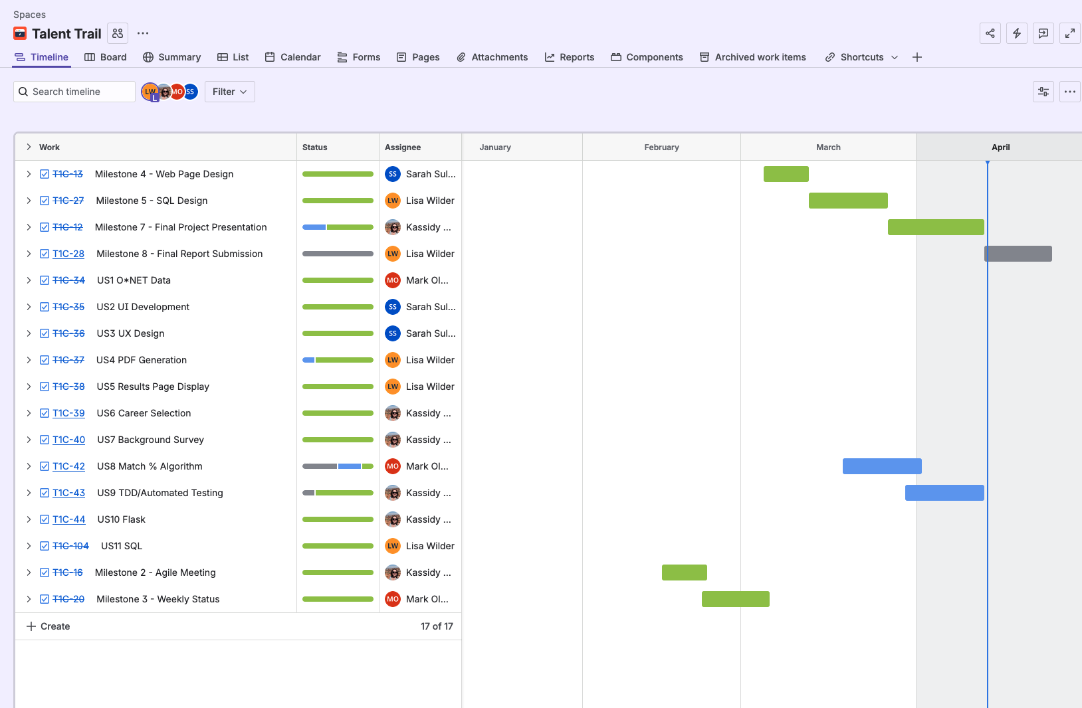
Tools Used
Lisa Wilder:
Jira Board:
Track tasks, ownership and team progress
Communication about tasks
Visual representation of status of project
Initially the board had a minimal framework that grew as the project evolved
Notes:
Tools used aligned with class structure and material, difficult to choose early on due to lack of domain knowledge.

Slide 10
Key Features Implemented
Kassidy Flick:
Career Selection & Skill Retrieval
Browse Careers from the O*NET Database
Automatically fetch the most important skills for selected career
Personalized Skill Survey
Users rate their proficiency in each skill (0-7)
Feedback and Guidance
Suggests which skills to focus on for career compatibility
Skill Gap Analysis & Compatibility Score
Compares user ratings to O*NET skill levels
Calculates a compatibility score based on if the user meets or exceeds the O*NET baseline
Highlights matched skills and skills that need improvement
PDF Report Generation
Generates a downloadable, formatted PDF of survey results and O*NET proficiency comparison

Slide 11

Compatibility Score
Mark Olmscheid:
Users rate their proficiency in each skill (0–7 scale, matching O*NET Leveling system)
For each skill, the app compares the user rating to the O*NET baseline
If the user meets or exceeds the O*NET Level, that skill is counted as a match.

Slide 12

Weighted Gap Methodology
Mark Olmscheid:
Scale | What It Measures | Range
Importance | How crucial a skill, task, or knowledge is to the job | 1–5
Level | How proficient or advanced a skill needs to be | 0–7
Users rate their proficiency in each selected skill
Raw gap is calculated
Negative gaps are reset to zero (not treated as a deficiency if above O*NET Level)
Gap is weighted by importance
Weighted gap is used to rank skills from the highest priority deficiency to lowest.
Notes:
Weighted gap just means that the importance is ranked using the ONET importance. If the skill is a 5, the gap is multiplied by 1, if the importance is a 4, the gap is multiplied by .8, etc.

Slide 13
Major Technical Challenges
Lisa Wilder:
Handling Large O*NET Data
Processing and querying the full database efficiently on JupyterHub
JupyterHub Proxy & URL Routing
Adapting Flask routes to work behind the JupyterHub service prefix
PDF Generation
Learning and implementing libraries (WeasyPrint) to dynamically create reports

Slide 14
What Went Well
Kassidy Flick:
Backend Functionality
Successfully integrated Flask with SQLite and O*NET data
Implemented skill gap calculation and weighted gap ranking
User Flow & Frontend
Smooth career selection and survey experience
Clear display of match scores and skill gaps
Standard CSS styling throughout entire website
Early usability improved overall design
PDF Report Generation
Downloadable reports created from survey results
Problem-Solving & Learning
Overcame challenges with JupyterHub proxy URLs
Learned new tools like WeasyPrint
Data Handling
Efficient queries for top skills and career-level information

Slide 15
What Could Have Gone Better
Sarah Suliman:
Time Management
Busy schedules caused uneven progress
Team Communication
In the beginning, coordination issues led to delays and caused some miscommunications
MVP Scope Adjustment
Removed previous experience and education from compatibility scoring and user reports to meet deadlines
Version Control & Merging Conflicts
PDF Generation
Implementing final report generation and design towards the end of the project, which caused some last minute minor bugs
Large & Complex Database
Many tables and schemas made initial querying and integration tricky

Slide 16
Lessons Learned
Lisa Wilder:
Time & Scope Management
Break work into smaller milestones to avoid last-minute pressure
Prioritize core MVP features over “nice-to-haves”
Team Communication
Frequent check-ins and clear task assignments reduce misunderstandings
Version control best practices prevent merge conflicts
Technical Insights
Large datasets require careful querying and memory management
Learning new libraries takes additional time
Backend design should anticipate proxy environments (like JupyterHub)

Slide 17
Potential Future Expansions
Kassidy Flick:
Feature | Description | Benefit
Incorporate Experience and Education | Include previous work experience and education in compatibility scoring | Produces a more holistic and accurate assessment of career readiness
Education Distribution Visualization | Display typical education distribution for selected careers | Helps users understand common career paths and educational requirements
Multi-Career Comparison | Compare user skills across multiple careers | Helps users explore alternative career paths and make informed decisions
User Accounts & Saved Reports | Enable login and report saving for multiple sessions | Supports long-term tracking and personalized planning
Trie Tree Career Selection | Replace career selection dropdown with Trie Tree algorithm | Faster and more intuitive career search. Improves UX

Slide 18
Final Reflection
Sarah Suliman:
We learned how to:
Plan and deliver iterative milestones, adjusting the MVP as needed
Collaborate effectively using GitHub, including managing merge conflicts
Handle technical challenges with large datasets and proxy environments (JupyterHub)
Integrate multiple backend and frontend components in a full-stack project
Generate and format professional PDF reports from dynamic data
See a project through from idea to demo

Slide 19
Thank You
Any Questions?
GitHub:
https://github.com/kflick3r/Talent_Trail

