Slide 1

Phylogen
PHYLOGENETICS DATA INTERFACE
UPDATE
KEVIN FLORIAN JOSHUA ROWE ERICA WRIGHT

Slide 2
What We Are Building
Phylogenetic data input program.
Takes gathered data from user and translates it into NEXUS format.
Also can autofill some selections for user to speed up data entry and serve to make entered data conform to what is required.
Can take files from NEXUS and autofill data for user to modify and then translate back to NEXUS.
Potentially, a subset of the phylogenetic analysis that PAUP encounters.

Slide 3
Technologies
C# - main langauge
Platform – Xamarian cross platform (Windows, OS X, iOS, Android)
.NET (Mono open source)
PhyloXML – to store data in a well represented phylogenetic format
Graphing libraries such as D3
Tools:
Visual Studio / Xamarian Studio
Pivotal Tracker – Agile progress tracker / organizer
Slack – team communication

Slide 4
Structures
Little to no traditional data structures (XML is stored in files).
We might require lists or other simple containers when processing user input and other file input, but this is only an intermediate format. *We could instantly write to file, versus having some storage in the middle too*
Data objects – mostly Xamarian and native C# classes.

Slide 5
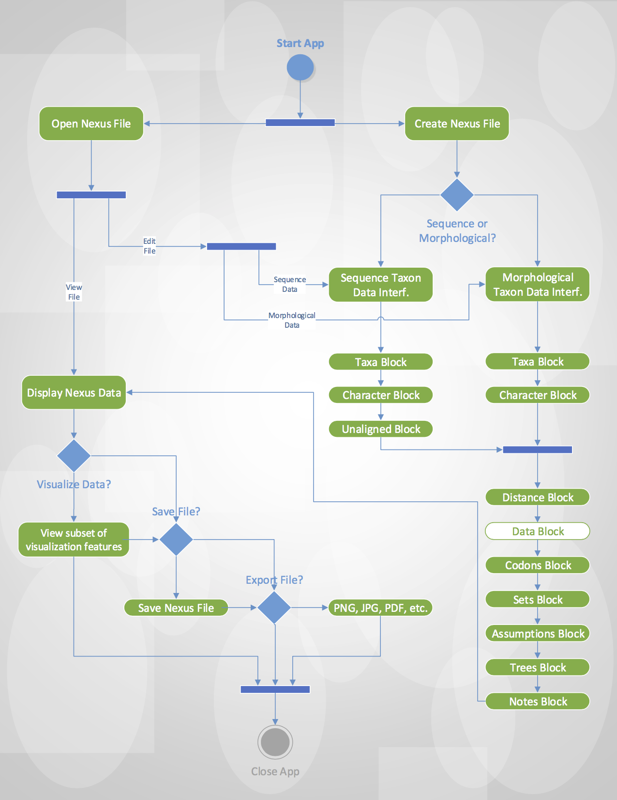
Architecture

Slide 6
Procedural Design “User Stories”
Are used to provide enough detail to implement, but does not specify too much before actually coding
Alludes to a dynamic approach when implementing that allows a solution to grow and change during development.
It’s what Pivotal Tracker uses as the base of a unit of work!

Slide 7
Our User Stories (So Far)
User can start and exit app. (No content at first)
User can see fields and dialogs to enter appropriate information.
User can enter information into program via fields / dialogs.
User can use prompted autofill information after entering initial info.
User can request loading information from file (NEXUS format)
User can output entered information to NEXUS for processing in phylo-analysis app.
User can output JPG, PNG, etc. of the Trees block.
User can output JPG, PNG, etc. of their entered information.
User can see traditional menu options (undo, redo etc.)

Slide 8
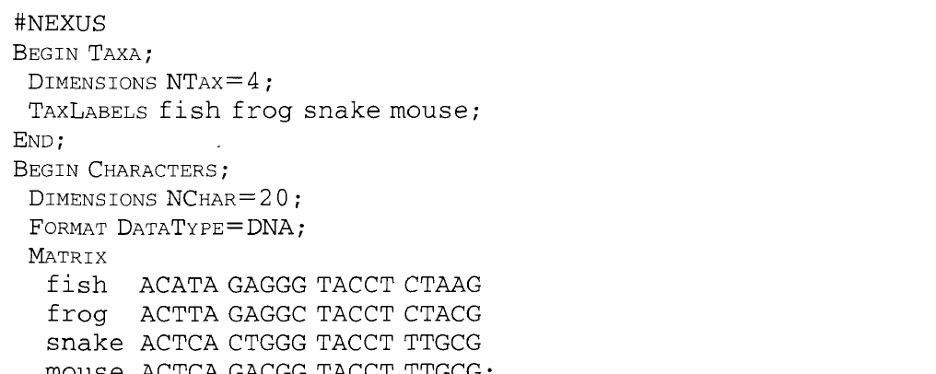
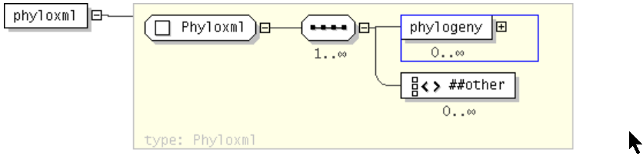
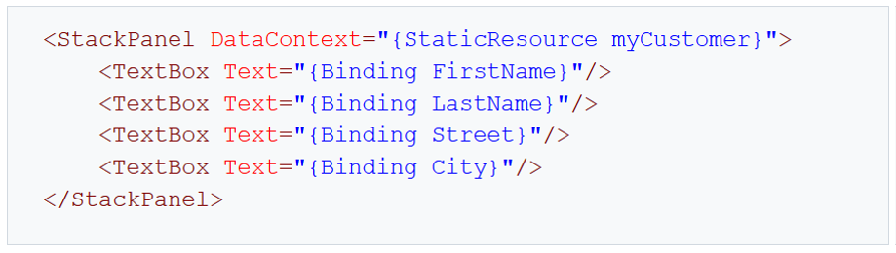
NEXUS
PhyloXML
XAML

Slide 9
NEXUS
PhyloXML
XAML

