Slide 1
Phylogen
PHYLOGENETICS DATA INTERFACE
SOFTWARE REQUIREMENTS SPEC
KEVIN FLORIAN JOSHUA ROWE ERICA WRIGHT

Slide 2

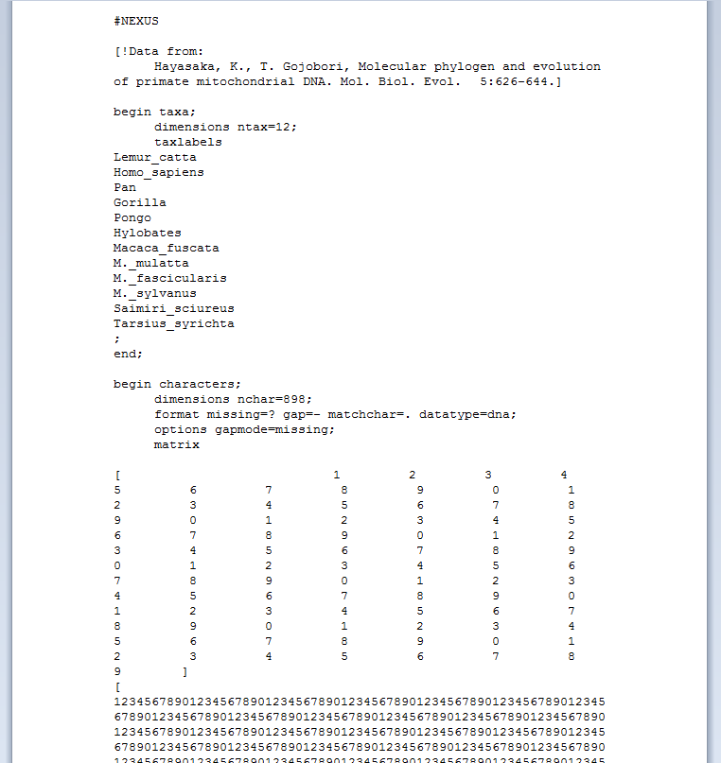
Purpose
Nexus file generator
Subset of phylogenetic analyses
Easy UI to aid in process
Allows end user to range from beginning biology student to an experienced phylogenetic researcher

Slide 3
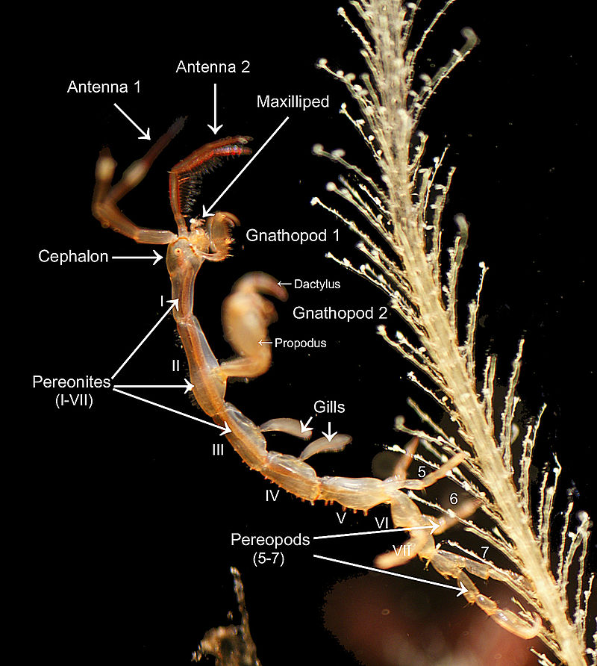
Definitions
Taxa - taxonomic category or group, such as a phylum, order, family, genus, or species.
Phylogeny - is the study of phylogenesis, or the evolutionary history, development and relationships among groups of organisms (e.g.species, or populations)
Morphological data – Morphology, a branch of biology dealing with the study of the form/structure of organisms and their features

Slide 4
Definitions
GenBank - is the NIH genetic sequence database, an annotated collection of all publicly available DNA sequences
Nexus File – As of now, the plain text file that PAUP, and systems like it, use to compare the taxa and DNA elements to determine how closely a set of organisms are related in evolution
PAUP- is a computational phylogenetics program for inferring evolutionary trees (phylogenies)
er

Slide 5
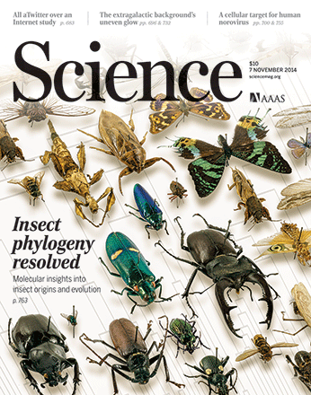
System Overview
This system would be used exclusively by biologists and biology students
System would simplify the data process in Phylogenetic analysis
Students currently face a hurdle in acclimating to current Phylogenetic analysis software
PHYLOGEN would ease the current process in PAUP/other in obtaining phylogenies
Current process is time-consuming even for biologists; PHYLOGEN would fill this niche, with an emphasis on education field

Slide 6
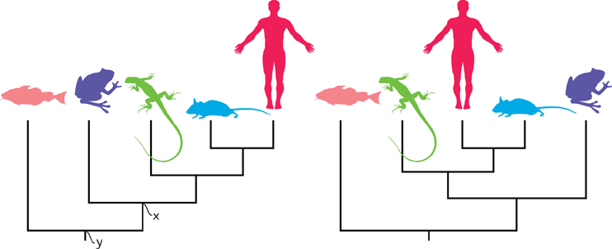
References
Increased productivity in analyses will save time and money as current processes are time-consuming
New data interface will create time efficiencies for biologists in research, professors in Universities, and students of Phylogenetics
Software familiarization
Because this niche is in research/education, time cost here will be on professors implementing into curriculum, scientists into workflow
…

Slide 7
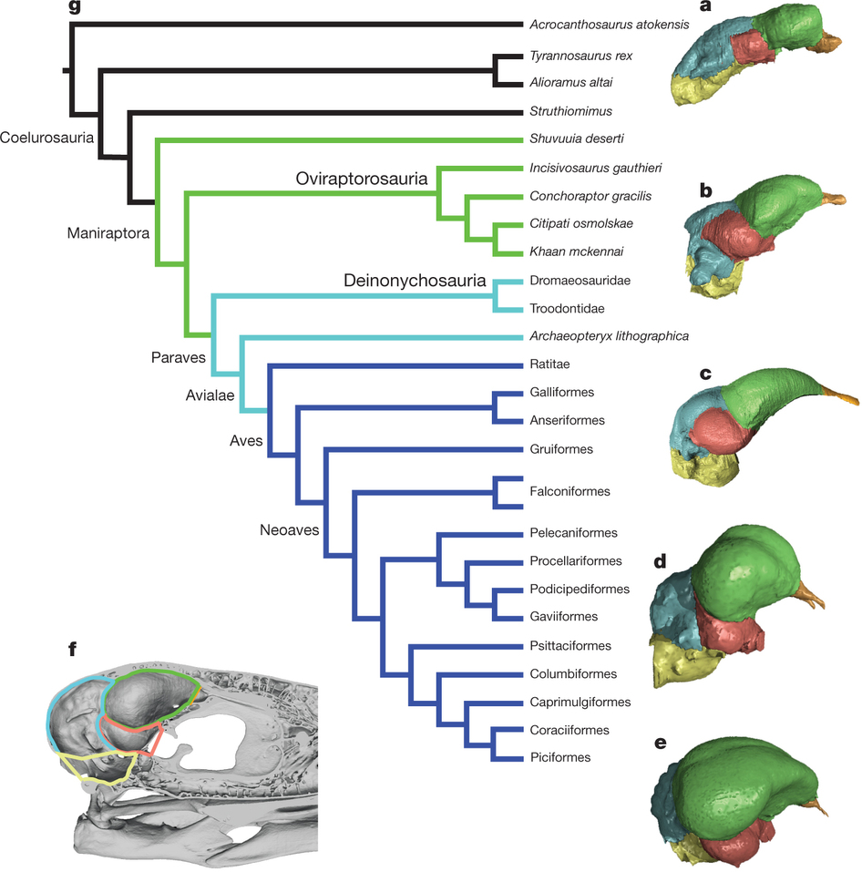
System Interfaces
Phylogeny is highly informative to other related disciplines
There are a vast number of applications that perform Phylogeny research, yet they are outdated in terms of UI, and few target the Education field
A modern UI for Nexus-File Manipulation on a mobile-friendly platform will set our niche package apart from the rest.
With efficient PAUP integration, our interface will serve as a powerful phylogenetic analysis launchpad
students will benefit from its mobility, clarity, and efficiency

Slide 8
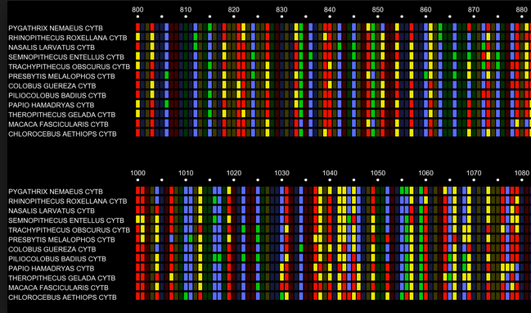
User Interfaces
There really are no alternative solutions to this very particular vacancy/pinch in the process.
due to the already established algorithms and analysis methods in this branch of bioinformatics
given the traditional common data format of NEXUS files

Slide 9
Hardware Interfaces
There really are no alternative solutions to this very particular vacancy/pinch in the process.
due to the already established algorithms and analysis methods in this branch of bioinformatics
given the traditional common data format of NEXUS files

Slide 10
Software Interfaces
There really are no alternative solutions to this very particular vacancy/pinch in the process.
due to the already established algorithms and analysis methods in this branch of bioinformatics
given the traditional common data format of NEXUS files

Slide 11
Communication Interfaces
There really are no alternative solutions to this very particular vacancy/pinch in the process.
due to the already established algorithms and analysis methods in this branch of bioinformatics
given the traditional common data format of NEXUS files

Slide 12
Memory Constraints
There really are no alternative solutions to this very particular vacancy/pinch in the process.
due to the already established algorithms and analysis methods in this branch of bioinformatics
given the traditional common data format of NEXUS files

Slide 13
Operations
There really are no alternative solutions to this very particular vacancy/pinch in the process.
due to the already established algorithms and analysis methods in this branch of bioinformatics
given the traditional common data format of NEXUS files

Slide 14
Site Adaptation Requirements
There really are no alternative solutions to this very particular vacancy/pinch in the process.
due to the already established algorithms and analysis methods in this branch of bioinformatics
given the traditional common data format of NEXUS files

Slide 15
Product Functions
Increased productivity in analyses will save time and money as current processes are time-consuming
New data interface will create time efficiencies for biologists in research, professors in Universities, and students of Phylogenetics
Software familiarization
Because this niche is in research/education, time cost here will be on professors implementing into curriculum, scientists into workflow
…

Slide 16
Product Functions
Increased productivity in analyses will save time and money as current processes are time-consuming
New data interface will create time efficiencies for biologists in research, professors in Universities, and students of Phylogenetics
Software familiarization
Because this niche is in research/education, time cost here will be on professors implementing into curriculum, scientists into workflow
…

Slide 17
User Characteristics
Increased productivity in analyses will save time and money as current processes are time-consuming
New data interface will create time efficiencies for biologists in research, professors in Universities, and students of Phylogenetics
Software familiarization
Because this niche is in research/education, time cost here will be on professors implementing into curriculum, scientists into workflow
…

Slide 18
Constraints/Assumptions
Increased productivity in analyses will save time and money as current processes are time-consuming
New data interface will create time efficiencies for biologists in research, professors in Universities, and students of Phylogenetics
Software familiarization
Because this niche is in research/education, time cost here will be on professors implementing into curriculum, scientists into workflow
…

Slide 19
Specific Requirements
Increased productivity in analyses will save time and money as current processes are time-consuming
New data interface will create time efficiencies for biologists in research, professors in Universities, and students of Phylogenetics
Software familiarization
Because this niche is in research/education, time cost here will be on professors implementing into curriculum, scientists into workflow
…

Slide 20
External Interface Requirements
Increased productivity in analyses will save time and money as current processes are time-consuming
New data interface will create time efficiencies for biologists in research, professors in Universities, and students of Phylogenetics
Software familiarization
Because this niche is in research/education, time cost here will be on professors implementing into curriculum, scientists into workflow,
…

Slide 21
Functional Requirements
Phylogeny is highly informative to other related disciplines
There are a vast number of applications that perform Phylogeny research, yet they are outdated in terms of UI, and few target the Education field
A modern UI for Nexus-File Manipulation on a mobile-friendly platform will set our niche package apart from the rest.
With efficient PAUP integration, our interface will serve as a powerful phylogenetic analysis launchpad
students will benefit from its mobility, clarity, and efficiency

Slide 22
Performance Requirements
Phylogeny is highly informative to other related disciplines
There are a vast number of applications that perform Phylogeny research, yet they are outdated in terms of UI, and few target the Education field
A modern UI for Nexus-File Manipulation on a mobile-friendly platform will set our niche package apart from the rest.
With efficient PAUP integration, our interface will serve as a powerful phylogenetic analysis launchpad
students will benefit from its mobility, clarity, and efficiency

Slide 23
Design Constraints
Phylogeny is highly informative to other related disciplines
There are a vast number of applications that perform Phylogeny research, yet they are outdated in terms of UI, and few target the Education field
A modern UI for Nexus-File Manipulation on a mobile-friendly platform will set our niche package apart from the rest.
With efficient PAUP integration, our interface will serve as a powerful phylogenetic analysis launchpad
students will benefit from its mobility, clarity, and efficiency

Slide 24
Database Requirement
Phylogeny is highly informative to other related disciplines
There are a vast number of applications that perform Phylogeny research, yet they are outdated in terms of UI, and few target the Education field
A modern UI for Nexus-File Manipulation on a mobile-friendly platform will set our niche package apart from the rest.
With efficient PAUP integration, our interface will serve as a powerful phylogenetic analysis launchpad
students will benefit from its mobility, clarity, and efficiency

Slide 25
Software System Attributes
Phylogeny is highly informative to other related disciplines
There are a vast number of applications that perform Phylogeny research, yet they are outdated in terms of UI, and few target the Education field
A modern UI for Nexus-File Manipulation on a mobile-friendly platform will set our niche package apart from the rest.
With efficient PAUP integration, our interface will serve as a powerful phylogenetic analysis launchpad
students will benefit from its mobility, clarity, and efficiency

Slide 26
Reliability & Security
There really are no alternative solutions to this very particular vacancy/pinch in the process.
due to the already established algorithms and analysis methods in this branch of bioinformatics
given the traditional common data format of NEXUS files

Slide 27
Availability & Portability
There really are no alternative solutions to this very particular vacancy/pinch in the process.
due to the already established algorithms and analysis methods in this branch of bioinformatics
given the traditional common data format of NEXUS files

Slide 28
Maintainability & Security
There really are no alternative solutions to this very particular vacancy/pinch in the process.
due to the already established algorithms and analysis methods in this branch of bioinformatics
given the traditional common data format of NEXUS files

