Slide 1

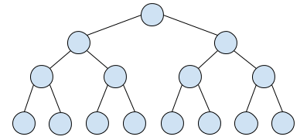

IsPresent( key1 ) = NO
IsPresent( key2 ) = LIKELY
hashes
Bloom filter
(key presence check)
1
crash log (key/value, on-disk, append-only)
read(key2)
write
5
4
3
2
index 1
index 2
index 3
index 4
memtable
(balanced BST: red black, AVL, ...)
CRASH RECOVERY
SSTable 1
SSTable 2
SSTable 3
SSTable 4
MERGE & COMPACT
merge sort by (key, -creation_time)
Time
in-memory
Created by: @lukefei
on-disk

