Slide 1
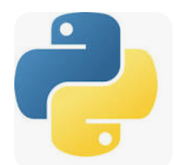
Python
Project3: Converting Speech To Text

Slide 2
Use Case Details
Convert speech to text using laptop microphone

Slide 3
Required Libraries
speech_recognition
pyttsx3 - is a text-to-speech (TTS) conversion library in Python that works offline and supports multiple speech engines:
sapi5 (Windows)
nsss (Mac)
espeak (Linux)

Slide 4
Step1: Import the modules
import speech_recognition as sr
import pyttsx3

Slide 5
Step2: Build a function to convert speech to text
def speechToText(command):
#initialize the engine
engine = pyttsx3.init()
engine.say(command)
engine.runAndWait()

Slide 6
Step3: Continue loop to recognize speech from microphone
with sr.Microphone() as source2:
# wait for some time to adjust the surround noise level
r.adjust_for_ambient_noise(source2,duration=0.2)
#listens for the user's input
audio2 = r.listen(source2)
# Using google to reognize audio
myText = r.recognize_google(audio2)
myText = myText.lower()
# Print what user said
print("Did you say:",myText)
# calling speaktoText function
speaktoText(myText)

