Slide 1

caretStack
Notes:
Package developed by Henry and me
Machine learning ensemble method
Intended to be user-friendly – ask for help!

Slide 2
Pros:
More flexible than other prediction methods – variables are not required to be normal or uncorrelated/independent
Usable for a relatively low N/P ratio
Can identify a wider variety of relationships (i.e. linear, nonlinear, piecewise relationships and local interactions)
Higher accuracy
Also gives variable importance
Cons:
Takes longer to train
More difficult to interpret
Always use a simpler method if you can.

Slide 3
Base learner – prediction algorithm, machine learning model
Stacking – combining the predictions of more than one machine learning model to increase the accuracy of the final prediction. “Wisdom of crowds” approach.
Nested Cross Validation – cross validation performed on more than one level. For this method, we have two levels of cross-validation.

Slide 4

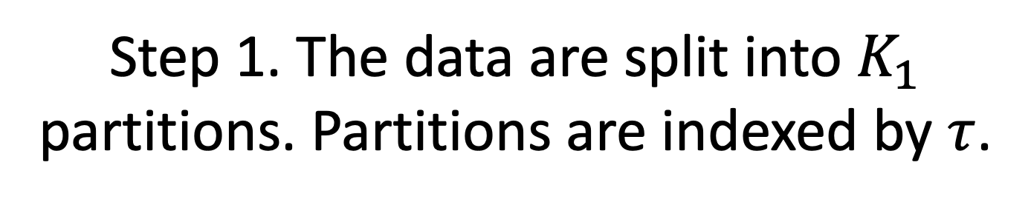


Step 1. The data are split into $K_{1}$ partitions. Partitions are indexed by $τ$.
$$τ=1$$
$$τ=2$$
…
$$τ=K_{1}$$

Slide 5
Step 2. One partition is set aside as a testing set. The other partitions are used as the training set, which is input into the inner loop.
$$τ=1$$
$$τ=2$$
…
$$τ=K_{1}$$
Training set
Inner loop

Slide 6








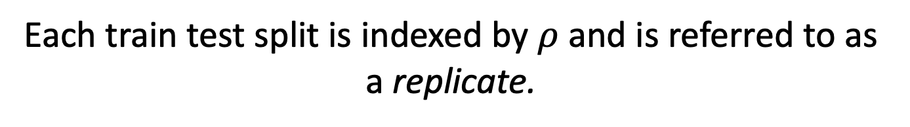











Each train test split is indexed by $ρ$ and is referred to as a replicate.
$$ρ=1$$
$$τ=1$$
$$τ=2$$
$$τ=3$$
$$…$$
$$τ=K_{1}$$
$$ρ=2$$
$$τ=1$$
$$τ=2$$
$$τ=3$$
$$…$$
$$τ=K_{1}$$
$$ρ=3$$
$$τ=1$$
$$τ=2$$
$$τ=3$$
$$…$$
$$τ=K_{1}$$
…
$$ρ=K_{1}$$
$$τ=1$$
$$τ=2$$
$$τ=3$$
$$…$$
$$τ=K_{1}$$
Testing set
Training set

Slide 7


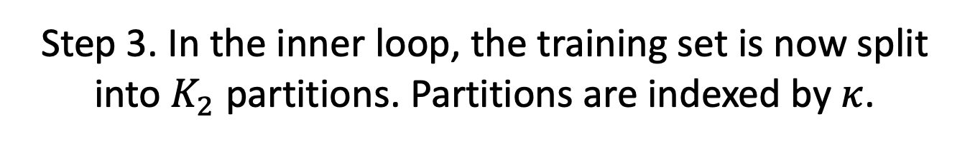



Step 3. In the inner loop, the training set is now split into $K_{2}$ partitions. Partitions are indexed by $κ$.
$$τ=1$$
$$τ=2$$
…
$$τ=K_{1}$$
$$κ=1$$
$$κ=2$$
…
$$κ=K_{2}$$

Slide 8


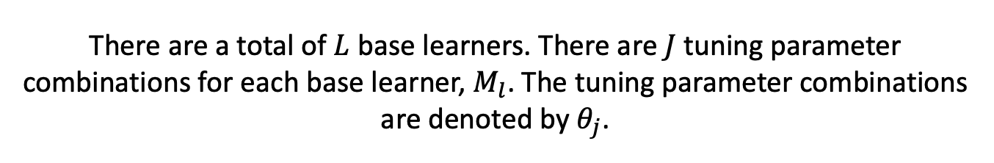



There are a total of $L$ base learners. There are $J$ tuning parameter combinations for each base learner, $M_{l}$. The tuning parameter combinations are denoted by $θ_{j}$.
$$θ_{1}$$
$$θ_{2}$$
$$M_{l}$$
$$θ_{3}$$
…
$$θ_{J}$$

Slide 9

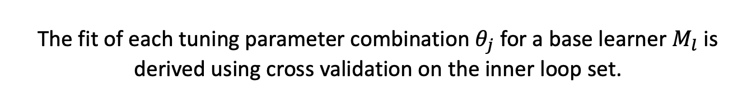
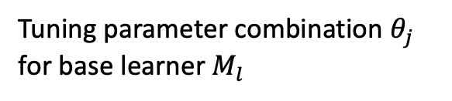


The fit of each tuning parameter combination $θ_{j}$ for a base learner $M_{l}$ is derived using cross validation on the inner loop set.
$$κ=1$$
$$κ=2$$
…
$$κ=K_{2}$$
Training set
Tuning parameter combination $θ_{j}$ for base learner $M_{l}$

Slide 10


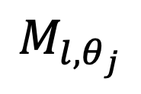
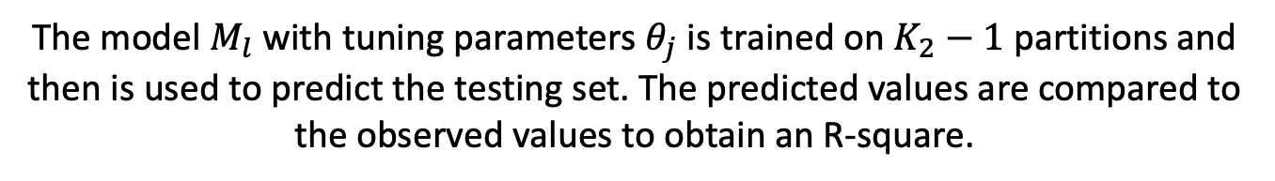




The model $M_{l}$ with tuning parameters $θ_{j}$ is trained on $K_{2}−1$ partitions and then is used to predict the testing set. The predicted values are compared to the observed values to obtain an R-square.
$$κ=2$$
$$κ=3$$
$$…$$
$$κ=K_{2}$$
$$M_{l, θ_{j}}$$
$$R^{2}$$
$$κ=1$$

Slide 11








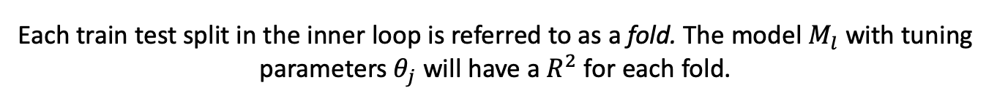








Each train test split in the inner loop is referred to as a fold. The model $M_{l}$ with tuning parameters $θ_{j}$ will have a $R^{2}$ for each fold.
$$R^{2}$$
$$κ=1$$
$$κ=2$$
$$κ=3$$
$$…$$
$$κ=K_{2}$$
$$R^{2}$$
$$κ=1$$
$$κ=2$$
$$κ=3$$
$$…$$
$$κ=K_{2}$$
$$R^{2}$$
$$κ=1$$
$$κ=2$$
$$κ=3$$
$$…$$
$$κ=K_{2}$$
…
$$R^{2}$$
$$κ=1$$
$$κ=2$$
$$κ=3$$
$$…$$
$$κ=K_{2}$$
Testing set
Training set

Slide 12



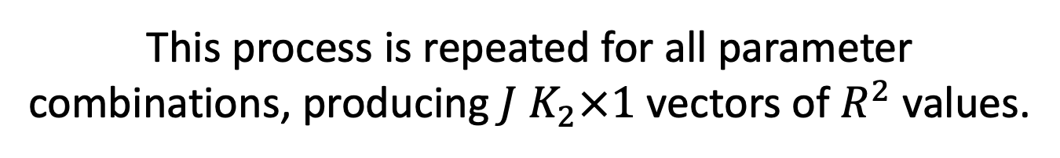






This process is repeated for all parameter combinations, producing $J$ $K_{2}×1$ vectors of $R^{2}$ values.
$$θ_{1}$$
$K_{2}$ $R^{2}$’s
$$θ_{2}$$
$K_{2}$ $R^{2}$’s
$$M_{l}$$
$$θ_{3}$$
$K_{2}$ $R^{2}$’s
…
$$θ_{J}$$
$K_{2}$ $R^{2}$’s

Slide 13
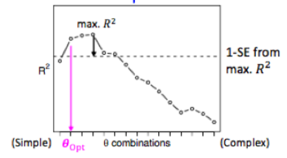

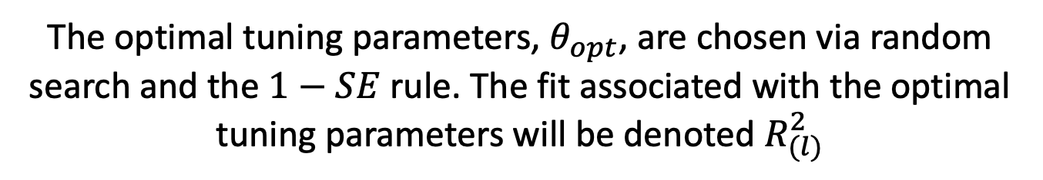




The optimal tuning parameters, $θ_{opt}$, are chosen via random search and the $1−SE$ rule. The fit associated with the optimal tuning parameters will be denoted $R_{(l)}^{2}$
max $R^{2}$
$1−SE$ from max $R^{2}$
$$R^{2}$$
| | | | | | | | | | | | | | |
(Simple)
$$θ_{opt}$$
$θ$ combinations
(Complex)
Notes:
1-se method: chooses the largest smoothing parameter within one standard error of the optimum.

Slide 14
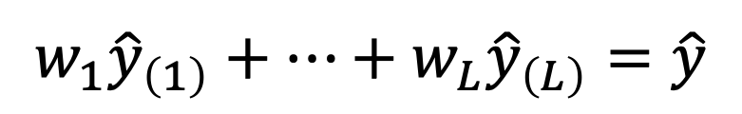
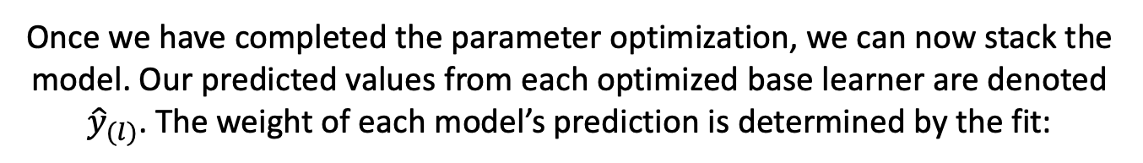
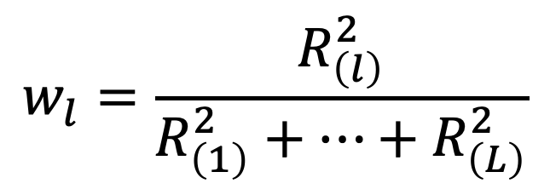
Once we have completed the parameter optimization, we can now stack the model. Our predicted values from each optimized base learner are denoted ${\hat{y}}_{(l)}$. The weight of each model’s prediction is determined by the fit:
$$w_{l}=\frac{R_{\left(l\right)}^{2}}{R_{\left(1\right)}^{2}+…+R_{\left(L\right)}^{2}}$$
Thus, the stacked model for this replicate is described as
$$w_{1}{\hat{y}}_{\left(1\right)}+…+w_{L}{\hat{y}}_{\left(L\right)}=\hat{y}$$

Slide 15


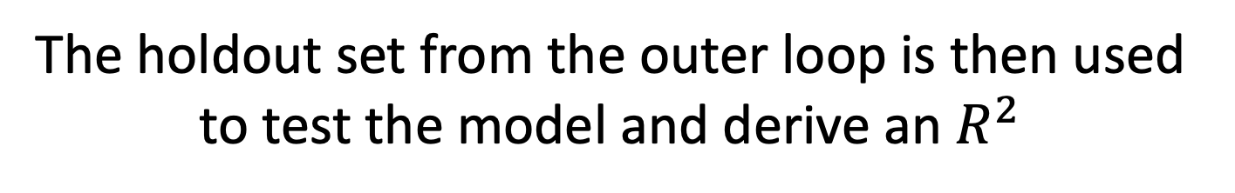


The holdout set from the outer loop is then used to test the model and derive an $R^{2}$
$$τ=2$$
…
$$τ=K_{1}$$
$$τ=1$$
$$w_{1}{\hat{y}}_{\left(1\right)}+…+w_{L}{\hat{y}}_{\left(L\right)}=\hat{y}$$
$$R^{2}$$

Slide 16
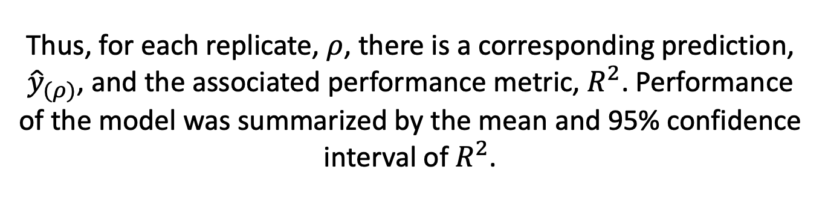
Thus, for each replicate, $ρ$, there is a corresponding prediction, ${\hat{y}}_{(ρ)}$, and the associated performance metric, $R^{2}$. Performance of the model was summarized by the mean and 95% confidence interval of $R^{2}$.

Slide 17
Predictors must be numeric
Binary: convert to 0’s and 1’s
Categorical (ordinal): rank categories
Categorical (nominal): one-hot-encoding. Make each category into a binary variable.

Slide 18
Target can be categorical, binary, or numerical
Binary and categorical variables must be factors with non-numeric levels.

Slide 19
Other things to note
Will use KNN imputation to impute missing variables
Will remove observations with >.3 missingness (will not do the same check for variables-- make sure you don’t input variables with high missingness)
Removes any observations missing the response variable
Will not overwrite files that already exist. If you want to run again using the same name, delete existing files.
Can do parallel computing for faster processing.
New: can use optimized model to make predictions on novel data using function stackPred.

