Slide 1

BeamID: Domain-Adaptive Radio Fingerprinting
with MIMO Beamforming Feedback
K Foysal Haque*†, Francesca Meneghello*, Francesco Restuccia*
*Institute for Intelligent Networked Systems, Northeastern University, Boston, USA
†IMDEA Networks Institute, Madrid, Spain

Slide 2

The Era of Massive Connectivity
Today’s Digital World Runs on 21+ Billion Connected Devices [1]
Number of the connected devices predicted to reach 39 Billion by 2030
1. State of IoT 2025: Number of connected IoT devices growing 14% to 21.1 billion globally “https://iot-analytics.com/number-connected-iot devices/ ”

Slide 3
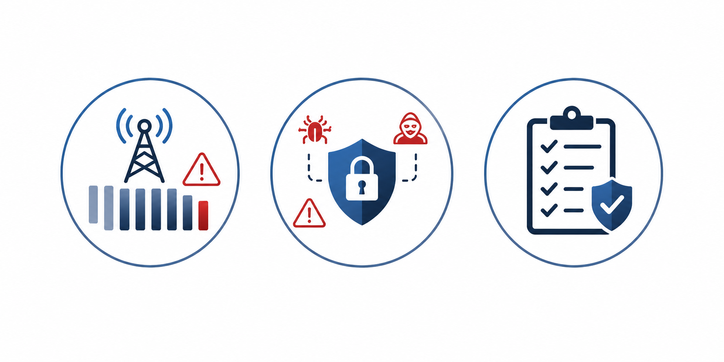
What are the Implications?
Spectrum
Management
Network
Policies
Security
Concerns
We need to reliably identify and authenticate
devices at the physical layer

Slide 4
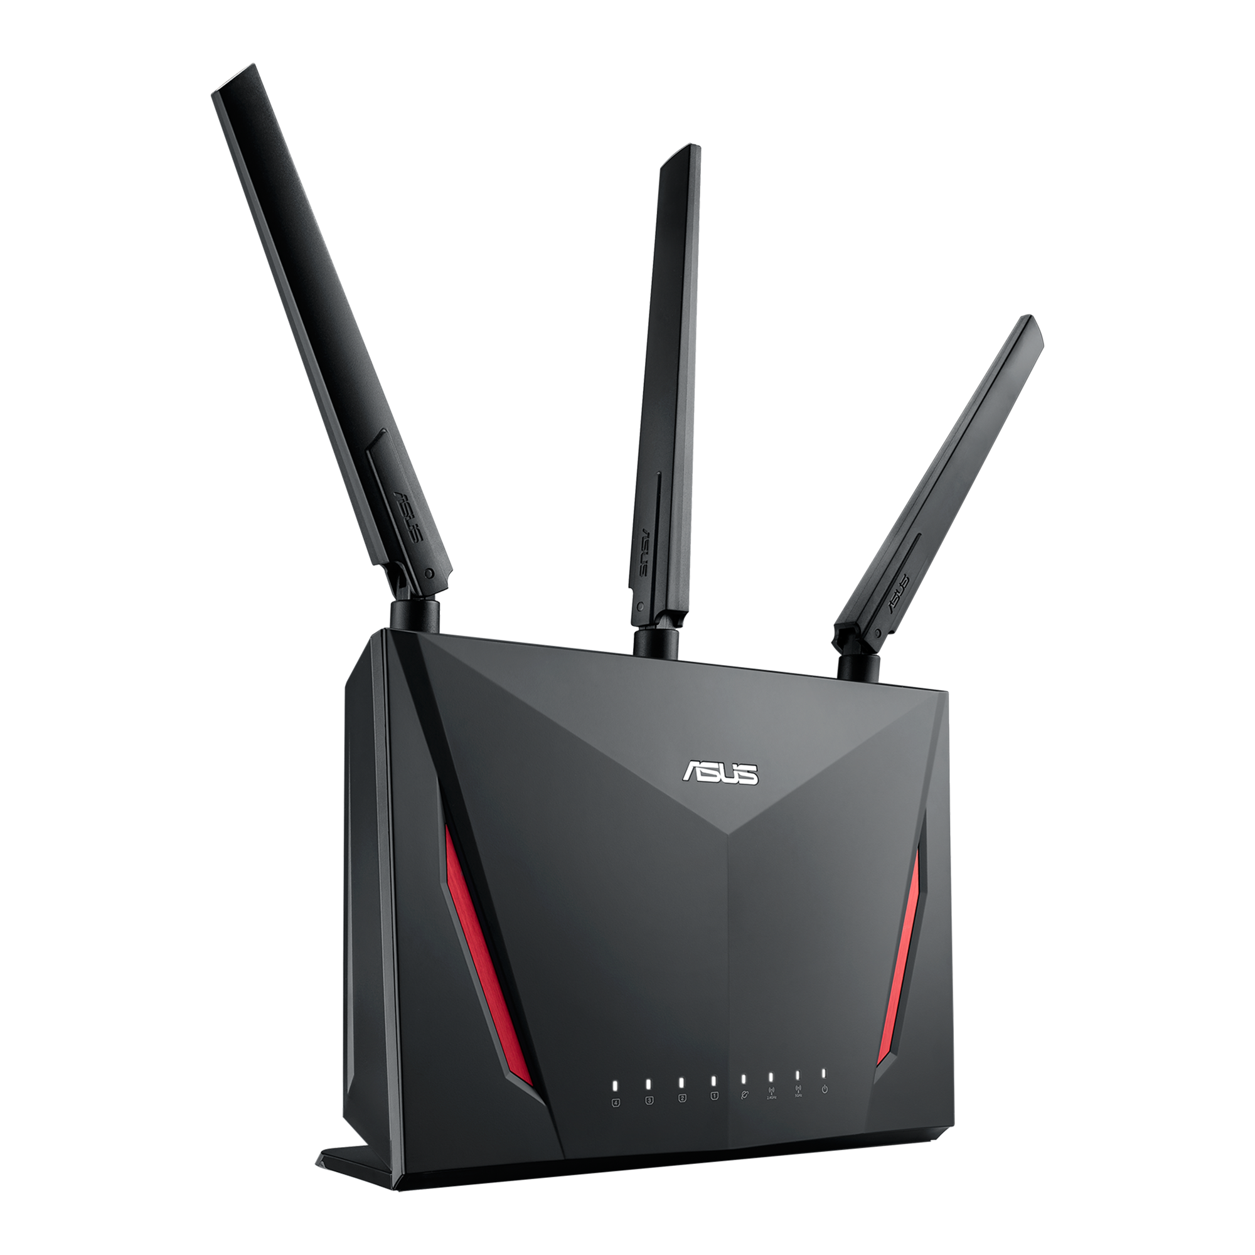




Radio Fingerprinting for Authentication
Radio Fingerprinting is a promising alternative to cryptographic authentication
STA 1
Authentication
of the STA
Access point (AP)
STA 2
Hardware Imperfections Percolate to Signal
Notes:
Cryptographic-based authentication has long been the standard for security. However, it requires key management and additional communication and computation overhead. Furthermore, if a device’s secret key is compromised, the attacker can successfully impersonate that device. These limitations have motivated radio fingerprinting as a promising alternative to cryptographic authentication

Slide 5
What has been Done so Far ? (1)
CFR and I/Q based fingerprinting are few of the popular choices
STA 1
DNN Model
Extract CFR or I/Q
Authenticate
STA
Access point (AP)
STA 2
Requires specialized hardware / firmware support
Kong, R. and Chen, H., 2024. DeepCRF: Deep learning-enhanced CSI-based RF fingerprinting for channel-resilient WiFi device identification. IEEE Transactions on Information Forensics and Security, 20, pp.264-278.
Kong, R. and Chen, H., 2024. CSI-RFF: Leveraging micro-signals on CSI for RF fingerprinting of commodity WiFi. IEEE Transactions on Information Forensics and Security, 19, pp.5301-5315.
Restuccia, F., D'Oro, S., Al-Shawabka, A., Belgiovine, M., Angioloni, L., Ioannidis, S., Chowdhury, K. and Melodia, T., 2019, July. DeepRadioID: Real-time channel-resilient optimization of deep learning-based radio fingerprinting algorithms. In Proceedings of the twentieth ACM international symposium on mobile ad hoc networking and computing (pp. 51-60).

Slide 6


What has been Done so Far ? (2)
BFI based fingerprinting doesn’t need specialized firmware / hardware
STA 1
Over-the-air BFI capture
AP
STA 2
DNN Model
Authenticate
STA
Beamforming Feedback Info. (BFI)
Cannot generalize to unseen domains
Meneghello, F., Rossi, M. and Restuccia, F., 2022, July. DeepCSI: Rethinking Wi-Fi radio fingerprinting through MU-MIMO CSI feedback deep learning. In 2022 IEEE 42nd International Conference on Distributed Computing Systems (ICDCS) (pp. 1062-1072). IEEE.
Meneghello, F., Haque, K.F. and Restuccia, F., 2025, May. Radio Fingerprinting of Wi-Fi Devices Through MIMO Compressed Channel Feedback. In IEEE INFOCOM 2025-IEEE Conference on Computer Communications Workshops (INFOCOM WKSHPS) (pp. 1-6). IEEE.

Slide 7
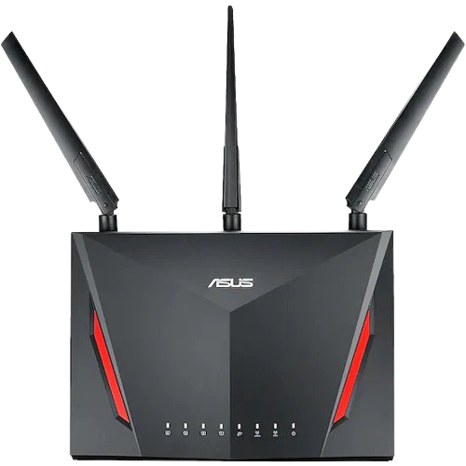
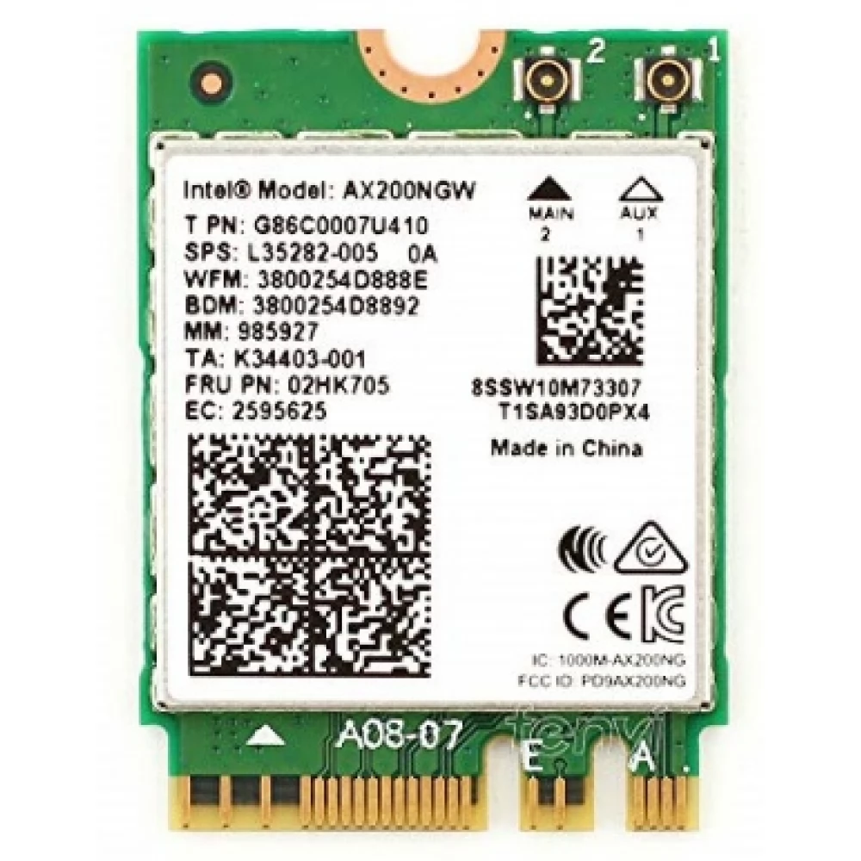
Preli. Analysis on Domain Generalization
Performed fingerprinting to identify 15 different
NICs with BFI using VGG based model
AP
Spacing of 4 inch between two diff. NIC loc.
5 diff. location for each NIC
Domain shift is a fundamental challenge
in radio fingerprinting

Slide 8
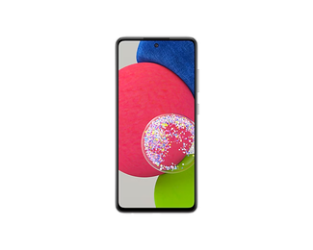
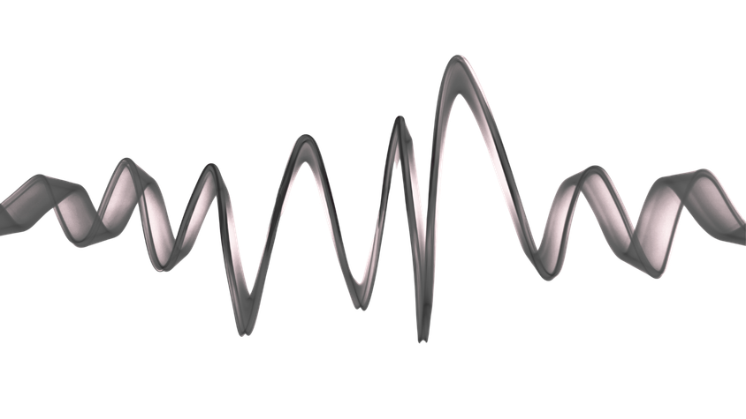
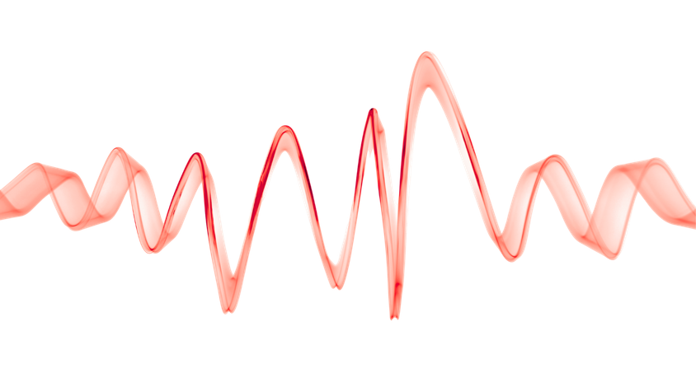



BeamID: Domain-Adaptive RFP with BFI
Domain 1
Domain 2
Inference
Train
Train and Test in Different Domain
Train and Test in Same Domain

Slide 9

Summary of Contributions
We propose BeamID, a domain-adaptive RFP framework that exploits MIMO beamforming feedback
We introduce an embedding-based few-shot adaptation strategy built upon supervised contrastive learning to support domain adaptation
We validate BeamID with extensive experiments with a Wi-Fi testbed, with 15 different NICs at each of 9 distinct locations
BeamID takes only 5 target-domain (unseen) samples per client, achieving up to 99% accuracy while requiring only 2.3 seconds of adaptation time

Slide 10
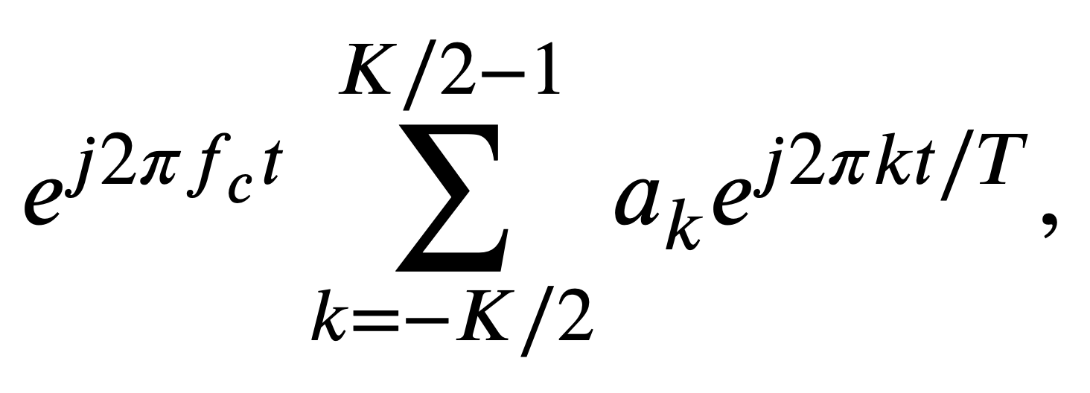

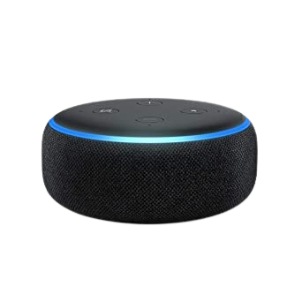

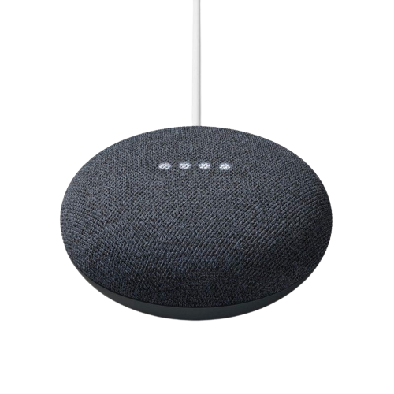
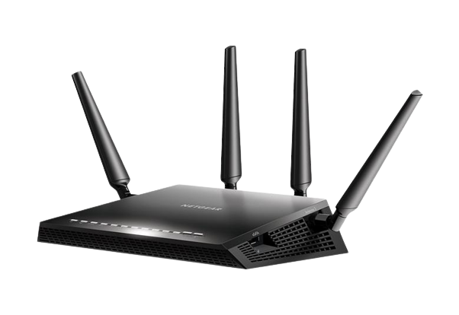
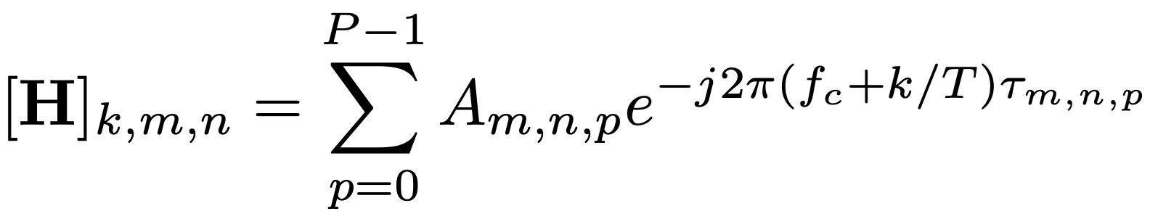
From CFR to BFI
1
2
Null Data Packet (NDP)
MU-MIMO Beamformees
MU-MIMO Beamformer
Estimate CFR, H
Compress CFR, V_{k}
Create BFI Frame
Beamforming Feedback Information
4
3

Slide 11
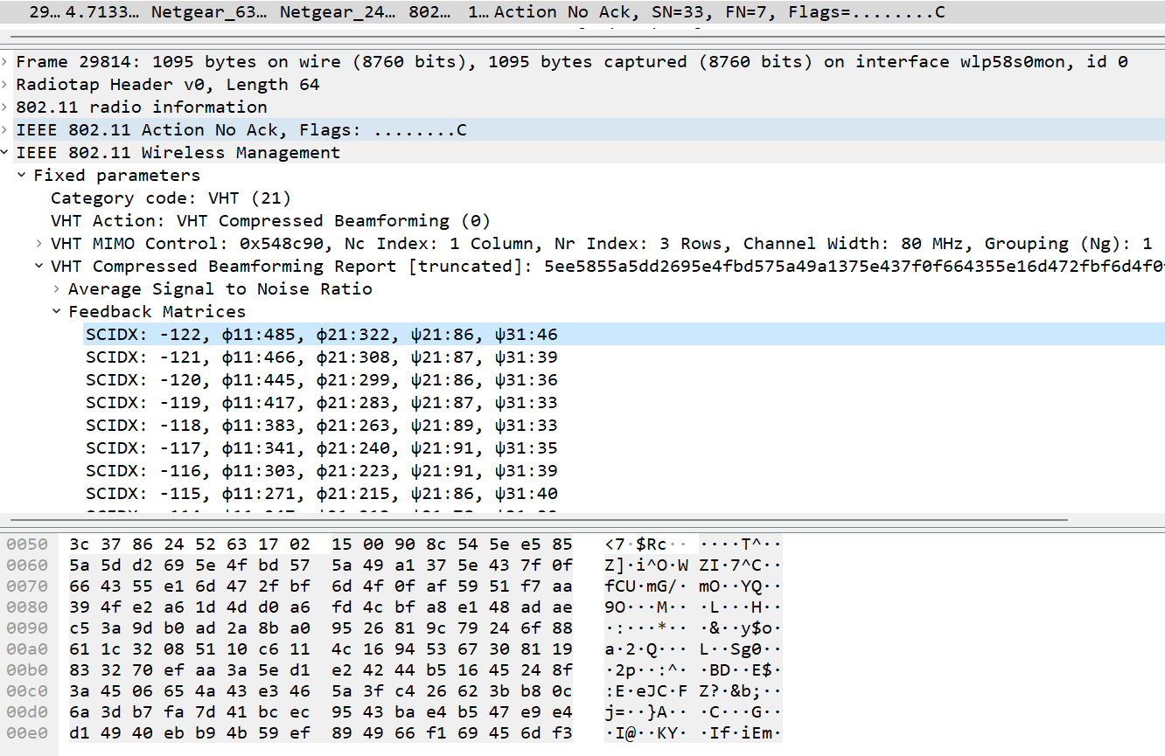
Beamforming feedback matrices
Transmitted unencrypted
Packet Bytes

Slide 12

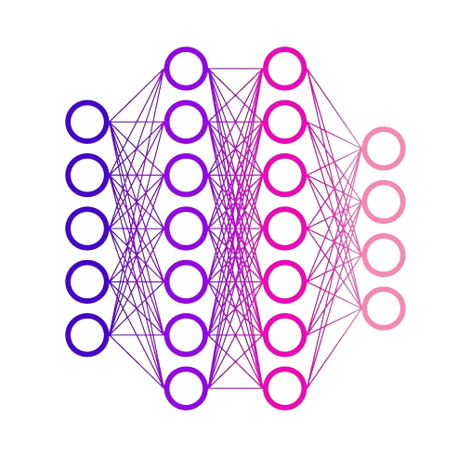



BeamID Walkthrough
1
2
MU-MIMO Beamformees
Null Data Packet (NDP)
MU-MIMO Beamformer
4
3
Beamforming Feedback Information
Estimate CFR
Feedback Frame Capture with
Wi-BFI [1]
Compress CFR
5
Create BFI Frame
BeamID Dataset Creation
BeamID Model training
BeamID
Inference
If Switching to
A new domain
Domain Adaptation
6
7
8
9
1. Haque, K.F., Meneghello, F. and Restuccia, F., 2023, October. Wi-BFI: Extracting the IEEE 802.11 beamforming feedback information from commercial Wi-Fi devices. In Proceedings of the 17th ACM Workshop on Wireless Network Testbeds, Experimental evaluation & Characterization (pp. 104-111).

Slide 13


Source-Domain Representation with Embedding
V matrices
Data Aggregation
Encoder
Global Average Pooling
AdaptiveAvgPool1D →
(B × 128)
1D Convolution Block 1
Conv1D (32),
Batch Normalization,ReLU
V-matrix Tensor
Shape: (B × 16 × 250)
1D Convolution Block 2
Conv1D (32),
Batch Normalization,ReLU
1D Convolution Block 3
Conv1D (32),
Batch Normalization,ReLU
Output Embedding 𝒛 ∈ ℝᵈ
(d = 128)

Slide 14
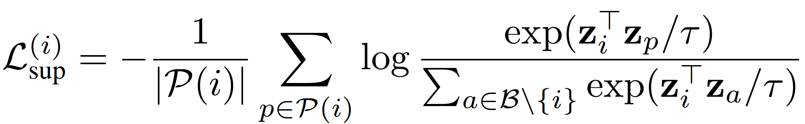
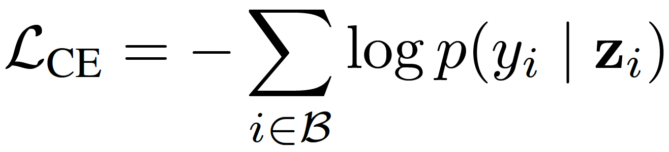

Enabling Domain Invariant Features
We employ Supervised Contrastive loss, which directly enforces intraclass compactness and inter-class separation-properties
Numerator pulls same-client embeddings together, whereas, Denominator contrasts against all other embeddings in the batch
To enable device identification during training, the contrastive objective is combined with a standard cross-entropy loss
The overall training objective

Slide 15
Impact of Super Contrastive Learning
Train and Tested in the same domain
BeamID and SOTA approach-– both achieves ~99%
Train and Tested in the different domain
DeepCSIv2’s performance is random
BeamID is not totally random but still very poor

Slide 16
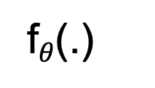
Few-Shot Domain Adaptation in Embedding Space
Collect K-shot labeled target samples
Fine-tune classifier + last encoder layer
Align target embeddings with source clusters
Preserve inter-client separation
f$θ$(.)
D_{s}
Z_{s}
D^{k}_{t}
Fine-tune
Z_{t} ≈ Z_{s}

Slide 17

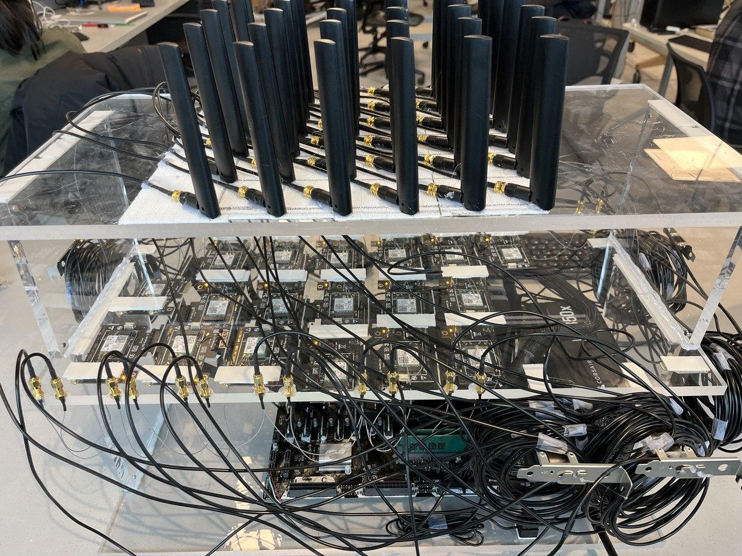
Experimental Evaluation
Evaluate BeamID with WiSEC testbed, a large-scale multi-NICs platform
Hosts 15 intel AX210 Wi-Fi NIC implementing IEEE 802.11ax.
Used ASUS RT-AX86U as AP
Testbed Setup
Wi-Fi NICs
Access Point
NIC Antenna
9 diff. loc. for each NIC
NIC 15
Spacing of 4 inch between two diff. NIC loc.
NIC 1

Slide 18
BeamID Performance (1)
Performance with domain adaptation
Pairwise cross-domain transfer accuracy at k = 15
Legends show the training domain
Tested with rest of the domain

Slide 19
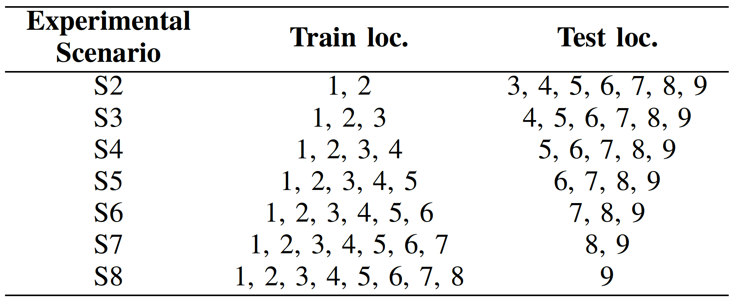
BeamID Performance (2)
Accuracy vs number of source environments
Experimental Scenarios with Training and Testing Locations
Impact of fine-tuning the encoder

Slide 20
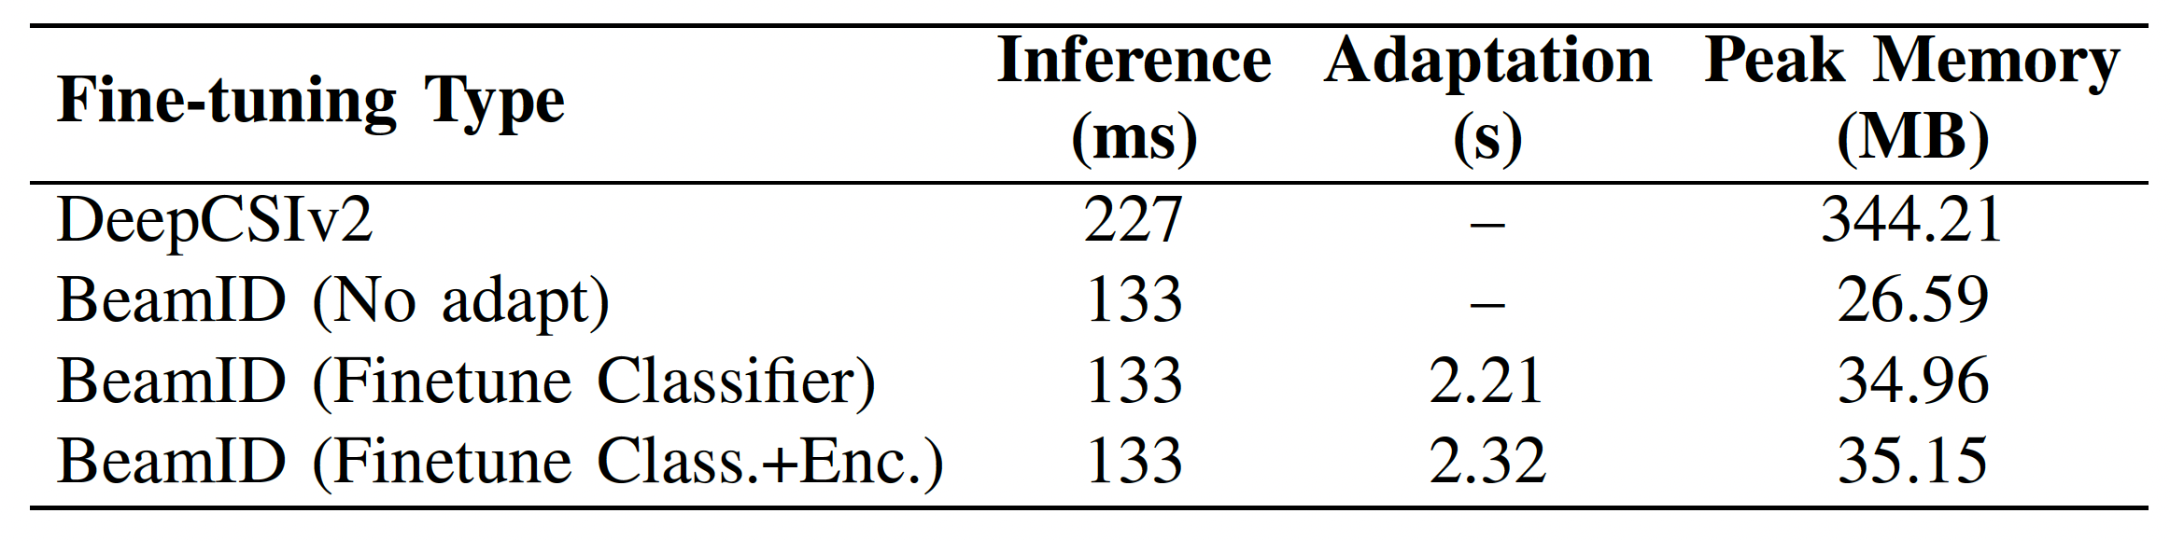
Computational Overhead of BeamID
Executed BeamID in a linux machine with intel core i7-12700K CPU
and RTX A4000 GPU with 84 GB RAM
BeamID takes only 133 ms for inference time whereas it takes up to 2.32 s
for adapting to an unseen domain

Slide 21

Possible Next Steps?
✅ Few-shot cross-domain RFP from standard MIMO beamforming feedback
This work 💪
⚠️ Extend BeamID across heterogeneous AP hardware
⚠️ Generalize BeamID across different frequency bands
Future Directions 🚀

Slide 22

BeamID: Domain-Adaptive Radio Fingerprinting
with MIMO Beamforming Feedback
THANK YOU
K Foysal Haque
Haque.k@northeastern.edu

Slide 23
Controller-level integration of BeamID

