Slide 1
MAGIC: Meta-Learning Adaptive Gesture Recognition with mmWave MIMO CSI
K Foysal Haque, K M Rumman, Arman Elyasi, Francesca Meneghello, Francesco Restuccia
Institute for the Wireless Internet of Things (WIoT)
Northeastern University
IEEE WoWMoM 2025

Slide 2
Agenda
Introduction
Contribution
Related Work
System Workflow
Preprocessing
Adaptation Process
Setup
Results
Conclusions

Slide 3
AR/VR Applications
Demanding higher data rates to support AR/VR applications

Slide 4
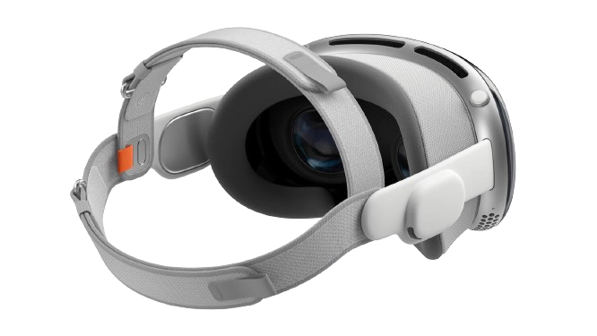
What are the bottlenecks?
120 Hz @ 8K 40 Gbps WiFi supports 1.2 Gbps
LARGER AND RELIABLE BANDWIDTH IS NEEDED!!!
mmWave spectrum is the choice.

Slide 5
mmWave Spectrum
{
Human Activity Classification [1, 2]
Offers substantial bandwidth
Gesture Recognition [3, 4]
Intrusion Detection [5]
More precise wireless sensing capabilities
Patient Monitoring [6]
[1] Haque, K.F., Zhang, M. and Restuccia, F., 2023, June. Simwisense: Simultaneous multi-subject activity classification through wi-fi signals. In 2023 IEEE 24th International Symposium on a World of Wireless, Mobile and Multimedia Networks (WoWMoM) (pp. 46-55). IEEE.
[2] Haque, K.F., Zhang, M., Meneghello, F. and Restuccia, F., 2025. Beamsense: Rethinking wireless sensing with mu-mimo wi-fi beamforming feedback. Computer Networks, 258, p.111020.
[3] Yu, J.T., Tseng, Y.H. and Tseng, P.H., 2024. A mmWave MIMO radar-based gesture recognition using fusion of range, velocity, and angular information. IEEE Sensors Journal, 24(6), pp.9124-9134.
[4] Xu, L., Wang, K., Gu, C., Guo, X., He, S. and Chen, J., 2024, July. GesturePrint: Enabling user identification for mmWave-based gesture recognition systems. In 2024 IEEE 44th International Conference on Distributed Computing Systems (ICDCS) (pp. 1074-1085). IEEE.
[5] Cenkeramaddi, L.R., 2023. Recent Advances in mmWave-Radar-Based Sensing, Its Applications, and Machine Learning Techniques: A Review.
[6] Pan, P., Zhang, F., Zhou, A., Ma, H. and Jia, H., 2024, July. mmCare: A Nursing Care Activity Monitoring System via mmWave Sensing. In Proceedings of the ACM Turing Award Celebration Conference-China 2024 (pp. 18-22).

Slide 6
Contributions
Proposed MAGIC, a novel gesture recognition system
Developed adaptive temporal embedding network for efficient long-range temporal feature extraction
Evaluated through a wide range of subjects and environments

Slide 7
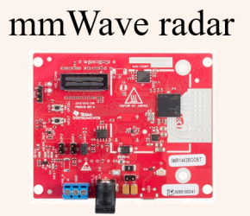
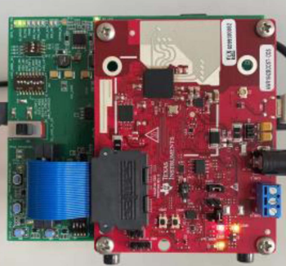
Previous Work
mTransSee [1]
Transfer-Learning Approach
77-81GHz
3 * 4 Communication System
Gesture-mmWAVE [2]
Transformer Network
77 GHz
2 * 4 Communication System
[1] Jin, B., Ma, X., Hu, B., Zhang, Z., Lian, Z. and Wang, B., 2024. Gesture-mmWAVE: Compact and accurate millimeter-wave radar-based dynamic gesture recognition for embedded devices. IEEE Transactions on Human-Machine Systems.
[2] Liu, H., Cui, K., Hu, K., Wang, Y., Zhou, A., Liu, L. and Ma, H., 2022. mTransSee: Enabling environment-independent mmWave sensing based gesture recognition via transfer learning. Proceedings of the ACM on Interactive, Mobile, Wearable and Ubiquitous Technologies, 6(1), pp.1-28.

Slide 8
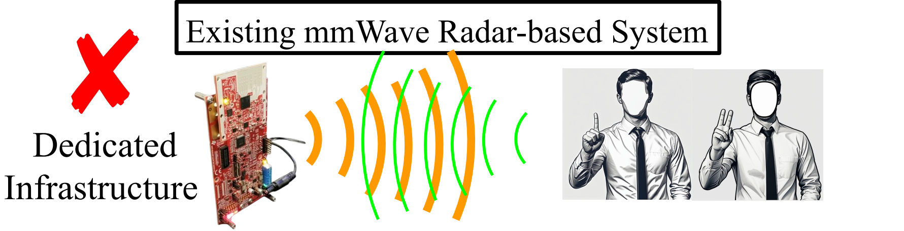
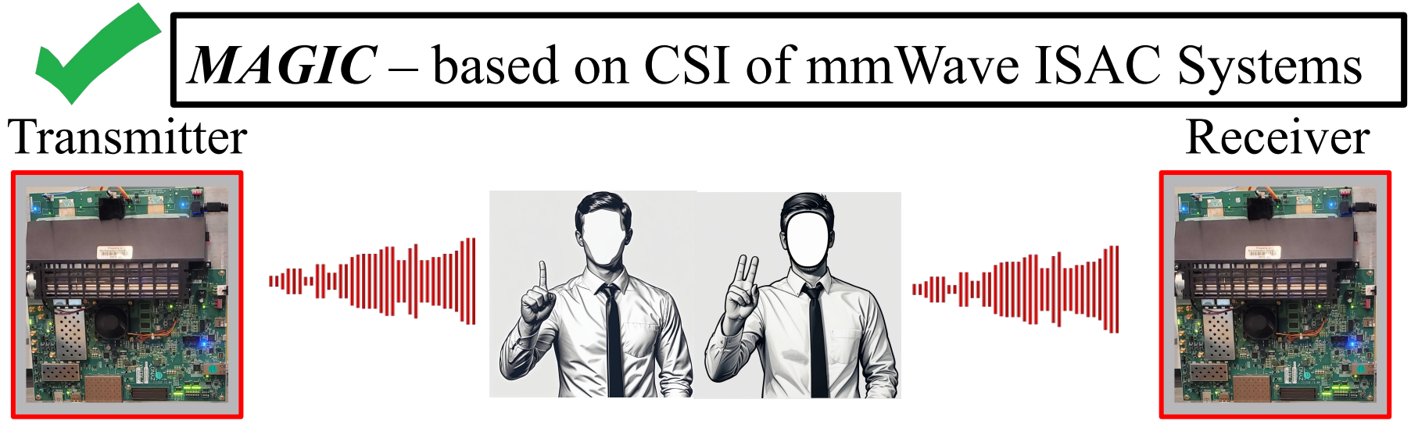
MAGIC vs Existing mmWave Radar-based system

Slide 9
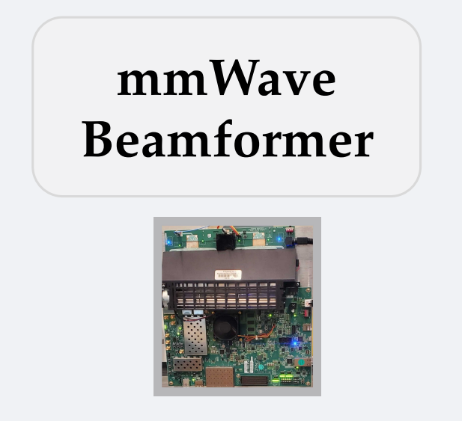
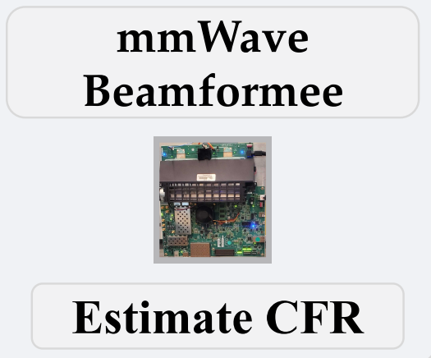


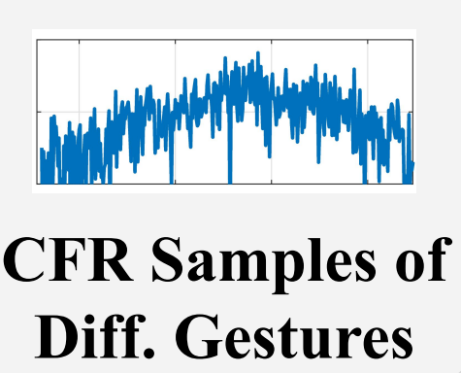
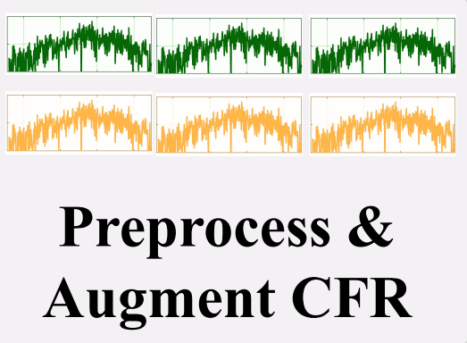

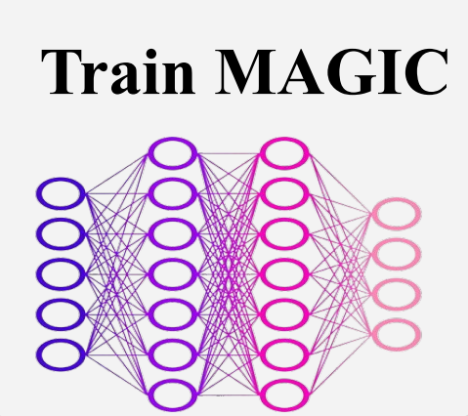


System Workflow
Step 1
NDP
Step 2
Step 3
Detected Gesture

Slide 10

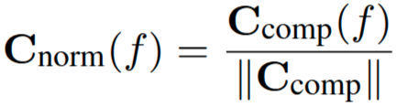
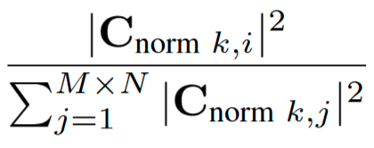
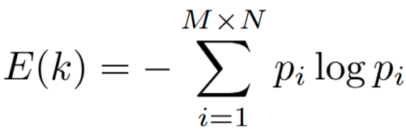
Domain-adaptive Preprocessing Pipeline (DAPP) (1)
Path Loss Compensation
CFR Matrix
Attenuation Factor
Frequency Normalization
Frobenius norm
Entropy-Guided Filtering

Slide 11


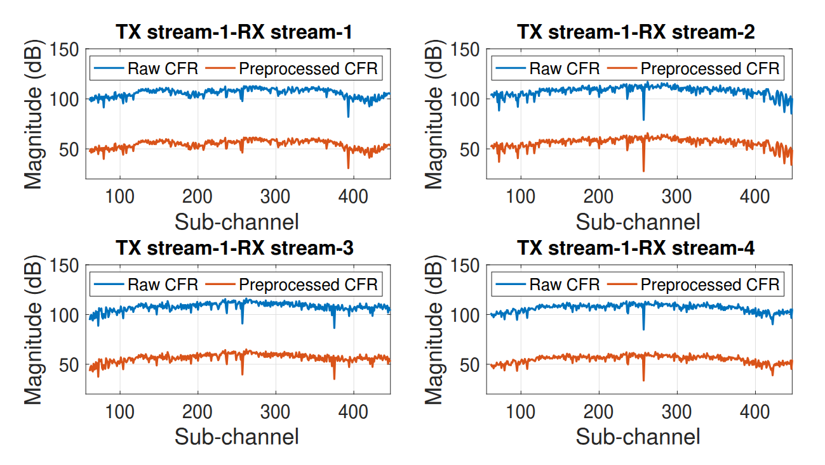
Domain-adaptive Preprocessing Pipeline (DAPP) (2)

Slide 12


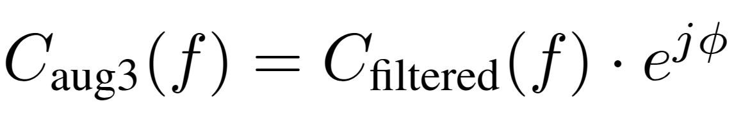
Data Augmentation
Noise Addition
Scaling
Scaling Factor
Phase Perturbation
Random Phase Shift

Slide 13
Adaptive Temporal Embedding Network (ATEN)
Generalizing across Environments
Feature Encoding with TCNs
Query-specific Adaptation and
Classification
Task Embedding
Meta-learning-driven Adaptation

Slide 14
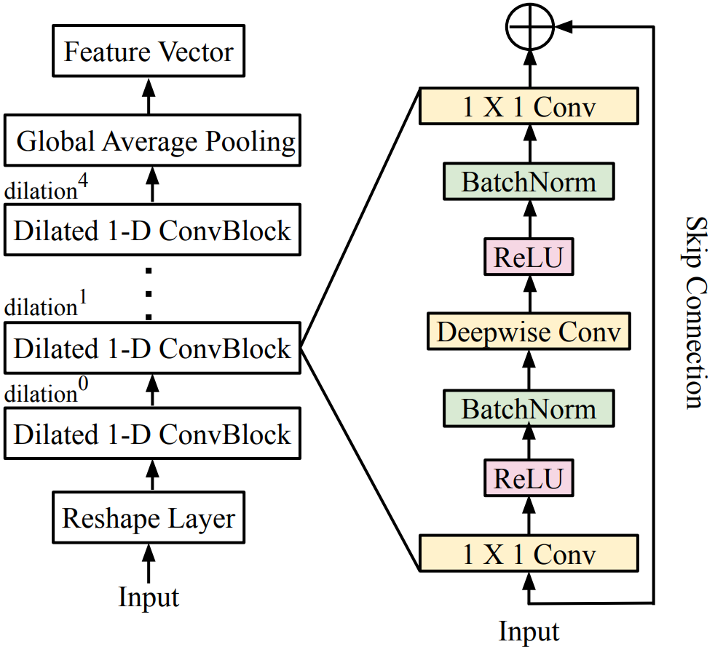
Feature Encoding with TCNs
Encode temporal patterns from mmWave CFR sequences
Capture both short- and long-term dependencies in gesture dynamics
Generate compact and informative feature vectors for classification
Temporal Convolutional Network (TCN)

Slide 15
Task Embedding
Summarize the essence of a task using its support examples
Enables the model for adaptation to new and unseen tasks
Core idea
A feature extractor processes each input to a latent vector
Vectors are aggregated into a single task embedding
Refinement

Slide 16
Query-Specific Adaptation and Classification
Adapts query features using task embedding to align with task-specific context
Combines query representation and task summary through a learnable transformation
Produces a context-aware embedding tailored to the current task
Adapted features are passed to a classifier

Slide 17
Meta-learning-driven adaptation
Training the model for generalization
Aggregates losses for forming a unified meta-loss
Using cross-entropy loss on query samples
Optimizes feature extractor, task embedding and classifier using gradient descent

Slide 18
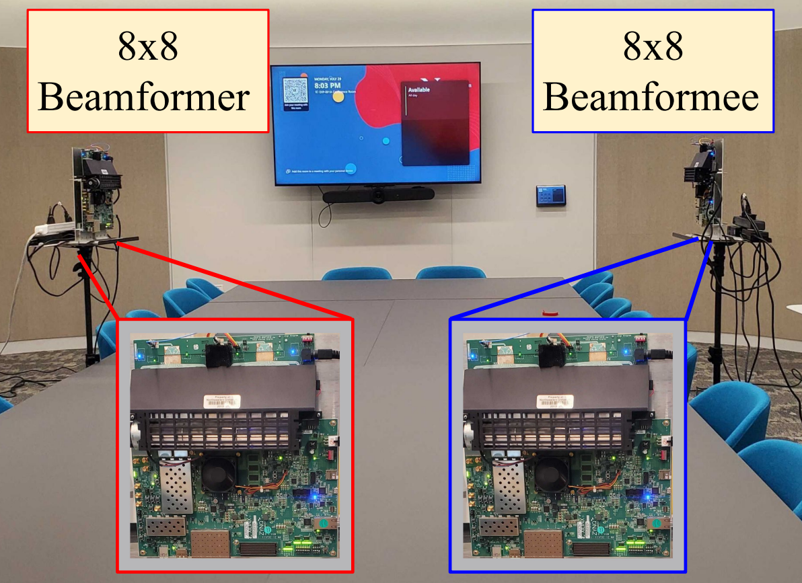
Experimental Setup [1]
Multiplexing and Diversity Gain
Digital Beamforming
P2P, SU-MIMO, MU-MIMO
Operating in 57-64 GHz
OFDM
1 GHz of bandwidth
[1] Haque, K.F., Meneghello, F., Rumman, K.M. and Restuccia, F., 2024, December. m3MIMO: An 8× 8 mmWave Multi-User MIMO Testbed for Wireless Research. In Proceedings of the 30th Annual International Conference on Mobile Computing and Networking (pp. 1922-1929).

Slide 19
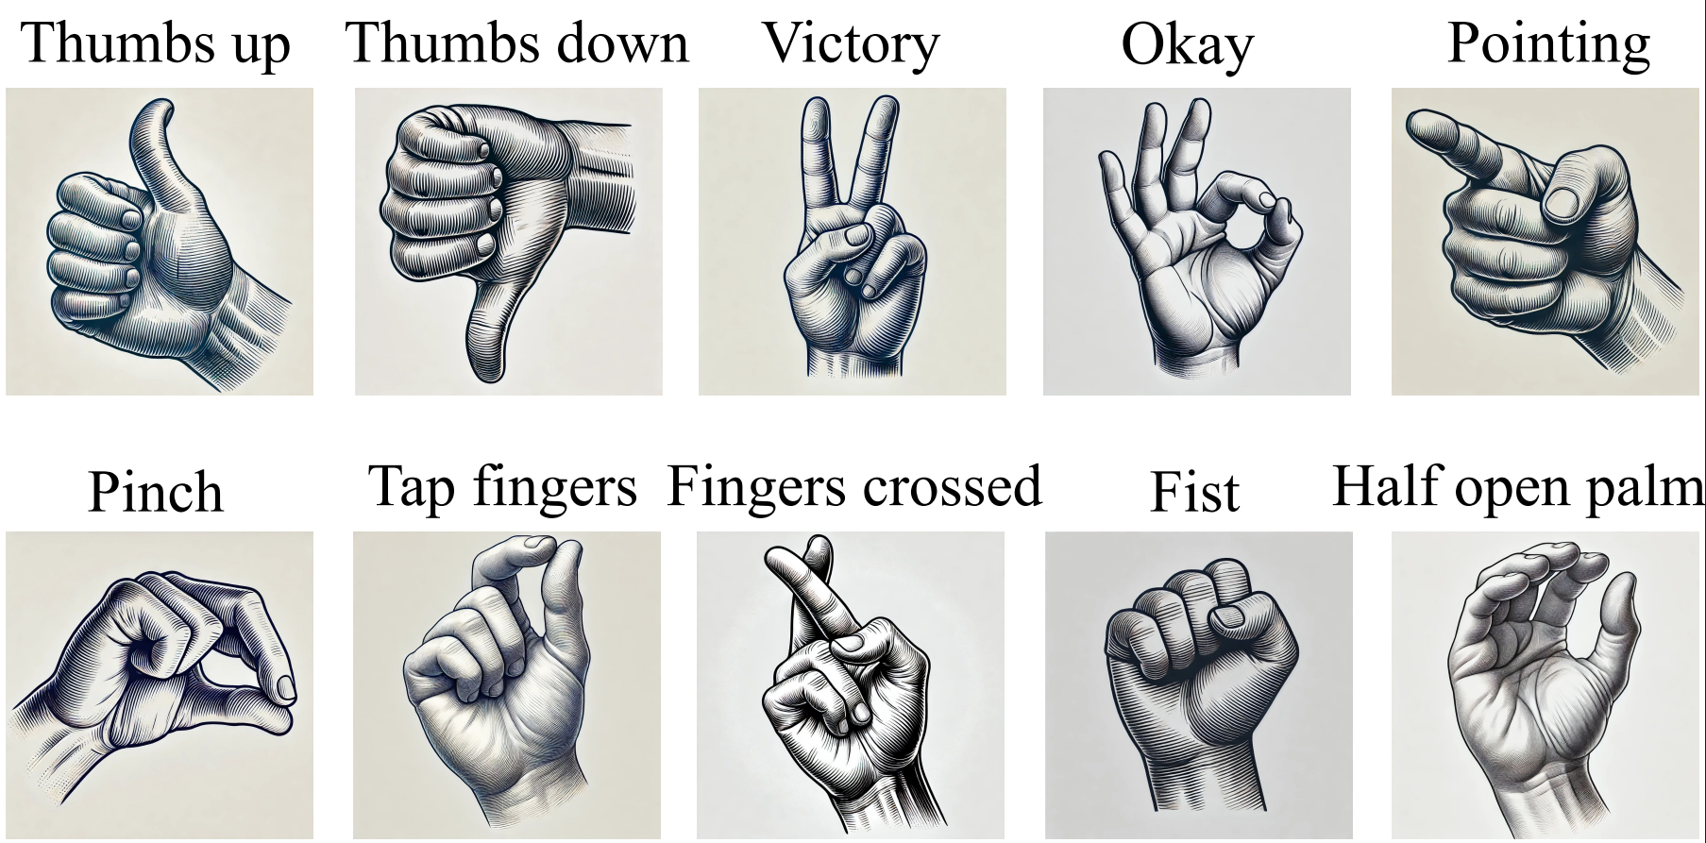
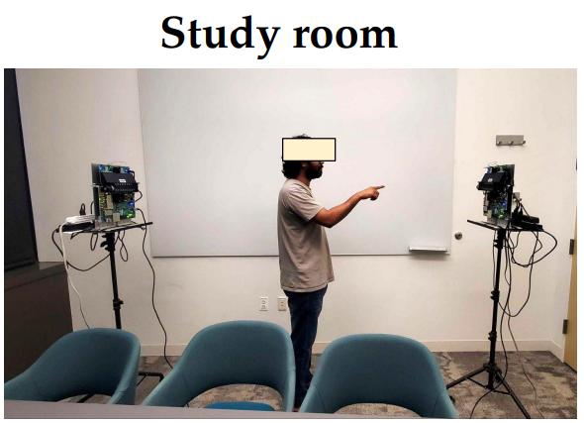
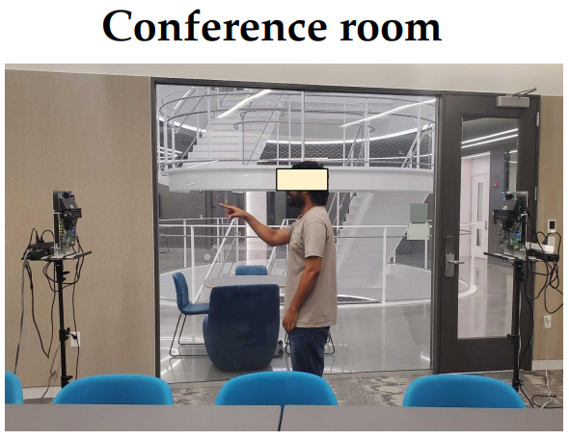
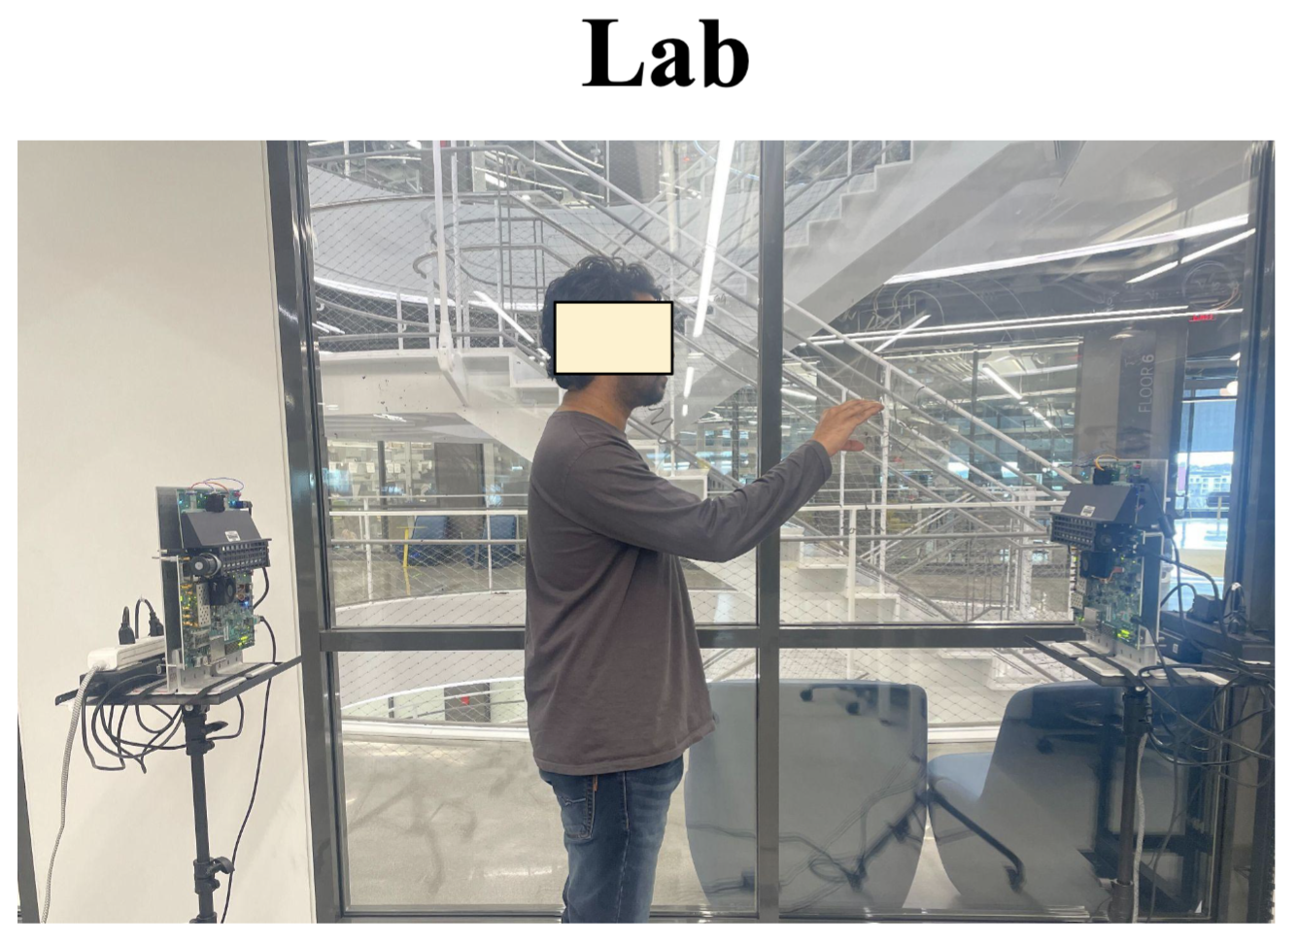
Data Collection
50 repetitions of each gesture per subject, with each lasting 3 seconds

Slide 20
Performance Evaluation
DI-Gesture [1]
Incorporates Dynamic Range Angle Images (DRAI) and basic data augmentation
Baselines
RadarNet [2]
Processes range-Doppler maps for spatial-temporal motion
[1] Li, Y., Zhang, D., Chen, J., Wan, J., Zhang, D., Hu, Y., Sun, Q. and Chen, Y., 2022, December. DI-gesture: Domain-independent and real-time gesture recognition with millimeter-wave signals. In GLOBECOM 2022-2022 IEEE Global Communications Conference (pp. 5007-5012). IEEE.
[2] Hayashi, E., Lien, J., Gillian, N., Giusti, L., Weber, D., Yamanaka, J., Bedal, L. and Poupyrev, I., 2021, May. RadarNet: Efficient gesture recognition technique utilizing a miniature radar sensor. In Proceedings of the 2021 CHI Conference on Human Factors in Computing Systems (pp. 1-14).

Slide 21
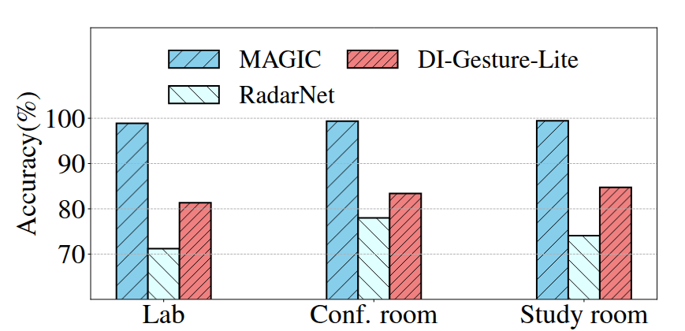
Results
Accuray of gesture recognition methods in different environments
MAGIC outperforms the SOTA Models with the average of 24.13% across all the environments

Slide 22
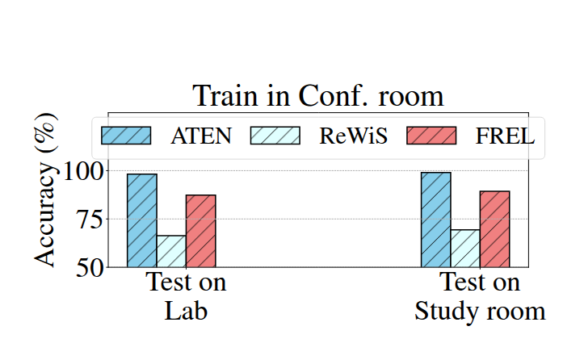
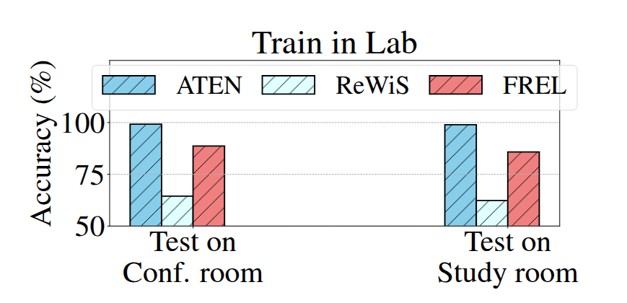
Results
Environment Generalization Performance
MAGIC outperforms ReWis and FREL by 54% and 12% respectively
MAGIC outperforms ReWis and FREL by 66% and 15% respectively

Slide 23
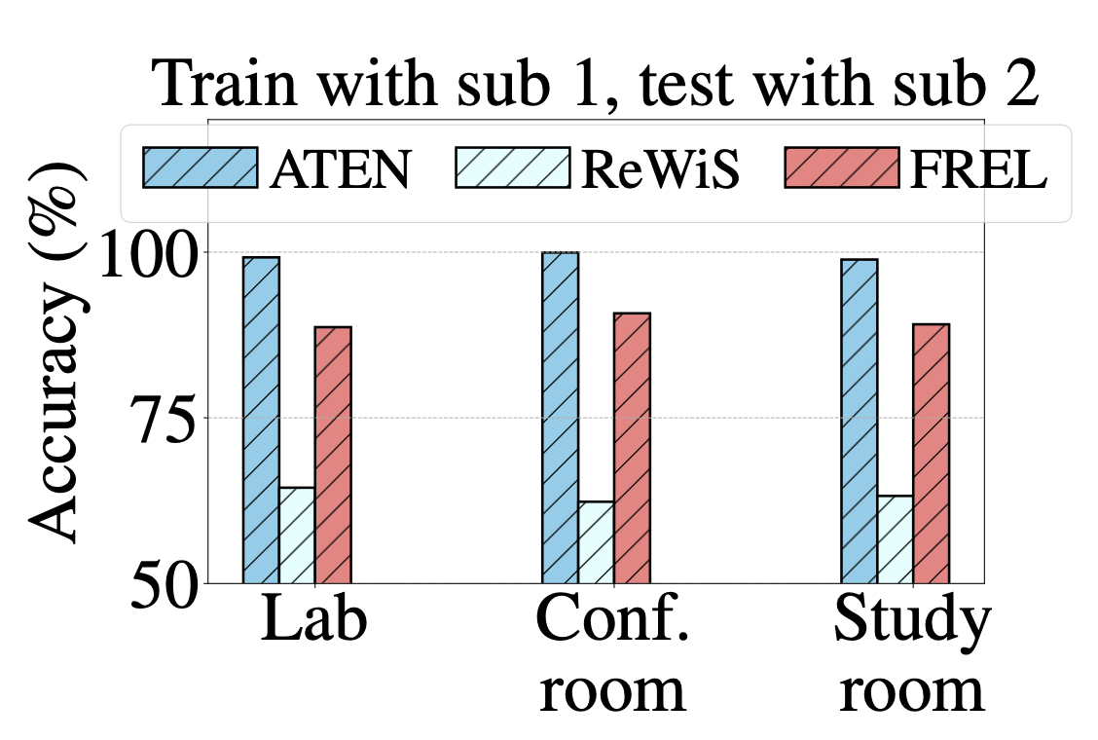
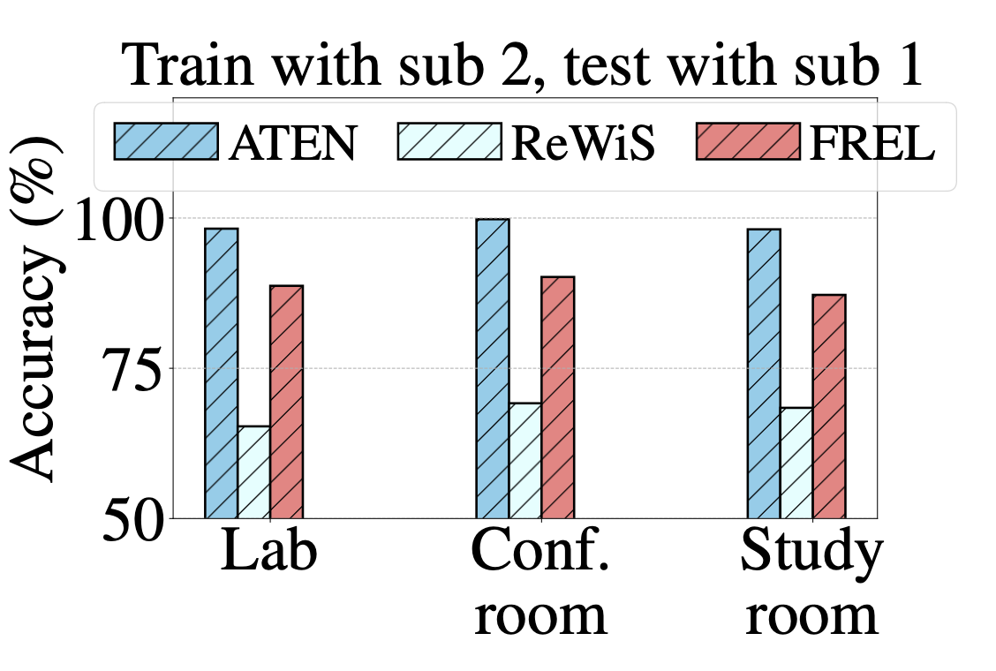
Results
Subject Generalization Performance
Outperforming ReWiS and FREL by 55% and 10% respectively

Slide 24
Conclusions
We introduced MAGIC, a novel gesture recognition framework using mmWave CSI, which eliminates the need for radar-specific hardware
Achieves high accuracy and strong generalization across different subjects and environments
A scalable, efficient and robust solution for real-world gesture recognition applications

Slide 25
Thanks for your attention!

