Slide 1

DEER: Simultaneous Multi-Modal
Decentralized Energy Efficient Covert Routing
K F Haque*, Justin Kong †, Terrence J. Moore †, Francesco Restuccia*, Fikadu T. Dagefu
*Institute For the Wireless Internet of Things, Northeastern University, Boston, USA
DEVCOM Army Research Laboratory

Slide 2




Ensuring Resiliency and Security of Wireless Networks
Is of Paramount Importance
Agent
Client
Covert communication aims to evade detection by adversary
Covert networks need to meet a multitude of conflicting requirements

Slide 3

State of the art single-modal covert routing is inefficient
Modality 1
Modality 2
Modality 3
Most works are based on single modality
Doesn’t fully exploit the diversity of the HetNets
High Energy Consumption
Low Throughput

Slide 4

DEER: Simultaneous Multi-modal Decentralized
Energy Efficient Routing
High Throughput
Low Energy Consumption
DEER aims to minimize combined transmit power while maintaining throughput and covertness

Slide 5
Novel Contributions of DEER
DEER Leverages simultaneous multi-modal transmissions
Minimizes total end-to-end transmit power through node-level and network-level optimization.
Maintains user-required constraints on throughput and covertness.
Enables decentralized, energy-efficient routing using local information.

Slide 6
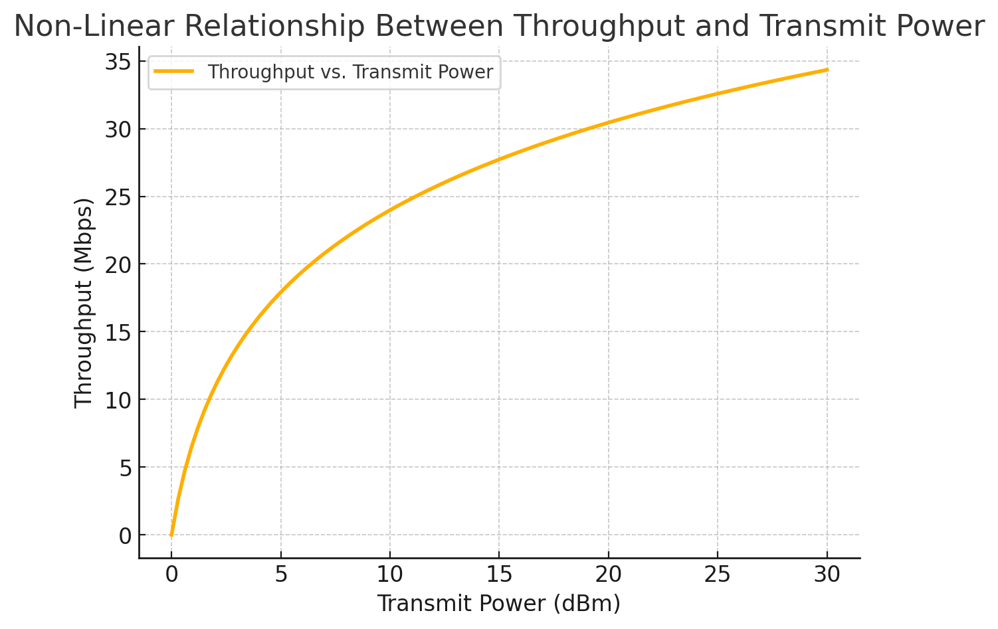
Intuition Behind DEER
Throughput depends on channel conditions
It has a non-linear relationship with transmit power
DEER Optimally leverages multiple modalities simultaneously to achieve higher throughput with lower energy consumption

Slide 7
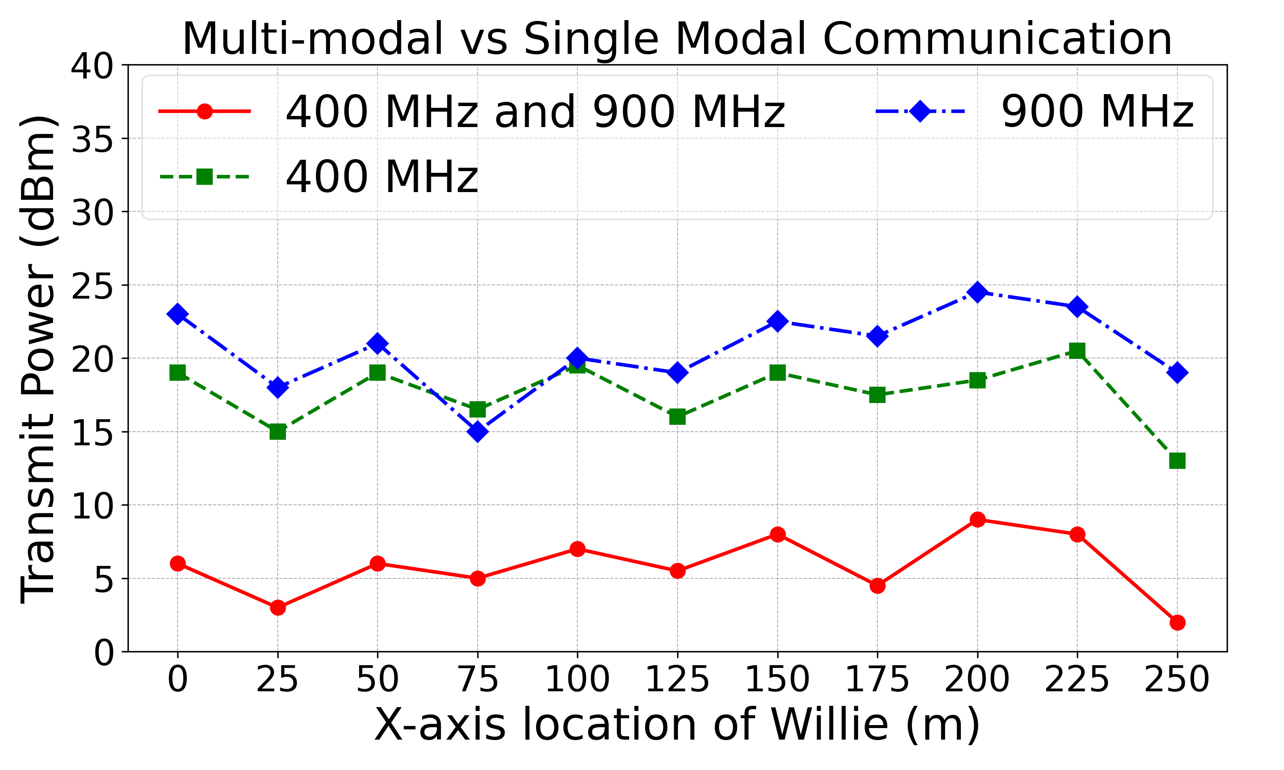
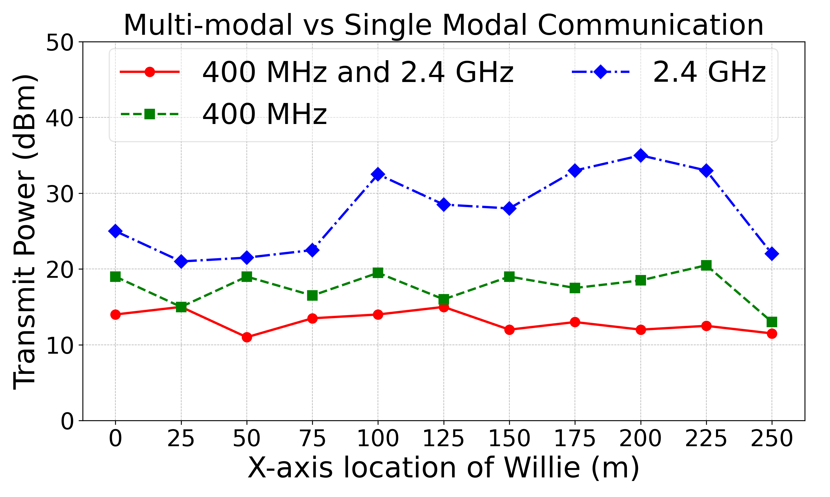
Proof of simultaneous multi-modal transmission being more energy efficient
Simultaneous multi-modal approaches take least transmission power while achieving same throughput and DEP (single hop test)
Covertness threshold = 0.5 and Throughput threshold = 40 Mbps

Slide 8
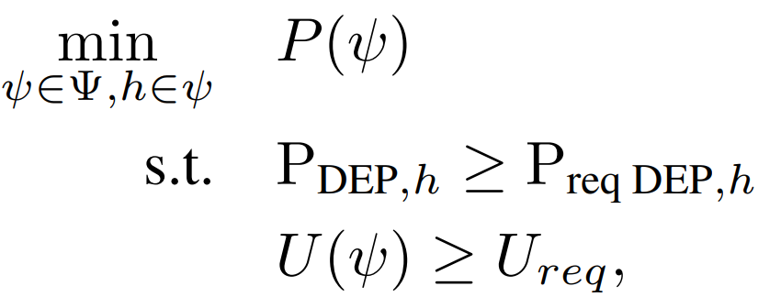
DEER Overview
DEER aims to minimize the end-to-end total transmit power of the whole route in a decentralized fashion
It also maintains the constraints on end-to-end throughput and per-hop detection error probability (DEP)
End-to-end transmit power
Per-hop DEP
End-to-end throughput

Slide 9
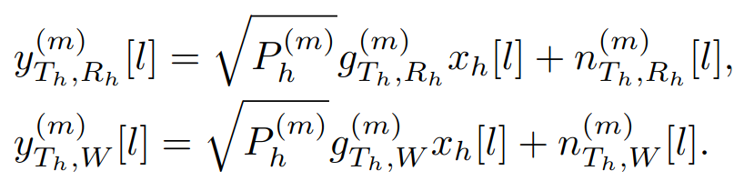
Signal Model
Signal is transmitted from Transmitter T_{h} to Receiver R_{h} for the hop h of the whole route ψ where Willie W is the adversary. Here m^{k} = { m¹ , m²}
Rcv signal
Tx Power
Channel
Tx data
AWGN noise

Slide 10


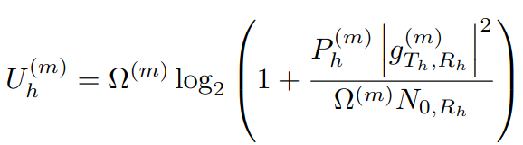
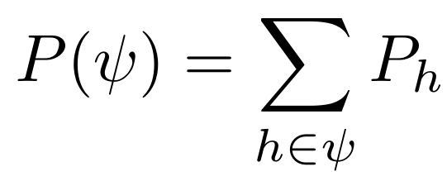

Network Metrics
Overall E2E throughput
E2E throughput for modality
Throughput for modality
m and hop h
Combined Tx Power of hop h
E2E Tx Power

Slide 11
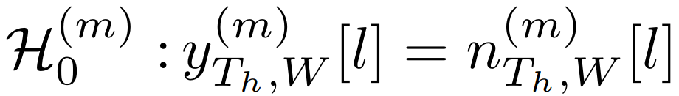
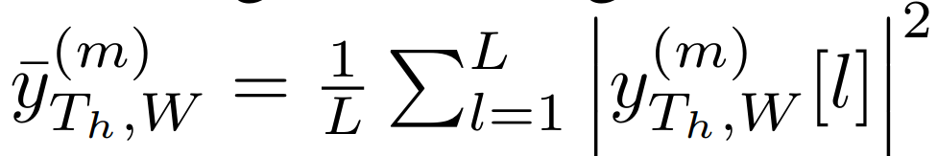
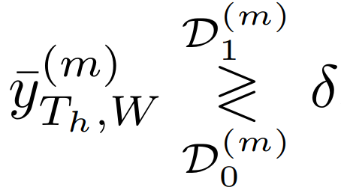
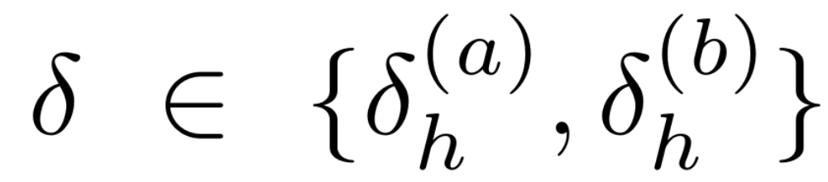
Detection at Willie
Willie perform separate hypothesis for each modality. For each modality, Willie has null hypothesis, H₀ (no transmission) and and alternative hypothesis, H₁ (transmission exists).
Willie calculate the average RSS for L channel uses and perform threshold check
denotes the detection threshold for modality {a, b}, and D₀ and D₁ denote decisions in favor of H₀ and H₁ for modality {a, b } and hop h

Slide 12
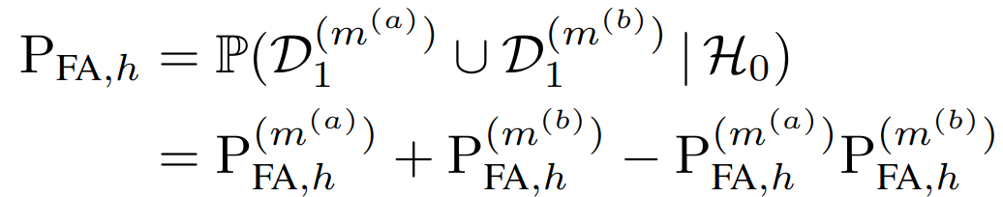
Detection at Willie
The associated detection error probabilities (DEPs) for each threshold test are defined as:
Willie then combines the decision obtained for each modality
Probability of missed detection and the probability of false alarm for the overall decision

Slide 13
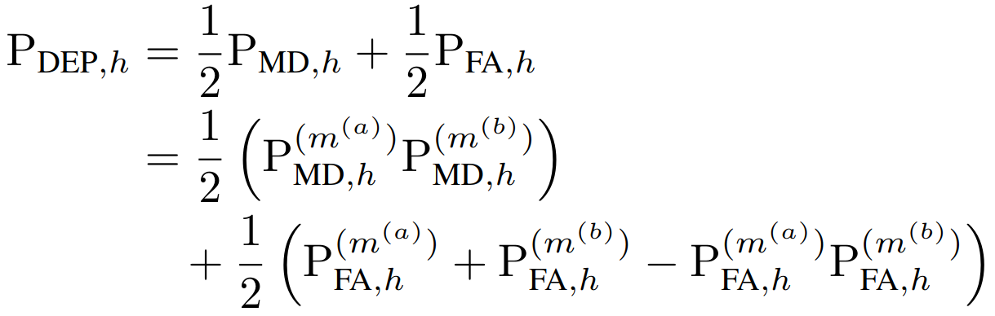
Per hop Covertness in terms of Detection Error Probability
Alice tosses an unbiased coin to decide whether to transmit or not
Therefore Alice transmits with equal a priori probabilities of 1/2
P_{DEP} of the hop h

Slide 14
Let’s Recap the Problem Formulation
DEER solves the formulated optimization problem with node-level and network-level optimization strategies
End-to-end transmit power
Per-hop DEP
End-to-end throughput
DEER Optimization Problem

Slide 15
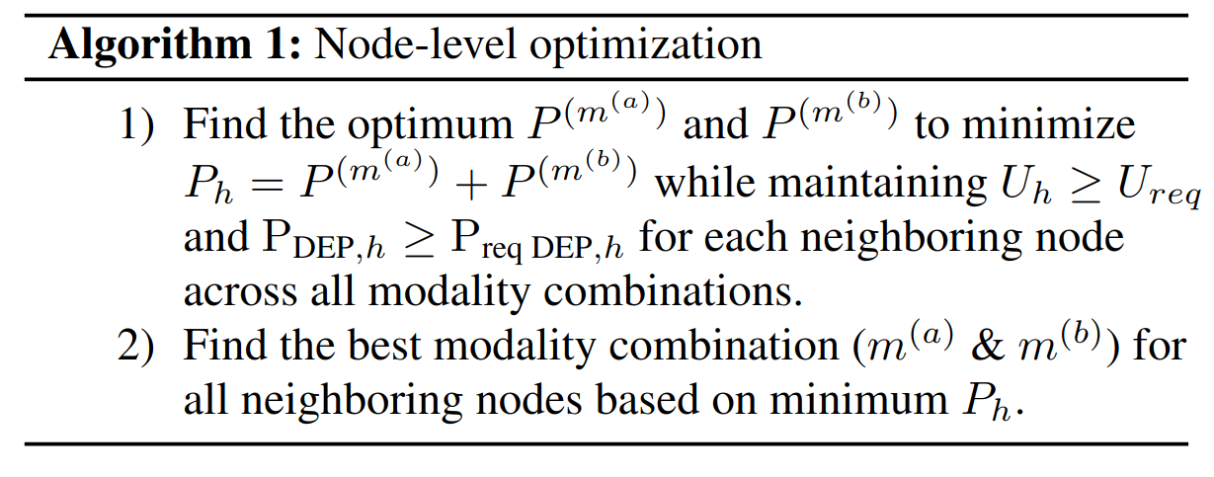
DEER Algorithm : Node Level Optimization
Minimizes total transmit power (P_{h}​) while ensuring throughput and covertness constraints
Chooses the best modality combination for each neighbor

Slide 16
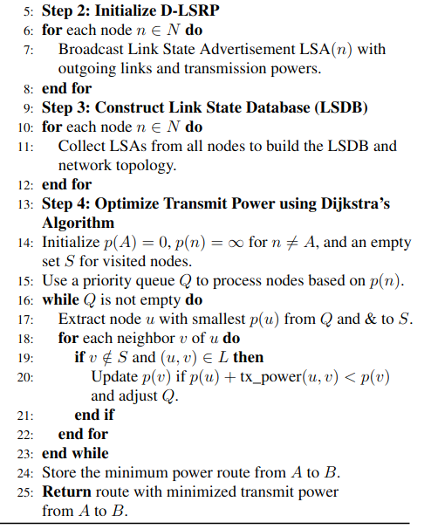
DEER Algorithm : Network Level Optimization
Initializes D-LSRP by broadcasting LSAs with outgoing links and transmission powers
Builds LSDB by collecting LSAs to construct the network topology
Finds the minimum power route using Dijkstra’s algorithm
Updates transmission costs iteratively to minimize end-to-end power consumption

Slide 17
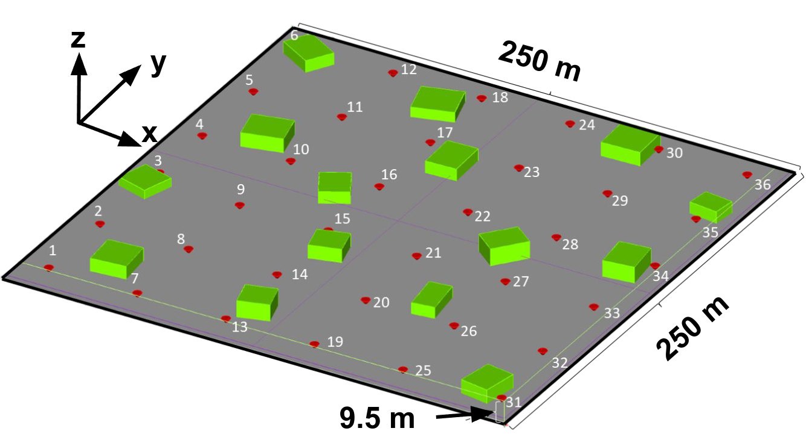
Simulation Scenario of DEER
3D Simulation Setup:
Dimensions: 250 × 250 × 9.5 m³
Obstacles: Multiple concrete buildings (green cuboids)
Nodes: 36 transceiver nodes (red cones) equipped
with vertically polarized short dipole antennas at 3 m height
Communication Modalities:
Frequencies: 400 MHz, 900 MHz, and 2.4 GHz
Channel Estimation: Conducted using EM.CUBE ray tracing

Slide 18
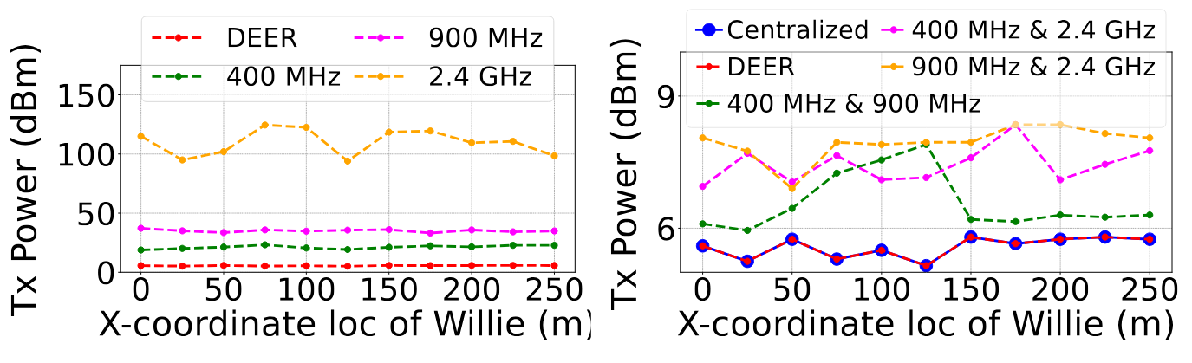
DEER as a Function of Willie’s Location (1)
End-to-end total transmit power as a function of Willie’s X coordinates with
P_{req DEP,h} = 0.5; U_{req} = 30 Mbps; Modality BW: 3 MHz
DEER Vs single-modal approaches
DEER Vs naive multi-modal approaches
Improves energy consumption
by up to 23.5x
Improves energy consumption
by up to 1.5x

Slide 19
DEER as a Function of Willie’s Location (2)
End-to-end total transmit power as a function of Willie’s X coordinates with
P_{req DEP,h} = 0.5; U_{req} = 30 Mbps; Modality BW: 1% of center freq.
DEER Vs single-modal approaches
DEER Vs naive multi-modal approaches
Improves energy consumption
by up to 16x
Improves energy consumption
by up to 1.5x

Slide 20
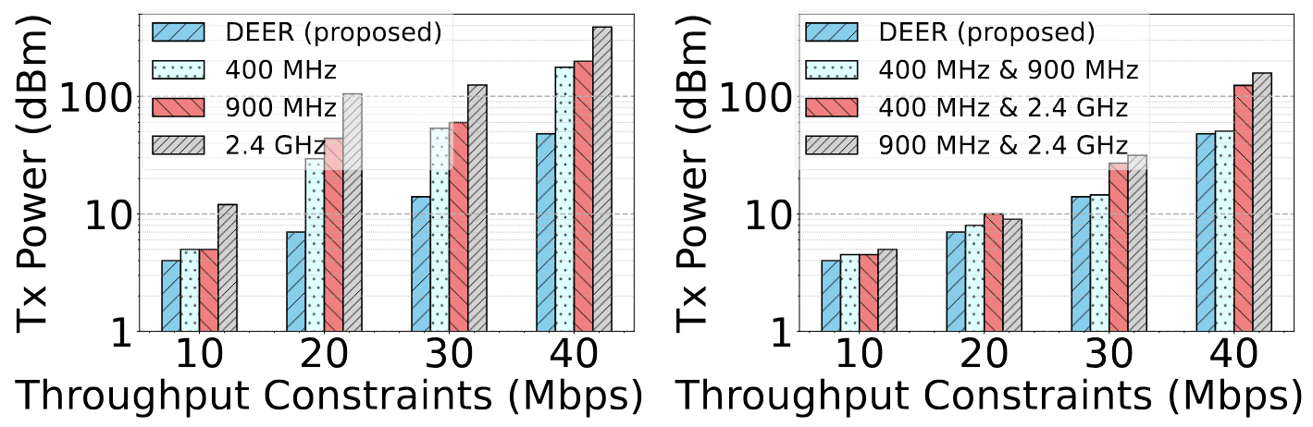
DEER as a Function of Required Throughput
User defined per hop covertness: P_{req} DEP,h = 0.5
DEER Vs single-modal approaches
DEER Vs naive multi-modal approaches
improves energy consumption by up to 15x

Slide 21

Summary of Key Contributions
We introduce DEER, a decentralized energy-efficient covert routing strategy
It is the first covert routing approach to leverage multiple wireless modalities simultaneously
It improves the energy efficiency by up to 23.5%

Slide 22

Possible Next Steps?
This work 💪🏻
⚠️ Reduce Routing Data Overhead
⚠️ Scale the System to N number of simultaneous modalities
Things
to do 😅

