Slide 1

SiMWiSense: Simultaneous Multi-Subject Activity Classification Through Wi-Fi Signals
K. Foysal Haque, Milin Zhang, Francesco Restuccia
Institute for the Wireless Internet of Things (WIoT)
Northeastern University

Slide 2
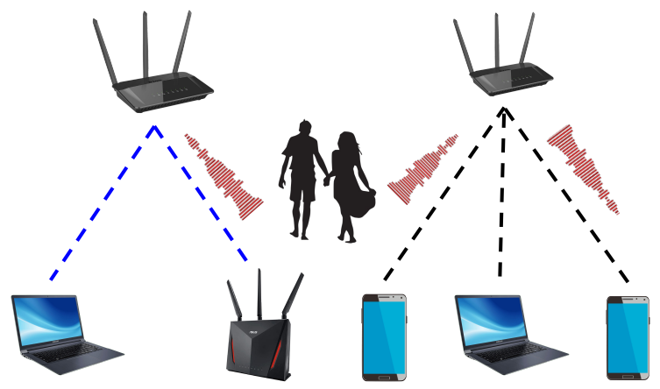
Why the Wi-Fi Sensing ?
Wi-Fi is one of the most pervasive wireless technologies
Wi-Fi market is predicted to reach $4.9T by 2025¹
Beyond connectivity, Wi-Fi signals can be used to perform sensing tasks
Example: Wi-Fi sensing can aid the computer vision applications in the edge devices
Wi-Fi Alliance, “The Economic Value of Wi-Fi: A Global View (2018 and 2023),” https://tinyurl.com/EconWiFi, 2021.

Slide 3
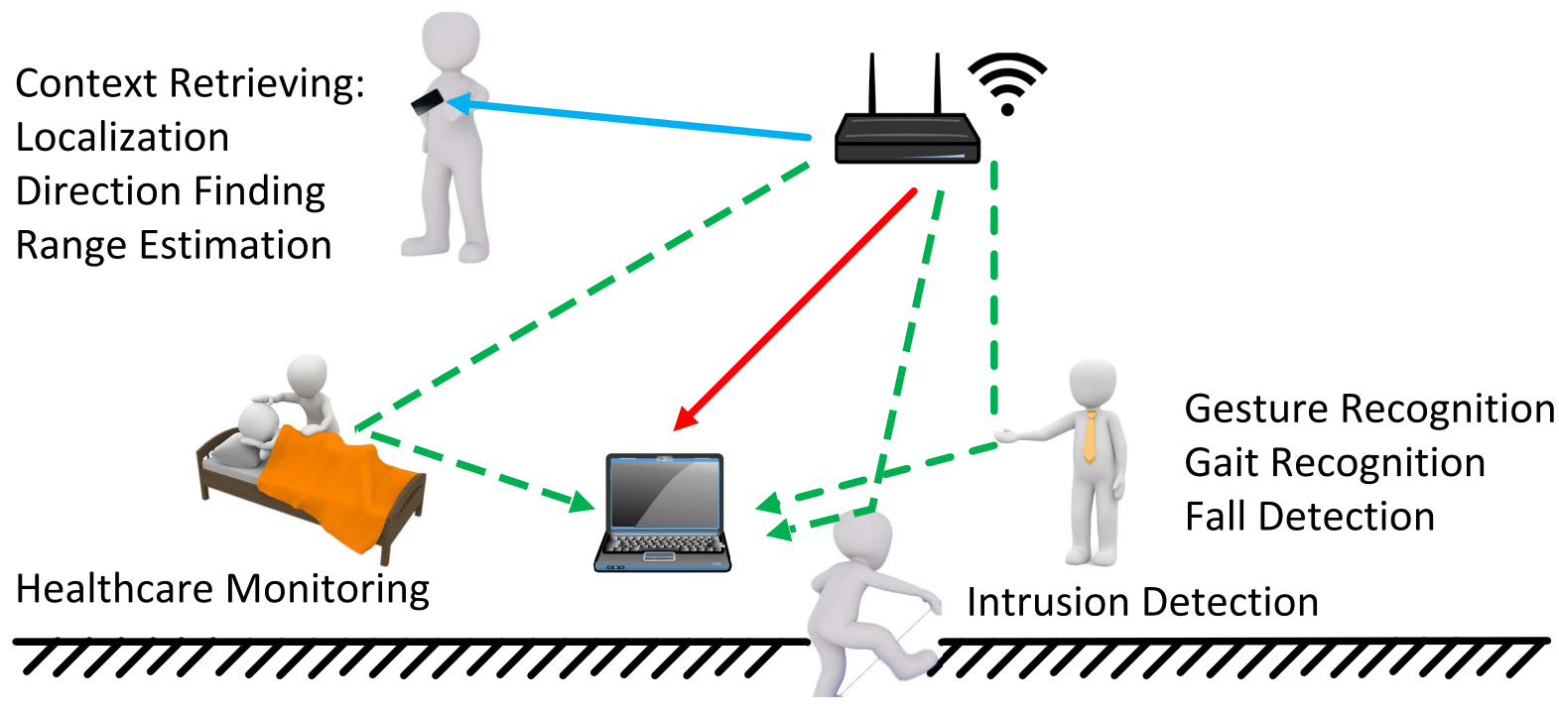
Traditional Wi-Fi Sensing Applications
Image source: doi: 10.1109/ACCESS.2018.2812887

Slide 4
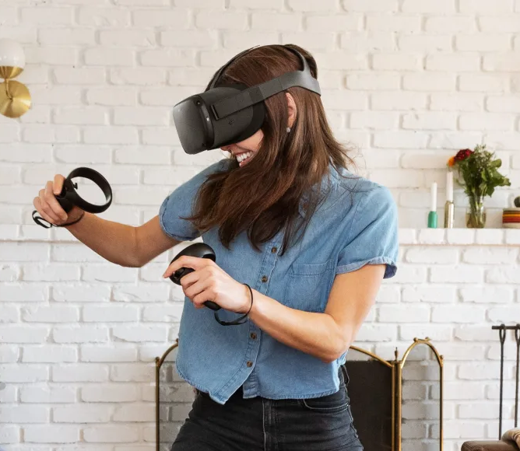
Wi-Fi Sensing in Metaverse
Metaverse is a virtual world where objects, places, and people are represented digitally
It’s use case includes education, remote working, social media interactions and gaming
The global Metaverse market is predicted to reach 1500 B by 2029¹
Image source: https://variety.com/2019/digital/news/oculus-quest-sales-data-1203239945/
1. https://www.fortunebusinessinsights.com/metaverse-market-106574

Slide 5
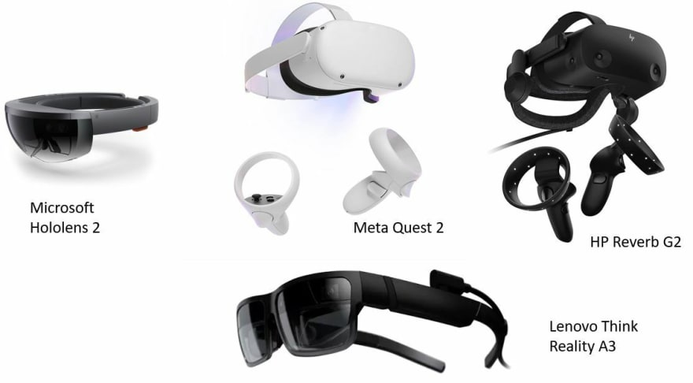
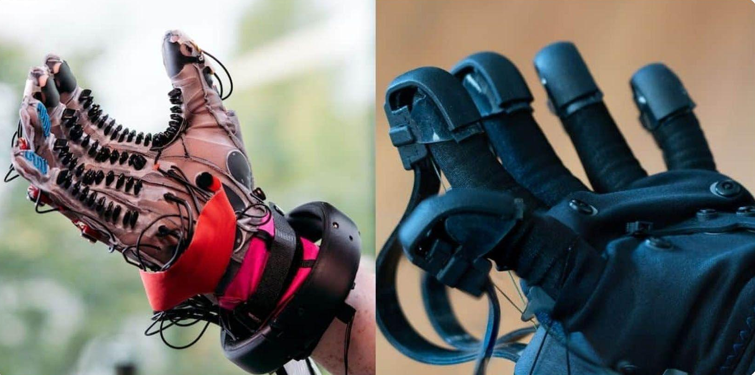
Wi-Fi Sensing in Metaverse
Need dedicated infrastructure
Cost: $ (1500 - 4000)
Could prevent adoption
Wi-Fi sensing can address these challenges
Image source: https://dev.to/codemaker2015/introduction-to-metaverse-1e6i
Image source: https://sensoriumxr.com/articles/metaverse-gear
VR Gloves

Slide 6

Prior Work and Existing Challenges
R. Xiao, J. Liu, J. Han, and K. Ren, “OneFi: One-Shot Recognition for Unseen Gesture via COTS WiFi,” in Proceedings of the ACM Conference on Embedded Networked Sensor Systems (SenSys), pp. 206–219, 2021.
F. Meneghello, D. Garlisi, N. Dal Fabbro, I. Tinnirello, and M. Rossi, “SHARP: Environment and Person Independent Activity Recognition with Commodity IEEE 802.11 Access Points,” IEEE Transactions on Mobile Computing, pp. 1–16, 2022.
S. Depatla and Y. Mostofi, “Crowd counting through walls using wifi,” in 2018 IEEE international conference on pervasive computing and com munications (PerCom), pp. 1–10, IEEE, 2018.
Only Single Sub Sensing
Can’t Generalize Domains
Wi-Fi Sensing Challenges
Offline Preprocessing Needed
Limited no. of Hardware

Slide 7
Prior Work and Existing Challenges
Challenges of Simultaneous Multi-subject Sensing with Current Approaches:
If n and m are the number of subjects and activities, the number of classes becomes m^{n}
For example, 3 subjects and 10 activities correspond to more than 1,000 classes
Challenges of Current Generalization Approaches:
Most of the work consider only a few activities¹
Overall performance can be improved
F. Meneghello, D. Garlisi, N. Dal Fabbro, I. Tinnirello, and M. Rossi, “SHARP: Environment and Person Independent Activity Recognition with Commodity IEEE 802.11 Access Points,” IEEE Transactions on Mobile Computing, pp. 1–16, 2022

Slide 8
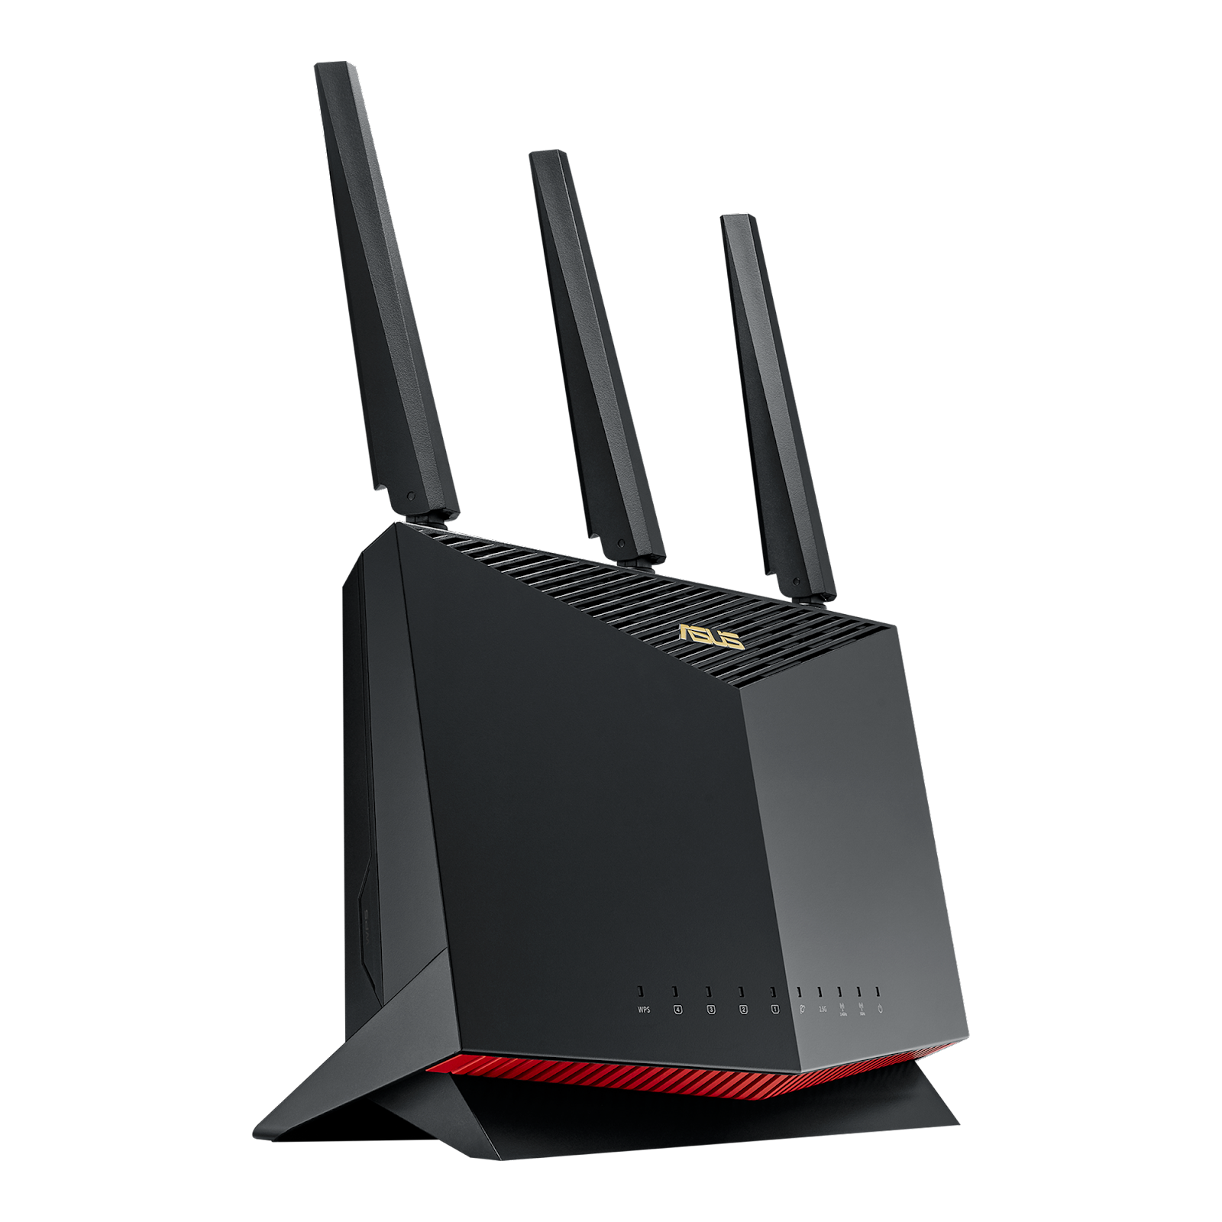
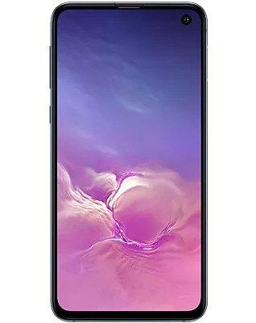




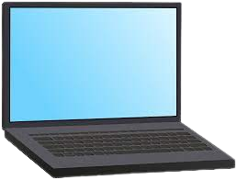
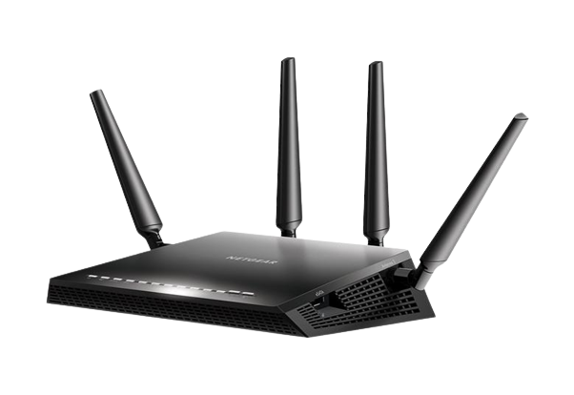
Introduction on Wi-Fi Sensing
Perceived by the changes in the channel frequency response (CFR).
Main approaches are based on:
(i) Received Signal Strength
(ii) Passive Wi-Fi Radar
(iii) Channel State Information (CSI)
Transmitted Wi-Fi
Signals
Activity
Recognition
Health Monitoring
Presence Detection
Received
Wi-Fi Signals
Channel Information
Feature Extraction
Classification

Slide 9


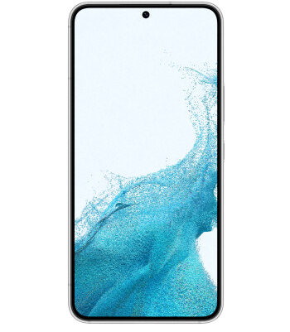
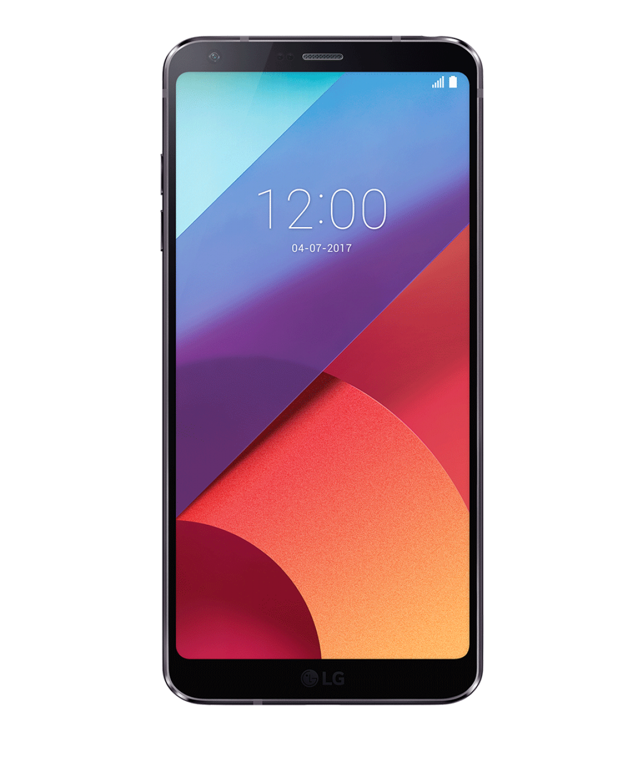
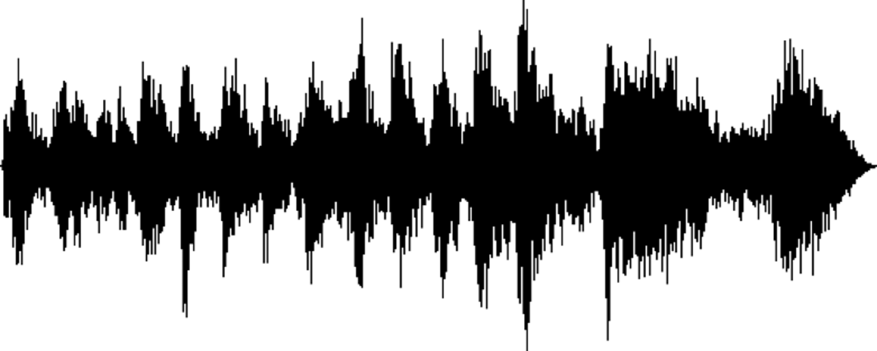
Simultaneous Multi-Subject Sensing
CSI
Dataset
SiMWiSense
Subject i, Activity j
...
...
Subject 1
Activity 1
Subject 2
Activity 2
Subject N
Activity M
Wi-Fi Signal

Slide 10
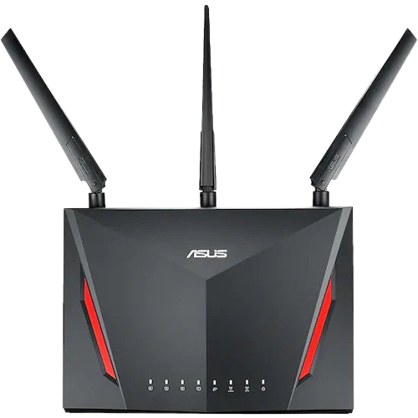
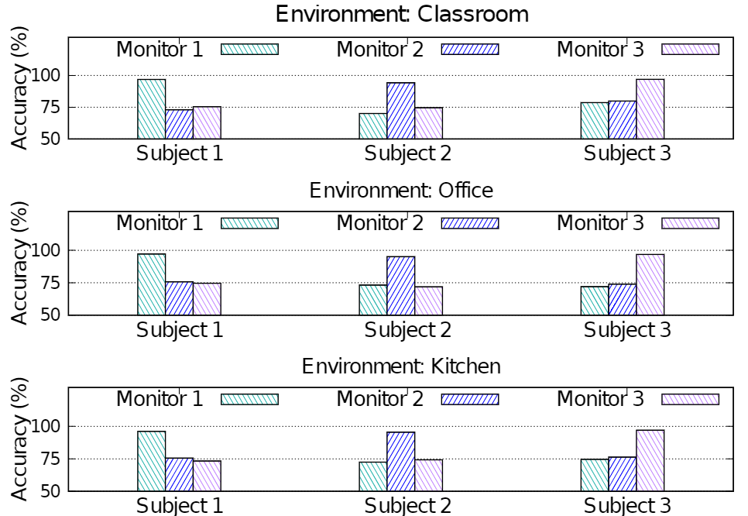


Experimental Proof of Our Intuition
Sensing proximity test is performed with 3 different subjects at 3 different environments
With Monitor 1, subject 1 achieves 95%, whereas the accuracy of Subject 2 and Subject 3 decreases by 30% on an average.
Proximity test setup
Accuracy vs sensing proximity
Subject 1
CSI Monitor 1
Access
Point
Activity
Subject 2
CSI Monitor 2
Activity
Noise
Signal Perturbed by Activity
Subject 3
CSI Monitor 3
Activity
Noise
Signal Perturbed by Noise

Slide 11
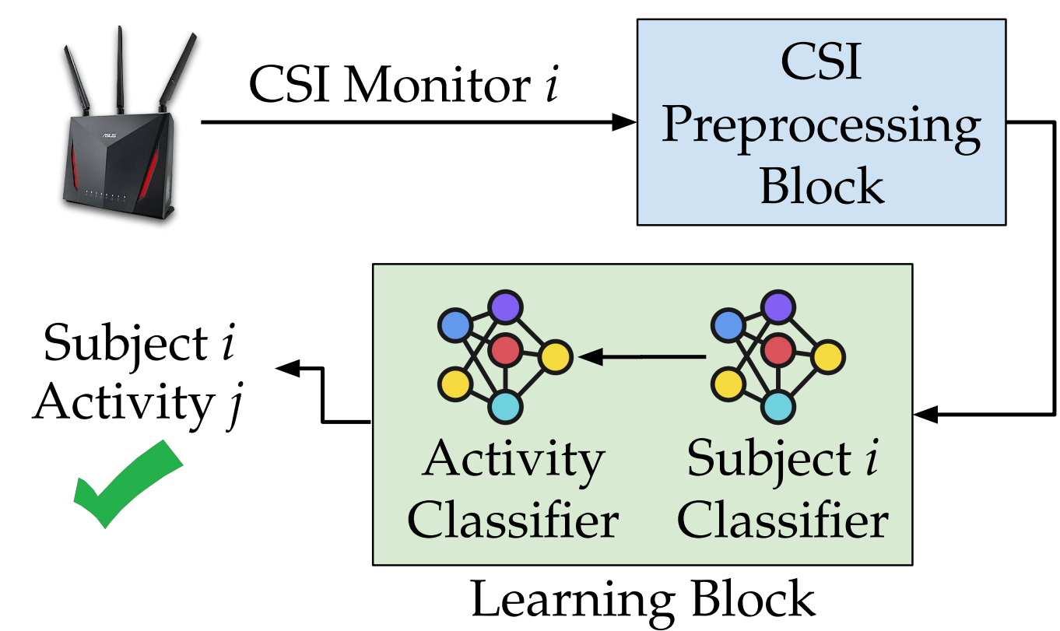
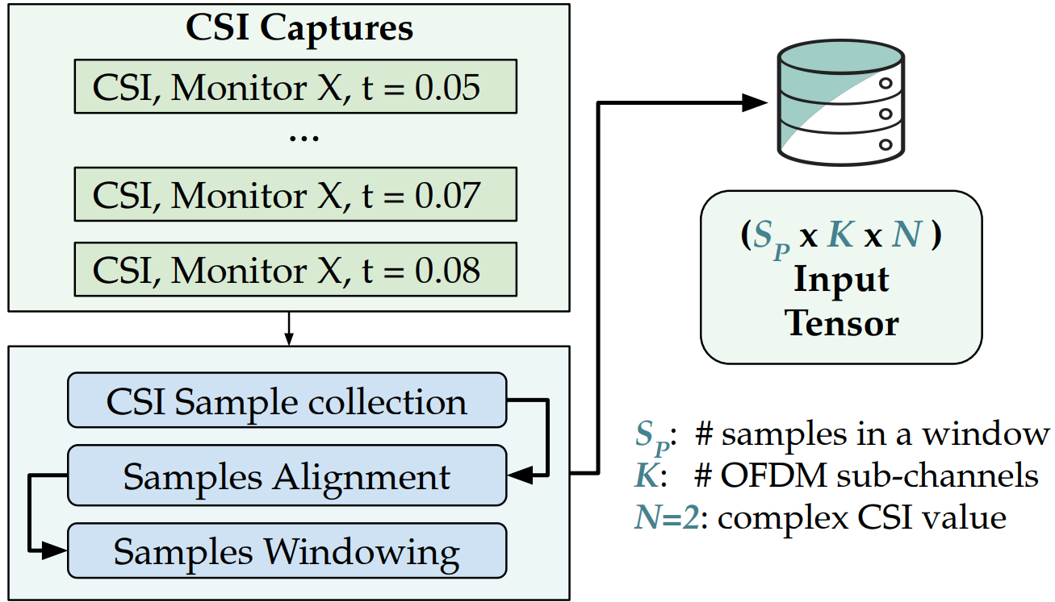
SiMWiSense Overview
CSI Preprocessing Block

Slide 12
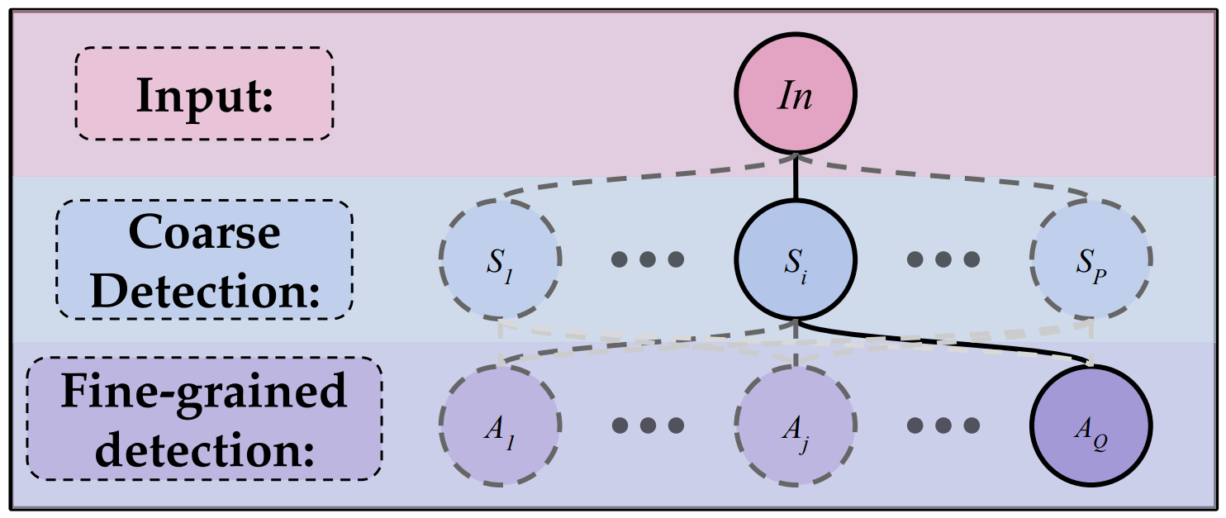
SiMWiSense Learning Block
Coarse Detection: a deep learning (DL) model is used to discriminate subjects n
Fine-grained Detection: another DL model is used to determine the activities m.
Thus Complexity becomes n + m instead of m^{n}

Slide 13
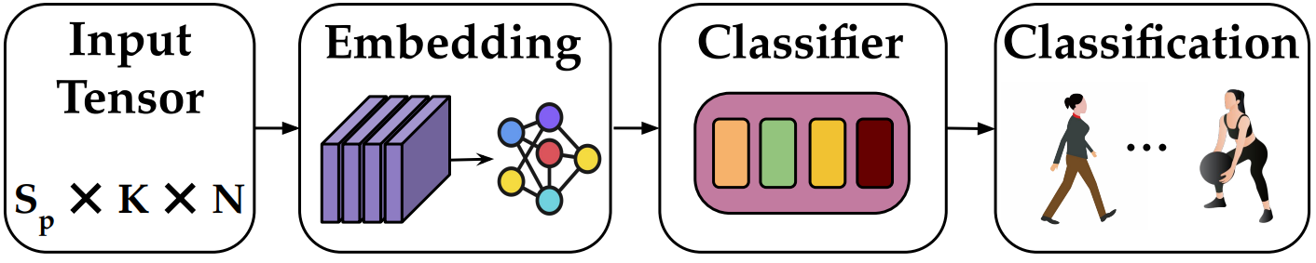
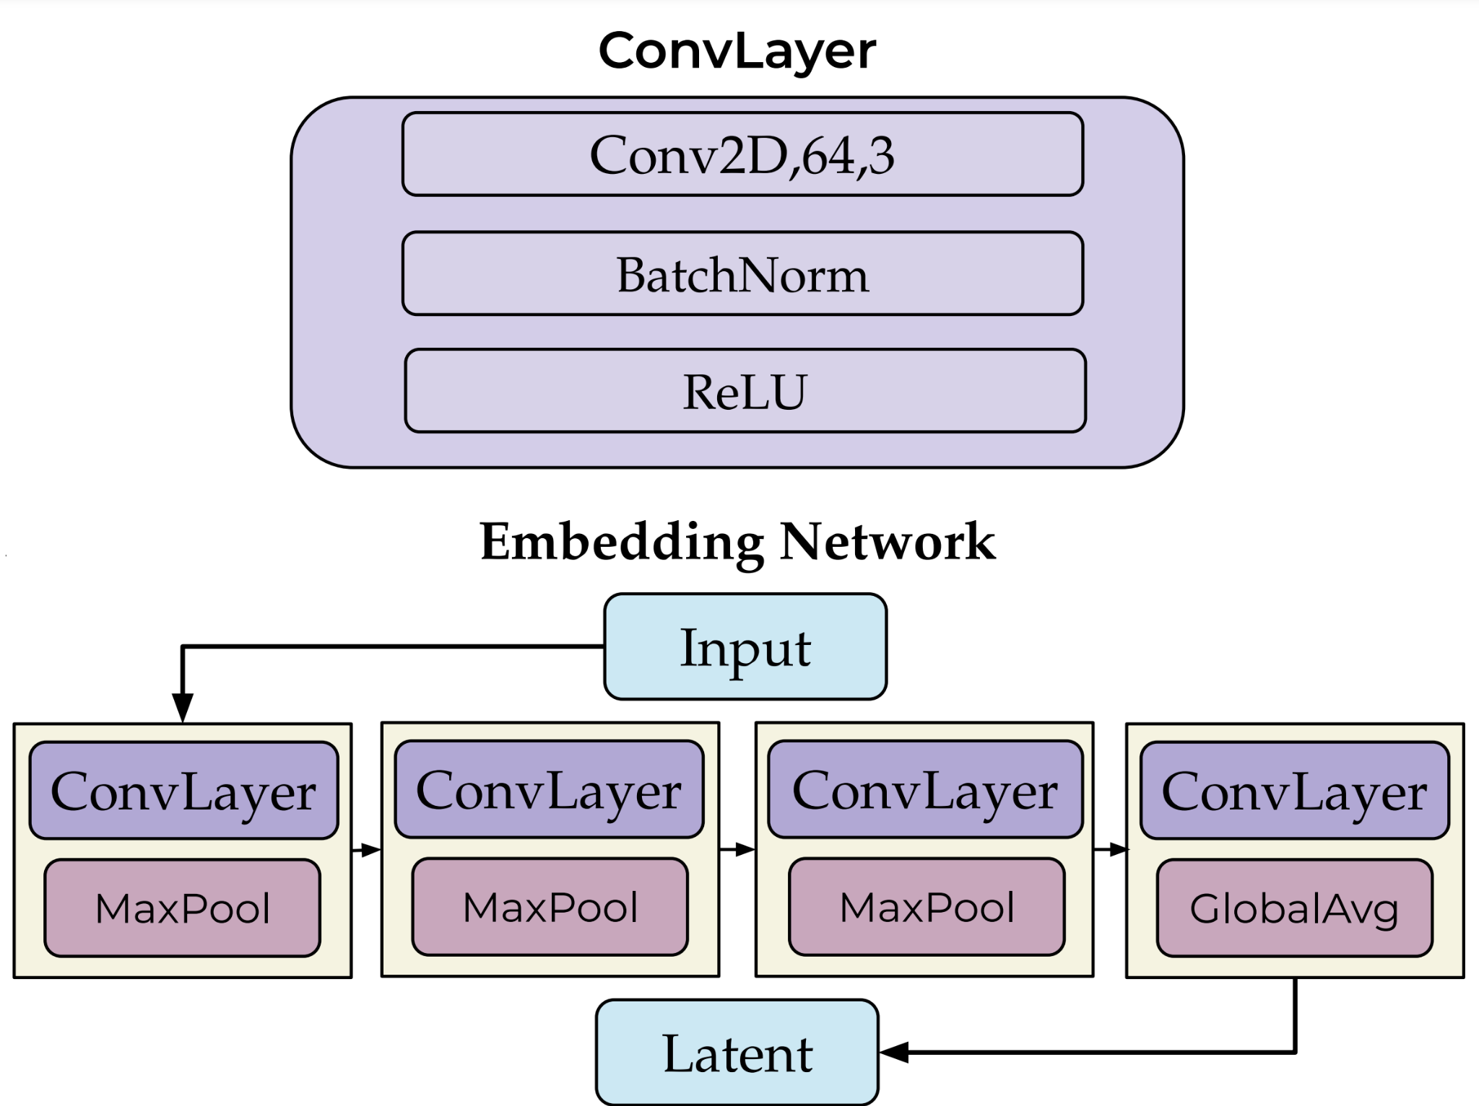
Feature Reusable Embedding Learning (FREL)
Feature Reusable Embedding Learning (FREL)
The embedding network and classifier are jointly trained with a mini-dataset like Embedding Learning.
Then, like Meta Learning, we further optimize the classifier with a few samples.
Embedding Network

Slide 14
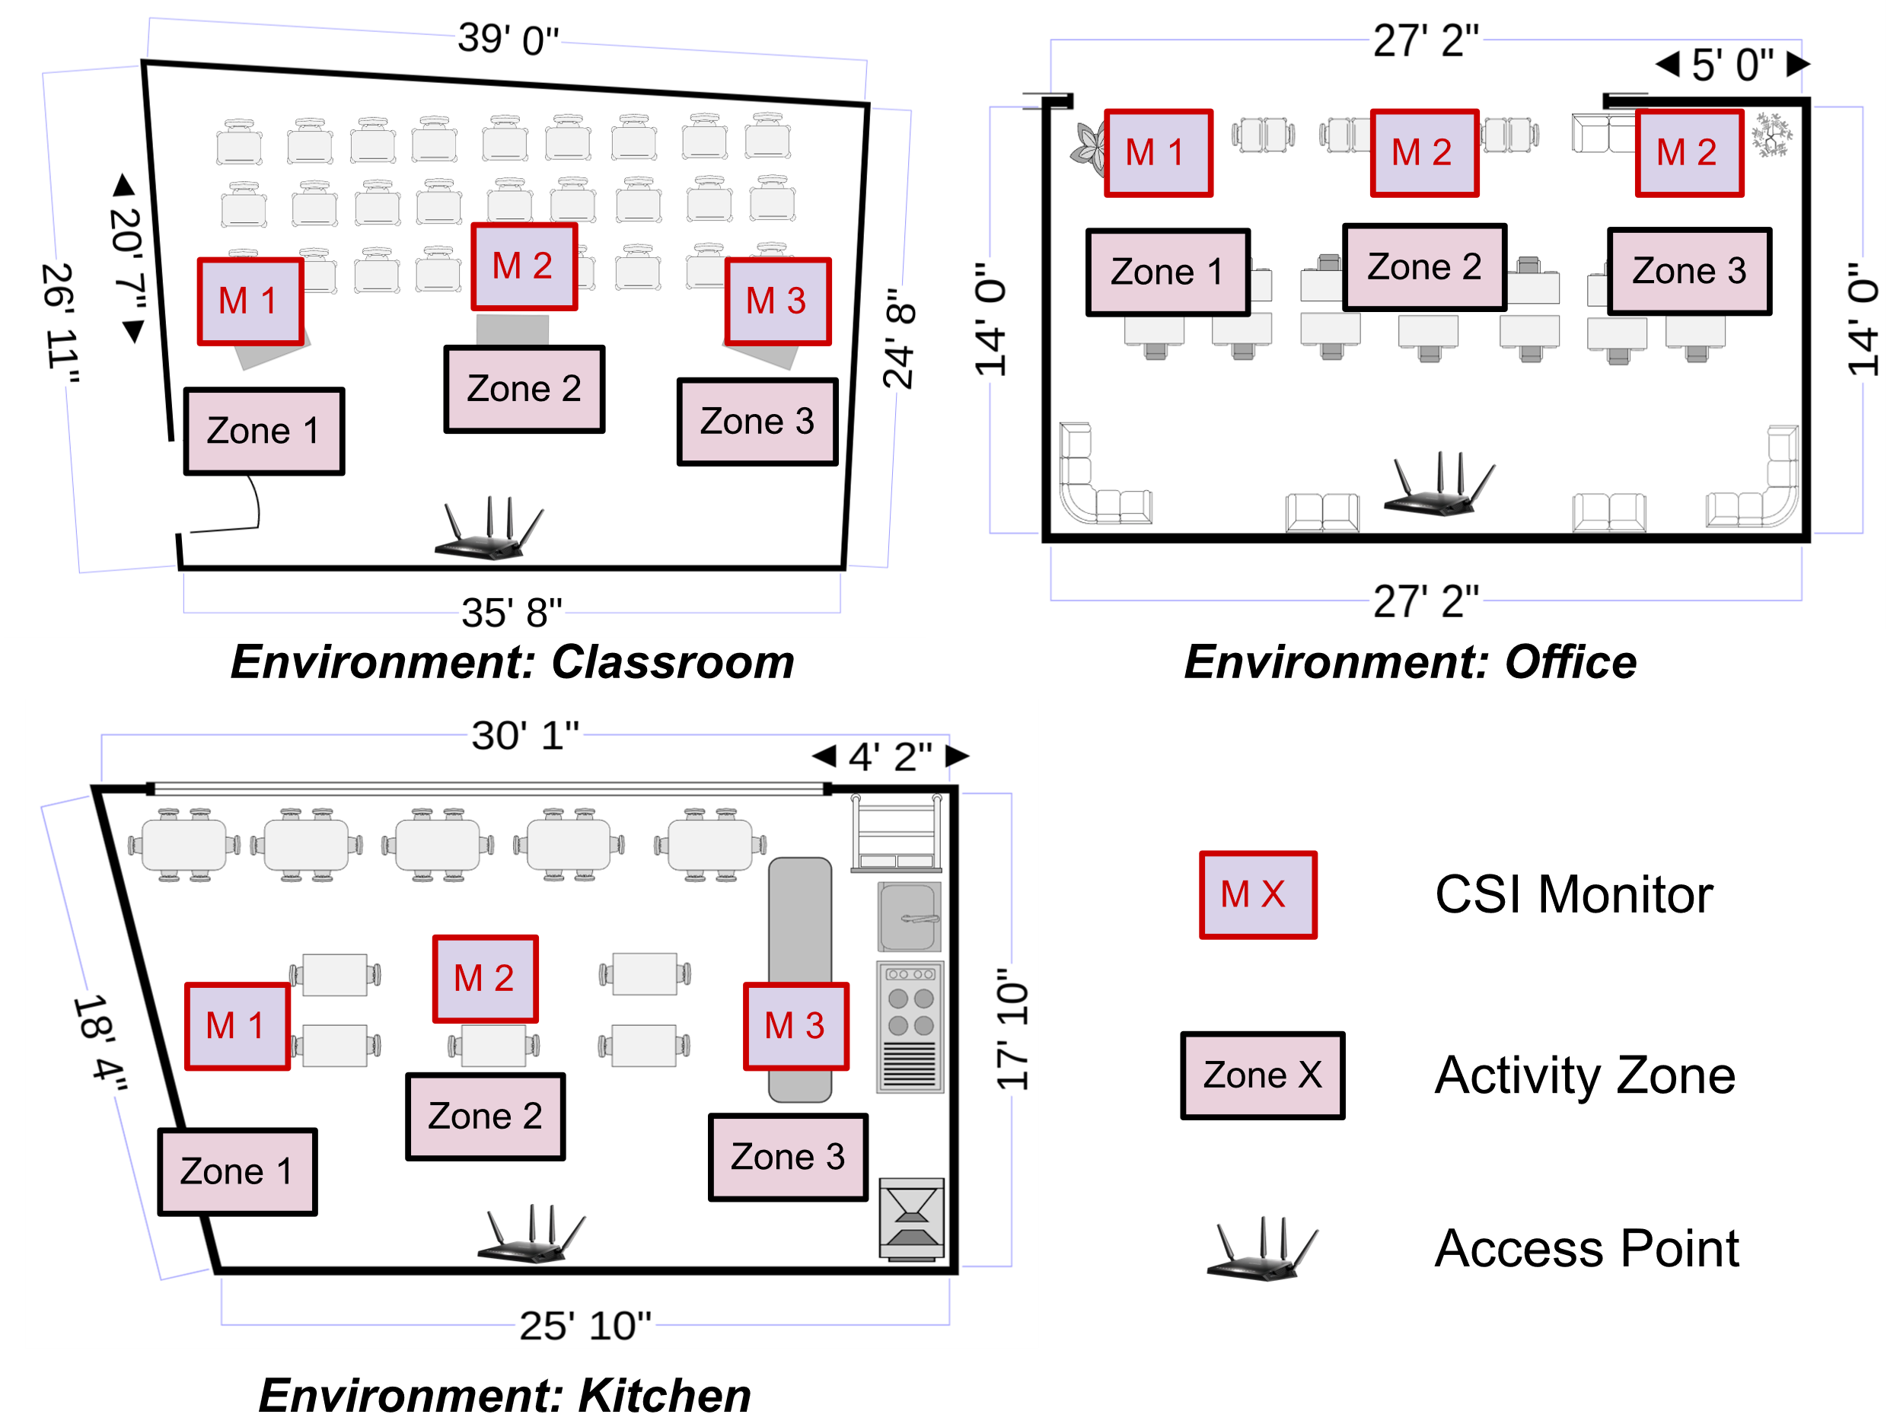
Experimental Testbeds

Slide 15
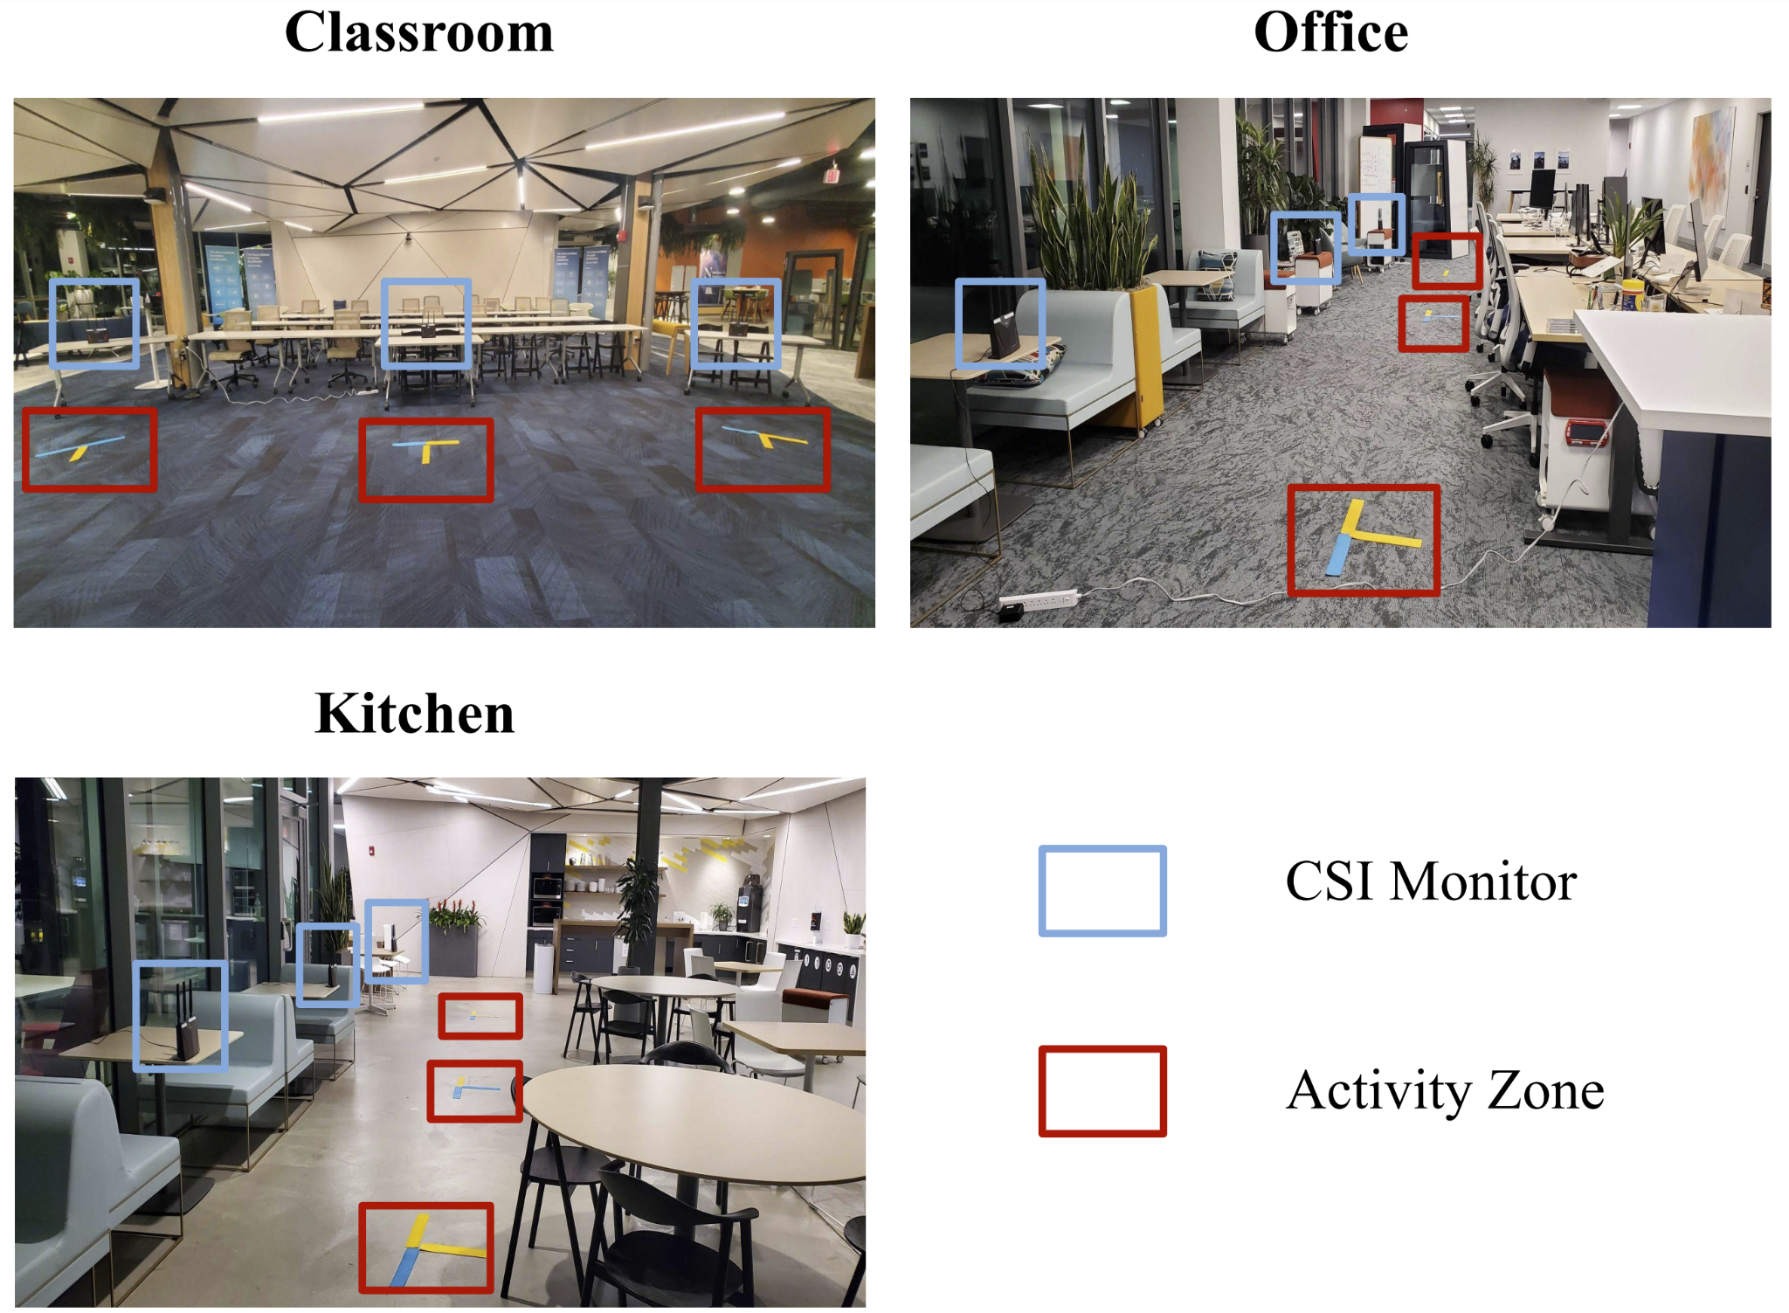
Data Collection Campaign
Three CSI extractors are setup at a distance of 1.5-3.0 m
Video Streams has been recorded as ground truth
Data collection campaign is done with 3 different persons, 20 activities each in 3 different environment.
push | rotate | Hands up | waive | brush
clap | Sit | Eat | Wash hands | Bend forward
drink | call | kick | writting | read
Waive-sitting | Side bend | Check wrist | standing | Browsing phone

Slide 16
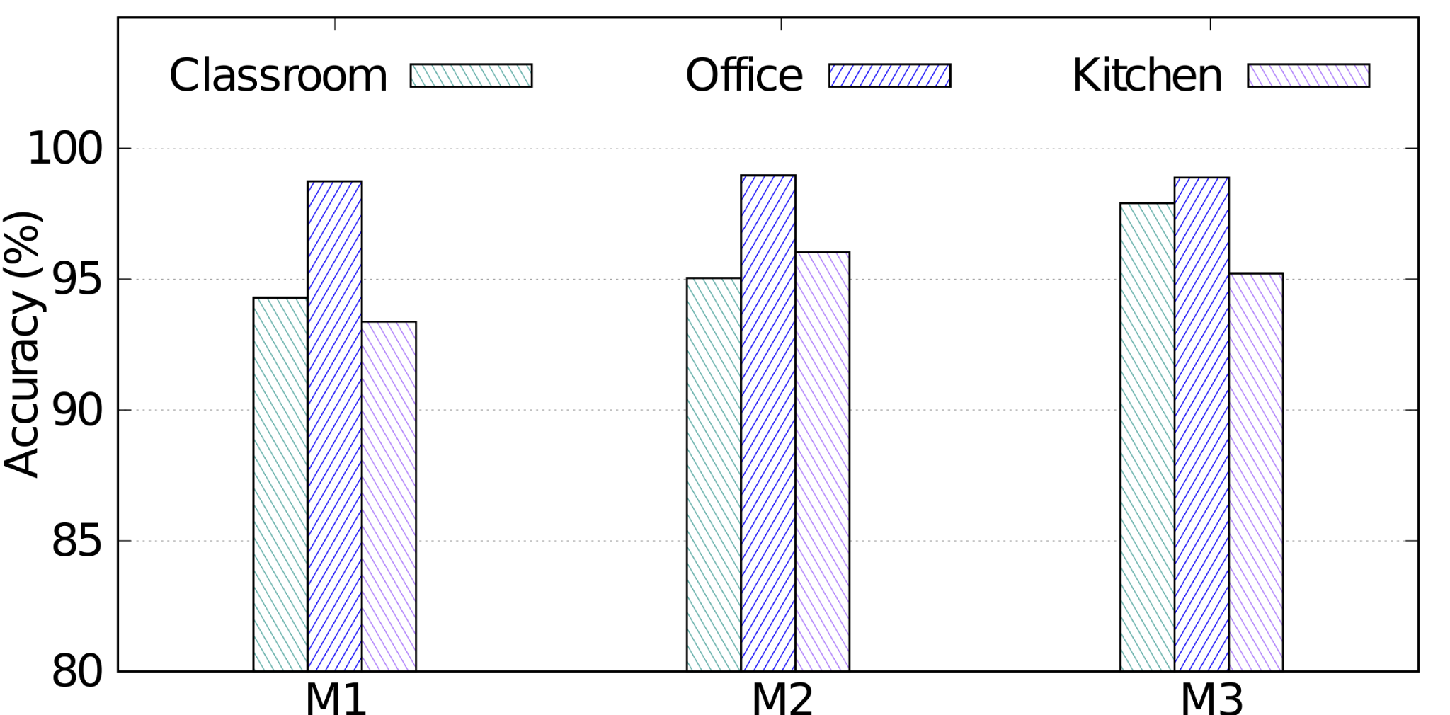
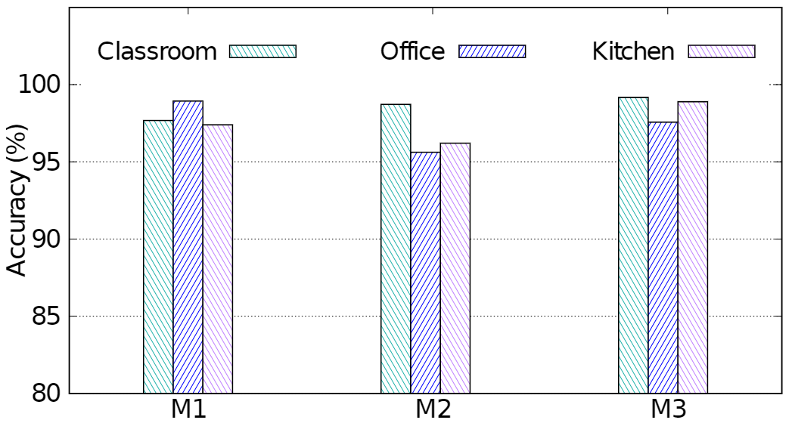
Performance with Baseline CNN
Average subject identification accuracy of M1, M2 and M3 is 96.49%.
With baseline CNN, Activity classification can achieve up to an accuracy of 97%.
However, CNN cannot generalize to new environments or subjects
Subject Classification Performance
Activity Classification Performance

Slide 17
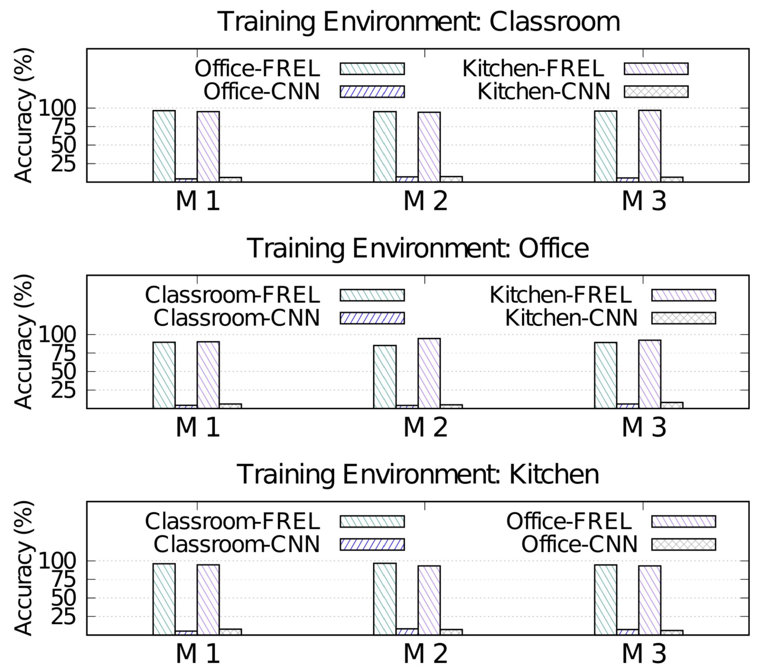
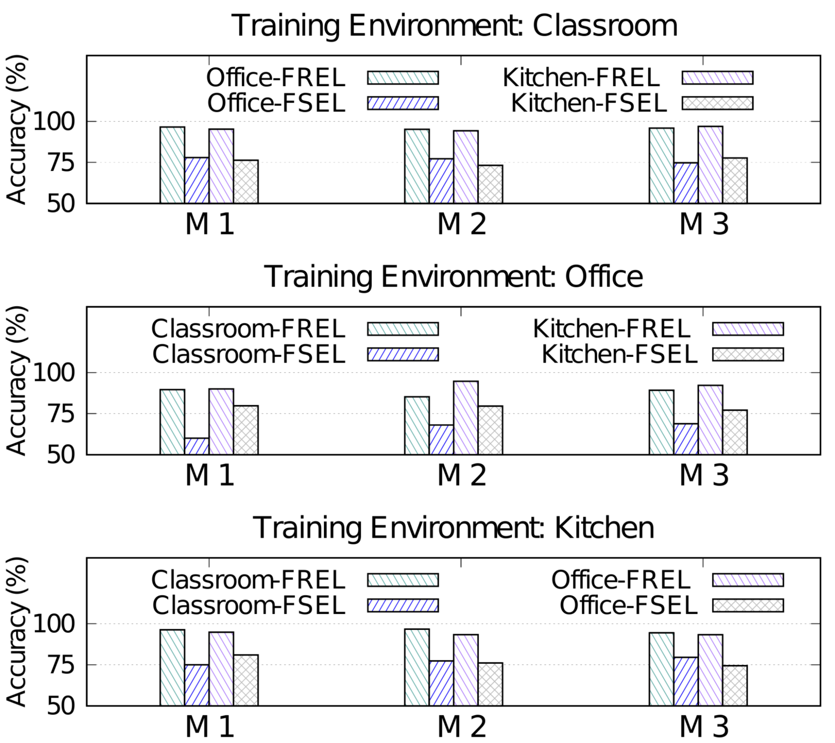
Performance of FREL as Subject Identifier
In unseen environments, CNN only limits to 6.19% compared to the average performance of 93.53% for FREL
FREL demonstrates an accuracy boost of 17.7% on an average in comparison to SOTA embedding model (FSEL)

Slide 18
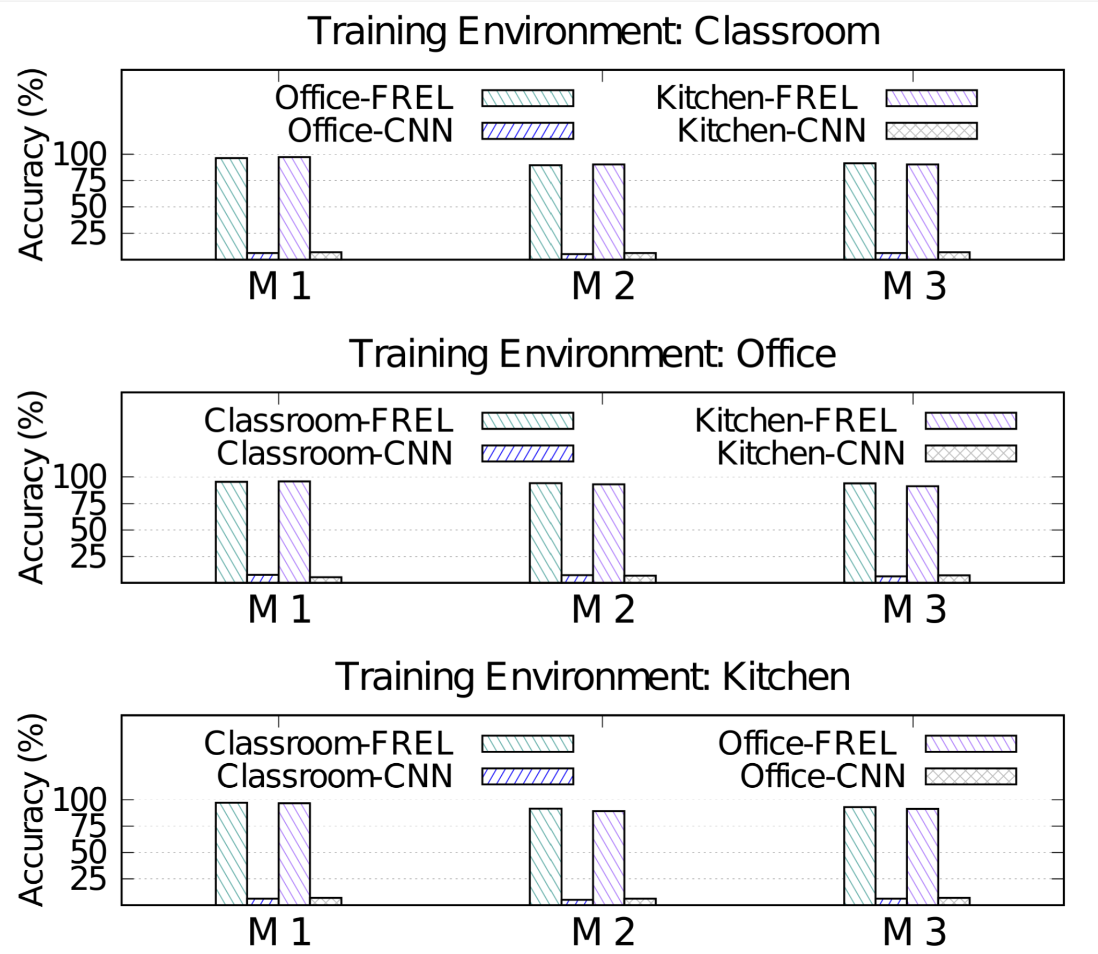
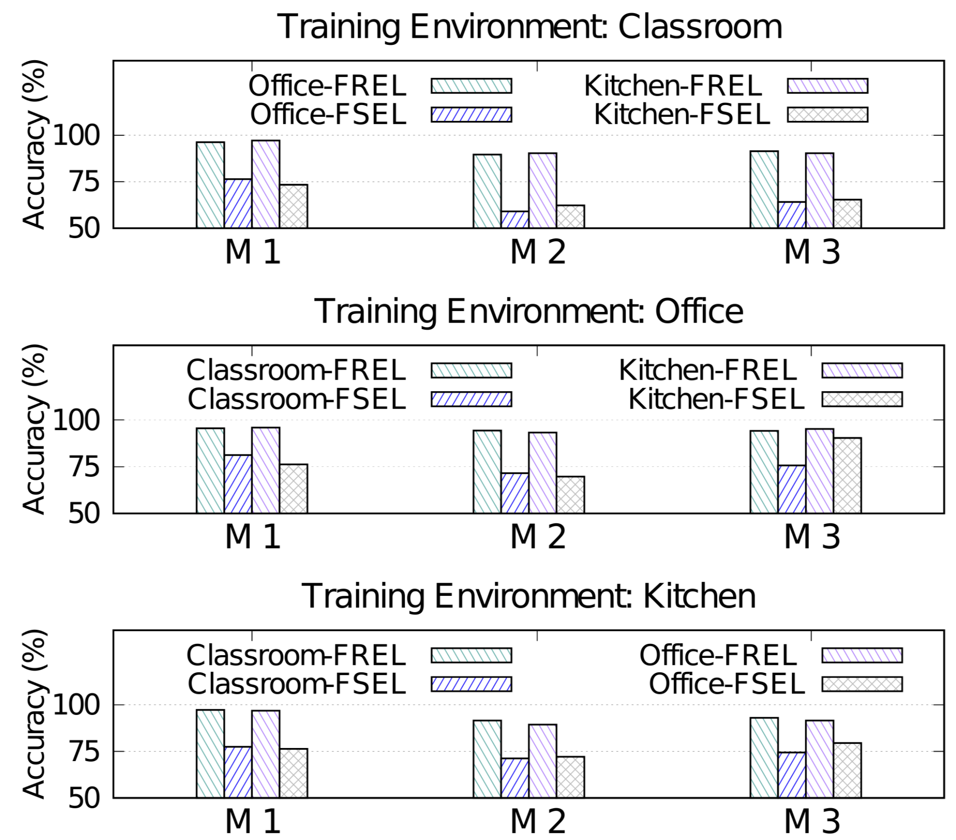
Performance of FREL as Activity Classifier
In generalizing new environments, FREL surpass CNN by 86.6% on an average.
With 15s of new data FREL boosts the performance of SOTA model (FSEL) by 17.5% on an average.

Slide 19
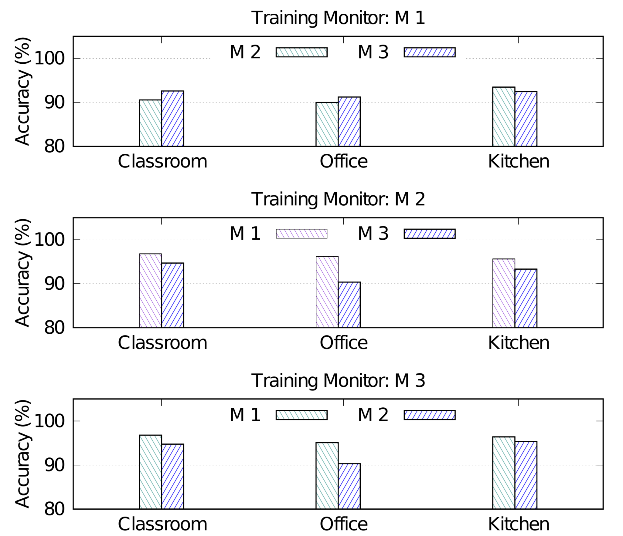
Performance of FREL with Unseen Subjects
It can achieve an average accuracy of 94% while trained with one Monitor and tested with others.
FREL enables any system to be trained only on one monitor and deployed with n number of monitors.

Slide 20

Key Findings and Limitations
We present SiMWiSense, the first framework for multi-subject simultaneous activity classification using Wi-Fi
To address the challenge of generalizing to new environments and subjects, a novel algorithm FREL is proposed which surpass the SOTA model
Limitations:
The model still needs 15s of data from new environment to fine tune

Slide 21

Future Work
Sensing without no additional data at all from new environment
Sensing with larger band to have more sensing granularity

Slide 22
SiMWiSense: Simultaneous Multi-Subject Activity Classification Through Wi-Fi Signals
Thank You

