Slide 1

Kotlin

Slide 2
What is Kotlin?
General purpose, open source, statically typed
OO and functional
Runtimes
  JVM
  Android
  JavaScript(ECMAScript 5.1)
  Native (via LLVM)
Started by JetBrains
Inspired by Java, C#, JavaScript, Scala and Groovy

Slide 3
Why Kotlin?
Isn’t Java Perfect?
No:
HasThisTypePatternTriedToSneakInSomeGenericOrParameterizedTypePatternMatchingStuffAnywhereVisitor.class

Slide 4
Goals of Kotlin
Concise
More type safe (non-nullable types)
100% Interoperable with Java
Expressive
Easy to learn

Slide 5
What is Kotlin not?
Doesn’t fix type erasure
Doesn’t allow true multiple inheritance

Slide 6
Hello World
package demo
fun main(args: Array<String>) {
println(“Hello, world!”)
}
package demo
public class HelloWorld {
public static void main(String[] args) {
System.out.println(“Hello, World”);
}
}

Slide 7
Visibility
Private
Protected
Public
Internal

Slide 8
Nullable Values
References must explicitly be marked as nullable when null is possible
Uses “?”
fun parseInt(str: String): Int? { … }
fun printProduct(arg1: String, arg2: String) {
val x = parseInt(arg1)
val y = parseInt(arg2)
// Using `x * y` yields error because they may hold nulls.
if (x != null && y != null) {
// x and y are automatically cast to non-nullable after null check
println(x * y)
}
else {
println("either '$arg1' or '$arg2' is not a number")
}
}

Slide 9
Live Examples

Slide 10
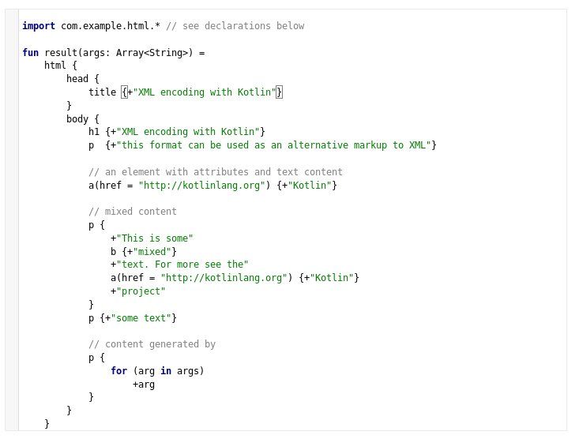
DSL

