Slide 1




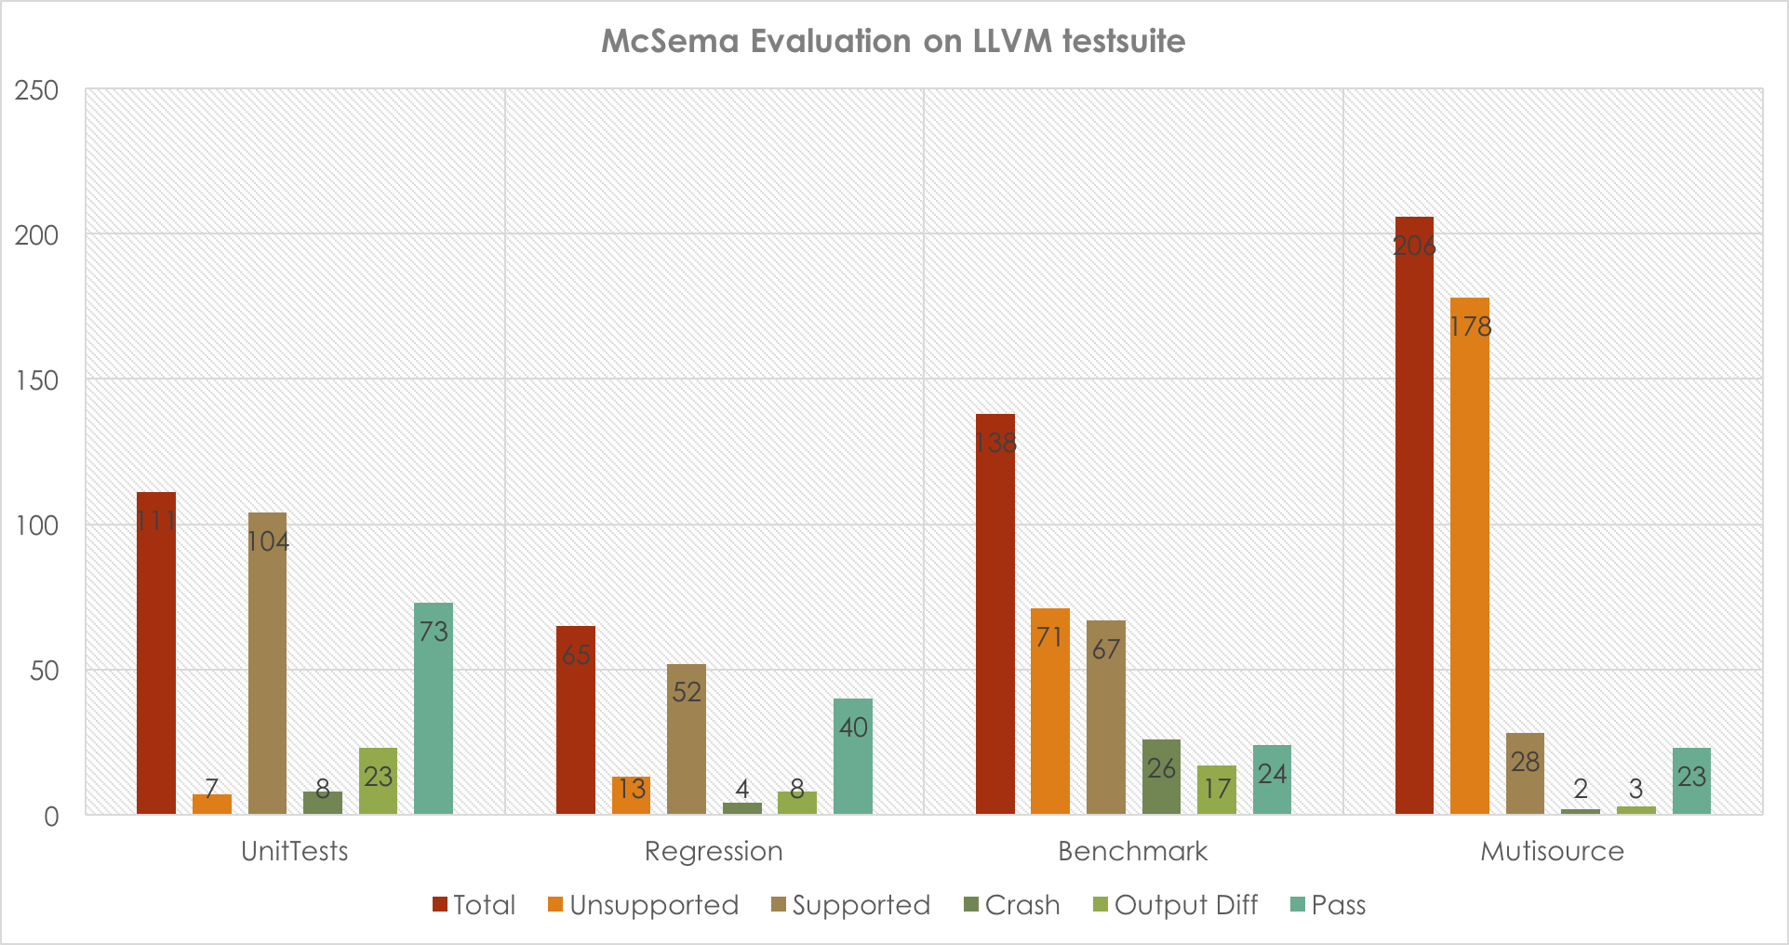
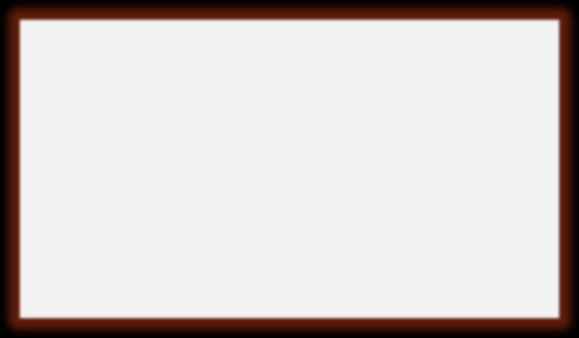

Binary Decompilation to LLVM IR
Sandeep Dasgupta, Joshua Cranmer, Edward Schwartz and Vikram Adve
Motivation and Goals
Our Approach
ALLVM: Represent all software components as LLVM IR, which provides new opportunities for analysis and optimization.
What about the software components which are in binary ?
Translate binary to “rich” LLVM IR where richness includes
  Variable and type recovery
  Per procedure stack frame recovery
  Function signature recovery
X86 / X86-64
IDA Pro
CFG
McSema
LLVM IR
Stack
Recovery
LLVM IR
Variable
Recovery
LLVM IR
Type
Inference
LLVM IR
Goals
commercial
External
Internal
Completed
Ongoing
Ongoing
McSema Pluses
McSema Minuses
Open Sourced
Output IR fully functional
Plug & play CFG recovery
Hardware registers not distinguishable from memory
Process stack represented as flat array
Variables not identified.
No usable type information
Stack Recovery
Related Work
Learning & Evaluation
High Address
arg1
Learning
arg1
%rbp + 16
Ad hoc IR
McSema generated IR is not amenable to pointer analysis due to `ptrtoint` casts and conservativeness of the available pointer analysis.
Transformed the IR based on type information and using available analysis into more succinct form which can assist pointer analysis to some degree.
%rbp + 24
arg2
Divine and its related work
Hex-Rays decompiler
BAP (Binary Analysis Platform) & TIE
BitBlaze
Caller Stack
arg2
%rbp + 8
%rbp + 16
Return address
Return address
parent_stack_end
old %rbp
Not Open Sourced
Evaluation
%rbp
old %rbp
Divine and its related work
Second-Write and its related work
Hex-Rays decompiler
BitBlaze (Partially Open Sourced)
TIE
Callee Stack
(foo)
%rbp
Not Rich IR
Low Address
Extracting LLVM IR using QEMU
BitBlaze
RevGen
Rev.ng
foo:
push %rbp
mov %rsp, %rbp
mov 16(%rbp), %rax
mov 24(%rbp), %r10
foo (parent_rbp, parent_stack_end):
push %parent_rbp
mov %rsp, %rbp
mov 8(%parent_stack_end), %rax
mov 16(%parent_stack_end), %r10

