Slide 1
Secure Programming, Continued
Computer Security
Peter Reiher
May 17, 2016

Slide 2
Outline
Introduction
Principles for secure software
Major problem areas

Slide 3
Example Problem Areas
Buffer overflows
Error handling
Privilege escalation
Race conditions
Use of randomness
Proper use of cryptography
Trust
Input verification
Variable synchronization
Variable initialization

Slide 4
Error Handling
Error handling code often gives attackers great possibilities
It’s rarely executed and often untested
So it might have undetected errors
Attackers often try to compromise systems by forcing errors

Slide 5
A Typical Error Handling Problem
Not cleaning everything up
On error conditions, some variables don’t get reset
If error not totally fatal, program continues with old values
Could cause security mistakes
  E.g., not releasing privileges when you should

Slide 6
Some Examples
Remote denial of service attack on Apache HTTP server due to bad error handling (2010)
ntpd (Network Time Protocol Daemon) error handling flaw (2015)
  Essentially allowing attacker to set target’s clock

Slide 7
Checking Return Codes
A generalization of error handling
Always check return codes
A security program manager for Microsoft said this is his biggest problem
Very dangerous to bull ahead if it turns out your call didn’t work properly
Example: Nagios XI didn’t check the return value of setuid() call, allowing privilege escalation

Slide 8
Privilege Escalation
Programs usually run under their user’s identity with his privileges
Some programs get expanded privileges
  Setuid programs in Unix, e.g.
Poor programming here can give too much access

Slide 9
An Example Problem
A program that runs setuid and allows a shell to be forked
  Giving the caller a root environment in which to run arbitrary commands
Buffer overflows in privileged programs usually give privileged access
Privilege escalation – using program flaws to obtain greater access privileges you shouldn’t get

Slide 10
A Real World Example
Lenovo System Update Service
Run by an unprivileged user to perform valid system updates
Created a temporary admin account that had privileges to perform these updates
Account name and password were predictable, allowing attacker to guess them
And run as system administrator

Slide 11
What To Do About This?
Avoid running programs setuid
  Or in other OSs’ high privilege modes
If you must, don’t make them root-owned
  Remember, least privilege
Change back to the real caller as soon as you can
  Limiting exposure
Use virtualization to compartmentalize

Slide 12
Virtualization Approaches
Run stuff in a virtual machine
  Only giving access to safe stuff
Hard to specify what’s safe
Hard to allow safe interactions between different VMs
VM might not have perfect isolation

Slide 13
Race Conditions
A common cause of security bugs
Usually involve multiprogramming or multithreaded programs
Caused by different threads of control operating in unpredictable fashion
  When programmer thought they’d work in a particular order

Slide 14
What Is a Race Condition?
A situation in which two (or more) threads of control are cooperating or sharing something
If their events happen in one order, one thing happens
If their events happen in another order, something else happens
Often the results are unforeseen

Slide 15
Security Implications of Race Conditions
Usually you checked privileges at one point
You thought the next lines of code would run next
  So privileges still apply
But multiprogramming allows things to happen in between

Slide 16
The TOCTOU Issue
Time of Check to Time of Use
Have security conditions changed between when you checked?
And when you used it?
Multiprogramming issues can make that happen
Sometimes under attacker control

Slide 17
A Short Detour
In Unix, processes can have two associated user IDs
  Effective ID
  Real ID
Real ID is the ID of the user who actually ran it
Effective ID is current ID for access control purposes
Setuid programs run this way
System calls allow you to manipulate it

Slide 18
Effective UID and Access Permissions
Unix checks accesses against effective UID, not real UID
So setuid program uses permissions for the program’s owner
  Unless relinquished
Remember, root has universal access privileges

Slide 19
An Example
Code from Unix involving a temporary file
Runs setuid root
res = access(“/tmp/userfile”, R_OK);
If (res != 0)
die(“access”);
fd = open(“/tmp/userfile”,O_RDONLY);

Slide 20
What’s (Supposed to Be) Going on Here?
Checked access on /tmp/userfile to make sure user was allowed to read it
  User can use links to control what this file is
access() checks real user ID, not effective one
  So checks access permissions not as root, but as actual user
So if user can read it, open file for read
  Which root is definitely allowed to do
Otherwise exit

Slide 21
What’s Really Going On Here?
This program might not run uninterrupted
OS might schedule something else in the middle
In particular, between those two lines of code

Slide 22
How the Attack Works
Attacker puts innocuous file in
/tmp/userfile
Calls the program
Quickly deletes file and replaces it with link to sensitive file
  One only readable by root
If timing works, he gets secret contents

Slide 23

The Dynamics of the Attack
Let’s try that again!
One more time!
Success!
/etc/secretfile
/tmp/userfile
Run program
2. Change file
res = access(“/tmp/userfile”, R_OK);
if (res != 0)
die(“access”);
fd = open(“/tmp/userfile”,O_RDONLY);

Slide 24
How Likely Was That?
Not very
  The timing had to be just right
But the attacker can try it many times
  And may be able to influence system to make it more likely
And he only needs to get it right once
Timing attacks of this kind can work
The longer between check and use, the more dangerous

Slide 25
Some Types of Race Conditions
File races
  Which file you access gets changed
Permissions races
  File permissions are changed
Ownership races
  Who owns a file changes
Directory races
  Directory hierarchy structure changes

Slide 26
A Real Example
In the Linux SystemTap utility (2011)
  Which gathers info about the system
Allows modules to be loaded
Checks privileges, but then there’s a delay before loading the module
  So it might load a different module
  Allowing privilege escalation
A genuine TOCTOU issue

Slide 27
Preventing Race Conditions
Minimize time between security checks and when action is taken
Be especially careful with files that users can change
Use locking and features that prevent interruption, when possible
Avoid designs that require actions where races can occur

Slide 28
Randomness and Determinism
Many pieces of code require some randomness in behavior
Where do they get it?
As earlier key generation discussion showed, it’s not that easy to get

Slide 29
Pseudorandom Number Generators
PRNG
Mathematical methods designed to produce strings of random-like numbers
Actually deterministic
  But share many properties with true random streams of numbers

Slide 30
Attacks on PRNGs
Cryptographic attacks
  Observe stream of numbers and try to deduce the function
State attacks
  Attackers gain knowledge of or influence the internal state of the PRNG

Slide 31
An Example
ASF Software’s Texas Hold’Em Poker
Flaw in PRNG allowed cheater to determine everyone’s cards
  Flaw in card shuffling algorithm
  Seeded with a clock value that can be easily obtained

Slide 32
Another Example
Netscape’s early SSL implementation
Another guessable seed problem
  Based on knowing time of day, process ID, and parent process ID
  Process IDs readily available by other processes on same box
Broke keys in 30 seconds

Slide 33
A Recent Case
The chip-and-pin system is used to secure smart ATM cards
Uses cryptographic techniques that require pseudo-random numbers
Cambridge found weaknesses in the PRNG
Allows attackers to withdraw cash without your card
Seems to be in real use in the wild

Slide 34
How to Do Better?
Use hardware randomness, where available
Use high quality PRNGs
  Preferably based on entropy collection methods
Don’t use seed values obtainable outside the program

Slide 35
Proper Use of Cryptography
Never write your own crypto functions if you have any choice
  Another favorite piece of advice from industry
Never, ever, design your own encryption algorithm
  Unless that’s your area of expertise
Generally, rely on tried and true stuff
  Both algorithms and implementations

Slide 36
Proper Use of Crypto
Even with good crypto algorithms (and code), problems are possible
Proper use of crypto is quite subtle
Bugs possible in:
  Choice of keys
  Key management
  Application of cryptographic ops

Slide 37
An Example
An application where RSA was used to distribute a triple-DES key
Seemed to work fine
Someone noticed that part of the RSA key exchange was always the same
  That’s odd . . .

Slide 38
What Was Happening?
Bad parameters were handed to the RSA encryption code
It failed and returned an error
Which wasn’t checked for
  Since it “couldn’t fail”
As a result, RSA encryption wasn’t applied at all
The session key was sent in plaintext . . .

Slide 39
Another Example
From an Android app
It derived an encryption key from the user’s password
  The key looked like this:
  EFBFBDEFBFBDEFBFBD603466EFBFBD7BEFBFBD6C24E2B2AA576AEFBFBDEFBFBDEFBFBD0C6BEFBFBDEFBFBDEFBFBDEFBFBD76EFBFBDEFBFBDEFBFBDEFBFBDEFBFBD
  Hmm . . .
They created the key as a byte array
  So far, so good
Then cast the byte array to a string

Slide 40
Why Did That Cause Problems?
Android’s default character set is UTF-8
If UTF-8 gets a bit pattern that isn’t a proper character, it replaces it with
  The hex string “EFBFB”
Lots of random bit patterns aren’t UTF characters, so
B7B0F88D603466CF7BF26C24E2B2AA576AAFC5E90C6BD4EECCC576B9D7F1E9C3
Was cast to
EFBFBDEFBFBDEFBFBD603466EFBFBD7BEFBFBD6C24E2B2AA576AEFBFBDEFBFBDEFBFBD0C6BEFBFBDEFBFBDEFBFBDEFBFBD76EFBFBDEFBFBDEFBFBDEFBFBDEFBFBD

Slide 41
Trust Management
Don’t trust anything you don’t need to
Don’t trust other programs
Don’t trust other components of your program
Don’t trust users
Don’t trust the data users provide you

Slide 42
Trust
Some trust required to get most jobs done
But determine how much you must trust the other
  Don’t trust things you can independently verify
Limit the scope of your trust
  Compartmentalization helps
Be careful who you trust

Slide 43
Two Important Lessons
Many security problems arise because of unverified assumptions
  You think someone is going to do something he actually isn’t
Trusting someone doesn’t just mean trusting their honesty
  It means trusting their caution, too

Slide 44
Input Verification
Never assume users followed any rules in providing you input
They can provide you with anything
Unless you check it, assume they’ve given you garbage
  Or worse
Just because the last input was good doesn’t mean the next one will be

Slide 45
Treat Input as Hostile
If it comes from outside your control and reasonable area of trust
Probably even if it doesn’t
There may be code paths you haven’t considered
New code paths might be added
Input might come from new sources

Slide 46
For Example
Shopping cart exploits
Web shopping carts sometimes handled as a cookie delivered to the user
Some of these weren’t encrypted
So users could alter them
The shopping cart cookie included the price of the goods . . .

Slide 47
What Was the Problem?
The system trusted the shopping cart cookie when it was returned
  When there was no reason to trust it
Either encrypt the cookie
  Making the input more trusted
  Can you see any problem with this approach?
Or scan the input before taking action on it
  To find refrigerators being sold for 3 cents

Slide 48
Variable Synchronization
Often, two or more program variables have related values
Common example is a pointer to a buffer and a length variable
Are the two variables always synchronized?
If not, bad input can cause trouble

Slide 49
An Example
From Apache web server
cdata is a pointer to a buffer
len is an integer containing the length of that buffer
Programmer wanted to get rid of leading and trailing white spaces

Slide 50
The Problematic Code
while (apr_isspace(*cdata))
++cdata;
while (len-- >0 &&
apr_isspace(cdata[len]))
continue;
cdata[len+1] = ‘/0’;
len is not decremented when leading white spaces are removed
So trailing white space removal can overwrite end of buffer with nulls
May or may not be serious security problem, depending on what’s stored in overwritten area

Slide 51
Variable Initialization
Some languages let you declare variables without specifying their initial values
And let you use them without initializing them
  E.g., C and C++
Why is that a problem?

Slide 52
Variable Initialization
Some languages let you declare variables without specifying their initial values
And let you use them without initializing them
  E.g., C and C++
Why is that a problem?

Slide 53
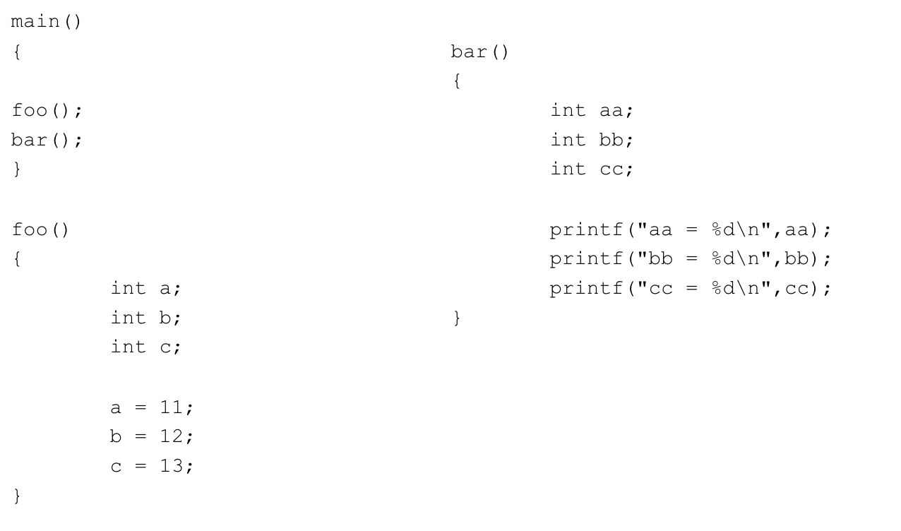
A Little Example

Slide 54
What’s the Output?
lever.cs.ucla.edu[9]./a.out
aa = 11
bb = 12
cc = 13
Perhaps not exactly what you might want

Slide 55
Why Is This Dangerous?
Values from one function “leak” into another function
If attacker can influence the values in the first function,
Maybe he can alter the behavior of the second one

Slide 56
Variable Cleanup
Often, programs reuse a buffer or other memory area
If old data lives in this area, might not be properly cleaned up
And then can be treated as something other than what it really was
E.g., bug in Microsoft TCP/IP stack
  Old packet data treated as a function pointer

Slide 57
Use-After-Free Bugs
Increasingly popular security bug type
Related to memory management
  Memory structures are dynamically allocated on the heap
Either explicitly or implicitly freed
  Depending on language and context
In some cases, pointers can be used to access freed memory
  E.g., in C and C++

Slide 58
An Example Use-After-Free Bug
In OpenSSL (from 2009)
. . .
frag->fragment,frag->msg_header.frag_len);
}
dtls1_hm_fragment_free(frag);
pitem_free(item);
if (al==0)
{
*ok = 1;
return frag->msg_header.frag_len;
}
dtls1_hm_fragment_free(frag);
return frag->msg_header.frag_len

Slide 59
What Was the Effect?
Typically, crashing the program
But it would depend
When combined with other vulnerabilities, could be worse
E.g., arbitrary code execution
Often making use of poor error handling code

Slide 60
Recent Examples of Use-After-Free Bugs
Internet Explorer (2014, several in 2012-2013)
Adobe Flash (2016, multiple cases in 2015)
Mozilla, multiple products (2012)
Google Chrome (2012)

Slide 61
Some Other Problem Areas
Handling of data structures
  Indexing error in DAEMON Tools
Arithmetic issues
  Integer overflow in Adobe Flash (2016)
  Signedness error in XnView (2012)
Errors in flow control
  Samba error that causes loop to use wrong structure
Off-by-one errors
  Denial of service flaw in Clam AV (2011)

Slide 62
Yet More Problem Areas
Null pointer dereferencing
  FreeBSD denial of service (2016)
Side effects
Punctuation errors
Typos and cut-and-paste errors
  iOS vulnerability based on inadvertent duplication of a goto statement (2014)
There are many others

Slide 63
Why Should You Care?
A lot of this stuff is kind of exotic
Might seem unlikely it can be exploited
Sounds like it would be hard to exploit without source code access
Many examples of these bugs probably unexploitable

Slide 64
So . . .?
Well, that’s what everyone thinks before they get screwed
“Nobody will find this bug”
“It’s too hard to figure out how to exploit this bug”
“It will get taken care of by someone else”
  Code auditors
  Testers
  Firewalls

Slide 65
That’s What They Always Say
Before their system gets screwed
Attackers can be very clever
  Maybe more clever than you
Attackers can work very hard
  Maybe harder than you would
Attackers may not have the goals you predict

Slide 66
But How to Balance Things?
You only have a certain amount of time to design and build code
Won’t secure coding cut into that time?
Maybe
But less if you develop code coding practices
If you avoid problematic things, you’ll tend to code more securely

Slide 67
Some Good Coding Practices
Validate input
Be careful with failure conditions and return codes
Avoid dangerous constructs
  Like C input functions that don’t specify amount of data
Keep it simple

