Slide 1
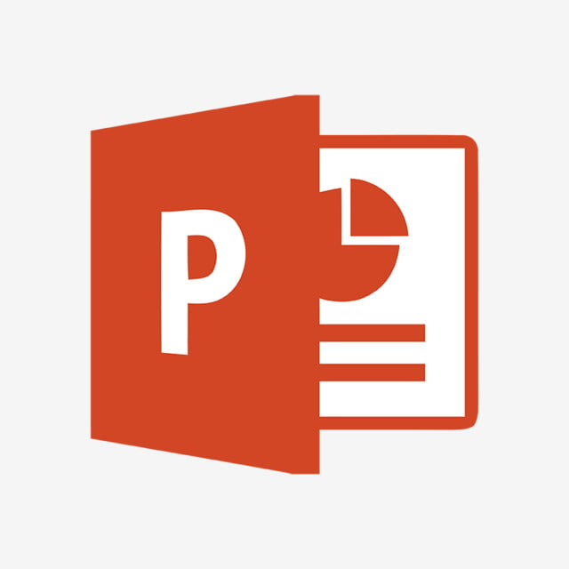
PowerReader

Slide 2
What is this?
Why watch a 30 minute video when you can read through it quicker?
PowerReader is an innovative AI solution that correlates your transcriptions with your PowerPoint slides, so you have a single document that captures what was spoken in a remote meeting.

Slide 3
Benefits
Easy to use, simply upload your video and receive your document!
Embraces OneMicrosoft
Uses the goodness from Microsoft 365 and Azure, 2/3 of the Microsoft Cloud

Slide 4
Interested?
Check out our HackBox!

