Slide 1
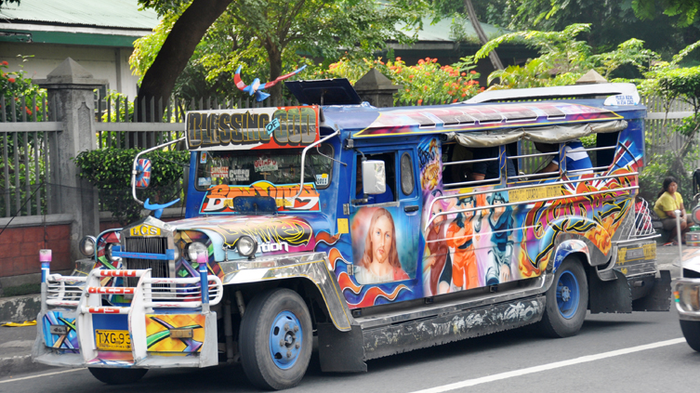
NeedFinding
Rianzares, Kervin
Murillo, Jean

Slide 2
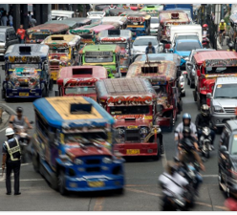
Commuting Discipline

Slide 3
WHAT WE OBSERVED
We Observed that most of the commuters ride in undisciplined way because they don’t want to fall in line, because the line is long and sometimes, they are in a hurry.

Slide 4
USER OBSERVATION
#1 Nathaniel Alzate, a student at University of Makati and currently taking an Information technology course. He usually ride jeepneys when going to school and at work because he is a working student. As a commuter he sometimes ride jeepneys in the illegal loading areas but sometimes he also fall in line on terminals to ride a jeepney.

Slide 5
User Observation
#2 Junnel Segura, a student of Rizal Technological University and currently taking Electronics and Communication Engineer. He usually ride jeepneys when going to school and going home. As a commuter he also had a hard time when riding a jeep and always riding on illegal loading areas because it is the easiest way.

Slide 6
User Observation
#3 Christian Barraceros, a student of Rizal Technological University and currently taking Computer Engineering. He usually ride jeepneys going to school and home. As a commuter he also had a hard time riding a jeep especially in rush hours and always riding in the illegal loading areas because he’s always in a hurry.

Slide 7
User Needs
Make the road violations more strict., So the drivers will learn and have discipline
Don’t get a ride anywhere especially when the area is prohibited for loading and unloading because it can cause traffic and accidents
Every terminals should have more traffic enforcers so the road will be controlled effectively
The terminals should have many jeepney and drivers so that they will get a ride faster and avoid taking a ride on the prohibited loading areas.
The MMDA and LTO should make a solution to avoid making the drivers stop when they got violations
We need to have a disciplined jeepney drivers and commuters

Slide 8
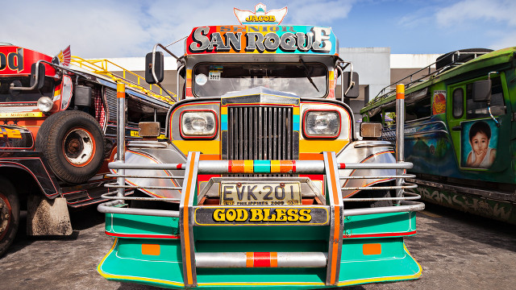
Need Finding Talk

Slide 9
What activity did you choose to examine?
The activity that we chose to examine is the commuters that ride PUV’s everyday and what they usually do when they are commuting., if they are disciplined or not.

Slide 10
How did you examine it, with what methods?
We examined it through experience because on my senior high school days I usually ride jeepneys and see jeepney terminals. My partner is also living near the jeepney terminal.

Slide 11
What major insights or breakdowns did you discover?
We noticed that some commuters are not disciplined enough in the road especially when riding PUV’s and these caused traffic problems.

Slide 12
What promising unmet needs were identified as a result?
The needs that we identified is lack of disciplined commuters and drivers. These can also be the causes of traffic problems and accidents in the road.

Slide 13
Point of view
How can I complain on the exact scene if there are no traffic enforcers in a specific area.(COMMUTER)
Can the government think of a solution to give violation to the drivers easily without causing any traffic? (TRAFFIC ENFORCER)
Being a driver, how can I report a co driver without conflict or without them knowing that we reported them so it will avoid road fights. (DRIVER)

Slide 14
Paper prototypes/feedback

Slide 15

Neil sarte (1st tester)
“EASY TO ACCESS”
Recommendation: there should also be a reporting feature for drivers

Slide 16
Ranz Martinez (2nd tester)
“Making the work of traffic enforcers easier”
“This app has many benefits”
Recommendations: If the driver has violations include in the app the drivers name and their license number

Slide 17
Driver tester
“It is Easy to Use”
“This app has many benefits”
Recommendations: The app logo and title

Slide 18
Traffic enforcer tester
“The app is Great”
“It will help the citezens and traffic”
Recommendations: The specific location of the violated driver.

