Slide 1

Mining Domestic Violence Data to Uncover Temporal Patterns & Trends
Kelley Stieler
GA Data Science
Winter 2017

Slide 2
BACKGROUND
Open Source Government Data
Use to better understand/ reduce societal ills
Police Department Data offers Unique Opportunities
Domestic Violence Trends
Perception Increase in Incidents over Holidays
National Domestic Violence Resource Center receives media calls every holiday season about the topic
Limited Studies with Mixed Findings
Idaho study – Air Force Study
National Domestic Violence Hotline Sudy

Slide 3
PROJECT GOALS
Uncover Temporal Patterns/Trends -> Predictions
Better allocate resources/target interventions → Prevention
Improve Officer Preparedness
Domestic Violence Calls are Most Dangerous Type of Call for Law Enforcement

Slide 4
DATASET
City of Chicago Data Portal
API
Thorough Data Dictionary
Crimes - 2001 to Present
Reported Crimes within City (excluding homicides)
Date/Time Incident Occurred
Description
Location (Block/Longitude/Latitude/Beat)
Qualifies as Domestic Violence

Slide 5
DATASET
Columns Extracted from Dataset
“Domestic” – Domestic Violence under Ill Statute
“Date” - January 1, 2001 to December 31, 2016
Data Cleaning/Preparation
No nulls/impossible dates!
Transform Data Types
“Date” → DateTimeIndex
“Domestic” → Boolean to Float
Eliminate Time from Date
Resampled incidents of Domestic Violence by Day
Train/Test Dataset
Train Data: January 1, 2001 through December 31, 2013
Test Data: January 1, 2014 to December 31, 2016

Slide 6
TRAIN SET Jan. 1, 2001 to Dec. 31, 2013
13 year period
4,748 days
679,125 reported incidents of domestic violence
Mean: 143 incidents/day
Standard deviation ~ 30
Median: 140 incidents/day
Maximum: 343 (Jan. 1, 2004)
Minimum: 68 (December 12, 2013)

Slide 7
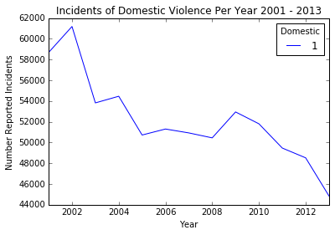
2001 – 2013 YEARLY TREND
Overall Decrease in Incidents/Year
2002 Max: 61,186
2013 Min: 44,839

Slide 8
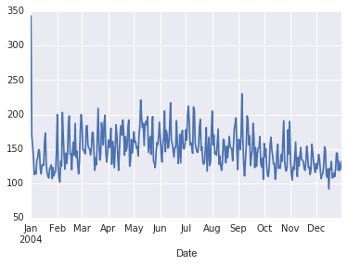
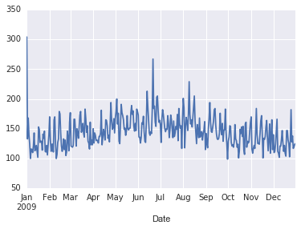
SAMPLE YEARLY TRENDS – 2004 - 2009 -

Slide 9
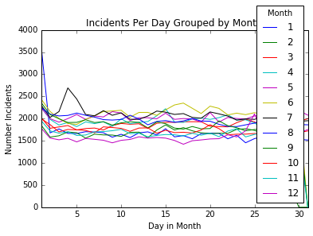
MONTHLY TRENDS
Nov/Dec/Jan/Feb lowest # incidents
May/June/July highest # incidents
“Holiday Season” – Thanksgiving to New Years
No evidence incidents increase in Holidays

Slide 10
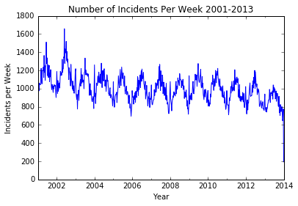
WEEKLY TRENDS

Slide 11
WEEKS WITH MOST INCIDENTS
Examine highest and lowest weeks
Across dataset and each year
Highest weeks consistently in Spring/Summer
Lowest weeks consistently in Winter
No evidence Holiday Season associated with an increase

Slide 12
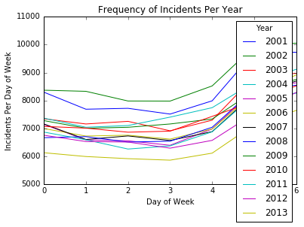
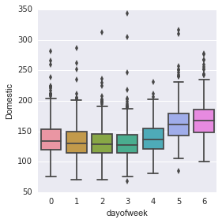
TREND BY DAY OF THE WEEK
0 = Monday . . . 6 = Sunday

Slide 13
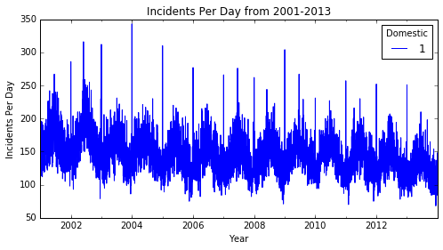
2001 -2013 DAILY TREND

Slide 14
EXPLORING OUTLIERS
.nlargest(5) across 13 years and by year
New Year’s Day
Highest number of daily incidents for 11 out of the 13 years (2nd highest other two)
Father’s Day
Top 5 for 9 out of the 13 years
Fourth of July
Top 5 in 5 of 13 years
No day in November or December ever in the top

Slide 15
BUILDING A MODEL
Initial Goal: Classifier – High/Not-high Incident Day
Consistent Outliers/Trends
Outliers were consistent every year, eliminated need to create a model to detect spikes
Domestic Violence Spikes
Sat/Sun highest
May, June, July highest
New Years Day, Fourth of July, Father’s Day (maybe)

Slide 16
BUILDING A MODEL
ARIMA - highest autocorrelation at 7 days 0.6
Data appears non-stationary
Downward trend and seasonality
Adjust for trend and seasonality
Transformation – log
Smoothing – rolling mean plus exponentially weight
Differencing
Train/Test with adjustments
Best result - exponentially weighted ARMA model
Mean Absolute Standard Error of 17

Slide 17
MODEL SELECTION
Data is stationary! – enough
Use unadjusted train set
Tune parameters
No differencing – any i greatly increases errors
Model Results
ARMA (3,3)
AR – ACF plot
MA – quickly adjust for shocks
MSE 16.61
Test set – mean 113 – Std 22 - max 216
Pred set - mean 119 – Std 11 – max 139

Slide 18
ARMA RESULTS
Dep. Variable: Domestic No. Observations: 4748
Model: ARMA(3, 3) Log Likelihood -21081.851
Method: css-mle S.D. of innovations 20.501
AIC 42179.701
BIC 42231.425
Sample: 01-01-2001 HQIC 42197.877
- 12-31-2013
================================================================
coef std err z P>|z| [95.0% Conf. Int.]
----------------------------------------------------------------------------------
const 142.0157 31.243 4.545 0.000 80.780 203.251
ar.L1.Domestic 2.2456 0.001 1981.434 0.000 2.243 2.248
ar.L2.Domestic -2.2449 0.001 -1698.827 0.000 -2.247 -2.242
ar.L3.Domestic 0.9985 0.001 913.126 0.000 0.996 1.001
ma.L1.Domestic -2.1158 0.009 -244.726 0.000 -2.133 -2.099
ma.L2.Domestic 2.0743 0.010 210.787 0.000 2.055 2.094
ma.L3.Domestic -0.8653 0.008 -102.900 0.000 -0.882 -0.849

Slide 19
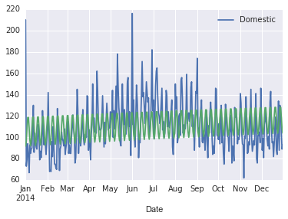
Test Data vs. Prediction

Slide 20
NEXT STEPS
Improve Model
Take out outliers (residuals plot – showed spikes at New Years)
“Stationary” – try more models that adjust for mild seasonality
Seasonal ARIMA Models
Autocorrelation was not very high for model – 0.6
ARIMA models can only explain so much
Tendency to revert to mean

Slide 21
SOURCES
Vazquez, S. P., Stohr, M. K., & Purkiss, M. (2005). Intimate partner violence incidence and characteristics: Idaho NIBRS 1995 to 2001 data. Criminal Justice Policy Review, 16, 99-114.
McCarthy, R. J., Rabenhorst, M. M., Milner, J. S., Travis, W. J., & Collins, P. S. (2014). What difference does a day make? Examining temporal variations in partner maltreatment. Journal of Family Psychology, 28, 421-428.
Jeltsen, M. (December 12, 2016) Why It’s Dangerous To Claim Domestic Violence ‘Spikes’ Over The Holidays Huffington Post.

