Slide 1
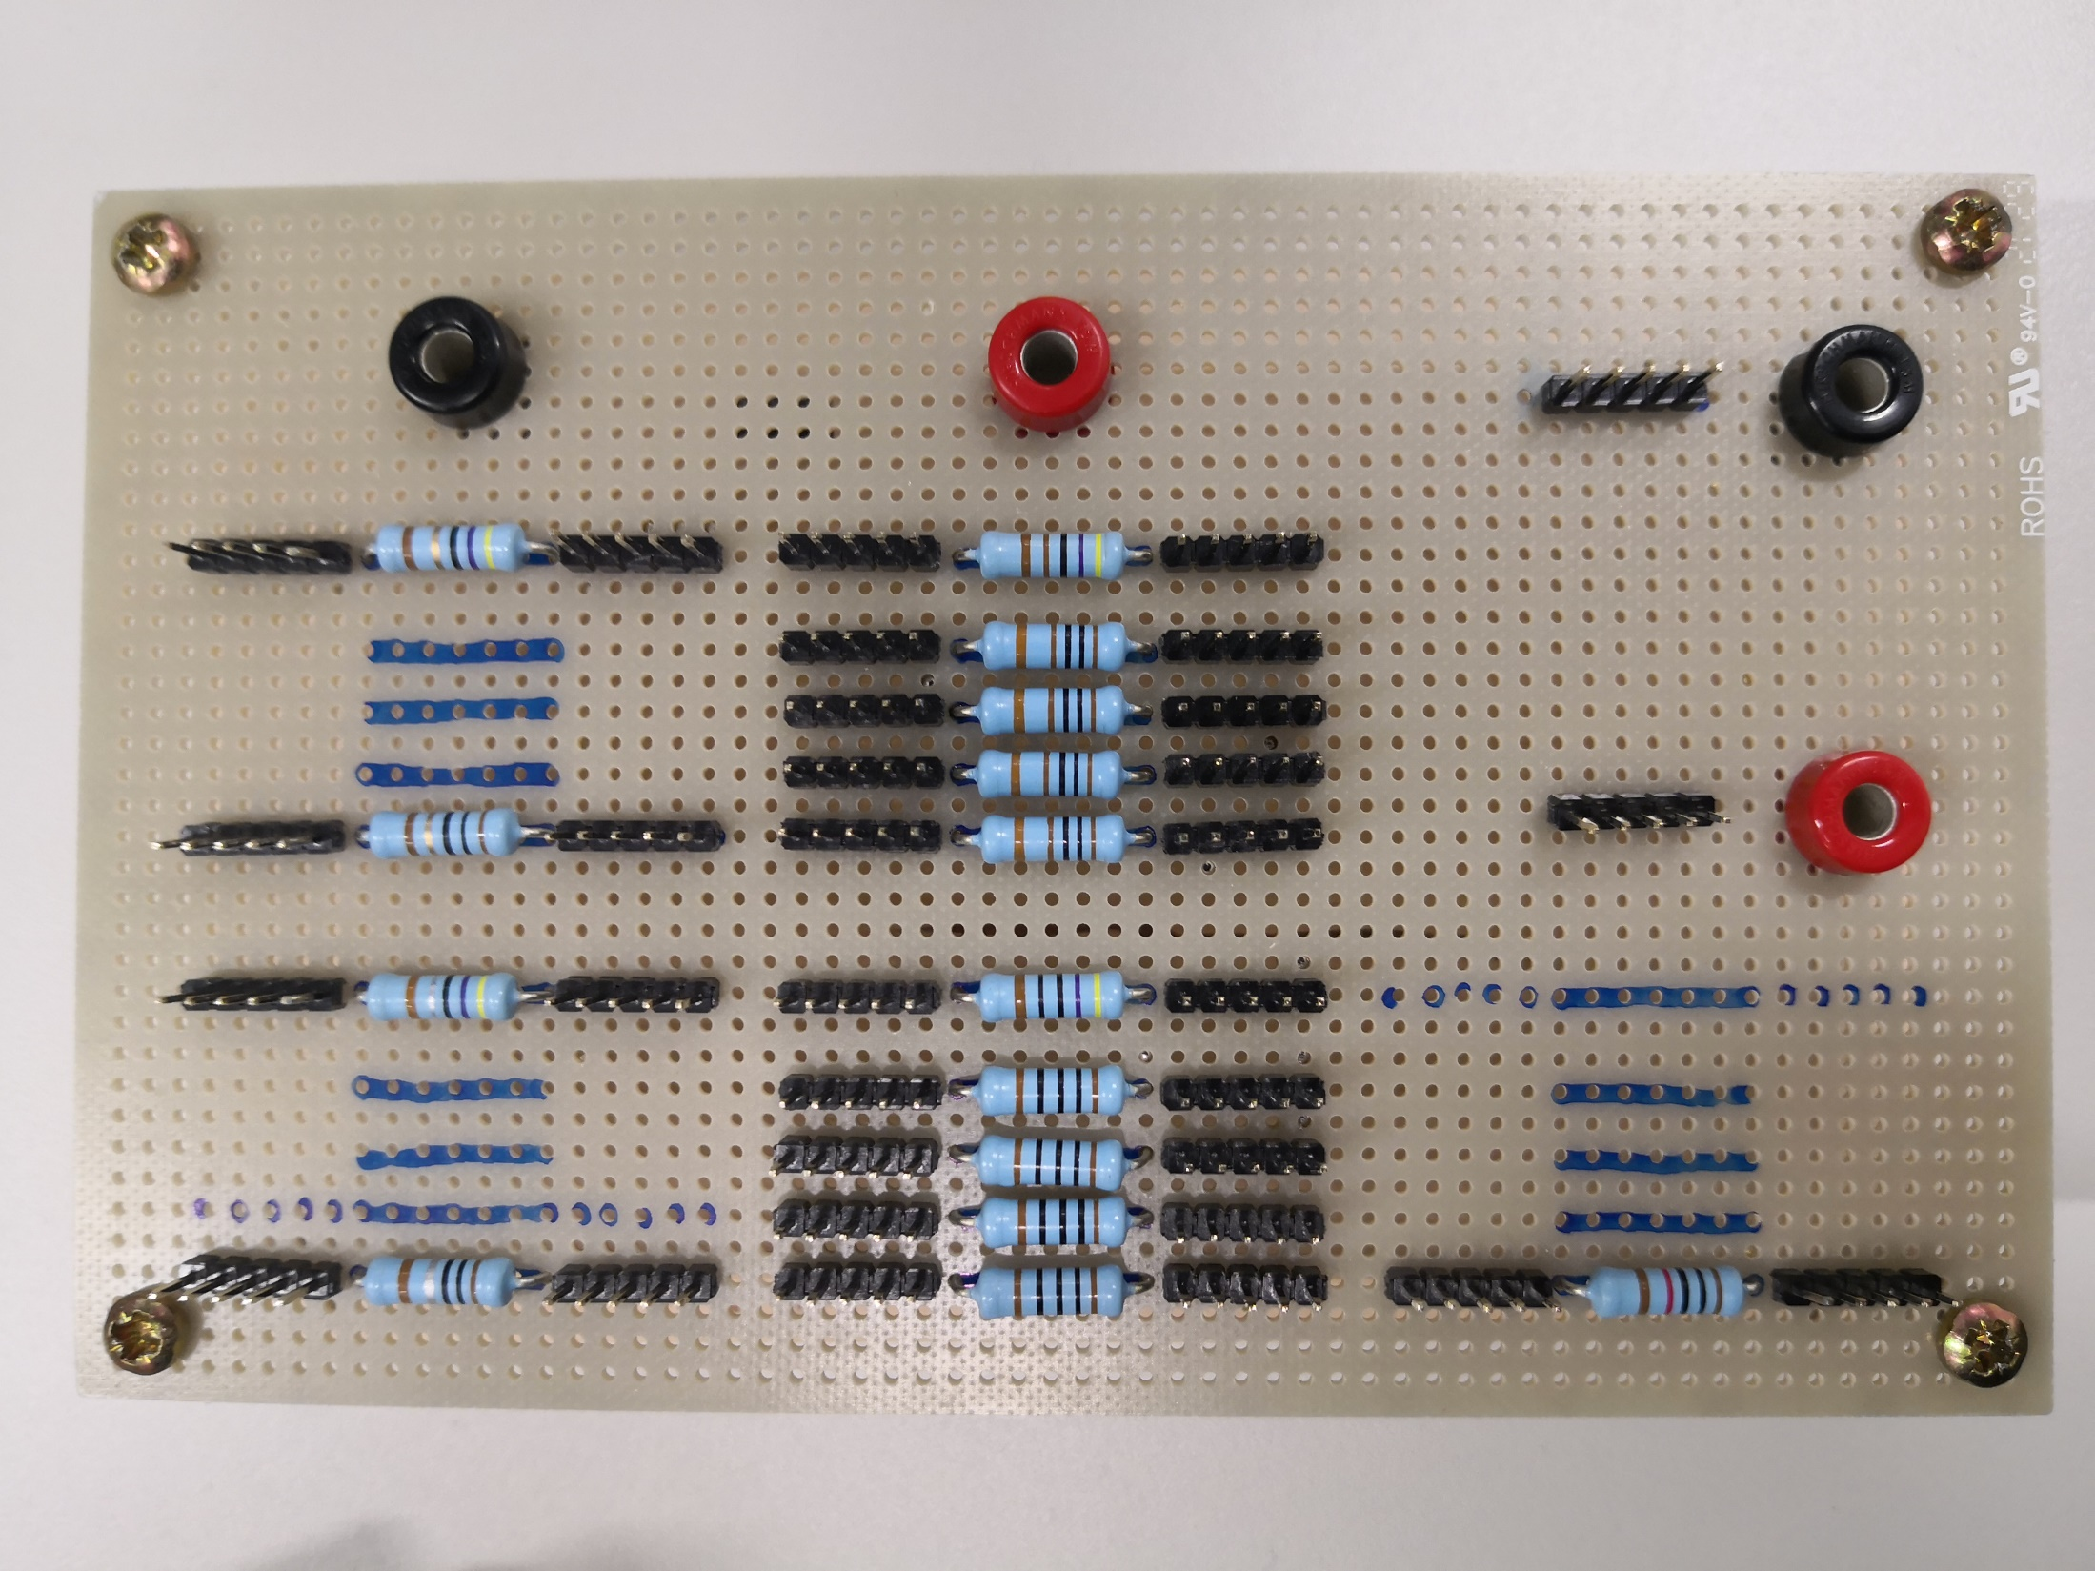
100 Ω
47 Ω
4.7 kΩ
1 kΩ
1 kΩ
1 kΩ
10 Ω
1 kΩ
4.7 Ω
470 Ω
100 Ω
100 Ω
100 Ω
1 Ω
100 Ω
10 kΩ

Slide 2
Bypass Diode
Load Terminal A
47 Ω
4.7 kΩ
1 kΩ
1 kΩ
Load Terminal B
1 kΩ
10 Ω
1 kΩ
Load Resistors
4.7 Ω
470 Ω
100 Ω
100 Ω
100 Ω
1 Ω
100 Ω
10 kΩ

Slide 3
Bypass Diode
Load Terminal A
47 Ω
4.7 kΩ
1 kΩ
1 kΩ
Load Terminal B
1 kΩ
10 Ω
1 kΩ
Load Resistors
4.7 Ω
470 Ω
100 Ω
100 Ω
100 Ω
1 Ω
100 Ω
10 kΩ

Slide 4
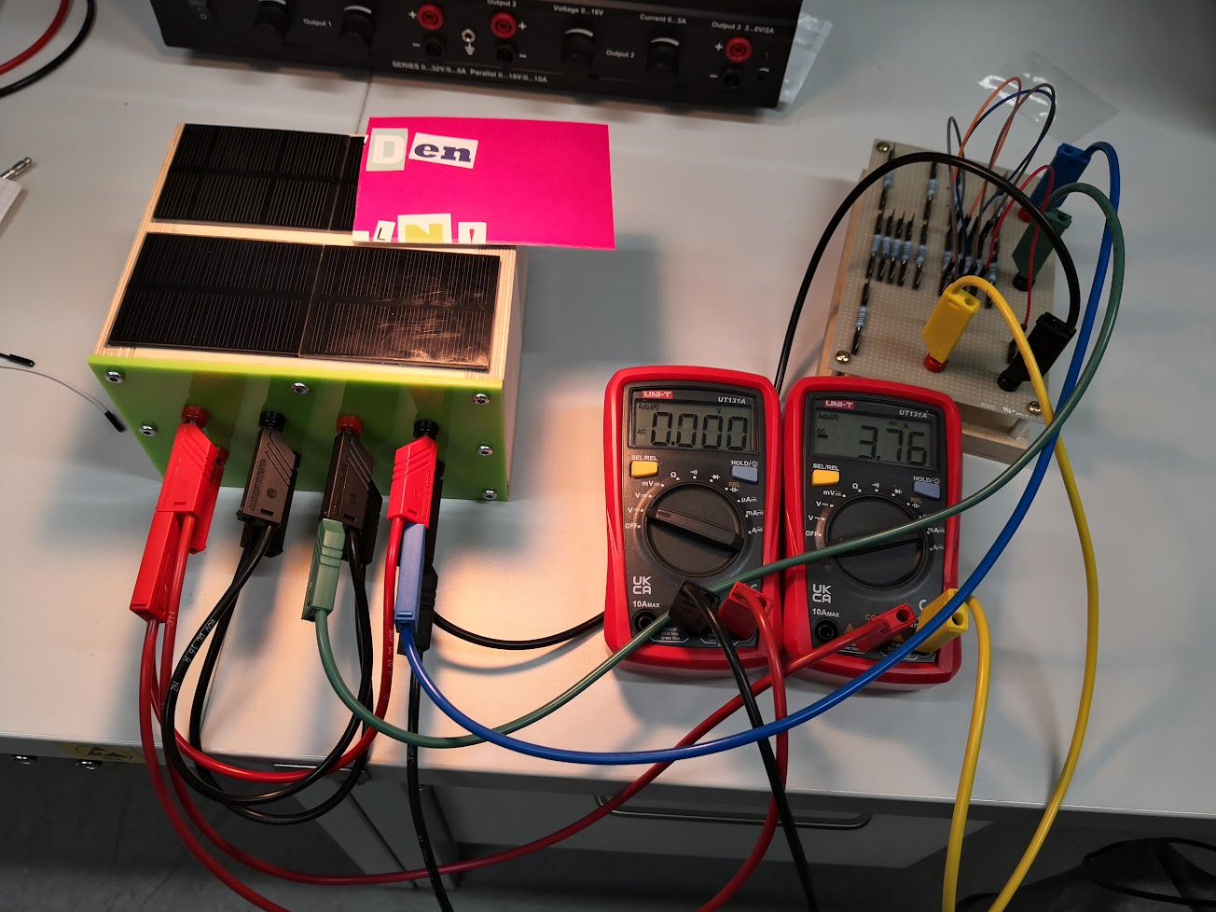
Load Resistor Panel
Mod. 2 is shaded
1
3
4
PVMiniBox with 4 PV modules
Voltmeter
Ampèremeter

Slide 5
PV1
PV2
PV1
PV2
Rload
PV3
PV4
PV3
PV4

