Slide 1
Microservices
By Karie Funk

Slide 2
What are Microservices?
In my own words, microservices or microservice architecture is an application that has been broken down into smaller pieces that are separately maintained. This is different than the traditional “monolithic” architecture, which is all just one piece.
A better definition is one I took from an online article on the topic of microservices:
“Microservices are an architectural style that develops a single application as a set of small services. Each service runs in its own process. The services communicate with clients, and often each other, using lightweight protocols, often over messaging or HTTP” ("What are microservices? code examples, tutorials & more," n.d.).

Slide 3
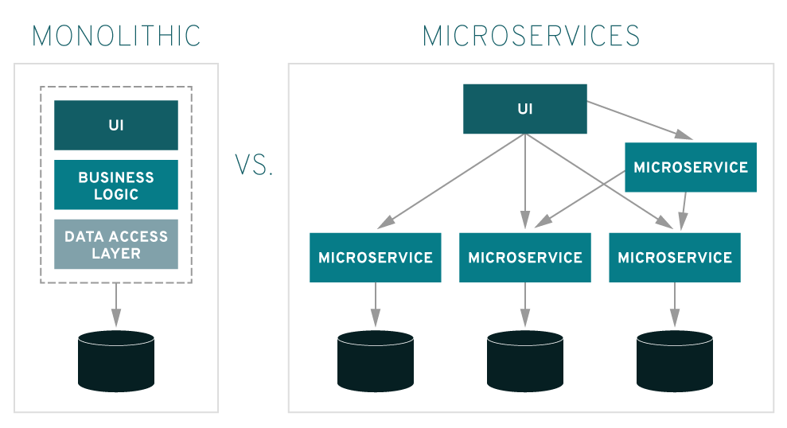
Example of Microservices: ("What are microservices?," n.d.)

Slide 4
What is API Gateway?
It is a layer that goes between your clients and services. It will pass requests to the correct service.
The most important role of the API gateway is that it ensures reliable process of every single API call.
“When an API Gateway receives a request, it looks up for the Microservice which can serve the request and delivers it to the relevant part. It maps the request parameters to the input arguments of the service or function if necessary, in order to complete the start of the request” (Martinez, 2017).

Slide 5
The advantages of microservices:
Many companies switch to microservices for several reasons. Some of these reasons include:
It’s easier to build and maintain apps.
More organized for business needs.
Increased speed and productivity.
Flexibility and scalability.
Microservices grant developers more independence to work autonomously and make technical decisions quickly in smaller groups.

Slide 6
The disadvantages of microservices:
While there are some awesome advantages to microservices there are also some drawbacks, some of these include:
Increased complexity of understanding microservices.
Higher costs associated with increase in remote calls.
Will require a DevOps and Agile team, so it will be a cultural shift for some companies.
Increased security challenges to consider.

Slide 7
How microservices are deployed in a production environment:
Before deployment make sure you have evaluated your requirements, discussed the options with your team, and determined that the best approach for building your application is to leverage microservices.
Here are a few different microservice deployment patterns you can choose from:
You can deploy your microservices with the Multiple Service Instances per Host pattern. With this pattern you provision one or more physical or virtual hosts and run multiple service instances on each one.
Another pattern you can use is the Service Instance per Host pattern. This pattern lets you run each service instance in isolation on its own host
There is also the Service Instance per Virtual Machine Pattern. This package will allow each service as a virtual machine (VM) image such as an Amazon EC2 AMI.

Slide 8
How microservices are deployed in a production environment cont:
There is the Service Instance per Container Pattern, where each service instance runs in its own container.
Another option is serverless deployment with AWS Lambda, which will automatically runs enough instances of your microservice to handle requests. You are simply billed for each request based on the time taken and the memory consumed.
Deploying microservices can be challenging because there are so many different ways to accomplish the deployment process, but just remember what will be right for your business and your development team.

Slide 9
How microservices are managed in a production environment:
Use containers. You need to use containerization for microservice architecture.
Microservices require reliable and scalable infrastructure.
Use serverless.
Use an API Gateway and Enterprise Service Bus.
Use service discovery.

Slide 10
How are microservices scaled?
“Because the app itself is broken down into smaller components that may or may not be spread across separate servers, you have to approach scalability a little differently” (Bradley, n.d.).
When there is an increase in use of the app, all the components have to be made to scale, or you will have to identify which elements need to scale to address the increase in demand.
“Using the Z-axis scaling approach from the Scale Cube allows you to segregate data across different servers based on routing criteria. You might route requests based on the primary key of the data being accessed, or based on customer type—sending paying or premium customers to servers with more bandwidth and capacity to deliver better performance” (Bradley, n.d.).

Slide 11
References:
What are microservices? Code examples, tutorials & more. (2019, Sept 13). Retrieved from https://stackify.com/what-are-microservices/
What are microservices?. (n.d.). Retrieved from https://www.redhat.com/en/topics/microservices/what-are-microservices
Martinez, Gabry. (2017, Dec 6.). Stupid question of the day: What is an API Gateway and what it has to do with a Serverless model? Retrieved from: https://medium.com/@gabrymartinez/stupid-question-of-the-day-what-is-an-api-gateway-and-what-it-has-to-do-with-a-serverless-model-2acee3e3eeba

Slide 12
References:
5 major benefits of microservice architecture - skelia. (n.d.). Retrieved from https://skelia.com/articles/5-major-benefits-microservice-architecture/
Deploying microservices: Choosing a strategy. (n.d.). Retrieved from https://www.nginx.com/blog/deploying-microservices/
Byndyu, A. (n.d.). Useful tools for managing complexity of microservice architecture. Retrieved from https://blog.byndyusoft.com/useful-tools-for-managing-complexity-of-microservice-architecture-109a2289acc
Bradley, Tony. (n.d.). The Challenges of Scaling Microservices. Retrieved from: https://techbeacon.com/app-dev-testing/challenges-scaling-microservices

