Slide 1
OAuth Presentation
Explanation of OAuth Implementation By: Karie Funk

Slide 2
OAuth History:
OAuth was released as an open standard in 2010. It soon became widely adopted.
OAuth version 1.0 was created and supported by Twitter and Google, as well as other companies. (Grimes, 2019)
Over the next two years it was changed substantially and was released as a new version in 2012. Behold OAuth 2.0. (Grimes, 2019)
It’s been criticized throughout years for many reasons, however it is still very popular and widely used by many companies.
Some of these companies include: Amazon, Facebook, Instagram, LinkedIn, Microsoft, Netflix, and Paypal. (Grimes, 2019)

Slide 3
OAuth 1.0 vs. OAuth 2.0:
“The changes that took place between OAuth 1.0 and OAuth 2.0 actually changed the nature of OAuth significantly enough that the two versions actually meet different needs, based on what you’re trying to accomplish” (Team, 2016).
OAuth 1.0, while perfect in a lot of ways, wasn’t the best when it came to crypto-implementation and crypto-interoperability. In another words, it was hard for developers to implement it.
OAuth 2.0 was much easier to implement and many larger enterprises started to use this version because it was more feasible for them.

Slide 4
Definition of OAuth:
OAuth stands for Open Authorization.
OAuth also known as OAuth Core is considered an authorization protocol.
In simpler terms, it’s a way for you to give a website permission to access some of your info about your account, without you giving them your account password.
Most users may not know what OAuth is, but they have experienced in one way or another. Specifically through Facebook login or Google login.
In the next slide I’ll show an image example of when a user may have experienced an OAuth encounter.

Slide 5
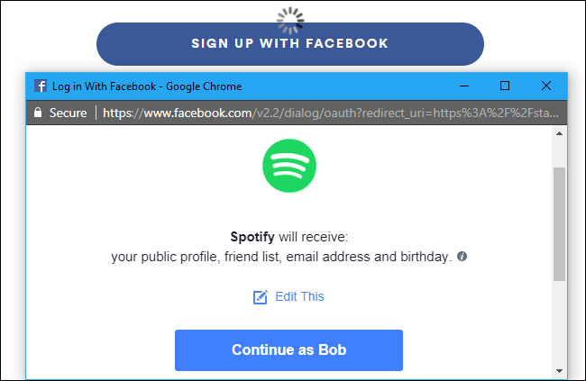
OAuth Example: (Hoffman, 2017)

Slide 6
How does OAuth work:
OAuth will use access tokens to work. The access token gives one third-party source temporary access to a limited amount of your personal information on another third-party source.
A real world example using social media would be: “Facebook would ask for your permission for access to your Instagram. You approve the request. Facebook would then receive an access token for that single photograph on your Instagram account. Instagram would verify the token and grant Facebook access so it could retrieve the photo. At no point does Facebook receive the login information for your Instagram” (Cabading, 2019).
This would be the user granting access tokens. Some tokens are granted for single use, while others are granted for recurrent use until deactivated (location sharing on your smartphone, for example). (Cabading, 2019)

Slide 7
The popularity of OAuth:
The most important feature of OAuth is that is protects users credentials.
Before OAuth was invented, if a user was to give a website info from a different account, the user had to give their credentials to a third-party website and some of these third-party sites were not credible and were taking advantage of users credentials to gain some of their personal information.
OAuth is credible, reliable, and easy to use.
It can also be used as a way to replace the need for a user to have a separate set of credentials for every website.
OAuth makes it easier for the third-party website to gain the information they need, but it also makes the process more convenient for the user.
“OAuth is a popular solution for both websites and users because it’s more secure than sharing credentials and allows users to utilize services across multiple platforms” (L, 2017.).

Slide 8
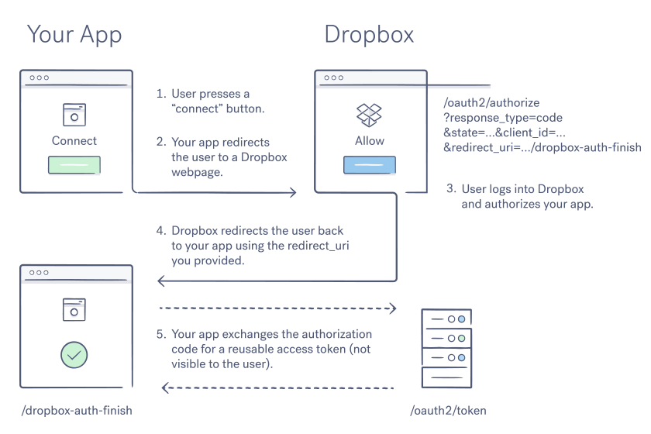
End to end data flow of an OAuth API:
("Oauth guide - developers - dropbox," n.d.)
("Oauth guide - developers - dropbox," n.d.)

Slide 9
References:
Grimes, Roger. (2019, Sept 20.). What is OAuth? How the open authorization framework works. Retrieved from: https://www.csoonline.com/article/3216404/what-is-oauth-how-the-open-authorization-framework-works.html
Hoffman, Chris. (2017, August 9.). What Is OAuth? How Those Facebook, Twitter, and Google Sign-in Buttons Work. Retrieved from: https://www.howtogeek.com/53275/exchanging-data-safely-with-oauth/
Team, S. E. (2016, March 11). What’s the difference between oauth 2.0 and oauth 1.0? | synopsys. Retrieved from https://www.synopsys.com/blogs/software-security/oauth-2-0-vs-oauth-1-0/

Slide 10
References Continued:
Cabading, Zach. (2019, July 12.). What is OAuth and How Does it Protect my Personal Information? Retrieved from: https://store.hp.com/us/en/tech-takes/what-is-oauth
L, Jamie. (2017, Nov 30.). What is OAuth? Retrieved from: https://swoopnow.com/what-is-oauth/
Oauth guide - developers - dropbox. (n.d.). Retrieved from https://www.dropbox.com/developers/reference/oauth-guide

