Slide 1
Continuous Integration
A Presentation by Karie Funk

Slide 2
What is Continuous Integration (CI)
Continuous Integration is a development process. The process starts by developers integrating code into a shared repository several times a day. After sharing the code, every check-in will then be verified by an automated build. This will allow teams to easily detect problems early on.
Many companies use CI because it allows for detection of errors quickly, and being able to locate them more easily.
“Continuous Integration (CI) is the process of automating the build and testing of code every time a team member commits changes to version control. CI encourages developers to share their code and unit tests by merging their changes into a shared version control repository after every small task completion” (SamGu, n.d.).

Slide 3
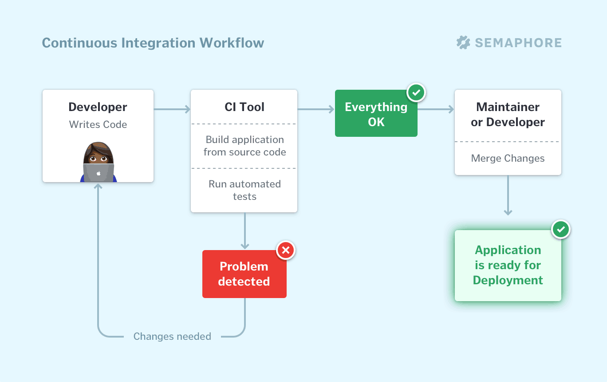
What is Continuous Integration (CI)
("Continuous integration (ci) explained - semaphore," n.d.)

Slide 4
Benefits of Continuous Integration (CI)
Say goodbye to long and tense integrations
Increase visibility enabling greater communication
Catch issues early and nip them in the bud
Spend less time debugging and more time adding features
Build a solid foundation
Stop waiting to find out if your code’s going to work
Reduce integration problems allowing you to deliver software more rapidly
("Continuous integration | thoughtworks," n.d.)

Slide 5
More on Continuous Integration (CI)
If your company does not integrate continuously, it can become expensive because you are not following a continuous approach, and therefore will have longer periods of time between integrations. This results in problems that are more difficult to find and to fix. This can also lead to projects not staying on schedule or failing altogether. Continuous integration is cheaper on the company and can keep things from failing and getting off schedule.
("Continuous integration | thoughtworks," n.d.)

Slide 6
Practices on Continuous Integration (CI)
To maintain a single source repository
Automate the build
Make your build self-testing
Every commit should build on an integration machine
Keeping the build fast
Test in a clone of the production environment
Make it easy for everyone to get the latest executable version
Anyone can see what’s happening
Automate deployment
("Continuous integration | thoughtworks," n.d.)

Slide 7
How Continuous Integration Works
The developers will check out code into their private workspaces
When done, commit the changes to the repository
The CI server monitors the repository and checks out changes when they occur
The CI server builds the system and runs unit and integration tests
The CI server releases deployable artefacts for testing
The CI server assigns a build label to the version of the code it just built
The CI server informs the team of the successful build
If the build or tests fail, the CI server alerts the team
The team fixes the issue at the earliest opportunity
Continue to continually integrate and test throughout the project
("Continuous integration | thoughtworks," n.d.)

Slide 8
Responsibilities of Developers
“Many teams develop rituals around these policies, meaning the teams effectively manage themselves, removing the need to enforce policies from on high” ("Continuous integration | thoughtworks," n.d.).
Have developers check in frequently
Make sure devs don’t check in broken code
Make sure devs don’t check in untested code
Make sure devs don’t check in when the build is broken
Don’t go home after checking in until the system builds

Slide 9
Continuous Integration vs Continuous Deployment
Both of these terms are closely related. CD is a type of software release process. It uses automated testing to make sure that changes to a codebase are correct and stable for immediate autonomous deployment to a production environment. (Atlassian, n.d.)
If a company adopts both CI and CD, you not only will reduce mistakes, but you will also catch bugs in the code quickly, as well as moving rapidly to software that works.
“With low-risk releases, you can quickly adapt to business requirements and user needs. This allows for greater collaboration between ops and delivery, fueling real change in your organization, and turning your release process into a business advantage” ("Continuous integration | thoughtworks," n.d.).

Slide 10
References:
SamGu. (n.d.). What is continuous integration? - azure devops. Retrieved from https://docs.microsoft.com/en-us/azure/devops/learn/what-is-continuous-integration
Continuous integration (ci) explained - semaphore. (n.d.). Retrieved from https://semaphoreci.com/continuous-integration
Continuous integration | thoughtworks. (n.d.). Retrieved from https://www.thoughtworks.com/continuous-integration
Atlassian. (n.d.). What is continuous deployment? | atlassian. Retrieved from https://www.atlassian.com/continuous-delivery/continuous-deployment

