Slide 1
The Technology Value Stream
By Karie Funk

Slide 2
Defining Lead Time vs. Processing Time
There are two ways you can measure performance in value streams:
Lead Time
Processing Time
Processing time is also known as touch time or task time.
The lead time clock starts when the request is made and ends when it is fulfilled.
The process time clock will start only when work begins on the customer requests. More so when it omits the time that the work is in the queue, waiting to be processed. (Debois, Kim, Willis, Humble ,2017)

Slide 3
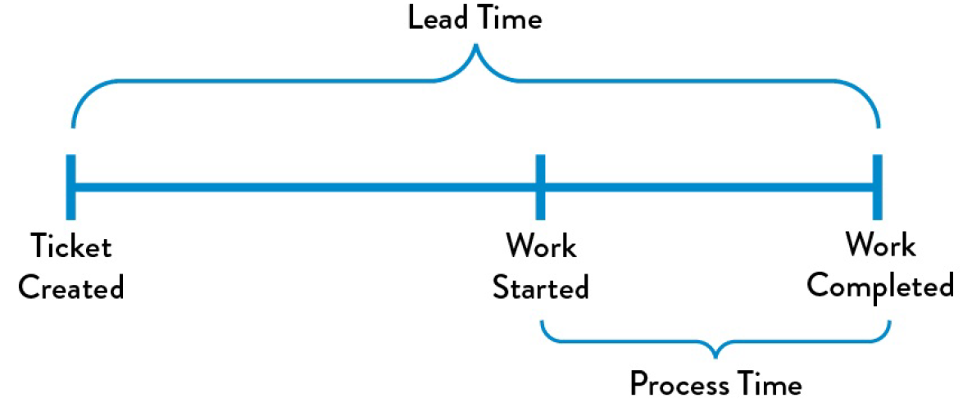
Defining Lead Time vs. Processing Time Example (Debois, Kim, Willis, Humble ,2017)

Slide 4
Defining Lead Time vs. Processing Time
The customer will always experience lead time. This is why most of the focus is on lead time instead of processing time.
“The proportion of process time to lead time serves as an important measure of efficiency—achieving fast flow and short lead times almost always requires reducing the time our work is waiting in queues” (Debois, Kim, Willis, Humble ,2017)

Slide 5
The Common Scenario: Deployment Lead Timers Requiring Months
In large complex organizations deployment lead times can require months to get a project done.
This can occur if the organization is relying on “tightly-coupled, monolithic applications, often with scarce integration test environments, long test and production environment lead times, high reliance on manual testing, and multiple required approval processes” (Debois, Kim, Willis, Humble ,2017).
Problems can arise in situations like this. This may result in nothing working at the end of the project specifically when the development team changes have been merged together. This will results in code that no longer works corrects or passes any tests.

Slide 6
The Common Scenario: Deployment Lead Timers Requiring Months
It’s important to understand that trying to fix each problem can require days or even weeks of investigating the problem and trying to find out where the broken code is. (Debois, Kim, Willis, Humble ,2017)
You also have to take into consideration how the code can be fixed.
This can and will results in a bad customer outcome and many customer complaints.

Slide 7
Our DevOps Ideal: Deployment Lead Times of Minutes
The DevOps deployment lead time compared to the common scenario lead time results in minutes instead of months for a project.
It’s different with DevOps because developers receive quick and consistent feedback on the work they are producing. This then enables them to quickly and independently implement, integrate, and confirm their code. They also have the code deployed into the production environment by themselves or others. (Debois, Kim, Willis, Humble ,2017)
This can be achieved by continually checking small code changes into our version control repository, performing automated and exploratory testing against it, and deploying it into production so any problems or concerns can be taken care of.

Slide 8
Our DevOps Ideal: Deployment Lead Times of Minutes
This can also be achieved when the architecture is modular. It also works well when it is encapsulated and small development teams are capable of working with it to make sure the failures are small and contained, without causing any major global problems. (Debois, Kim, Willis, Humble ,2017)
Metrics in DevOps are used as a way to measure deployment success as well as making sure what things could be improved or modified. (Riley, 2015)
DevOps metrics fall into three categories:
People
Process
Technology

Slide 9
Our DevOps Ideal: Deployment Lead Times of Minutes & Metrics
The people metric of DevOps can measure such things as turnover, capability, and response time. It’s best to always start with people. They are considered the hardest element of any element, and their influence is sometimes hard to spot. (Riley, 2015)
The process metric is always ongoing and involves continuous delivery, response, and repair. Process metrics can be a measure of speed,, appropriateness, effectiveness, and efficiency. (Riley, 2015)
The technology metric will measure things like uptime and failure rate.

Slide 10
References:
Riley, C. (2015). Metrics for devops - devops.com. Retrieved from https://devops.com/metrics-devops/
Kim, G., Debois, P., Willis, J., & Humble, J. (2017). The DevOps handbook: how to create world-class agility, reliability, and security in technology organizations. Portland, OR: IT Revolution Press, LLC.

