Slide 1
SOAP
A Guide to Understanding SOAP by Karie Funk

Slide 2
What is SOAP?
SOAP stands for Simple Object Access Protocol.
SOAP was created as a way to for web applications to communicate over HTTP, since HTTP is is supported by all Internet browsers and servers.
SOAP can provide a way for communication between applications running on different operating systems, with different programming languages and technologies.

Slide 3
More on SOAP
SOAP is an application communication protocol.
SOAP is a format for sending and receiving messages.
SOAP is platform independent.
SOAP is based on XML.

Slide 4
Building Blocks of SOAP
An Envelope.
A Header element.
A Body element.
A Fault element.

Slide 5
Envelope in SOAP
The SOAP envelope is a packaging mechanism.
The envelope in SOAP will indicate the beginning and end of a message so that the receiver knows when an entire message has been delivered. It solves the problem of knowing when you are done receiving a message and it is ready to be processed.

Slide 6
Envelope in SOAP cont.
Every SOAP message has a root Envelope element.
Envelope is a necessary part of SOAP message.
Every Envelope element must contain exactly one Body element.
The envelope changes when SOAP versions change.
If an Envelope contains a Header element, it must contain no more than one, and it must appear as the first child of the Envelope, before the Body.
The SOAP envelope is specified using the ENV namespace prefix and the Envelope element.

Slide 7
Headers in SOAP
The header in a SOAP message is an optional element.
The purpose of it is to pass application-related information that is to be processed by SOAP nodes along the message path.
Header elements can occur multiple times.
Headers are intended to add new features and functionality.
The SOAP header contains header entries defined in a namespace.

Slide 8
Headers in SOAP cont.
The header is the first immediate child element of the SOAP envelope.
When there are multiple headers, all immediate child elements are considered SOAP header blocks.
There are two attributes with SOAP headers: Actor attribute and MustUnderstand attribute.
By setting the Actor attribute, the client can specify the recipient of the SOAP header.
A MustUnderstand attribute indicates whether a Header element is optional or mandatory.

Slide 9
Faults and Fault Codes in SOAP
Say an errors occurs during the processing of SOAP, the first thing that happens is a SOAP fault element in the body of the message. The fault is then returned to the sender of the SOAP message.
The SOAP fault mechanism can return specific information about the error. This includes a predefined code, a description, and the address of the SOAP processor that generated the fault.

Slide 10
More on Faults and Fault Codes
A SOAP message can carry only one fault block.
Fault is an optional part of a SOAP message.
SOAP Fault is linked to the 500 to 599 range of status codes.
For HTTP binding, a successful response is linked to the 200 to 299 range of status codes.

Slide 11
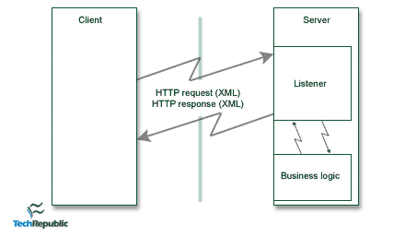
End-to-end data flow of a SOAP API

Slide 12
References:
Xml soap. (n.d.). Retrieved from https://www.w3schools.com/xml/xml_soap.asp
Soap - envelope - tutorialspoint. (n.d.). Retrieved from https://www.tutorialspoint.com/soap/soap_envelope.htm
Soap - header - tutorialspoint. (n.d.). Retrieved from https://www.tutorialspoint.com/soap/soap_header.htm
Soap - fault - tutorialspoint. (n.d.). Retrieved from https://www.tutorialspoint.com/soap/soap_fault.htm
Contributor, G. (n.d.). An introduction to the simple object access protocol (soap). Retrieved from https://www.techrepublic.com/article/an-introduction-to-the-simple-object-access-protocol-soap/

