Slide 1

Basketball stats nerd
Kyrus Wankadiya

Slide 2
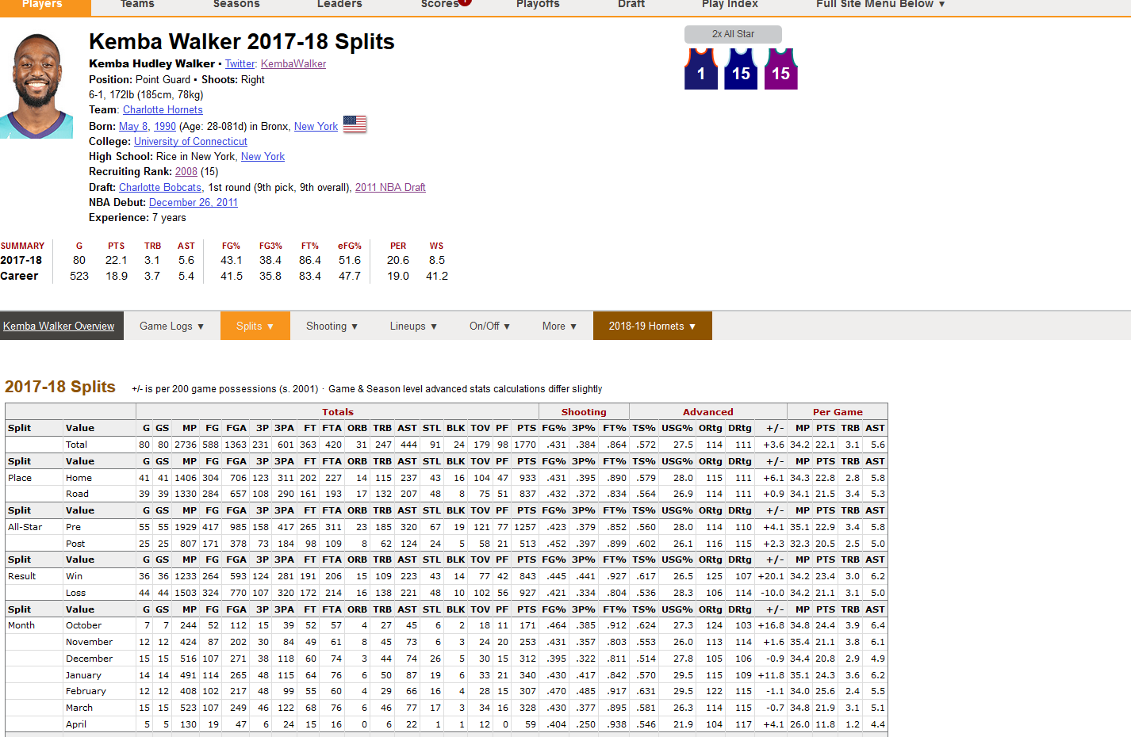
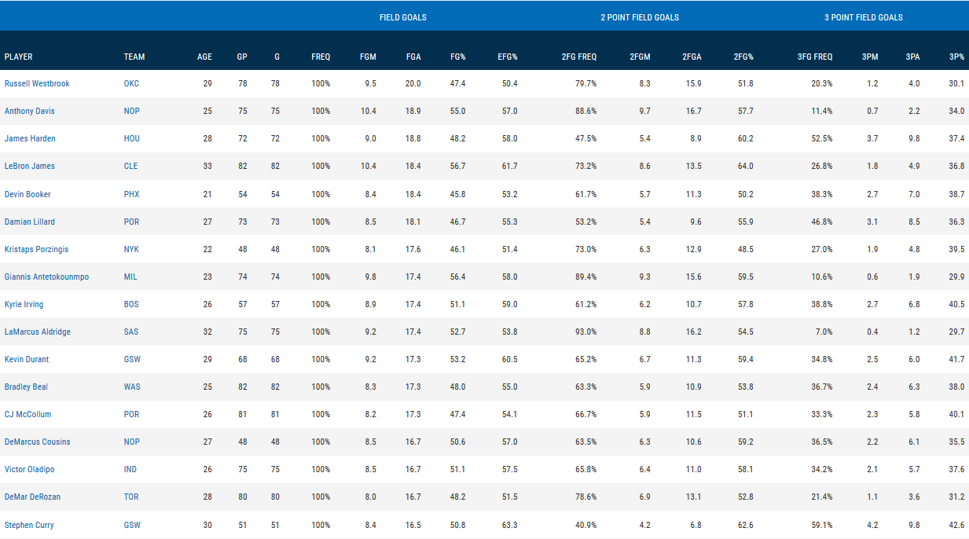
Goals of the project
Utilize vast amounts of NBA basketball data to create visualizations
Basketball-reference.com
Stats.nba.com
Just raw data, no graphs or charts there
Employ machine learning to characterize players based on their stats
Straying away from traditional positions
Inspired by 538’s CARMELO analytical model

Slide 3
NBA STATS OVERVIEW
Normal box score stats:
Points, assists, rebounds, steals, blocks…
Season totals, per game averages, adjusted per minute, adjusted per possession
Shooting stats
Player Makes and Misses broken down by range
Advanced stats
REB%, AST%, BLK%... percentage of team possessions where event occurred
TS% - shooting percentage that accounts for 3s and free throws
Pace
Other metrics
O-BPM, D-BPM, O-WS, D-WS, VORP, much more
Multiple stats used to quantify player impact

Slide 4

Data overload
Over 10 GB of .csv files scraped / downloaded
Team stats 1950-
Player season averages 1950-
Game logs 1997-
Every shots attempted, made by range, shot type 1997-
Every possession recorded with stats updated every few seconds 2018
Cleaning
Needed to merge tables from different sources
Broken files
Shrink the data so it would be useful

Slide 5
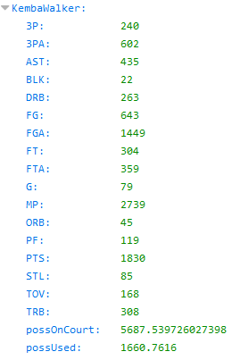
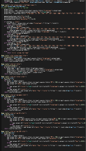
Setup of PROGRAM
Flask app reading in all the data
Created website in HTML
Website design using a w3css template
Data from the Flask-generated JSONs graphed with chart.js
Dynamically created JSONs
requested stats
Player Game Logs
External Jupyter Notebooks
data cleaning
machine learning
creation of shot charts

Slide 6
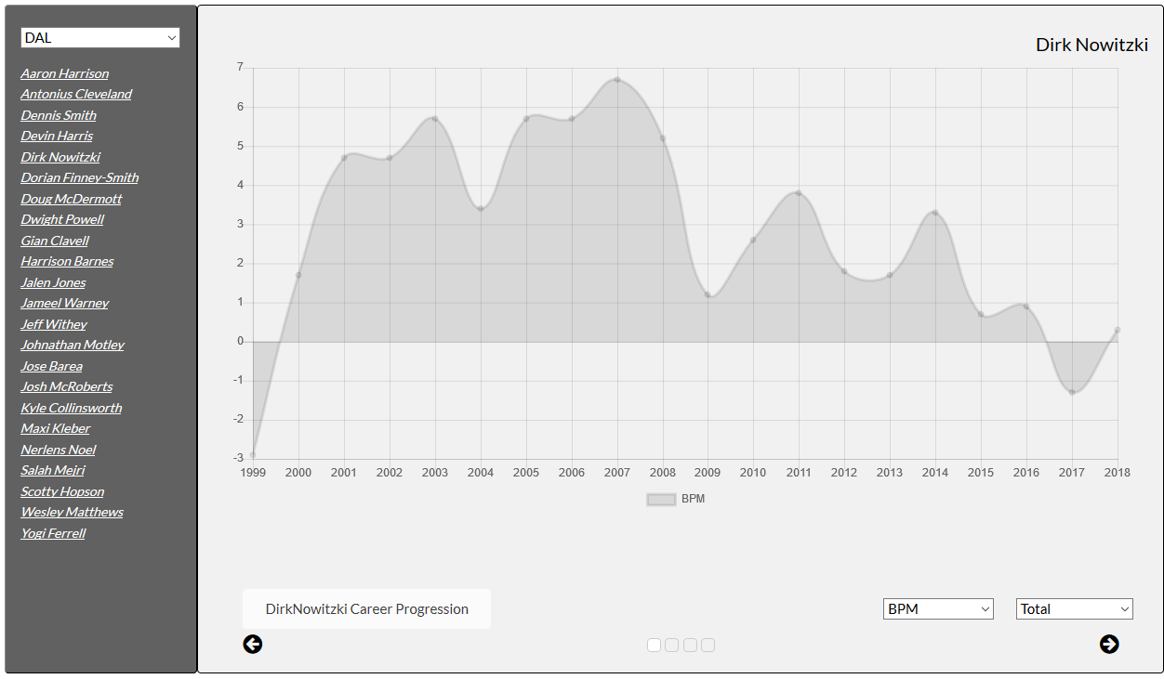
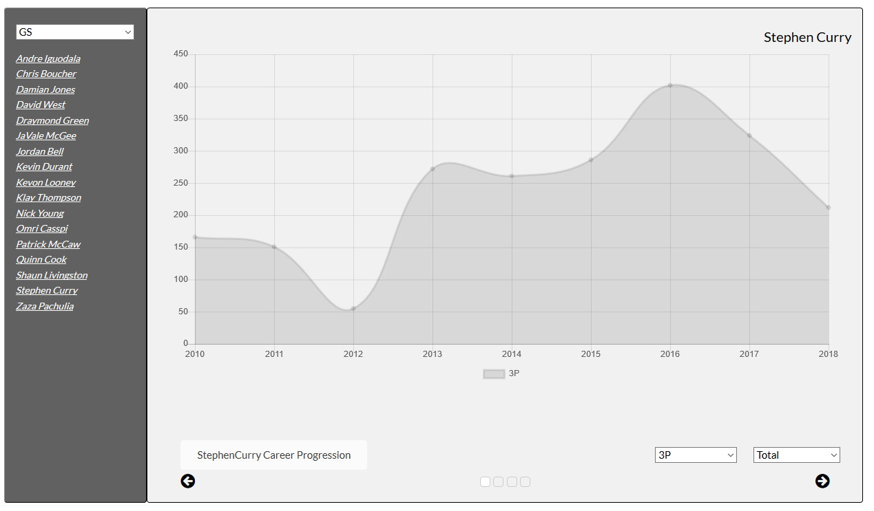
Player progressions
Basic line graph showing player’s progression over the years in a single stat
Also shows team rosters on the left

Slide 7
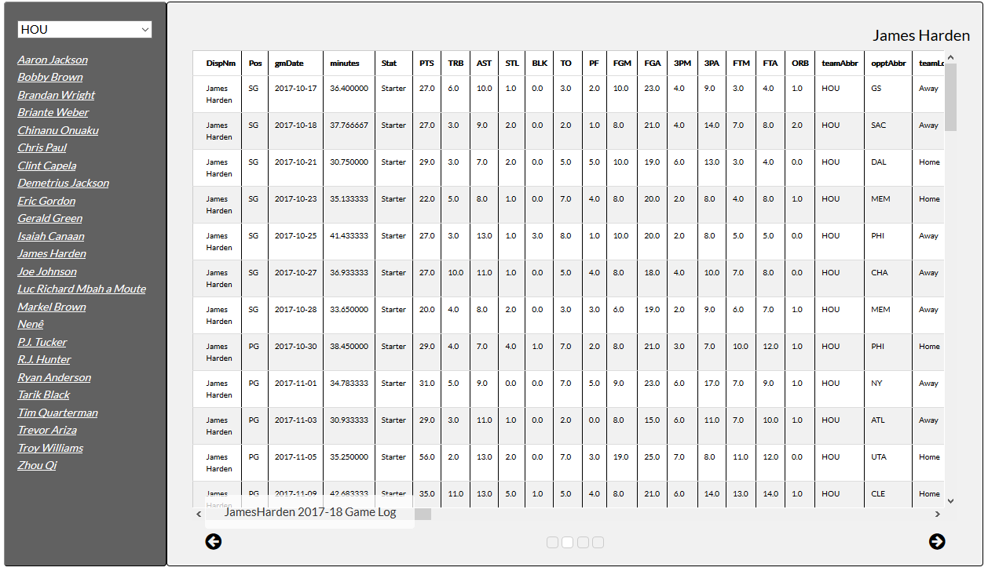
Game logs
Added players’ game log from 2017-18 that displays all regular and advanced stats available from each game

Slide 8
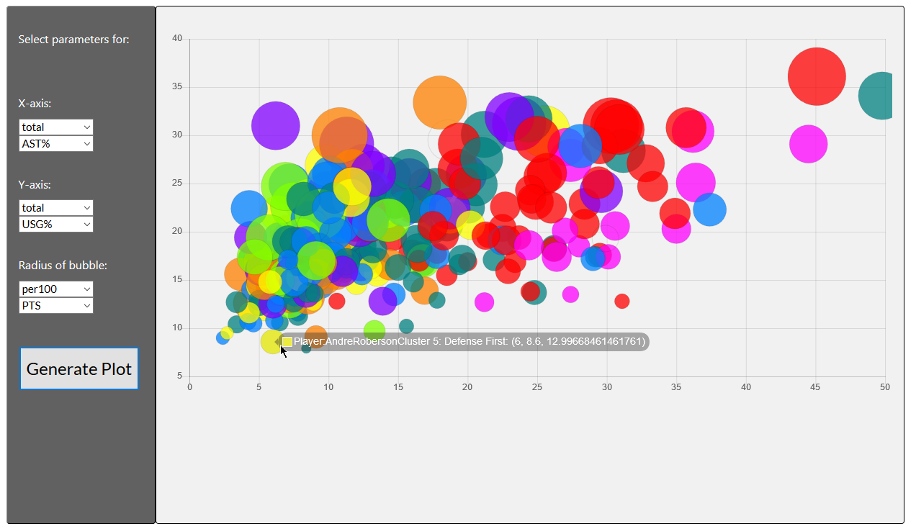
The main graph
Selecting any available stats and plotting them against each other
Colors are the clusters
When used with correct features, can see some correlations

Slide 9
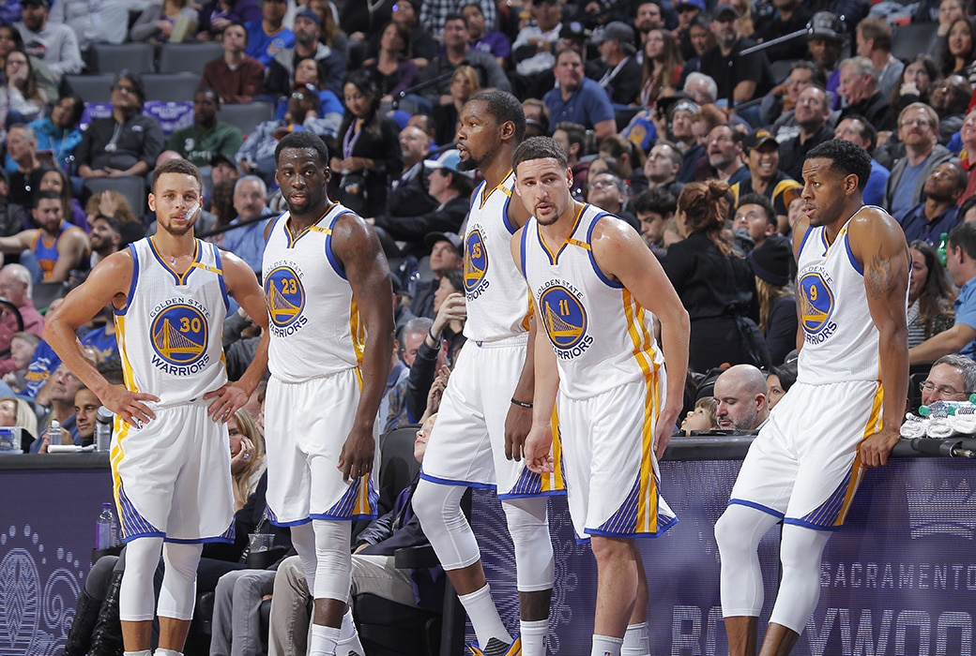
clustering
Using machine learning to group similar players together based on their stats and skills
But what about traditional positions like center, forward, and guard?
“Position-less basketball”
Teams don’t limit themselves to position labels
Value skill-set over listed position
Checking all the boxes

Slide 10
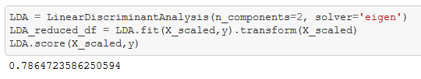
Classification notebook
Fed the machine learning algorithm combination of regular, advanced, and shot data from 1997 onwards
Input three position labels: G, F, C (guard, forward, center)
Split into 8 clusters using k means
Each cluster has a defined set of strengths and weaknesses decided on by the program
Introduced 8 dummy players with extreme stats to define the clusters
Run on full set to assign every player to one of the 8 clusters
79% LDA score

Slide 11
Clusters
0: Primary Ball-Handler
1: Two-Way Forward
2: Ball Hogging Scorer
3: Outside Shooter
4: Rim Protector
5: Defense First
6: Interior Scorer
7: All Scoring, No Defense

Slide 12
Primary ball-handler
Defining Trait: Very high assist rates or usage rates
Other trends
More effective shooting from long range
Higher steals and turnovers
Below average in most defensive metrics
Lines up pretty closely with the Point Guard position
Steve Nash
Jason Kidd
Stephen Curry

Slide 13
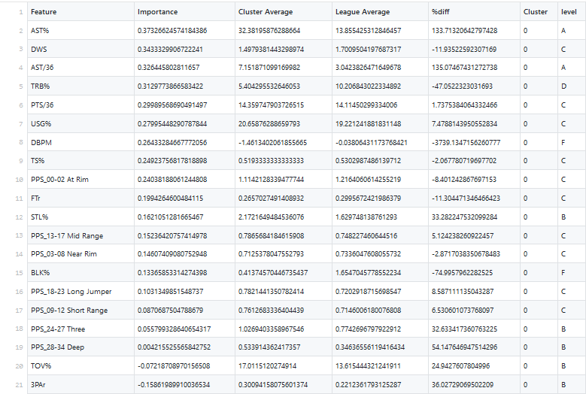
Feature list for cluster 1

Slide 14
Two way forward
Defining Trait: A combination of good defensive stats and high interior scoring
Other trends
Above average rebounding
Scores well from mid-range
Roughly average in most areas except 3-point shooting
Cluster is a mixed bag of players
Kevin Garnett
LaMarcus Aldridge
Pau Gasol

Slide 15
Ball-hogging scorer
Defining Trait: Better than average scoring from all ranges
Other trends
Average defensively
Very low passing numbers
Pretty wide range of players, but most are volume scorers
Tracy McGrady
Carmelo Anthony
Karl Malone

Slide 16
Outside Shooter
Defining Trait: High tendency and good efficiency on 3s
Other trends
Low turnovers
Subpar defense and rebounding
Mostly 3-point specialists
Reggie Miller
JR Smith
Klay Thompson

Slide 17
Rim Protector
Defining Traits: Elite rebounding, shot-blocking, efficient near the basket
Other trends
Above average defense
No range shooting
The easiest group to cluster.
Mostly traditional defensive centers who play within a very specific role
Dikembe Mutombo
Ben Wallace
Dwight Howard

Slide 18
Defense First
Defining Trait: Highest defensive metrics
Other trends
Well below average shooters and scorers
Average or below in most non-defensive categories
Defense is hard to quantify
Team effort where results can be skewed by 1/5 players
Lots of outliers (thanks Dirk)
Gerald Wallace
Andre Roberson
Shawn Marion

Slide 19
Interior Scorer
Defining Trait: Scoring efficiency from short range and at basket
Other trends
Good rebounding
High shot blocking and defensive stats
Not as high as the rim protectors
Middle ground between rim protector and two-way forward
Tim Duncan
Al Jefferson
Karl Anthony Towns

Slide 20
All Scoring, No Defense
Defining Trait: Above average scoring from most areas and poor defense
Other trends
Often times overlaps with the outside shooter
Better than average passing
High usage rates
Russell Westbrook
Ben Gordon
Kyrie Irving

Slide 21
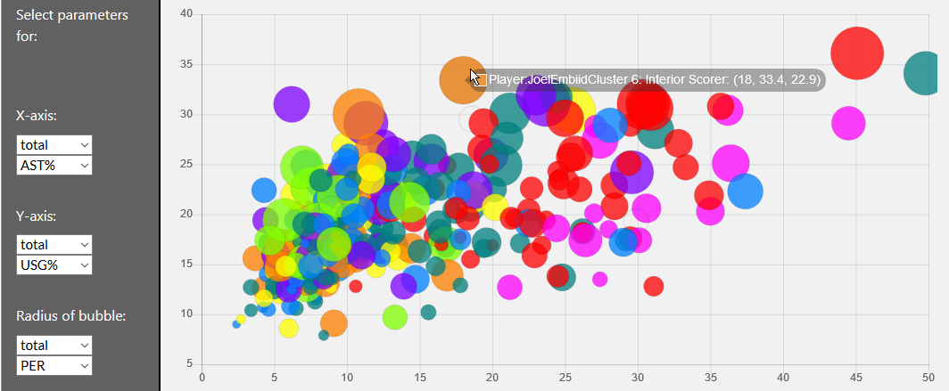
Sample graph

Slide 22
Problems
Machine learning algorithm needs further fine-tuning
Inconsistency between clusters
Two way forward and all score no defense might be redundant categories
Correlation is mostly good but a few major outliers that should not be there
Importance factors decided by program need adjustment

Slide 23
Future considerations
Calculating the similarity between a player’s stats and average of cluster
Break down each cluster into sub-clusters?
Find the five most similar players to a certain player
More detailed player profile – NBA 2k style radar charts?

