Slide 1
Case Study Part 2
Liang Liu

Slide 2
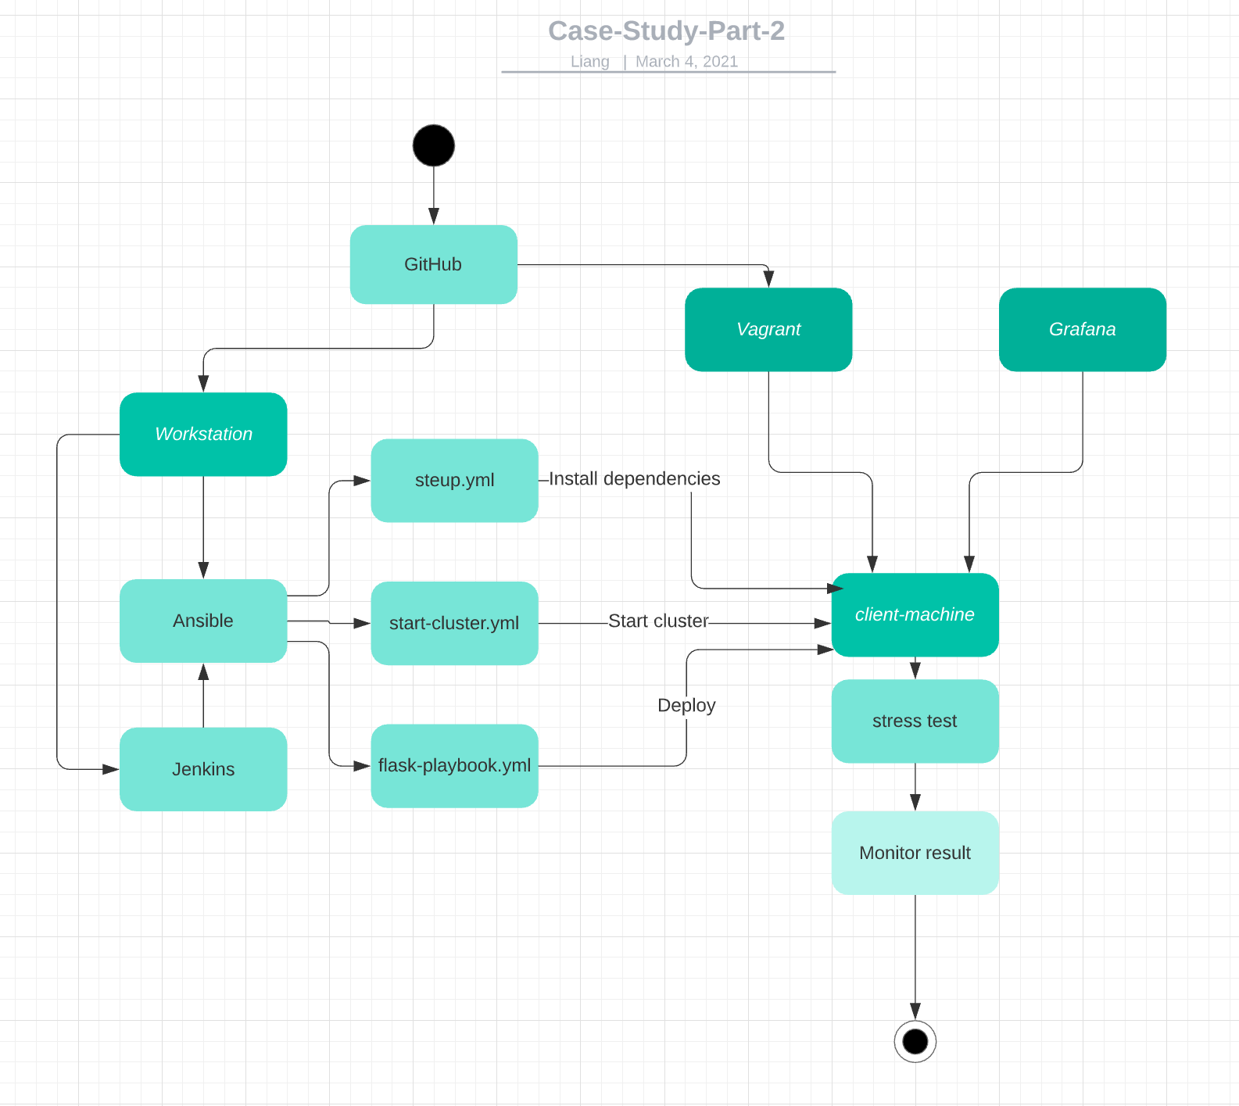
Design
1.Github as the SCM
2.Vagrant creates the VM
3.Ansible configure the VM and start up the kubernetes cluster.
4. CI/CD pipeline in Jenkins to deploy flask app through Ansible on the VM
5. Monitor the flask app on Grafana

Slide 3
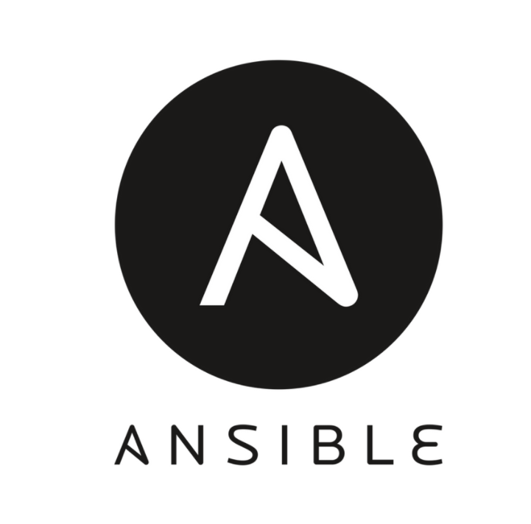

Provisioning the Environment
Provisioning the environment using Infrastructure as code. Create the VM using Vagrant and configure the VM using Ansible.
The benefits of using Vagrant and Ansible are we able to tear down the VM and recreate the same environment with only few simple commands. We can even create multiple VMs with same environment with very few manual steps. This simplified the whole process for provisioning the environment.

Slide 4

Application Deployment
Create a CI/CD pipeline in Jenkins to deploy the flask app through Ansible on client machine.
A CI/CD pipeline will simplified and shorten the deployment process. Whenever changes were pushed into the sources control(Github), Jenkins will automatic pull that changes and trigger a new build. Ansible will enable to deploy application on different or multiple target machine by simply modify the ansible inventory.

Slide 5

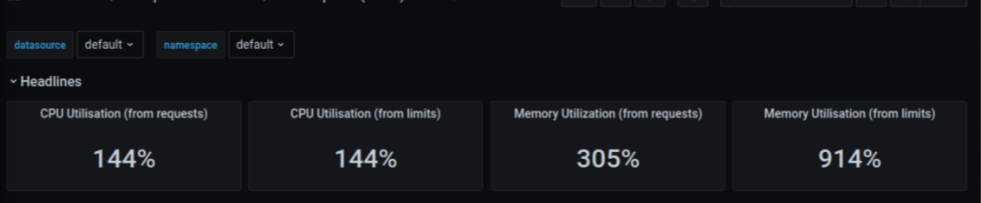
Monitoring
Monitoring the cluster on Grafana
Grafana give us a more visual representation of resource used by the application such as CPU and memory usage and network traffics. We are able to determine whether we should give the machine more resources base on the consumption of each different resources for the application.

