Slide 1
PROJECT CONTROL PORTFOLIO
Digital Banking Platform Upgrade
A bank IT project run end-to-end — schedule, cost control, governance and executive reporting
$1.26M
12 months
OSFI B-13
4 tools
Budget controlled
Duration
Regulatory driver
MS Project · D365 · Excel · Power BI
Keshaav Gite · Project Coordinator / PCO · PMP, CSM
kg0876.github.io · keshavg0876@gmail.com · (437) 331-5861
Practice project on a fictional bank — built to real bank-grade standards to demonstrate PCO capability.

Slide 2
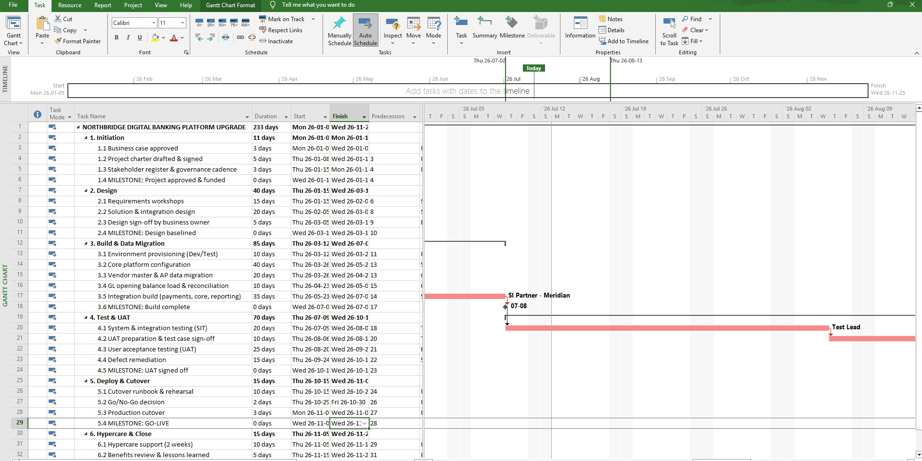
The Project & My Toolchain
Every tool in its real place — the way a bank PCO actually works
1
MS PROJECT
Schedule, WBS, dependencies, milestones, baseline
2
DYNAMICS 365
Vendors, POs, invoices — actuals come from the AP export
3
EXCEL
RAID · change control · budget vs actual · EAC forecast
MS Project — my baselined schedule
4
POWER BI
Interactive executive dashboard for steering
13 governance documents in one control pack — business case, charter, stakeholder register, WBS, budget, RAID, change control, actions, decisions, milestone tracker, status report.

Slide 3
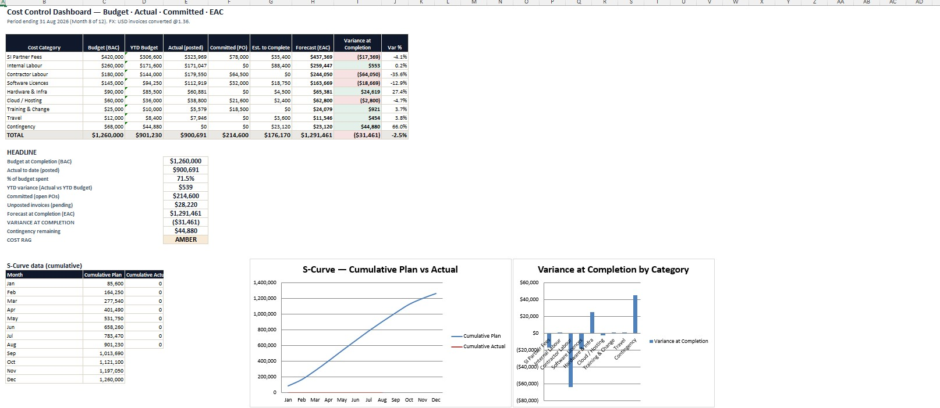
The Call That Shows Seniority
Reporting the truth, not just the surface number
YTD Actual vs Budget
−0.1%
Looks GREEN on the surface
+ Committed POs
$214,600
The piece juniors forget
Forecast at Completion
$1,291,461
vs $1,260,000 budget
My Excel cost model — EAC engine, S-curve, auto RAG
Variance at Completion
−$31,461
AMBER, not Green
The interview line: “Reporting Green on year-to-date spend alone would have been true — and misleading. Committed POs put us $31K over, so I reported Amber and brought a contingency drawdown to the sponsor.”

Slide 4
What This Proves
Skills a hiring manager can verify by opening the artifacts
Scheduling
Cost control
Built & baselined a 33-task schedule with dependencies & critical path in MS Project
Budget vs Actual vs Committed → EAC forecasting, variance analysis, S-curve
ERP financials
Governance
Reconciled a D365-format AP export — caught a duplicate invoice, a missing-PO breach, unposted invoices & an FX item
RAID, change control (incl. a rejected CR), decision log, steering-grade status reporting
Executive reporting
Regulatory awareness
Interactive Power BI dashboard with slicers for the steering committee
OSFI B-13 driver; Risk & Compliance go-live veto in the approval matrix
See it live: kg0876.github.io — every artifact is downloadable.

