Slide 1
MIDTERM PROJECT
VISIT NEPAL

Slide 2
MY PLAN
Website Theme: Travel Guide for Nepal[Visit Nepal]
Info about places to visit & things to do
Inspiration: https://www.lonelyplanet.com/nepal

Slide 3
Wireframe: Front Page
Visit Nepal Places to Visit Things to do About Nepal Contact Us
Drop Down Menus
A big picture on the background with a short catch phrase. The picture will change every 4 seconds.

Slide 4
Site Map
Main Page
Places to Visit
Things to do
About Nepal
Contact Us
Pokhara
Kayaking
Chitwan
Mountain Climbing
Kathmandu
Bunjee Jumping

Slide 5
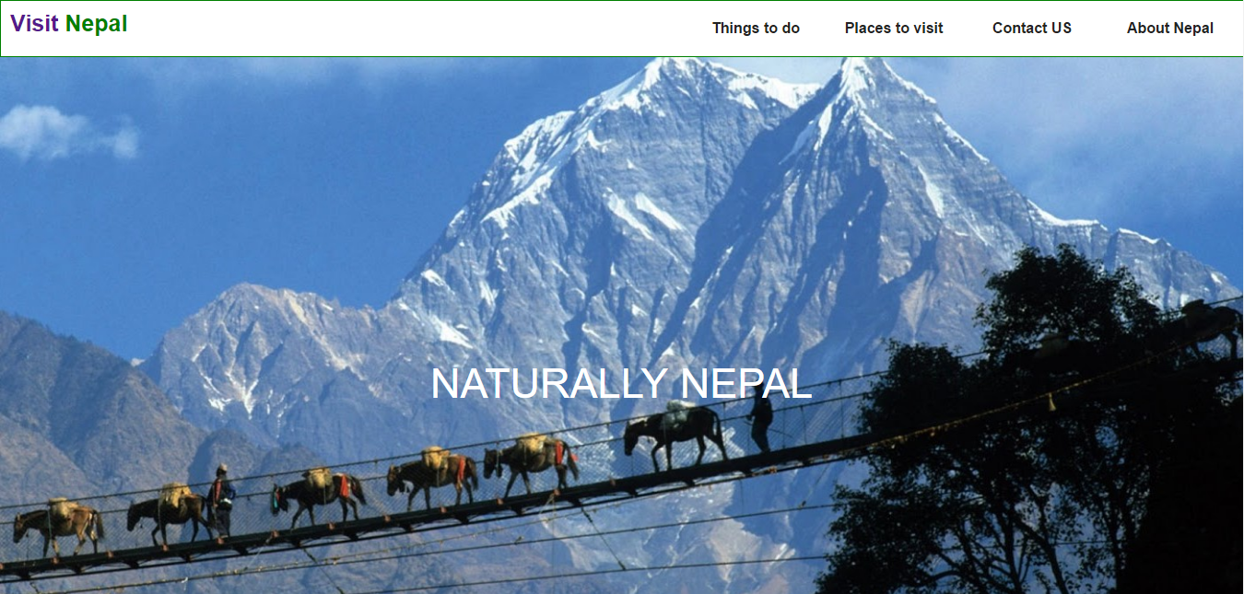
Home Page
Notes:
Design is very minimalist: Rather than giving lots of info I just wanted people to admire the photos that they see here. Give a good feeling!

Slide 6
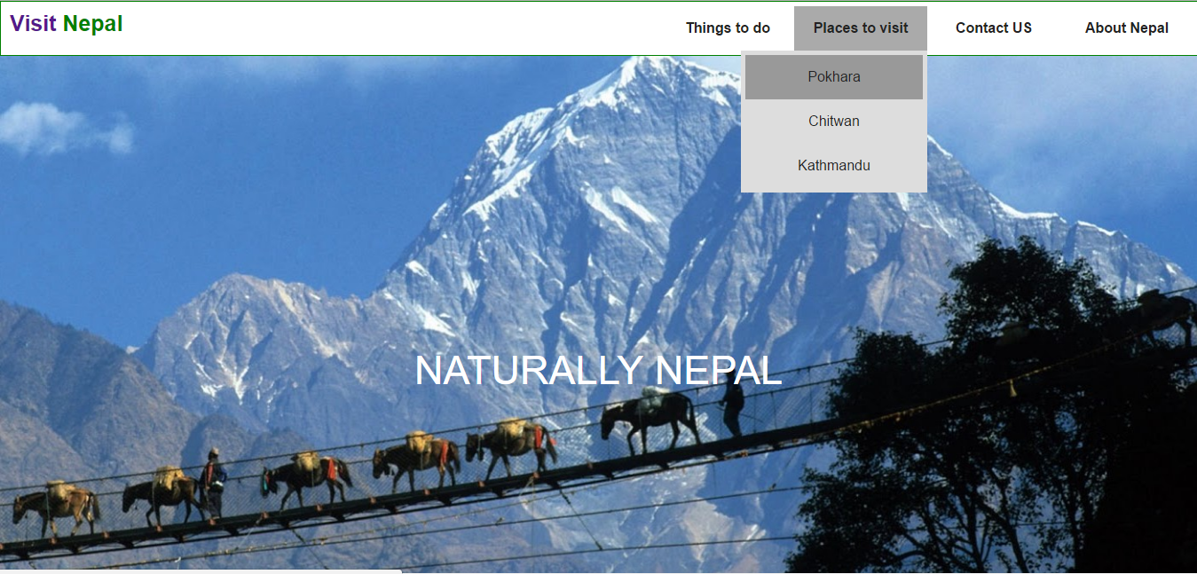

Slide 7
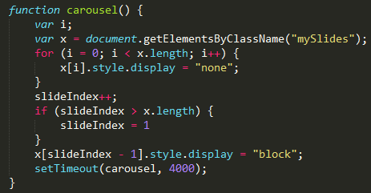
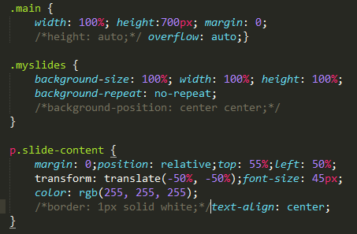
Problem I tried to solve

Slide 8
Next Steps
Complete the Site: Add Contact US and About US page
Contact US: Form (Use Javascript Skills)
Calendar (DOB), change it into Nepali Date
Add a new page called What’s happening in Nepal?
Add map

